Slide 1
Fid’Lin to Sprint 2
Team 2
Jakob Beckleheimer, Dylan Brownell, Tanner Groll, Derek Pendleton, & Phil Snider
Notes:
We are team 2, our project is the app that assists a player who wishes to play the fiddle or violin.

Slide 2
UML Diagrams and Updated Documents
New Gantt Chart (bye excel)
Updated Project Plan
Updated Project Document
New test cases

Slide 3
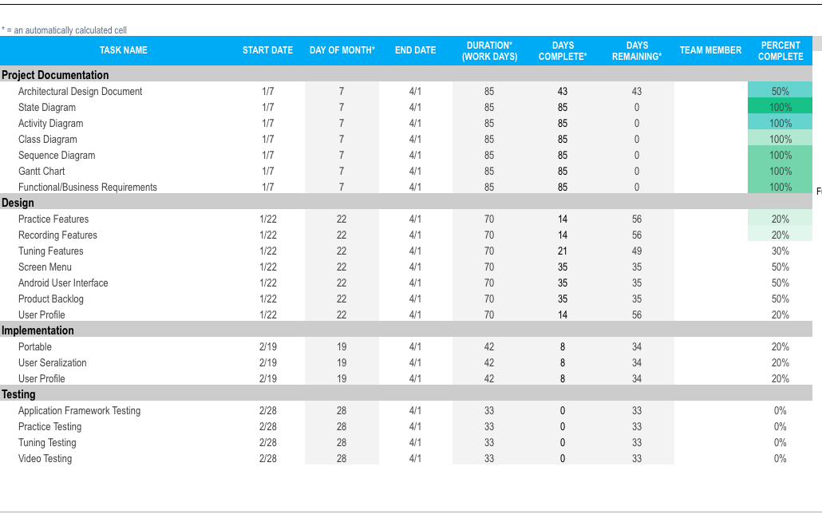
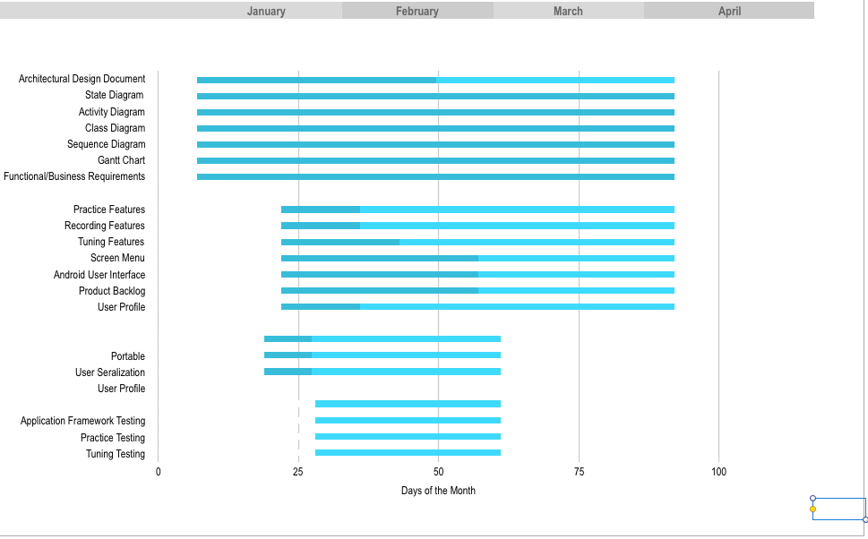
Gantt Chart

Slide 4
Project Document
Added a little terminology
Updated a few sections

Slide 5
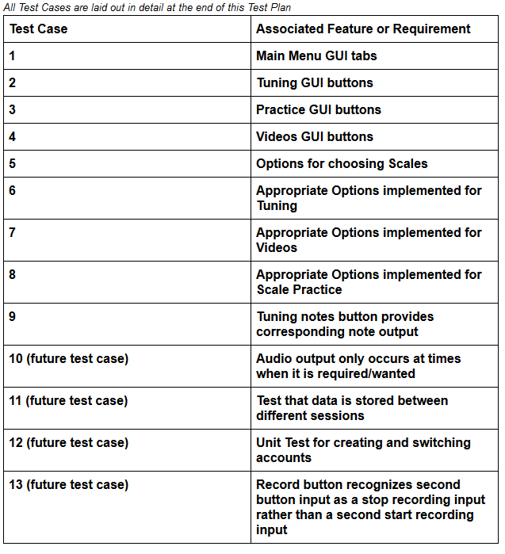
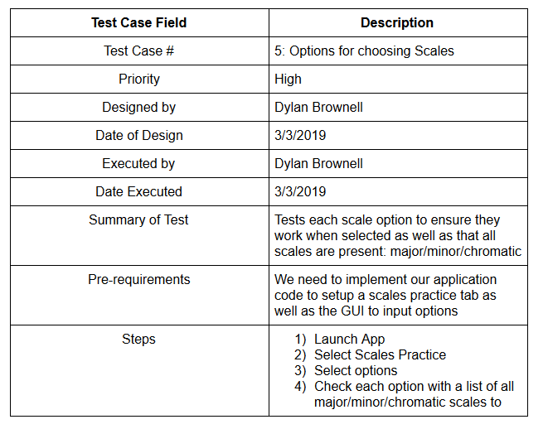
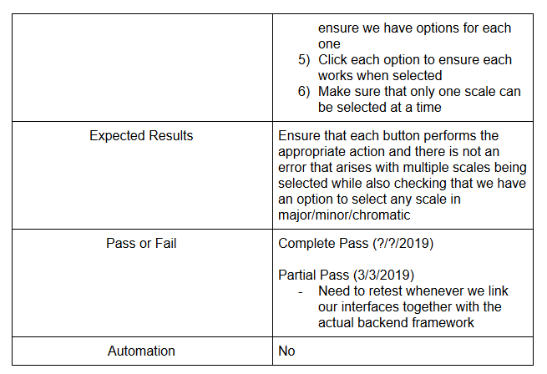
Test Cases
Test cases for this cycle were interface oriented
Not necessarily indicative of the high priority of interface functionality over other tests
Rather, good progress was made with the interface, and it is less likely to see drastic changes in future sprints
Meaning, lower chances that retesting will be required
Next sprint cycle will focus on the
high priority tests related to our
implementation of the source code

Slide 6
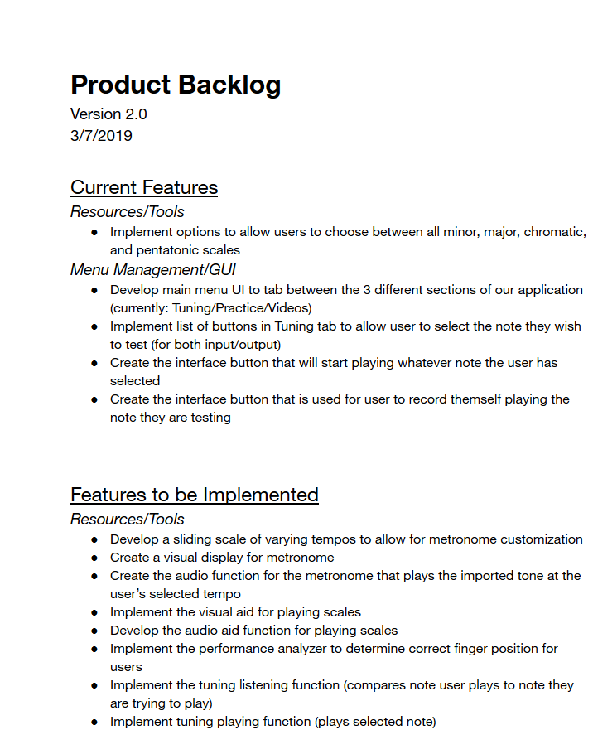
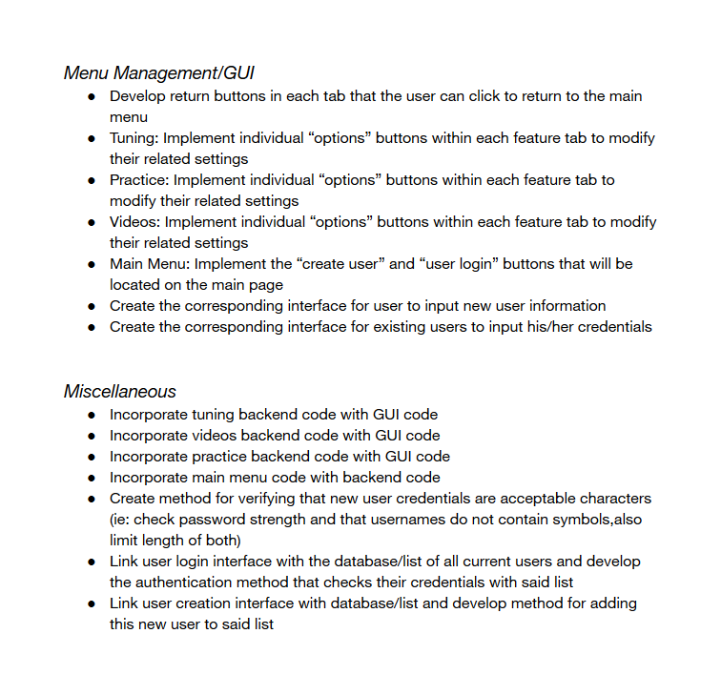
Changed backlog to reflect one-man tasks or implementation strategies

Slide 7
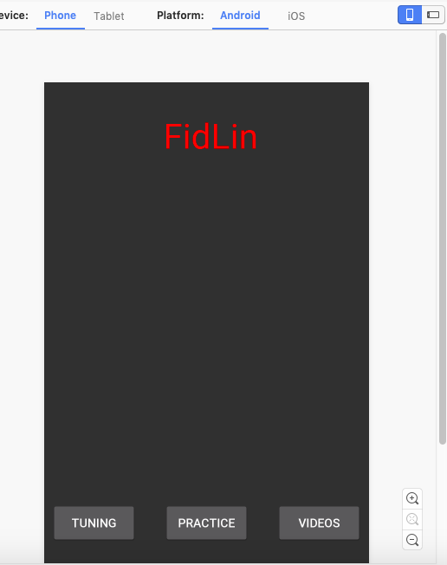
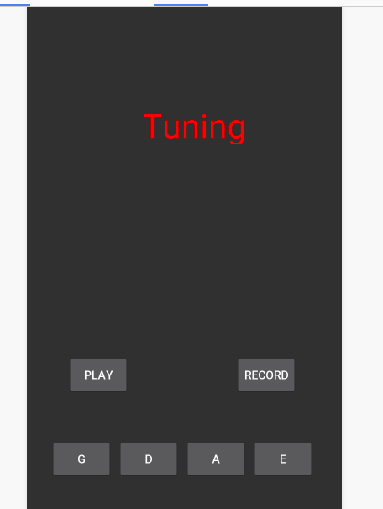
User Interface

Slide 8
Workload Distribution
Derek – Tuning
Phil, Dylan, and Jakob – Intonation, Scaling, Metronome

Slide 9
Intonation Game

Slide 10
If things go right..

Slide 11
Plan b

Slide 12
Scaling

Slide 13
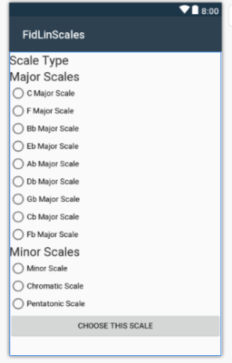

Slide 14
Metronome

Slide 15
Tuning (the beast)
Vocal Processor Demonstration
The Challenge of Adding it to the Program

Slide 16
Plan B
“Brain Tuning” – Essentially playing the sound as it should be and expecting the user to match it.

Slide 17
Updated Plan For Sprint 3
Functioning build of all features connected to the user interface.

