Slide 1

Data Science Project Review-2
Customer Churn Prediction and Analytics Using Machine Learning
Date& Time
11-09-2026
8:15-9:50AM
 | Under the Guidance of Dr.N.Sunanda Asistant Professor, Department of Computer Science and Engineering, KLH CSE Bowrampet Campus
Team Members Name:T.Nandini,B.Hasini,G.Saranya Roll Number:2420030325,324,071

Slide 2
Outline of Project Work
Focus
Introduction
Literature Survey
Challenges
Research Objectives
Conclusion & Future Work
References
Publications Details

Slide 3
Problem Statement
Customer churn is a major challenge for businesses because losing customers can reduce revenue and increase the cost of acquiring new customers. Companies often have large amounts of customer data, but it can be difficult to identify which customers are likely to leave.
The proposed project, “Customer Churn Prediction and Analytics Using Machine Learning,” aims to analyze customer information such as tenure, contract type, monthly charges, payment method, customer support interactions, and satisfaction levels to identify patterns related to customer churn.
Machine Learning algorithms will be used to predict whether a customer is likely to churn or stay. The project will also analyze the major factors contributing to churn and classify customers based on their churn risk. These insights can help businesses take early actions such as providing personalized offers, improving customer service, and retaining high-risk customers.
The main goal is to develop a data-driven system that helps organizations predict customer churn, understand its causes, and improve customer retention.

Slide 4
Objective
Collect Customer Data
collect customer data to understand their behavior.
Clean the Data
clean and prepare the data for analysis.
Find Churn Factors
identify the main reasons why customers leave.
Build ML Models
we build Machine Learning models to predict customer churn.
Evaluate Models
compare the models using performance metrics.
Identify High-Risk Customers
identify customers who have a high chance of leaving.
Improve Customer Retention
Provide suggestions to help the company retain customers.
Reduce Customer Loss
Our goal is to reduce customer loss and improve business performance.
Support Better Decisions
The results help the company make better decisions.

Slide 5
Literature Survey
Year / Authors | Title of the Paper | Methodology | Inferences | Limitation / Future Work
2021 – Al-Amin et al. [1] | Customer Churn Prediction in Telecom Sector with Machine Learning and Information Gain Filter Feature Selection Algorithms | Used SVM, MLP, Random Forest and Naive Bayes with Information Gain and Ranker feature selection. | Feature selection improved churn prediction performance, achieving 95.02% accuracy. | Future work can explore advanced feature-selection and hybrid ML techniques. (IEEE Xplore)
2022 – Shrestha et al. [2] | A Customer Churn Prediction Model using XGBoost for the Telecommunication Industry in Nepal | Applied XGBoost to a large real-world telecom dataset and evaluated accuracy and F1-score. | XGBoost achieved strong churn prediction performance, including 97% accuracy on the native telecom dataset. | Future work can evaluate the approach on additional real-world telecom datasets and imbalance-handling methods. (ScienceDirect)
2023 – Zhou et al. [3] | Early Warning of Telecom Enterprise Customer Churn Based on Ensemble Learning | Developed an ensemble-learning approach using customer characteristics to provide early churn warnings. | Ensemble learning can identify potential churners early and support targeted customer-retention actions. | Future work can improve early-warning accuracy and incorporate additional customer behavioral information. (PLOS)
2024 – Sikri et al. [4] | Enhancing Customer Retention in Telecom Industry with Machine Learning Driven Churn Prediction | Used machine learning with data balancing, resampling and ensemble techniques for churn prediction. | Data balancing and ensemble learning can improve churn prediction and support customer-retention strategies. | Future work can investigate additional datasets, features and real-time deployment. (Nature)
2025 – Abdelhady & Mohamed [5] | Leveraging Artificial Intelligence for Predictive Customer Churn Modeling in Telecommunications: A Framework for Enhanced Customer Relationship Management | Proposed an AI-driven churn prediction framework integrated with Customer Relationship Management (CRM). | AI-based predictive modeling can identify high-risk customers and support proactive retention. | Future work can focus on real-time CRM integration and validation across broader telecom datasets. (Nature)

Slide 6
Problem Gap Identification
Many businesses identify customer churn only after customers have already left, making retention difficult.
Existing methods often focus on basic customer analysis without accurately predicting which customers are likely to churn.
There is a lack of early identification of high-risk customers who need immediate attention.
Customer data is often available in large amounts, but it is not effectively used to discover the factors responsible for churn.
Different Machine Learning models may provide different prediction performances, but model comparison is often limited.
Businesses need not only churn predictions but also clear insights and actionable recommendations to improve customer retention.
Therefore, there is a need for an integrated ML-based system that predicts churn, identifies important churn factors, analyzes customer risk, and supports better retention decisions.

Slide 7
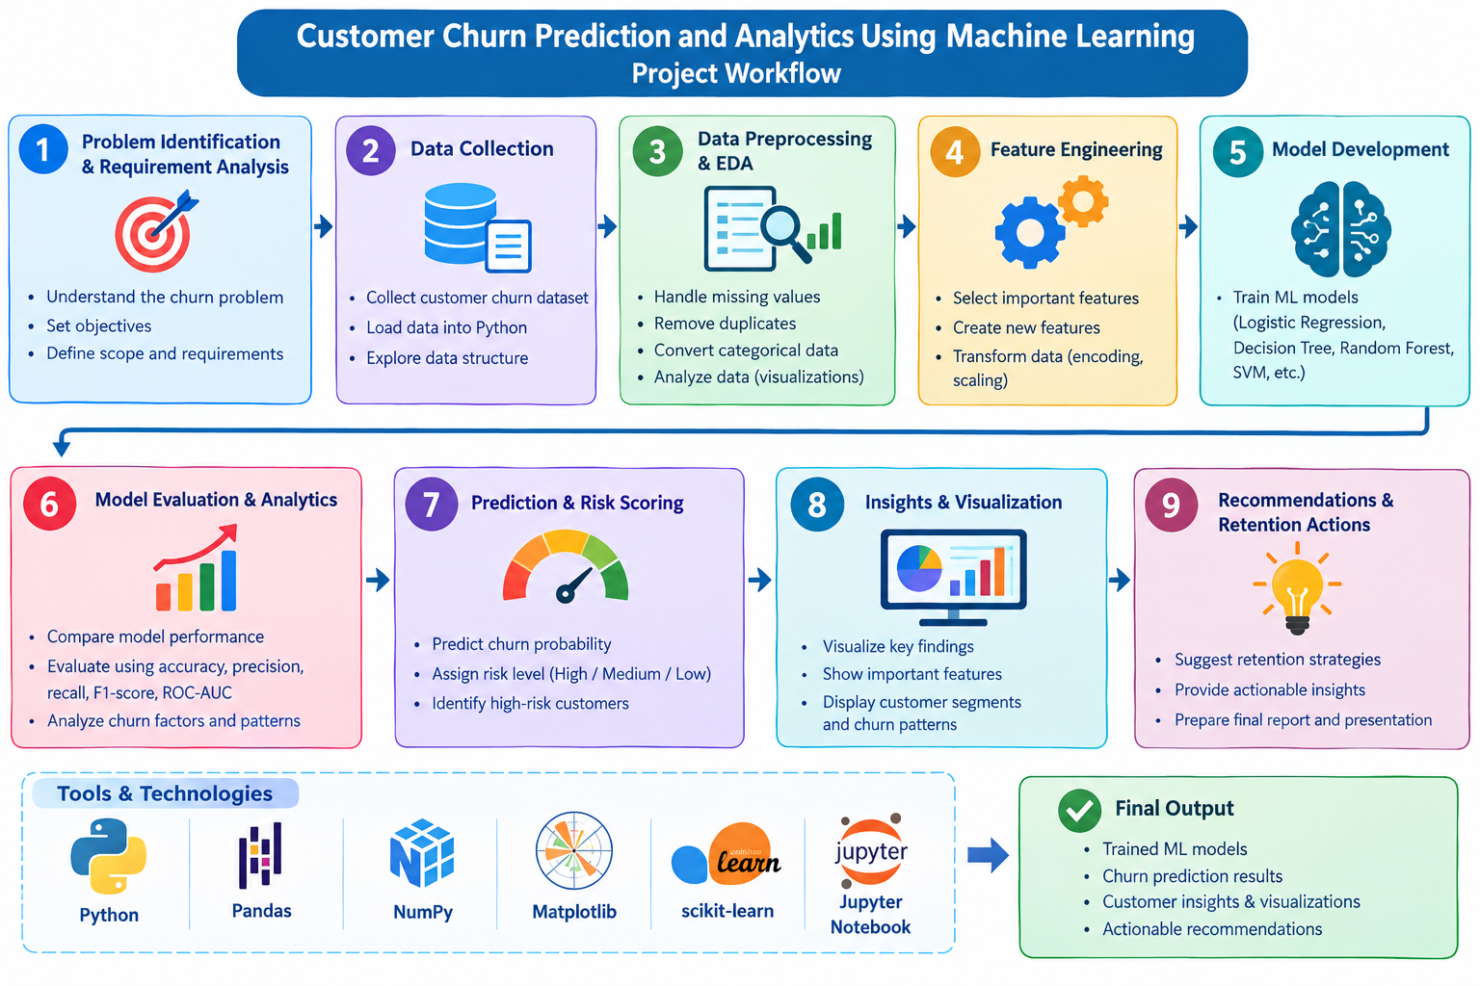
Feasibility and Project Plan

Slide 8
TimeLine Chart
Phase | W1 | W2 | W3 | W4 | W5 | W6 | W7
01. Problem Identification & Requirements | ■
02. Data Collection | ■ | ■
03. Data Preprocessing & EDA |  | ■ | ■
04. Feature Engineering |  |  | ■ | ■
05. ML Model Development |  |  |  | ■ | ■
06. Model Evaluation & Analytics |  |  |  |  | ■ | ■
07. Finalization & Documentation |  |  |  |  |  | ■ | ■

Slide 9
Innovation, Creativity, and Novelty
Innovation
Predictive Churn Monitoring: Identifies customers who may churn before they actually leave.
Dynamic Risk Scoring: Assigns each customer a churn probability instead of giving only a Yes/No result.
Data-Driven Retention: Uses customer data to support proactive retention decisions.
Creativity
Customer Risk Visualization: Uses charts and visual indicators to make high-risk customers easy to identify.
Customer Segmentation: Groups customers based on their behavior, characteristics, and churn risk.
Personalized Retention Strategies: Suggests different actions for different types of at-risk customers.
Novelty
Predict–Explain–Act Approach: Combines churn prediction, explanation of the reason, and recommended action in one system.
Customer-Specific Churn Explanation: Shows the major factors contributing to an individual customer's churn risk.
Priority-Based Retention: Helps businesses prioritize customers by considering both churn risk and customer value.
What-If Analysis: Allows businesses to examine how changes in customer factors could affect predicted churn risk.

