Slide 1
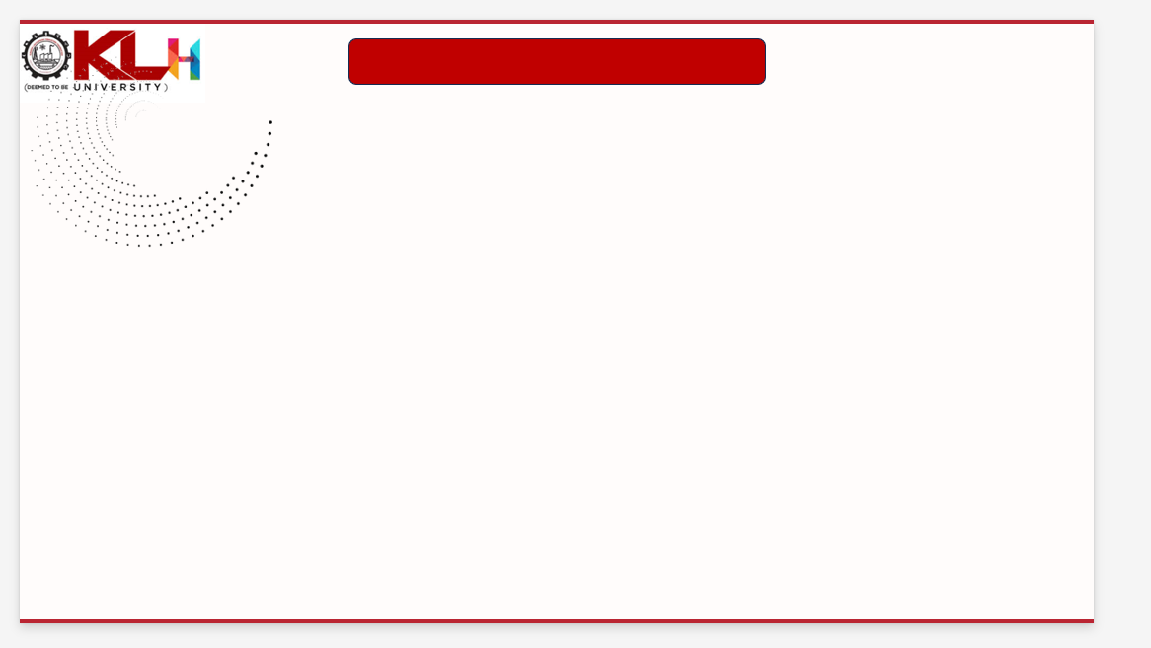
REVIEW -2
Comparative Study of Customer Segmentation Techniques Using Clustering Algorithms Assistant
Batch-3
SECTION-7
Dhanusha-240030159
Nandini– 2420030325
Lekha-2420030334

Slide 2
Methodology
1. Data Collection
2. Data Preparation
3. Feature Engineering
CSV Files, Open Datasets, Transaction Data, Demographic Data, Customer Records
Data Cleaning, Missing Values, Encoding, Scaling, Outlier Removal
Recency, Frequency, Monetary, Spending Patterns
4. Descriptive Mining
5. Predictive Mining
6. Evaluation
KPIs, Clustering, Correlation, Segment Profiles
K-Means, DBSCAN, OPTICS, BIRCH, FCM, Spectral Clustering
Silhouette Score, Davies-Bouldin Index, Calinski-Harabasz Index, Execution Time
Tourism Analytics | 4

Slide 3
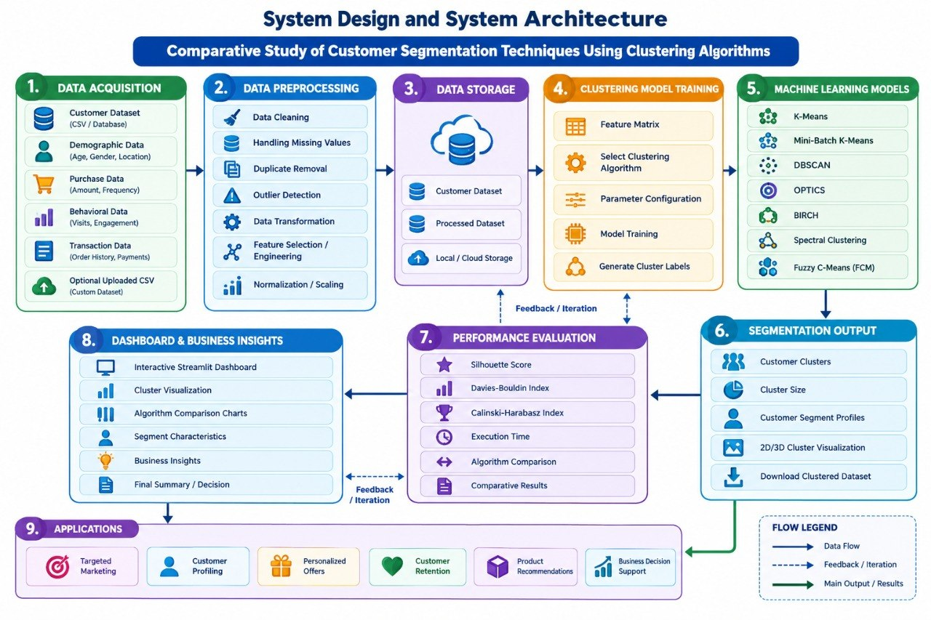
System Design / Architecture
Tourism Analytics | 5

Slide 4
Modern Tools & Technologies
Python
Forecasting
Visualization
Pandas, NumPy, Scikit-learn, Matplotlib, Seaborn, Streamlit
Scikit-learn, Pandas, NumPy, Matplotlib, Seaborn, Streamlit
Streamlit, Plotly, Matplotlib, Power BI
Backend
Storage
Deployment
Streamlit, FastAPI, Flask, REST APIs
MySQL, MongoDB, Cloud Storage
Docker, Git, CI/CD, cloud VM
Tourism Analytics | 8

Slide 5
Implementation
Step 1: Import and merge customer datasets.
Step 2: Handle missing values, duplicates, outliers and inconsistent categories.
Step 3: Create customer features such as Recency, Frequency, Monetary value and spending patterns.
Step 4: Apply clustering algorithms to identify customer segments.
Step 5: Store cluster results and evaluation metrics.
Step 6: Display insights in an interactive dashboard with dataset/segment filters.
# Example feature engineering
df["TotalAmount"] = df["Quantity"] * df["UnitPrice"]
df["Recency"] = (df["InvoiceDate"].max() - df["InvoiceDate"]).dt.days
df["Frequency"] = df.groupby("CustomerID")["InvoiceNo"].transform("nunique")
df["Monetary"] = df.groupby("CustomerID")["TotalAmount"].transform("sum")
df = df.dropna()
Implementation principle: reproducible notebooks + version-controlled scripts + saved model artifacts.
Tourism Analytics | 9

Slide 6
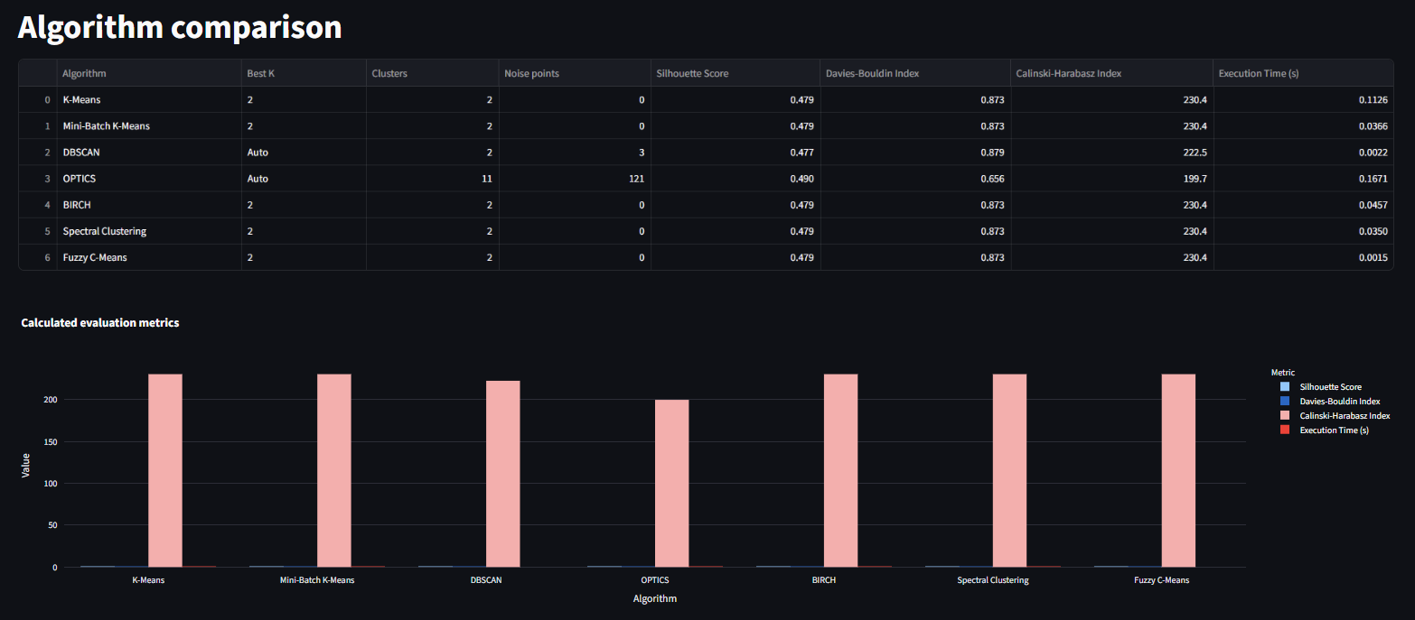
Results
The clustering results reveal meaningful customer segments based on their behavior and spending patterns.
Small differences between segments highlight variations in customer characteristics and purchasing behavior.
Dashboard users can compare customer segments using KPIs, cluster profiles and visualizations.
Results shown here are demonstration values, not measured project outcomes.
Recommended output: Customer segment table + cluster visualization + segment insights and recommendations.
Tourism Analytics | 10

Slide 7
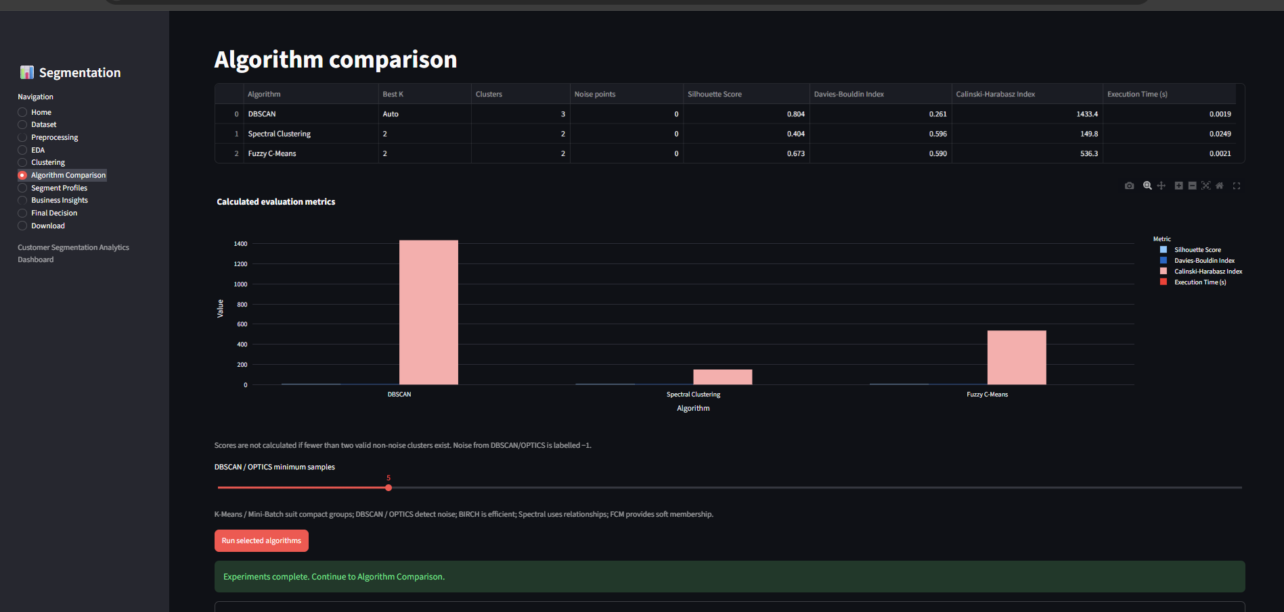

Slide 8
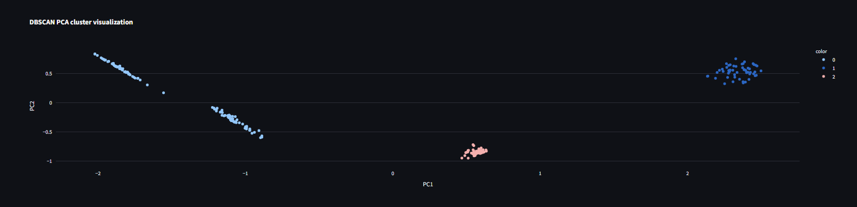
Performance Evaluation
Silhouette Score: Measures how well customers fit within their assigned clusters.
Davies-Bouldin Index: Measures similarity between customer clusters; lower is better.
Calinski-Harabasz Index: Measures cluster separation and compactness; higher is better.
Execution Time: Measures how long each clustering algorithm takes.
Evaluate algorithms using multiple clustering metrics and compare their overall performance.
Illustrative model comparison — actual values should be calculated from the final dataset.
Tourism Analytics | 11

Slide 9
Research Paper Evaluation
Study / Approach
Data & Method
Relevant Contribution
Limitation / Gap
K-MeK-Means Customer Segmentationans Customer Segmentation
Customer demographic and spending data; K-Means clustering
Identifies distinct customer groups based on similar characteristics
Sensitive to initial centroids and requires predefined number of clusters
DBSCAN-Based Segmentation
Customer behavioral data; DBSCAN clustering
Detects dense customer groups and identifies outliers
Performance depends on parameter selection
Fuzzy C-Means Segmentation
Customer attributes and purchasing behavior; FCM clustering
Allows customers to have partial membership in multiple segments
Sensitive to initialization and number of clusters
Multi-Algorithm Customer Segmentation
Customer and transaction data; multiple clustering techniques
Enables comparison of different clustering approaches
Existing studies often use limited algorithms and evaluation metrics
Tourism Analytics | 12

Slide 10
Conclusion & Future Scope
Descriptive mining explains customer behavior using spending patterns, customer profiles and segment analysis.
Clustering supports customer segmentation by grouping similar customers based on demographic, behavioral and transactional features.
A layered architecture improves maintainability, scalability and integration with the interactive dashboard.
Clustering evaluation should consider cluster quality, execution time, interpretability and business usefulness.
Future Scope
Real-time customer data integration from e-commerce and transaction systems.
Sentiment analysis from customer reviews and social media.
Explainable and personalized customer segmentation.
Geospatial analysis for location-based customer insights.
Model monitoring and automatic clustering updates.
Integration with CRM and marketing platforms.
Tourism Analytics | 13

