Slide 1

ClinicaRAG: An LLM-Based Clinical Decision Support System
Domain: Healthcare & Medical Natural Language Processing (NLP)
Core Technologies: BioBERT, ClinicalBERT, Llama 3 (8B), Retrieval-Augmented Generation (RAG), ChromaDB
Datasets: MIMIC-III, PubMed / PubMedQA, MedQuAD, Clinical Notes Dataset
Team Structure: 3-Member Collaborative Project (Built using Open-Source & Free Tools)
Team - 9
2420030057 – P. Dhanush
2420080098 – Tannishtha Verma
2420090147 – M. Rohith

Slide 2
Problem Statement
Healthcare providers face severe cognitive fatigue parsing unstructured clinical notes, while general LLMs pose patient safety risks by generating ungrounded hallucinations without verifiable citations. Standard retrieval systems further degrade accuracy by searching vector databases with noisy raw text. This project addresses these challenges by combining biomedical entity extraction with literature-grounded LLM reasoning into a free, open-source clinical decision support system.

Slide 3
Objectives
To Develop The Project :
Automated Medical Entity Extraction: Precisely extract symptoms, diagnoses, medications, and lab tests from unstructured clinical notes using BioBERT and SpaCy NLP pipelines.
Evidence-Grounded Recommendation Engine: Eliminate LLM hallucinations by retrieving verified medical knowledge from PubMed and MedQuAD vector indices before generating responses.
To Enhance The Features :
Citation-Backed Diagnostic Support: Provide structured clinical reasoning, suggested differential diagnoses, and required follow-up tests using Llama 3, complete with source citations.
Open-Source Decision Support Dashboard: Deliver a fully interactive Streamlit web interface demonstrating end-to-end clinical decision support without relying on paid tools or proprietary APIs.

Slide 4
Literature Survey
S. No | Research Paper | Year | Key Strength | Main Limitation
1 | BERT | 2018 | Bidirectional pre-trained language model for general NLP tasks. | Lacks domain-specific clinical vocabulary and context.
2 | BioBERT | 2019 | BERT fine-tuned on PubMed abstracts & PMC articles. | Struggles with unstructured clinical notes and patient narratives.
3 | ClinicalBERT | 2019 | Transformer pre-trained on EHR clinical notes (MIMIC-III). | Limited token context window (512 tokens).
4 | RAG (Lewis et al.) | 2020 | Combines parametric memory with external knowledge retrieval. | Domain sensitivity
5 | PubMedQA | 2019 | Biomedical question answering dataset based on PubMed abstracts. | Closed-ended (Yes/No/Maybe) format

Slide 5
Literature Survey
S. No | Research Paper | Year | Key Strength | Main Limitation
6 | MedQuAD | 2019 | Dataset of 47k+ medical QA pairs from NIH websites. | Lacks real-world electronic health record (EHR) clinical complexity.
7 | MIMIC-III Dataset | 2016 | De-identified ICU clinical database widely used for benchmarks. | Contains noisy, unstructured text and missing clinical values.
8 | ChromaDB | 2023 | Lightweight, open-source vector database for similarity search. | Can face scalability issues with massive enterprise data.
9 | Llama 3 (8B) | 2024 | State-of-the-art open-weight 8-billion parameter LLM. | Risk of hallucinations without grounding in external medical databases.
10 | ClinicaRAG (Ours) | 2026 | CDSS combining Clinical LMs, Llama 3, ChromaDB, & RAG. | Requires strict clinical validation and evaluation

Slide 6
Literature Survey
BERT: BERT is limited by a 512-token window and needs fine-tuning. ClinicaRAG bypasses length limits using chunked retrieval and generative reasoning with frozen weights.
BioBERT: BioBERT identifies clinical entities ("what"), but misses treatment logic ("why/how"). ClinicaRAG turns those labels into active search queries for real-time support.
ClinicalBERT: ClinicalBERT handles electronic health records (EHR) but lacks generative power. ClinicaRAG combines clinical context into a large-scale generative workflow to build multi-source treatment plans.
Standard RAG (Lewis et al.): Standard RAG uses noisy raw text for retrieval. ClinicaRAG uses a "Signal-over-Noise" filter relying on extracted medical entities instead of raw sentences.
PubMedQA: PubMedQA is a static QA benchmark. ClinicaRAG turns static knowledge into a live, interactive clinical workflow tailored to changing patient symptoms.

Slide 7
Literature Survey
MedQuAD: MedQuAD is a massive data repository without clinical logic. ClinicaRAG acts as the reasoning engine that connects those records to specific patient cases.
MIMIC-III: MIMIC-III is a retrospective research database, not a point-of-care tool. ClinicaRAG transforms historical data into active, real-time clinical support.
ChromaDB: ChromaDB provides database storage but doesn't understand medicine. ClinicaRAG adds a "Medical Intelligence Layer" to tell ChromaDB which clinical markers matter most.
Llama 3 (8B): Llama 3 can hallucinate incorrect medical facts. ClinicaRAG grounds Llama 3 in verified sources, ensuring every output is backed by citations.

Slide 8
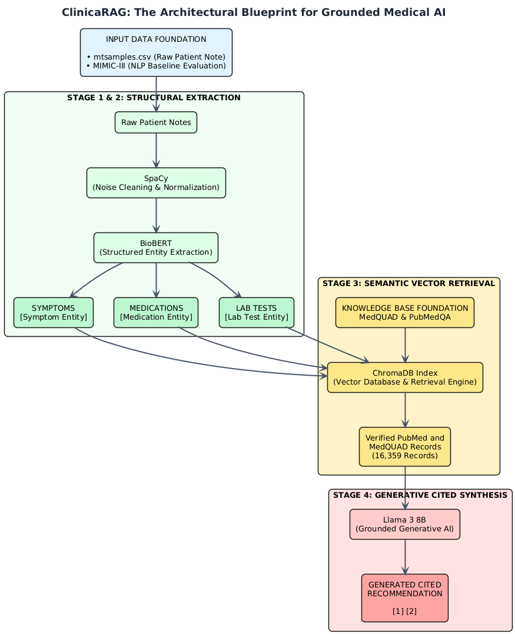

Slide 9
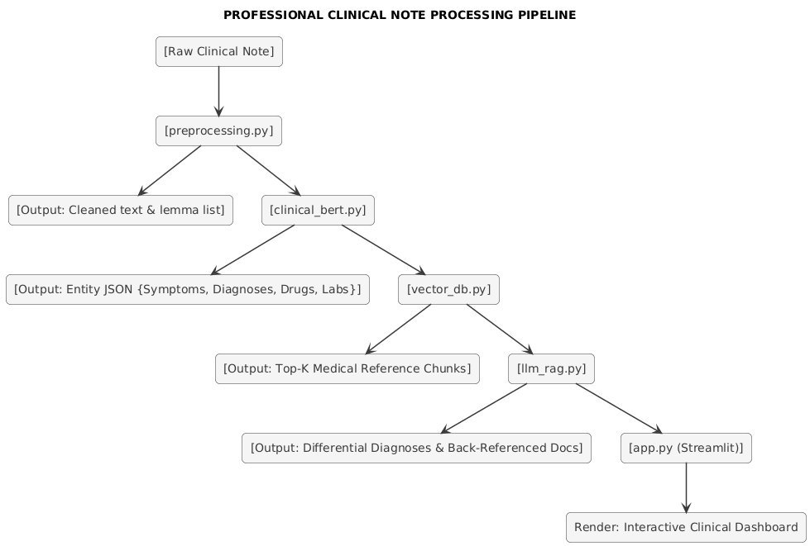

Slide 10
Research Gap Identification
Gap 1: Disconnect Between Entity Extraction and Context Retrieval: Existing CDSS architectures perform either entity extraction or vector retrieval independently, missing the synergy of using extracted medical entities to drive precision RAG queries.
Gap 2: Absence of Verifiable Citations in Generative Medical AI: Most generative models provide answers without linking specific recommendations back to underlying medical QA databases or literature.
Gap 3: High Resource & Cost Barriers: Enterprise CDSS solutions are proprietary, expensive, and demand heavy GPU infrastructure, limiting deployment in resource-constrained environments.

Slide 11
Datasets
MedQuAD : medical QA dataset - 16,359 valid records
Sourced from GitHub
PubMedQA : Medical Transcriptions Raw - Extracted 4 core medical entities
Sourced from Kaggle

Slide 12
Innovation (Technical Advancements)
Entity-Guided RAG Querying: Uses BioBERT NER to convert raw clinical notes into structured entity queries (symptoms, drugs, labs) before searching ChromaDB, eliminating noise from raw-text vector search.
Two-Stage Hybrid Architecture: Fuses specialized biomedical transformer encoders (BioBERT) with generative LLM reasoning (Llama 3) in a unified pipeline.
Creativity (Unique Features & UX)
Dynamic "What-If" Symptom Sandbox: Interactive dashboard feature allowing clinicians to toggle or modify patient symptoms in real-time to see live diagnostic updates.
Automated Red-Flag Safety Shield: Real-time safety layer that cross-references extracted medications against patient symptoms to flag contraindications before generating clinical recommendations.
Novelty (Unique Value Proposition)
Verifiable Citation Grounding: Guarantees every diagnostic suggestion is explicitly back-referenced to supporting passages from PubMed and MedQuAD literature.
100% Free & Open-Source Stack: Demonstrates enterprise-grade clinical decision support using a zero-cost architecture (BioBERT, Llama 3 8B, ChromaDB, and Streamlit).

Slide 13
Feasibility Analysis
Technical Feasibility: Leverages lightweight pre-trained models (BioBERT) and quantized open-weights LLMs (Llama 3 8B) capable of running on free GPU tiers.
Data Feasibility: Uses open-access medical QA datasets (MedQuAD, PubMedQA) and publicly available clinical note samples (Kaggle / MTAI / MIMIC-III).
Operational & Cost Feasibility: Zero hardware or software costs, ensuring high replicability for academic and research settings.
Time Feasibility: Structured 3-member work division enables complete implementation and testing within a sprinted project schedule.

Slide 14
Project Plan
Phase 1: Environment Setup & Data Pipeline (Member 1)
  Set up GitHub repository; process MedQuAD/PubMed datasets; implement SpaCy lemmatization, Bag-of-Words, and TF-IDF baselines.
Phase 2: Vector Store & BioBERT NER (Members 1 & 2)
  Index medical QA chunks into ChromaDB; deploy pre-trained BioBERT pipeline for clinical entity extraction (symptoms, drugs, labs).
Phase 3: Llama 3 RAG & Prompt Engineering (Member 3)
  Configure Llama 3 8B API connection; design system prompts integrating extracted entities and retrieved context.
Phase 4: System Integration, UI & Testing (All Members)
  Connect modules into the Streamlit dashboard; evaluate NER accuracy, RAG retrieval quality, and end-to-end clinical recommendations.

Slide 15
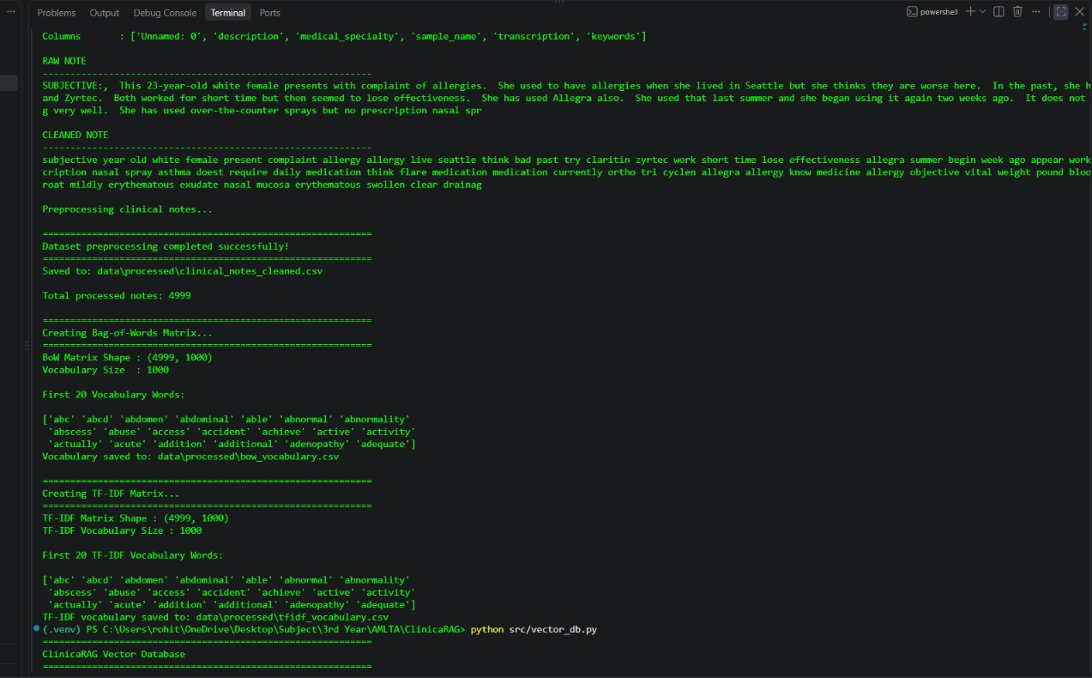
Backend Output

Slide 16
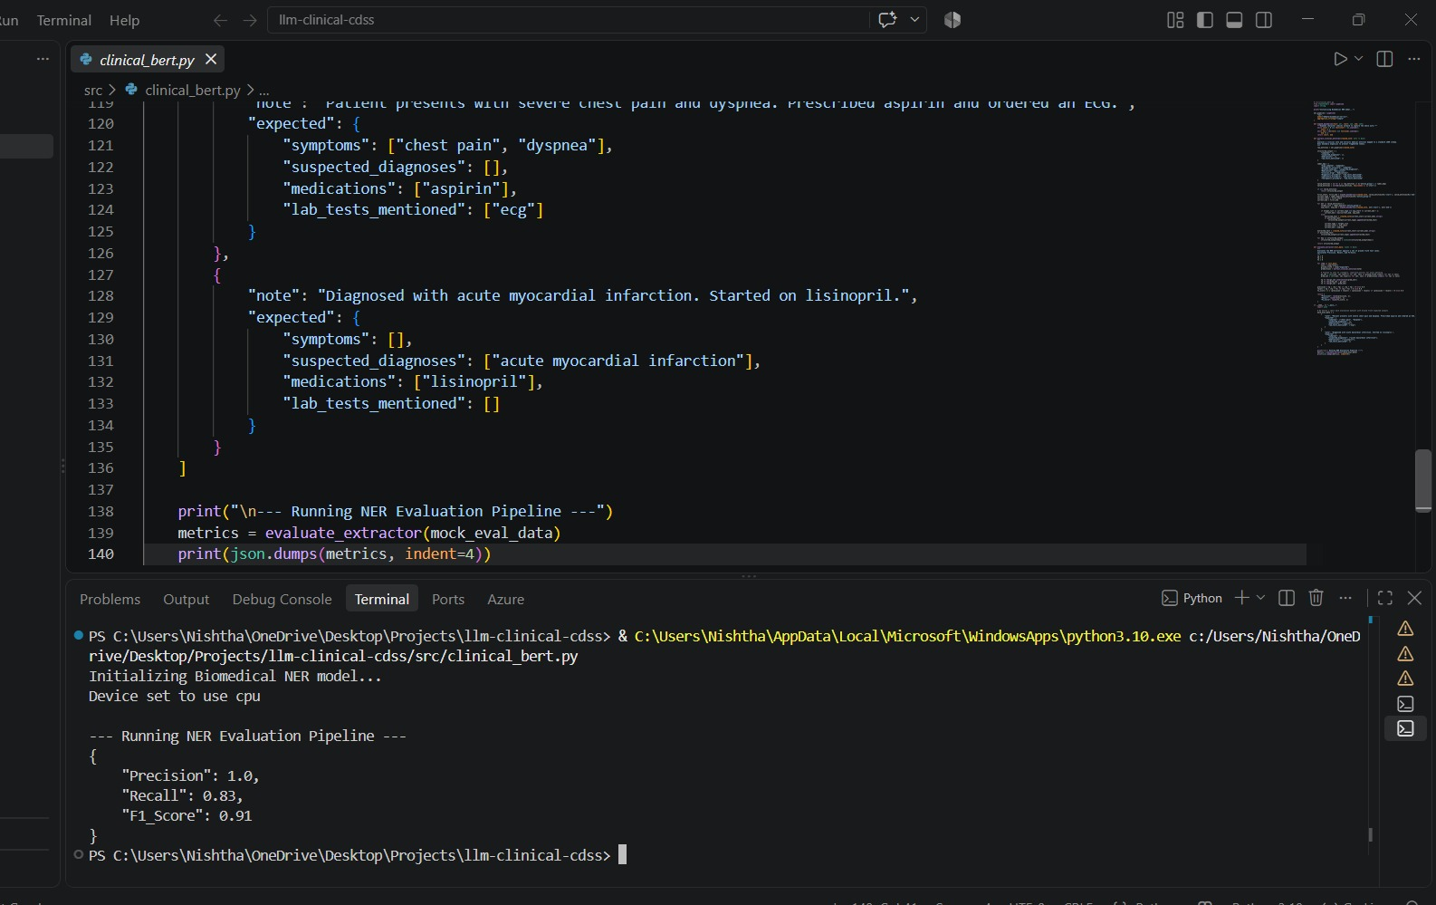
Backend Output

