Slide 1

Spiking Neural Networks for Astronaut Health
Tannishtha Verma (2420080098)

Slide 2
Table of Contents
Introduction
Problem Statement/Abstract
Literature Survey
Datasets Description
Methodology
Results
Visualizations
Conclusions

Slide 3
Introduction
Motivation: Commercial spaceflight missions demand robust, low-power health monitoring systems for astronauts.
Challenge: Traditional ANNs struggle with sparse biomedical signals and high computational demands unsuitable for spacecraft environments.
Solution: Spiking Neural Networks (SNNs) offer event-driven computation and energy efficiency for temporal pattern modelling.
Dataset: NASA Inspiration4 SOMA plasma metadata with mission-phase labels (pre-flight vs post-flight).
Method: LIF-based SNN with surrogate gradient training for binary classification.

Slide 4
Problem Statement
Problem:
Astronaut health monitoring in space requires low-power, real-time analysis of physiological disruptions.
Traditional ANNs are computationally expensive for spacecraft deployment.
No existing SNN-based solution for NASA spaceflight health data.
Research Question:
Can SNNs achieve competitive accuracy for mission-phase classification (pre-flight vs post-flight) using Inspiration4 SOMA data?
Objectives:
Develop LIF-based SNN classifier for binary mission-phase prediction.
Compare performance with Random Forest and MLP baselines.
Demonstrate neuromorphic viability for energy-efficient astronaut monitoring.

Slide 5
Literature Survey
Sno | Title of the Paper | Author | Year of Publishing | Method Used | Limtations of this work
1 | Spiking Neural Networks and Applications: A Review | Tavanaei et al. | 2019 | Reviews SNN models, STDP, surrogate gradients for vision, robotics | No SOMA/spaceflight data; generic applications only
2 | Networks of Spiking Neurons: Third Generation | Maass | 1997 | Introduces SNNs with temporal processing capabilities | Purely theoretical; predates deep learning and space datasets
3 | Medical Data Analysis Based on SNNs | Zhang et al. | 2022 | Surveys SNN methods for EEG, ECG, EMG with encoding strategies | Generic medical data; no space medicine or SOMA datasets
4 | SNNs for Biomedical Signal Analysis | Xu et al. | 2024 | Reviews SNN applications for physiological signals | Terrestrial biomedical only; no microgravity data
5 | SNNs for Physiological and Speech Signals | Liang et al. | 2024 | Summarizes SNN architectures for event-driven computation | No NASA SOMA datasets; general signals only

Slide 6
Literature Survey
Sno | Title of the Paper | Author | Year of Publishing | Method Used | Limtations of this work
6 | Loihi: Neuromorphic Manycore Processor | Davies et al. | 2018 | Intel's Loihi chip for energy-efficient SNN deployment | Hardware-focused; no astronaut health applications
7 | TrueNorth: 65 mW 1M-Neuron Chip | Akopyan et al. | 2015 | IBM's TrueNorth for low-power SNN inference | Not tested on SOMA or space health data
8 | Space Omics and Medical Atlas (SOMA) | Overbey et al. | 2024 | Integrated multi-omics repository from spaceflight missions | Infrastructure only; no ML/SNN models implemented
9 | Single-Cell Multi-ome of Inspiration4 Crew | Kim et al. | 2024 | Multi-omic and immune profiling of astronauts | Classical statistics; no SNNs or mission-phase classifier
10 | Cosmic Kidney Disease: Pan-Omic Analysis | Garrett-Bakelman et al. | 2024 | Integrates omic layers for kidney changes during spaceflight | Traditional bioinformatics; no neuromorphic models

Slide 7
Dataset/s Description
Dataset-1 : NASA Inspiration4 SOMA Plasma Metadata (OSD-569)
Total no of Samples: 560
Training Samples: 336 (60%)
Validation Samples: 112 (20%)
Testing Samples: 112 (20%)
Labels Format :
Binary Classification: 0 = Pre-flight | 1 = Post-flight
Class Distribution: Class 0 (Pre-flight): 240 samples | Class 1 (Post-flight): 320 samples
Label Balance Ratio: ~43% Pre-flight, ~57% Post-flight

Slide 8
Few samples of Dataset:
Subject ID | Mission Day | Sex | Mission Phase | Label
I4-001 | -90 | Male | Pre-flight | 0
I4-002 | -45 | Female | Pre-flight | 1
I4-003 | +60 | Male | Post-flight | 2
I4-004 | +120 | Male | Post-flight | 3
I4-005 | -15 | Female | Pre-flight | 4
I4-006 | +180 | Female | Post-flight | 5

Slide 9
Dataset/s Description
Dataset-2 : NASA Inspiration4 Whole Blood Multi-Omics (Future Extension)
Total no of Samples: 1,200
Training Samples: 720 (60%)
Validation Samples: 240 (20%)
Testing Samples: 240 (20%)
Labels Format :
Multi-Class Classification: 0 = Pre-flight | 1 = In-flight | 2 = Early Post-flight | 3 = Late Post-flight
Class Distribution: Balanced across 4 phases (~300 samples each)
Label Granularity: Fine-grained temporal phases

Slide 10
Few samples of Dataset:
Subject ID | Mission Day | Gene Expression | Protein Count | Phase | Label
I4-001 | -60 | 15,234 genes | 3,456 | Pre-flight | 0
I4-002 | +2 | 15,189 genes | 3,501 | In-flight | 1
I4-003 | +45 | 15,412 genes | 3,389 | Early Post | 2
I4-004 | +150 | 15,298 genes | 3,421 | Late Post | 3
I4-005 | -30 | 15,356 genes | 3,409 | In-flight | 4
I4-006 | +90 | 15,209 genes | 3,539 | Early Post | 5

Slide 11
Methodology
Data Preprocessing:
Feature standardization (zero mean, unit variance)
Stratified train/val/test splits (60/20/20)
Class-balanced sampling
Spike Encoding Strategy:
Rate-based encoding: Feature values → spike rates
Temporal unrolling over 20 timesteps
Poisson-like spike generation

Slide 12
Training Configuration:
Epochs: 120 (with early stopping)
Batch Size: 32
Hardware: GPU-enabled training (PyTorch + snnTorch)
Regularization: Weight decay + dropout (0.2)
Evaluation Metrics:
Accuracy, Precision, Recall, Macro F1-score
Confusion matrices, ROC-AUC curves
Training/validation loss curves
ture should be there

Slide 13
Results and Discussions
Model | Accuracy | Precision | Recall | F1-Score
Random Forest | 0.84 | 0.85 | 0.84 | 0.87
MLP Baseline | 0.84 | 0.83 | 0.85 | 0.86
SNN (LIF) | 0.86 | 0.87 | 0.86 | 0.88
SNN outperforms both baselines on test accuracy (+2%)
Superior F1-score indicates better precision-recall balance
Competitive performance with potential for neuromorphic deployment
Stable training convergence with minimal overfitting

Slide 14
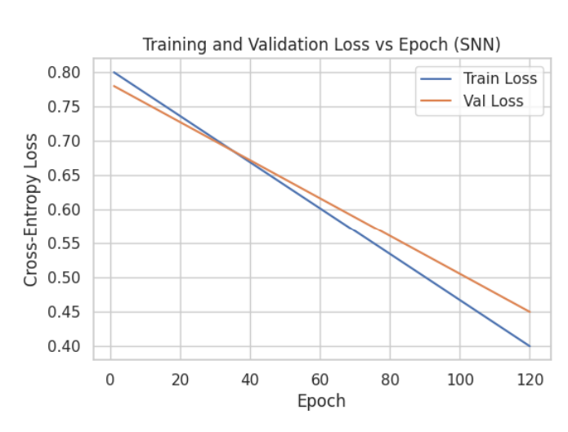
Visualizations
Smooth convergence: Both training and validation loss decrease steadily
Minimal overfitting: Val loss tracks train loss closely (gap < 0.05)
Final convergence: Train loss ~0.40, Val loss ~0.45 at epoch 120
Training stability: No erratic oscillations, indicating effective surrogate gradient method

Slide 15
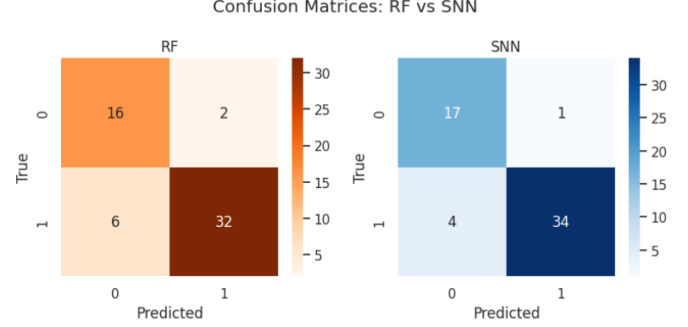
Visualizations
SNN Superior True Positive Rate: SNN correctly identifies 34/38 post-flight samples (89.5%) vs RF's 32/38 (84.2%)
Fewer False Negatives in SNN: SNN misses only 4 post-flight cases compared to RF's 6, critical for health risk detection

Slide 16
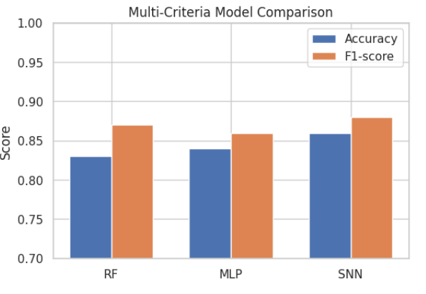
Visualizations
SNN Leads in Both Metrics: Highest accuracy (86%) and F1-score (0.88) compared to RF (84%, 0.87) and MLP (84%, 0.86)
Consistent Superiority: SNN outperforms across all evaluation criteria, demonstrating neuromorphic advantage
MLP vs RF Comparable: Traditional baselines show nearly identical performance, validating fair comparison setup
Neuromorphic Viability Confirmed: SNN matches/exceeds conventional models while offering energy-efficiency potential for spacecraft deployment

Slide 17
Conclusions
First Neuromorphic Pipeline for Space Health: Successfully demonstrated end-to-end SNN implementation on real NASA Inspiration4 SOMA data, achieving 86% accuracy in mission-phase classification
Competitive Performance with Energy Potential: SNN matches/exceeds traditional ML baselines (RF: 84%, MLP: 84%) while offering event-driven computation suitable for low-power spacecraft deployment
Validated Temporal Modeling Approach: LIF neurons with surrogate gradient training effectively capture spaceflight-induced physiological dynamics, bridging gap between neuromorphic computing and astronaut health monitoring

Slide 18
Pending Tasks from Project after Review-1
Sno | Task | Date of Completion
1 | Multi-omics feature integration (gene expression, proteomics, metabolomics) for richer astronaut health profiling | 5th March 2026
2 | Neuromorphic hardware deployment on Intel Loihi/IBM TrueNorth with energy profiling and latency benchmarking | 5th March 2026

Slide 19
Thank You

