Slide 1

Presentation
on
Skin Care Recommendation System
by
Tannoo Shukla 202410116100220
Trapti Rajput 202410116100224
Tannu Modanwal 202410116100221
Vanshika Srivastava 202410116100236
Session:2025-2026 (III Semester)
Under the supervision of
Dr. Neelam Rawat (Professor)
Dr. Amit Kumar Gupta(Professor)
Department Of Computer Applications
KIET GROUP OF INSTITUTIONS, DELHI-NCR, GHAZIABAD-201206

Slide 2
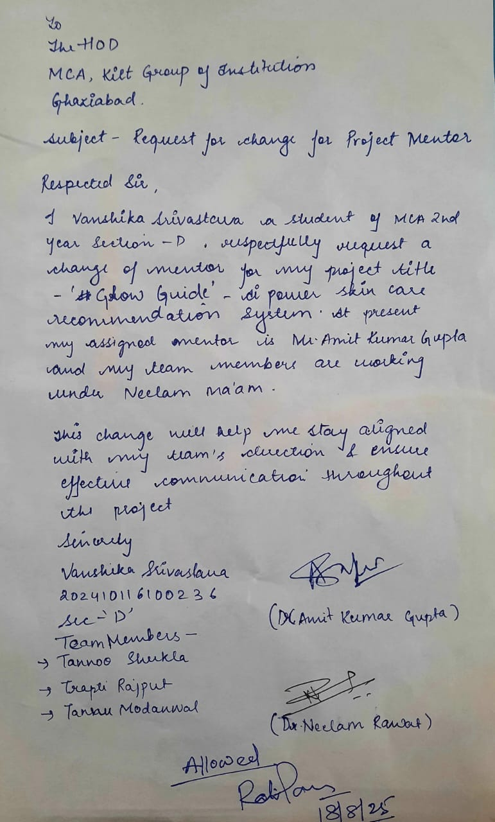

Slide 3
1. Title Slide:
Project title, team members, and presentation date.
2. Project Overview:
Briefly introduce the project, its purpose, and the problem it solves.
Highlight the project's significance and potential impact.
3. Project Objectives:
Clearly state the specific objectives of the project.
Explain what the project aims to achieve and how success will be measured.
4. Project Scope:
Define the boundaries of the project, outlining what is included and excluded.
Specify the key features, functionalities and modules
5. Methodology:
Describe the chosen software development methodology (e.g., Agile, Waterfall).
Explain the tools and technologies used for this approach.
6. Timeline:
Present a visual representation of the project schedule, including major milestones and deadlines.
Use a Gantt chart or similar diagram to show the project's timeline.
7. Project Outcome: Highlight the final result of the project, such as:
Research Paper Publication
Web/Mobile Application Development
Patent Filing/Grant

Slide 4
PROJECT OVERVIEW
Purpose: To provide personalized skincare product recommendations using AI.
Problem: Choosing the right skincare product is difficult due to diverse skin types and conditions.
Solution: An intelligent system that recommends suitable products based on user input such as skin type, concern, and product preference.
Impact: Helps users make informed decisions, enhances skincare routine, and reduces chances of skin issues.

Slide 5
PROJECT OBJECTIVE
Develop an AI-based recommendation system for skincare products.
Allow users to enter details like skin type and desired product category.
Provide skin type detection quiz for users unsure of their skin type.
Publish a research paper on the effectiveness and accuracy of the system.
Measure success by accuracy of recommendations and user satisfaction.

Slide 6
PROJECT SCOPE
Included:
Personalized product recommendations based on user input.
Skin-type quiz functionality for better personalization.
Synthetic dataset for training and testing.
Excluded:
Real-time dermatology consultation.
Live integration with e-commerce websites (future scope).
Key Features:
User input module: Skin type, concerns, product type.
Recommendation engine: AI-driven suggestions.
Skin quiz module: For identifying skin type.

Slide 7
METHODOLOGY
Development Methodology: Agile approach for iterative development.
Tools & Technologies:
Flask for building the web application.
Python for implementation and logic development.
Algorithm: To be finalized after discussion with mentor (future step). Dataset: Kaggle skincare dataset containing product details, skin types, and concerns. Link

Slide 8
LITERATURE REVIEW
Paper | Summary / Approach | Strengths | Limitations / Not Included
A comprehensive classification and analysis of oily sensitive facial skin: a cross-sectional study of young Chinese women (Kuang et al., 2025) | Developed an objective classification system for oily sensitive skin using 104 biophysical parameters and image analysis. Classified skin into subtypes (barrier-sensitive, neurosensitive, inflammatory-sensitive). | - Comprehensive noninvasive assessment. - Objective classification (overcomes subjective assessment issues). - Includes physiological and morphological analysis for accurate skincare recommendations. | - Limited demographic (only young Chinese women). - Focuses on skin analysis and classification, not on product recommendation. - No integration with AI or recommender systems.
Skin pH: From Basic Science to Basic Skin Care (Ali & Yosipovitch, 2013) | Explores the role of skin pH and acid mantle in barrier homeostasis, antimicrobial defense, and SC integrity. Discusses endogenous and exogenous factors affecting skin pH and implications for skincare product formulation. | - Strong theoretical basis for skincare product design. - Emphasizes importance of maintaining skin acidity. - Links pH with skin disorders (eczema, acne). | - Not a recommendation system. - No computational or AI-based approach. - Does not include modern data-driven personalization techniques.

Slide 9
LITERATURE REVIEW
Paper | Summary / Approach | Strengths | Limitations / Not Included
A Content-based Skincare Product Recommendation System (Gyeongeun Lee, 2020) | Proposed a content-based filtering system for skincare recommendation using ingredient composition and skin type. Utilizes cosine similarity and TF-IDF for matching products to user profiles | - Personalization based on skin type and ingredient composition. - Addresses overspecialization by recommending across categories. - Simple and interpretable approach. | - Cold-start problem for new users. - Limited to content-based filtering (no collaborative or hybrid features). - No image-based skin analysis.
Deep learning-based skin care product recommendation: A focus on cosmetic ingredient analysis and facial skin conditions (Lee et al., 2024) | Designed a deep learning model using Transformer encoder for ingredient analysis and U-Net-based CNN for skin analysis. Recommends products by combining ingredient patterns and facial image-based skin condition detection. | -- Dual approach (ingredient analysis + AI skin analysis). - Uses advanced deep learning (Transformers & CNN). - Provides personalized, image-based recommendation. | - Requires large dataset (data-hungry). - High computational cost. - Ingredient quantity in products often unknown, leading to approximation..

Slide 10
LITERATURE REVIEW
Paper | Summary / Approach | Strengths | Limitations / Not Included
A Machine Learning Based Recommendation System For Cosmetics (Chaurasia et al., 2022) | Developed a content-based recommendation system using binary matrix representation of ingredients and similarity measures. Handles six product categories and five skin types. | - Focuses on ingredient-level personalization. - Handles multiple product categories and skin types. - Simple to implement and computationally efficient. | - No hybrid approach (lacks collaborative filtering). - Does not incorporate real-time skin condition analysis. - Dataset size and diversity limitations.

Slide 11
TIMELINE
Phase | Duration
Requirement gathering & dataset preparation. | Week 1 – 2
Model development (recommendation engine). | Week 3 – 4
Skin type quiz module. | Week 5 – 6
UI development & integration. | Week 7 – 8
Testing & evaluation. | Week 9
Research paper drafting & submission. | Week 10 – 11
Used Gantt chart to plan weekly goals.
Each phase reviewed at the end of each week.
Agile helped with flexibility and changes.
Deadlines were set for data, model, and visualization tasks.

Slide 12
PROJECT OUTCOME
Research Paper Publication on AI-driven skincare recommendation systems.
Working Prototype of a recommendation engine integrated with a user-friendly interface.
Skin-type Detection Quiz for better personalization.
Future Scope:
Integration with real-world datasets.
E-commerce collaboration for live product availability.
Advanced ML models for better accuracy.

Slide 13
Thank You

