Slide 1
DG
DesignGuard
An automated tool that checks any website for accessibility problems.
🔗 View the project — github.com/Tannuiux/designguard
Give(a)Go HackSprint · Daytona

Slide 2
DG
DesignGuard
The Problem
• Websites often have accessibility bugs — missing image labels, bad contrast, and unlabeled buttons
• These bugs can make sites difficult or impossible to use for people with disabilities
• Checking for these problems manually takes a long time
• Most teams skip the check entirely

Slide 3
DG
DesignGuard
What is WCAG?
• WCAG means Web Content Accessibility Guidelines
• It is the official global rulebook for making websites accessible
• It was created by the W3C, the organization behind web standards
• DesignGuard checks WCAG 2.0 Levels A and AA
• So the report is based on a real standard — not just an opinion

Slide 4
DG
DesignGuard
How DesignGuard Works
• You give it a website link
• It opens the website in an isolated Daytona sandbox
• Playwright loads the page in a real browser
• axe-core scans the page against WCAG accessibility rules
• It gives a report: screenshot, number of issues, and exact list of issues
🔗 Source code — github.com/Tannuiux/designguard

Slide 5
DG
DesignGuard
Test 1: irs.gov
Result: 0 violations found
• IRS.gov is a U.S. government website
• DesignGuard found no automated WCAG A/AA issues
• This is important: the tool does not always flag issues
• It can correctly report that a site is clean

Slide 6
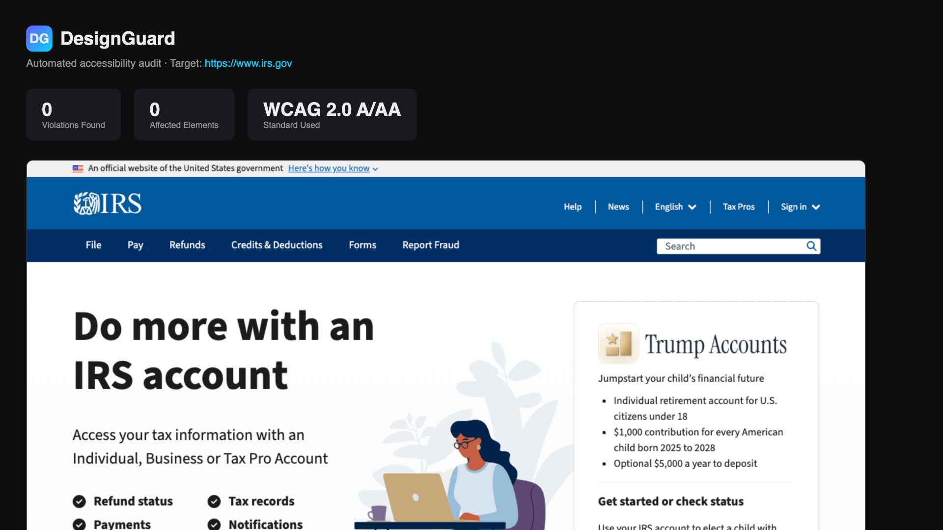
DG
DesignGuard
DesignGuard Report: irs.gov
Live scan · www.irs.gov

Slide 7
DG
DesignGuard
Test 2: Hacker News
Result: 4 violations · 243 elements
• 238 color-contrast issues: text is difficult to read
• 3 image-alt issues: images missing screen-reader text
• 1 label issue: a form field has no label
• 1 link-name issue: a link has no readable name
• The report tells developers exactly what to fix

Slide 8
DG
DesignGuard
DesignGuard Report: Hacker News
Live scan · news.ycombinator.com

Slide 9
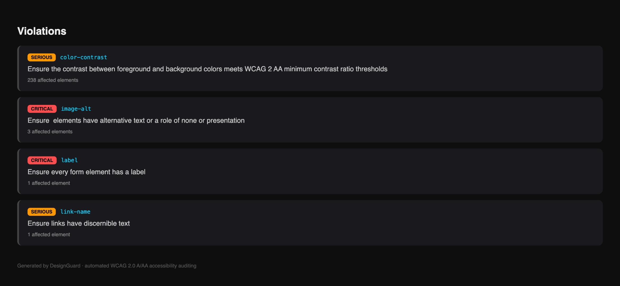
DG
DesignGuard
Violation Breakdown
Full severity + affected-element breakdown, generated automatically

Slide 10
DG
DesignGuard
Future Scope
• Auto-fix suggestions: recommend the exact code change for each issue
• Redesign mode: generate a more accessible version of the page
• Scheduled monitoring: check a website every week
• AI agent self-check: let coding agents test their websites before shipping
• Track accessibility scores over time

Slide 11
DG
DesignGuard
Automated accessibility audits for any website.
Node.js · Daytona · Playwright · axe-core
🔗 Star the repo — github.com/Tannuiux/designguard
Thank You

