Slide 1








DIGITAL IMAGE PROCESSING PROJECT
Paneer Contamination Detection Using Hyperspectral Imaging and Deep Learning
Presented By
23MIA1074 - Nadia Naureen
23MIA1099 - Divya P
23MIA1130 - Tannya Pasricha
Faculty: Dr Geetha S

Slide 2
Motivation
  Food contamination is a major issue in the dairy industry, especially in perishable products like paneer.
  Traditional contamination detection relies on manual inspection or chemical testing, which is slow and destructive.
  There is a need for non-destructive, automated methods to monitor food safety and quality in real time.

Slide 3
Base Paper Summary
“Bread Contamination Detection using Deep Learning and Thermal Imaging”
  Used thermal imaging to detect contaminated regions on bread.
  Applied YOLO-based deep learning for classification and detection.
  Achieved high accuracy in identifying contaminated zones through temperature variations.

Slide 4
Our Adaptation
Original Study:
  Food Type: Bread
  Camera Used: Thermal Camera
  Feature Extracted: Temperature Patterns
  Model Used: YOLOv11n
Our Project:
  Food Type: Paneer
  Camera Used: Hyperspectral Camera (80 Bands)
  Feature Extracted: Spectral Reflectance
  Model Used: YOLOv11n (Same as Original Study)

Slide 5
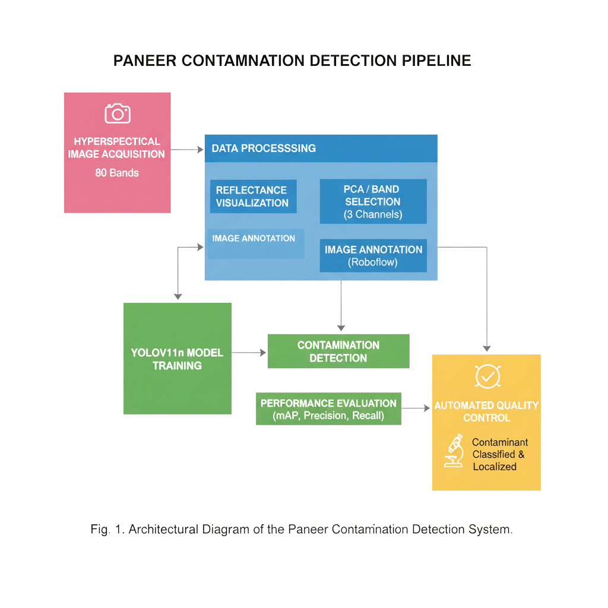
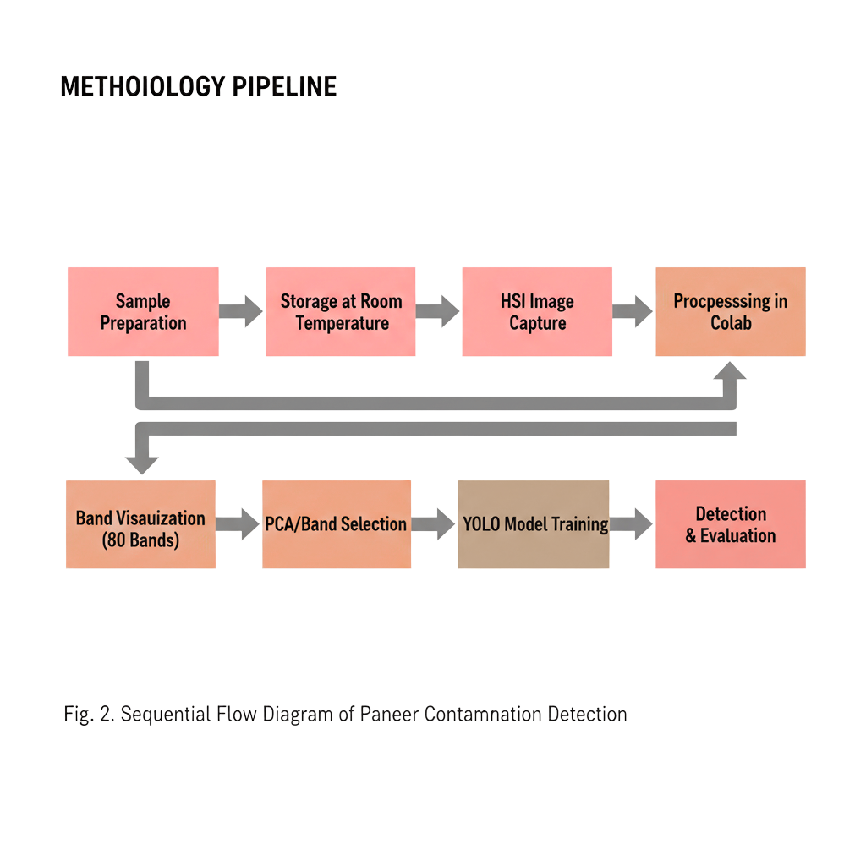
Methodology
Steps Followed:
1. Prepared 3 paneer types – Milkymist, Malai, Tofu.
2. Applied 5 treatments: normal, acetic acid (3 & 6 drops), hydrogen peroxide (3 & 6 drops).
3. Captured 140 HSI images (80 bands each).
4. Processed images using spectral library in Google Colab.
5. Visualized reflectance and pseudo-RGB images.

Slide 6
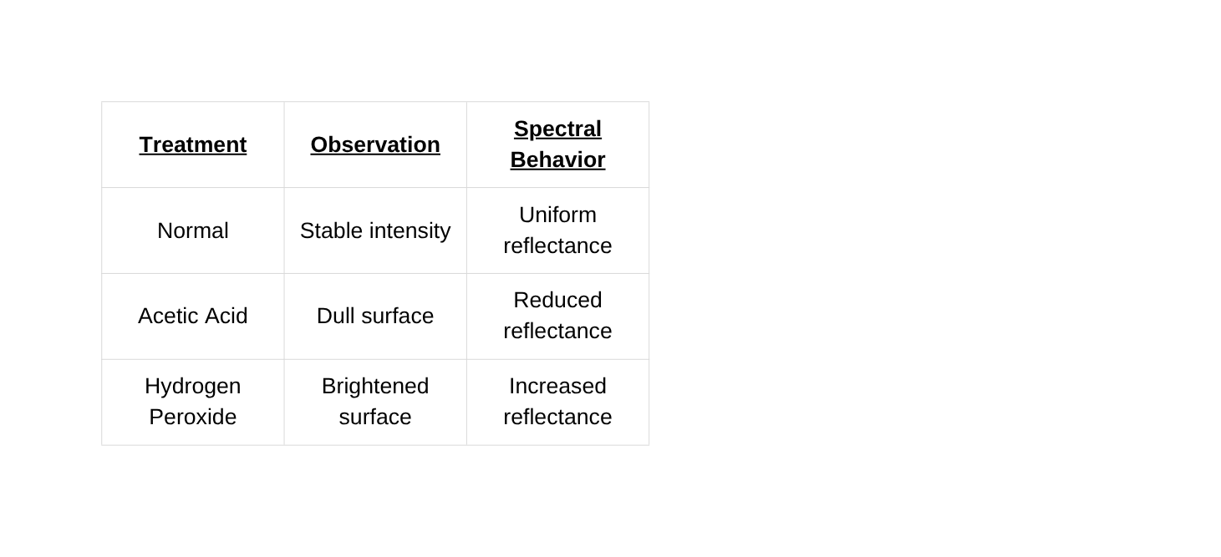
Results – Visualization & Findings
  Successfully visualized 140 hyperspectral images in Colab (25-Malai Paneer, 29-Tofu Paneer, 29-Natural Paneer)
  Observed clear differences between normal and treated samples.
  Bands 40–60 showed the strongest reflectance variation.
  Acid-treated cubes: darker spectral regions (lower reflectance).
  Peroxide-treated cubes: brighter spectral zones (higher reflectance).

Slide 7
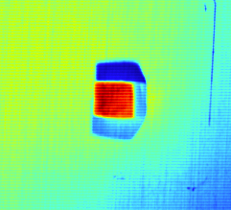
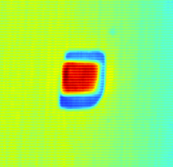
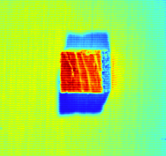
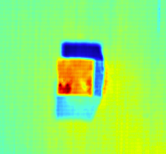
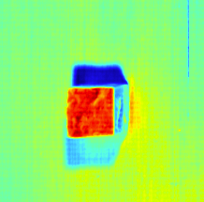
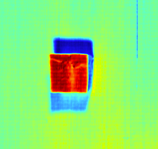
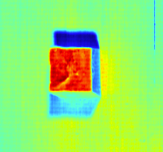
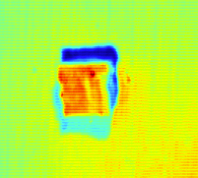
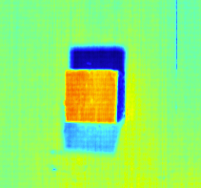
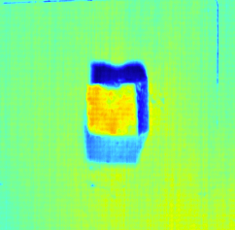
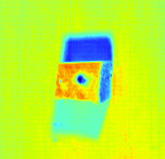
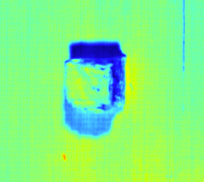
Natural Paneer
Malai Paneer
Tofu Paneer
RESULT IMAGES
https://drive.google.com/drive/folders/1J8_2B4R58m_Ac6yTE5FEuSctlXSK0IcV?usp=sharing

Slide 8
Key Findings
  Hyperspectral Imaging (HSI) effectively captures chemical and physical changes in paneer.
  Reflectance variations correspond to contamination or treatment intensity.
  Data structure and preprocessing pipeline are complete for deep learning integration.
  The method is non-destructive and more sensitive than thermal imaging.
  Established dataset and metadata ready for YOLOv11n model training.

Slide 9
Future Enhancements
Planned Next Steps:
  Apply PCA or band selection to compress 80 bands into 3-channel pseudo-RGB images.
  Annotate images using Roboflow for contamination labeling.
  Train the YOLOv11n model on the preprocessed dataset.
  Evaluate using *Precision, Recall, and mAP metrics.
  Extend dataset from 140 to 540 images for higher accuracy.

Slide 10
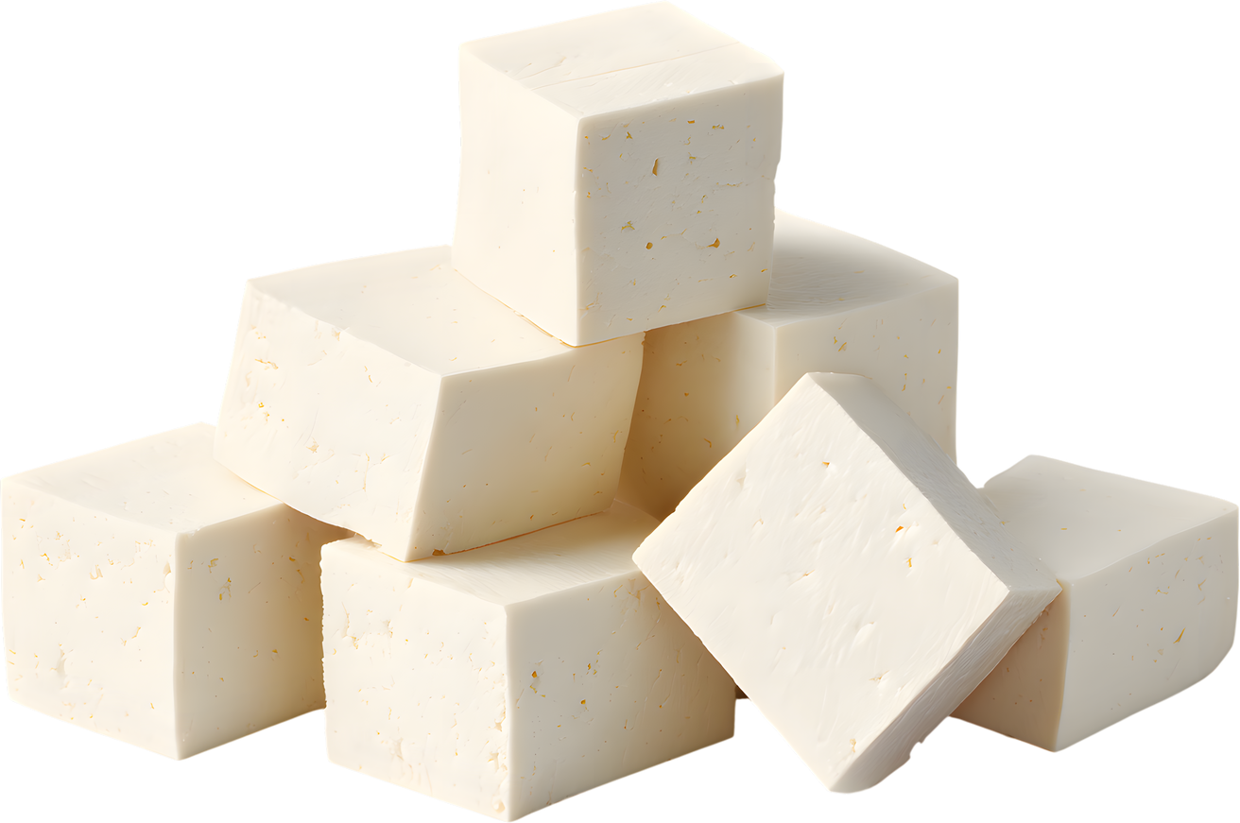
Future Scope
Real-time paneer quality monitoring in dairy production.
Integration with IoT sensors for smart food safety systems.
Expansion to other dairy products and imaging modalities.

Slide 11
Thank
You

