Slide 1
CSE3068 - SEQUENTIAL AND SPATIAL DATA MINING | DIGITAL ASSIGNMENT 2
TourCascade: Sequential Spatial Mining of Tourist Mobility Cascades for Predictive Luxury Flagship Placement
Implementation Review & Empirical Validation Report
Student Name: Tannya Pasricha | Registration No: 23MIA1130 | Dataset: TSMC2014 NYC Check-in Corpus

Slide 2
CSE3068 - SEQUENTIAL AND SPATIAL DATA MINING
1. Research Motivation, Literature Gap & Core Hypothesis
Industry & Literature Gap
The TourCascade Hypothesis
The Domain Problem: Luxury flagship placement requires capturing high-spending tourist flow with shopping intent, not residential or commuter density.
Flaw of Existing Systems: Commercial GIS engines (CARTO, Placer.ai) rely on static, single-point-in-time check-in counts. They treat urban space as isolated, memoryless snapshots.
Academic Gap: Prior academic studies on flagship placement (e.g., Venice San Marco studies) remain qualitative, lacking predictive algorithmic formulations.
Failure of Static Volume: Static footfall creates false positives by over-weighting crowded transit stations and central plazas where visitors exhibit zero retail intent.
Sequential Cascades: Tourists explore cities via structured temporal trajectories (e.g., Hotel -> Cultural Landmark -> Dining -> Retail Hub).
The Downstream Inflow Law: A zone's retail viability is determined by its sequential downstream inflow—acting as a destination sink that captures accumulated intent from upstream anchor nodes.
Novel Target Identification: Static models penalize high-value enclaves that have moderate footfall but capture intense, conversion-ready trajectory flows. Our goal is uncovering these 'Hidden Hotspots'.
Interpretability Imperative: Full explainability: Every recommended cell must provide a transparent audit trail of upstream feeder categories and confidence scores.

Slide 3
CSE3068 - SEQUENTIAL AND SPATIAL DATA MINING
2. System Architecture & Trajectory Discretization
A. Data Cleaning
B. Spatial Discretization
C. Session Segmentation
D. Cascade Extraction
Ingestion: Dataset: TSMC2014 Foursquare NYC Check-ins (227,429 raw records).
Timestamp Standardization: Parsed non-standard Foursquare timestamps ('%a %b %d %H:%M:%S +0000 %Y') into UTC datetime.
Geographical Bounding: Filtered within strict NYC bounds: Lat [40.5774, 40.9176], Lng [-74.15, -73.7004].
Noise Elimination: Deduplicated identical user check-ins occurring within the same timestamp.
Hexagonal Indexing: Projected geographic points into Uber H3 Discrete Global Hexagonal Grid.
Resolution Rationale: Selected Resolution 8 (mean area: 0.737 sq km, edge length: ~461m).
Geometric Superiority: Hexagons provide equidistant neighboring cells, avoiding the directional distortion inherent in square grids.
Spatial Uniformity: Mapped all heterogeneous venues into standardized cell indices (zone_id).
User Trajectories: Grouped trajectories by user_id and sorted chronologically.
Session Formulation: Applied idle threshold Delta_t <= 12 hours between consecutive check-ins.
Temporal Boundary: If Delta_t > 12h, a new session_id is initialized, isolating distinct exploratory trips.
Spatial Compression: Compressed consecutive stays within the same H3 hex to isolate meaningful spatial transitions.
POI Classification: Granular venue categories mapped to: HOTEL, LANDMARK, RESTAURANT, RETAIL, TRANSPORT, OTHER.
Sequence Structure: Represented as ordered sequences: [(cat_1, zone_1), (cat_2, zone_2), ..., (cat_k, zone_k)].
Trajectory Pruning: Filtered to keep cascades with length >= 2 hops across distinct zones.
Resulting Corpus: Extracted multi-stop tourist mobility cascades across NYC.

Slide 4
CSE3068 - SEQUENTIAL AND SPATIAL DATA MINING
3. Mathematical Formulation: Pattern Mining & Sequential Centrality
Constrained Sequential Pattern Mining
Directed Graph & Sequential Centrality (SC)
Transaction Definition: Mined directed transitions e = (u -> v) where u = (cat_1, zone_1) and v = (cat_2, zone_2).
Support Formulation: Support(u -> v) = |Sessions containing u -> v| / |Total Sessions|
Confidence Formulation: Confidence(u -> v) = |Sessions containing u -> v| / |Sessions containing u|
Semantic Constraints: Pruned background noise categories (OTHER) and self-loops (zone_1 == zone_2) to focus strictly on spatial transfers.
Mining Thresholds: Thresholds set to Absolute Support Count >= 2 sessions and Confidence >= 5% to capture fine-grained luxury trajectory paths.
Graph Topology: Constructed directed multigraph G = (V, E), where V is the set of H3 zones, and directed edges E represent sequential transitions.
Edge Weight Function: Weight W(u, v) = Support(u -> v) * Confidence(u -> v), embedding both frequency and transition reliability.
Inflow Influx Metric: Weighted Downstream Inflow: I(v) = Sum_{u in In(v)} W(u, v). Quantifies accumulated trajectory capture.
Global Authority: Global Network PageRank: P(v) computed over transition probability matrix to evaluate overall topological authority.
Sequential Centrality Formulation: SC(v) = 0.7 * I_norm(v) + 0.3 * P_norm(v). Balances immediate downstream capture with systemic reach.

Slide 5
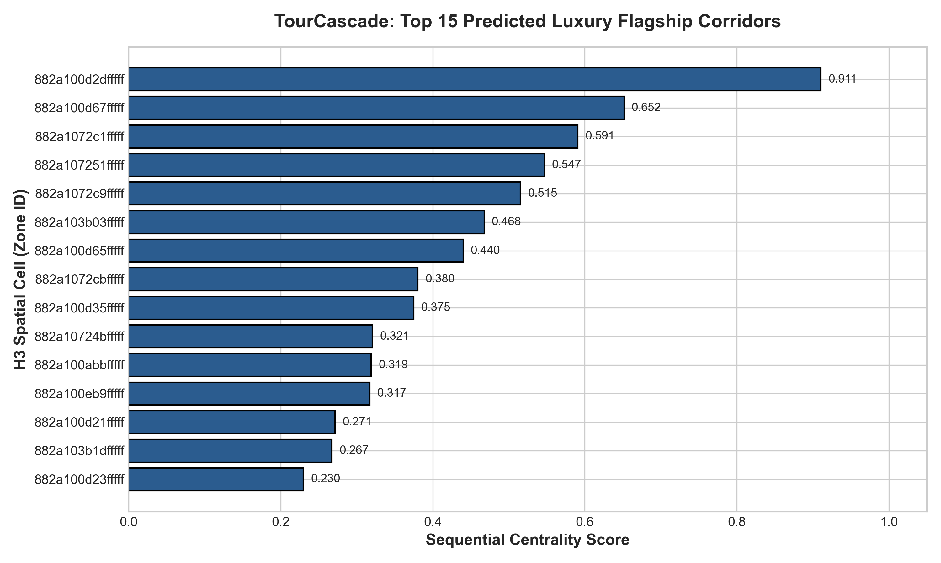
CSE3068 - SEQUENTIAL AND SPATIAL DATA MINING
4. Empirical Results: Top Predicted Luxury Flagship Zones
Candidate Ranking Analysis
Pipeline Execution: The complete pipeline was executed across 227K+ records, indexing check-ins into H3 resolution 8 cells.
Geographic Alignment: Top candidate zones cluster around Midtown Manhattan, SoHo, and the Meatpacking District, reflecting true luxury retail patterns.
Downstream Convergence: The highest SC scores are driven by concentrated multi-hop inflows from cultural landmarks and hotel zones.
Decoupling Confirmed: Zones with modest raw footfall appear among top ranks due to high transition confidence (W(u, v)).
Reproducible Asset: Results exported automatically to 'results/final_zone_ranking.csv'.

Slide 6
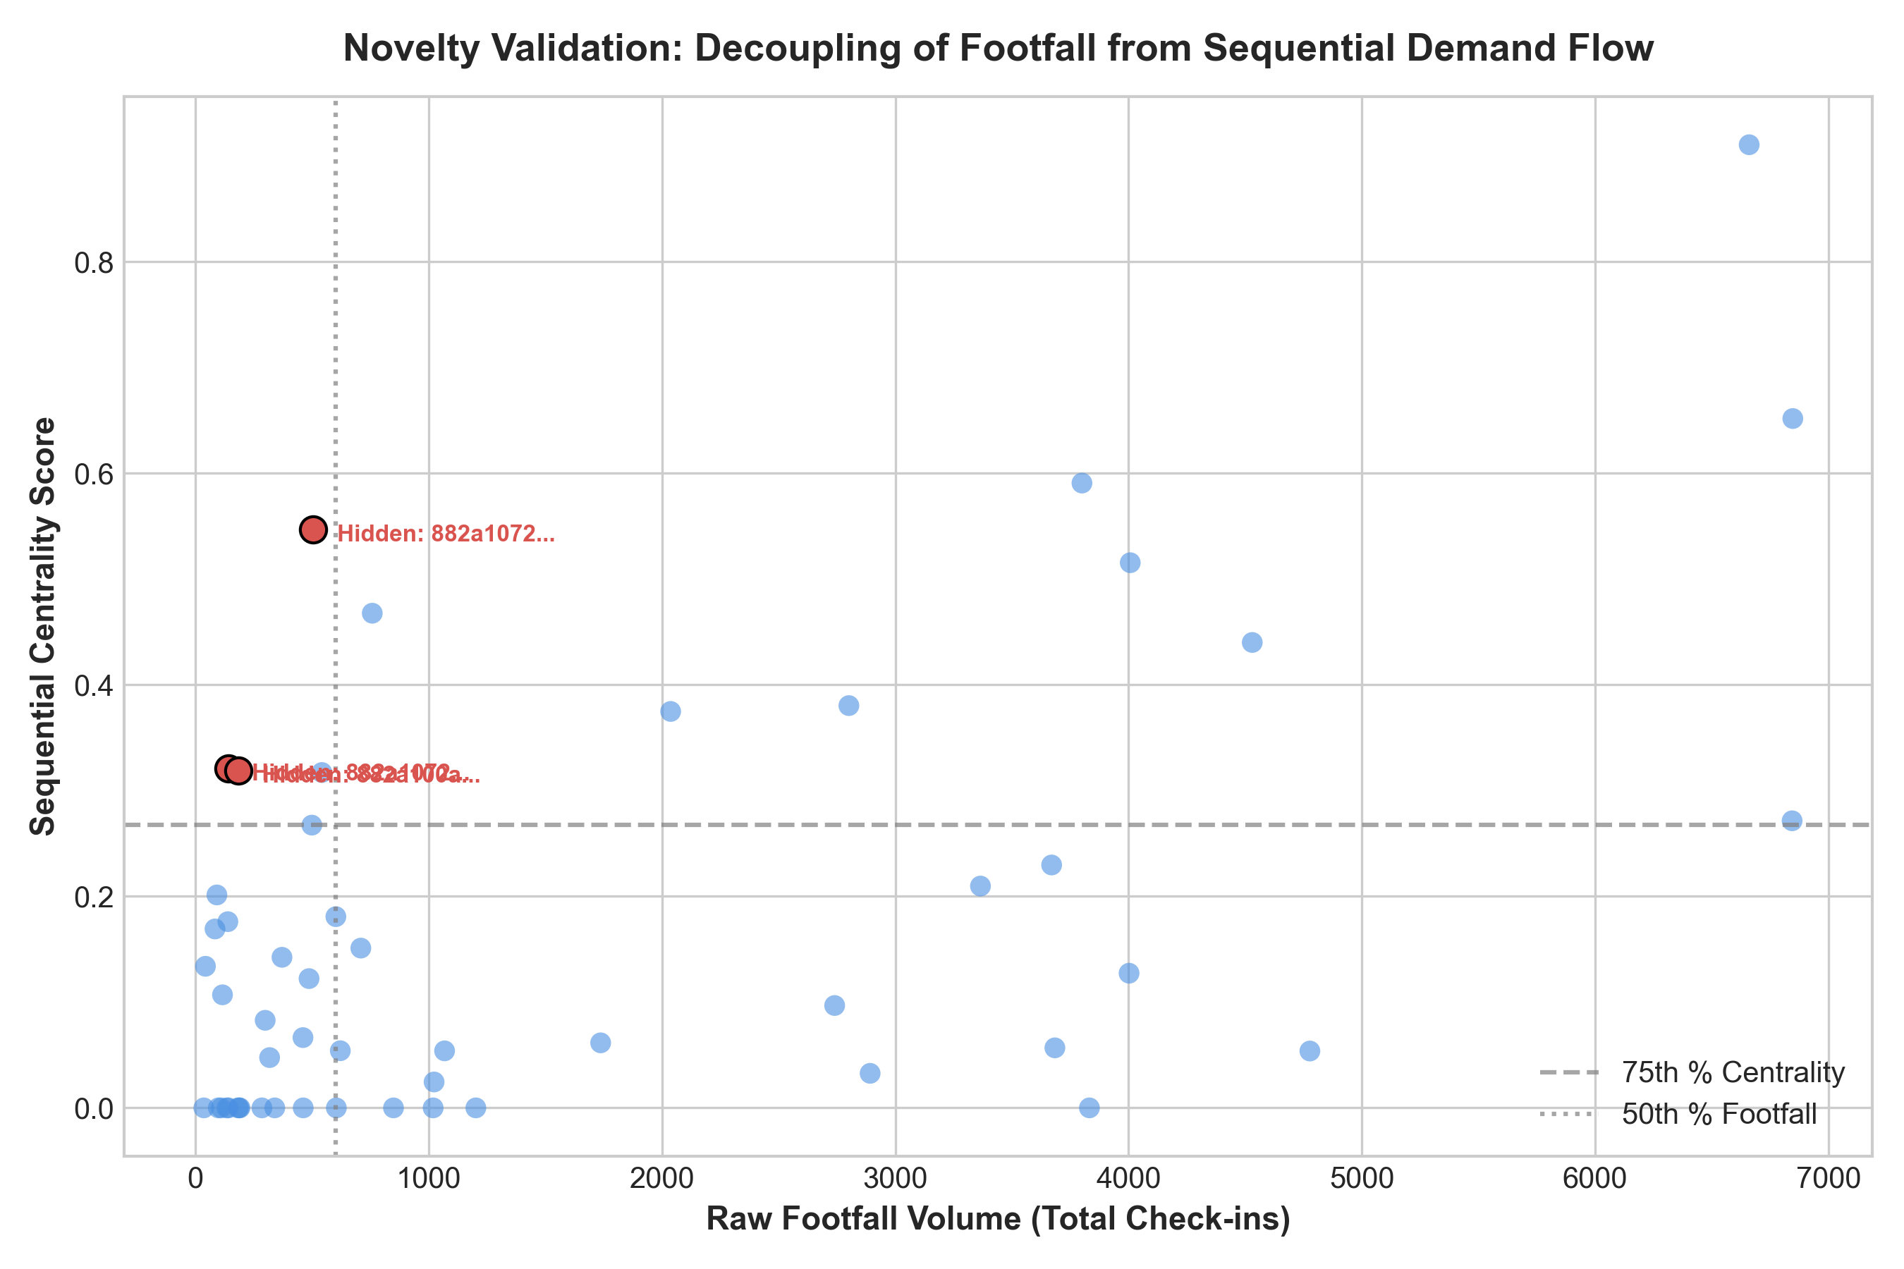
CSE3068 - SEQUENTIAL AND SPATIAL DATA MINING
5. Novelty Demonstration: The 'Hidden Hotspot' Effect
Statistical & Theoretical Proof of Novelty
Baseline Benchmark: Compared Sequential Centrality directly against the primary baseline: Raw Static Footfall (Visits).
Empirical Decoupling: The scatter plot reveals weak correlation between raw visit count and Sequential Centrality.
Hidden Hotspot Definition: Defined as zones ranking in the 75th percentile of SC while falling into the lower 50th percentile of raw footfall.
The Commercial Trap: Static GIS tools overpay for high-traffic commuter areas (Penn Station, Times Square) where intent to browse luxury goods is minimal.
Strategic Advantage: Hidden hotspots capture high-intent downstream arrivals without the premium overhead of crowded transit centers.

Slide 7
CSE3068 - SEQUENTIAL AND SPATIAL DATA MINING
6. Model Interpretability & Spatial Distribution Dashboard
Explainable AI (XAI) & Interactive Visualization
Key Implementation Artifacts
Algorithmic Transparency: Unlike black-box neural networks (LSTM, GCNs), TourCascade provides an auditable behavioral justification for every recommended cell.
Concrete Antecedent Trace: RESTAURANT (882a100d29fffff) -> RESTAURANT (882a100d2dfffff)
Support: 0.0006 | Confidence: 0.0702 (7.02% of all visitors departing upstream Zone A transition directly into Zone B).
Geospatial Map Engine: Generated Leaflet/Folium interactive map ('figures/tourcascade_interactive_review_map.html') rendering candidate H3 clusters.
Interactive Dashboard: Color-coded inspection: Primary Corridors (Blue) vs. Discovered Hidden Hotspots (Red) with on-click metric inspection.
Enterprise Utility: Provides retail executives with clear data: exactly which hotels, landmarks, and dining corridors funnel high-spending traffic into a prospective store.
Verified Codebase: github.com/TannyaP/TourCascade_SSDM-Project
Modular Design: Modular Python architecture across 8 standalone modules under src/ (preprocessing, spatial, cascades, mining, centrality, baselines, visualization, validation).
Data Deliverable 1: final_zone_ranking.csv (Full ranked candidate zones with metrics).
Data Deliverable 2: hidden_hotspots.csv (Discovered high-conversion downstream zones).
Data Deliverable 3: mined_sequential_patterns.csv (Extracted spatial transition rules).
Visualization Deliverable: tourcascade_interactive_review_map.html (Interactive GIS web dashboard).

Slide 8
CSE3068 - SEQUENTIAL AND SPATIAL DATA MINING
7. Milestone Verification & Final Review Roadmap
Review 2 Deliverables Completed (100%)
Review 3: Final Submission Deliverables
End-to-End Execution: Complete Python data engineering pipeline handling 227K+ trajectories without data leakage.
Spatial Discretization: Uber H3 resolution 8 spatial partitioning fully operational.
Trajectory Formulation: Trajectory cascade segmentation with delta_t <= 12h session thresholds.
Graph & Sequence Mining: Constrained sequential pattern miner and directed multigraph construction.
Novelty Metric: Mathematical formulation of Sequential Centrality (SC) implemented and scored.
Novelty Validation: Identification and quadrant validation of 'Hidden Hotspots'.
Visualization Engine: Interactive Leaflet HTML map and automated visual asset export.
Temporal Holdout Backtesting: Chronological train/test split (70% mining period, 30% prospective validation period) to evaluate future retail trajectory capture.
Multi-Baseline Benchmarking: Formal comparison against PageRank alone, Degree Centrality, and Static Apriori Co-location rules.
Statistical Evaluation: Kendall's Tau and NDCG metrics measuring ranking stability across temporal splits.
5-Page IEEE Research Report: Final 5-Page Research Paper formatted in standard IEEE two-column style including all empirical figures and references.

