Slide 1
MANUFACTURING AUTOMATION
ADITYA KALRA (14D100014)
TANYA GUPTA (150040010)

Slide 2
INDUSTRY VISIT
To WSS Kitchen Crafts. We were shown the list of equipment they manufacture and the machines/ manual labor used.
Objectives:
Need for Cutting machine
Better Bending machine
Effective Space utilization
Proper use of metal polishing machine

Slide 3
PAYBACK PERIOD
We suggested buying a cutting machine worth 5 lakh rupees and a hydraulic press worth 1 lakh machine that would suit their purposes.
Together, their use would reduce the time required for every project to 3/5th of the total time.
On calculation, we get the chance to take up 2 extra projects each year.
Since each project leads to a profit margin of 3 lakhs, we concluded that this initial investment would be recovered within the same year.

Slide 4
HYDRAULIC PRESS
Code: https://blogs.mathworks.com/images/seth/2011Q2/PLCCode.txt
SimMechanics from Matlab for simulations
Simulink for PLC Diagrams

Slide 5
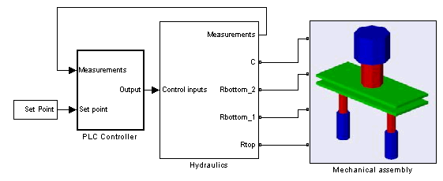
HOW IT LOOKS ON SIMULINK

Slide 6
CUTTING MACHINE
The screw cutting machine required a lot of floor space and manual labor before.
With our suggested stainless steel machine, they can do the same job with higher accuracy, better finish and faster speed.
Since cutting is the operation that is the bottle neck in the production line, reducing it’s time to 3/5th means the entire project’s time is reduced to 3/5^{th.}

Slide 7
FLOOR SPACE USE
They have a lot of plywood and stainless steel sheets kept unused on the floor in haphazard manner.
They also have not positioned the equipments efficiently
Along with introducing new machines, we helped them organize the raw materials such that efficient use is done

Slide 8
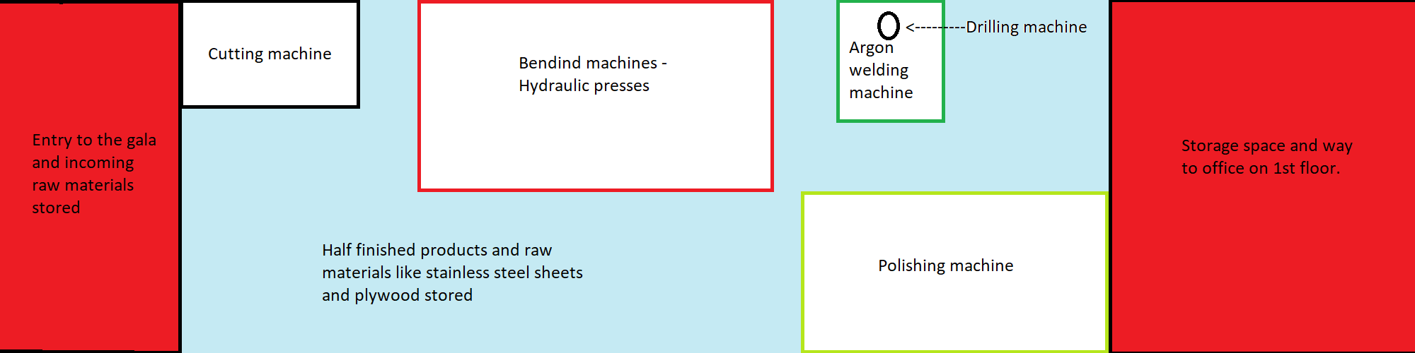

Slide 9
POLISHING MACHINE
The buffing machine they used had an old brush.
We suggested replacing the brush more frequently to ensure better finish of the product to create higher demand of their products in the market

Slide 10
CONCLUSION
We understood the need and use of automation in the manufacturing of the smallest and largest of equipment, and it was an eye-opening project
We thank Karunakaran Sir, WSS Kitchen Crafts, Hari Om Grinding Works and SIDDHESH Engineers for giving us the opportunity to learn something new.

Slide 11
THANK YOU
THANK YOU

