Slide 1
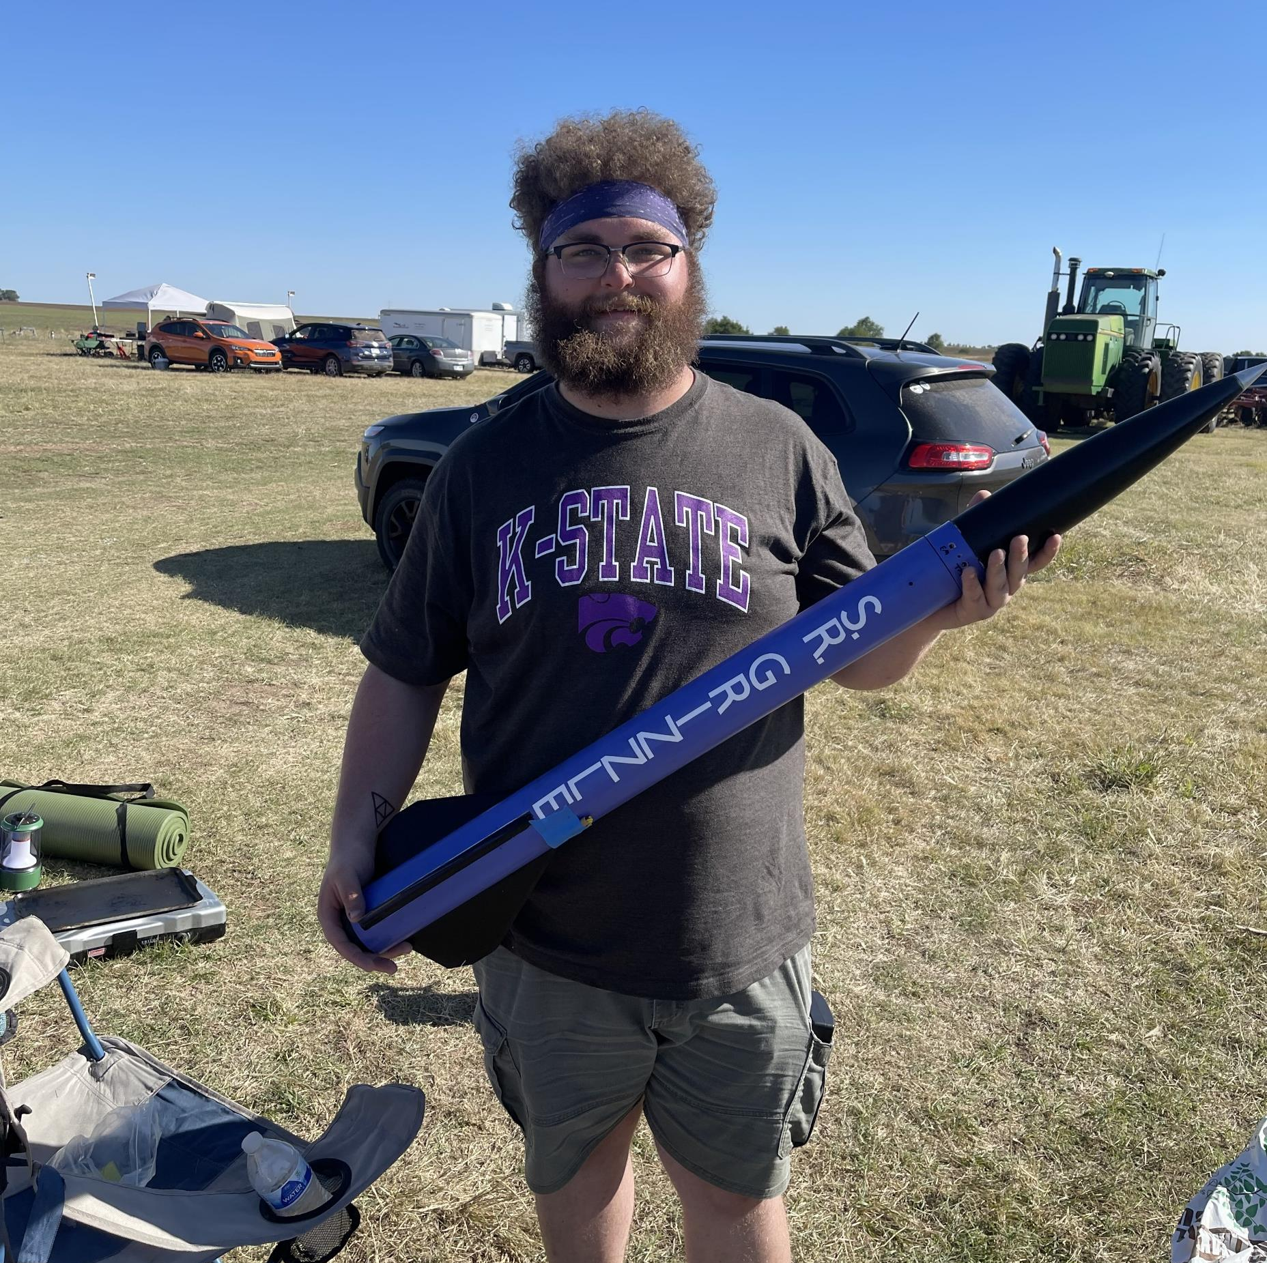
Rocket Flight Computer
Team Apogeenius
Tannyr Singleterry (L)(EE)
Gannon Bird (EE)
Ethan Benne (CMPEN)
Nathan Emerson (CMPEN)

Slide 2
Objectives, Significance, and Novelty
What, Why, Who

Slide 3
Requirements
Requirements Table goes here c:

Slide 4
Design Concept 1

Slide 5
Design Concept 2

Slide 6
Design Concept 3

Slide 7
Trade Studies and Design Alternatives

Slide 8
Block Diagram
We need a block diagram c:

Slide 9
Interfaces
USB?

Slide 10
Verification Plan

Slide 11
Feasibility Assessment
What obstacles/challenges do you anticipate facing?
What aspects do you feel like your team has strong expertise in.
E.g., all team members have not used SolidWorks previously
Limited PCB experience
Note how you plan to take on (mitigate) these challenges

Slide 12
Risks

Slide 13
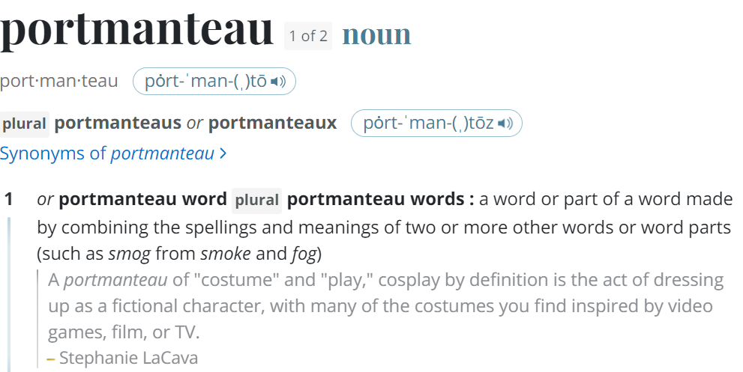
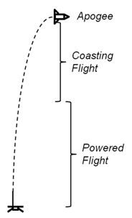
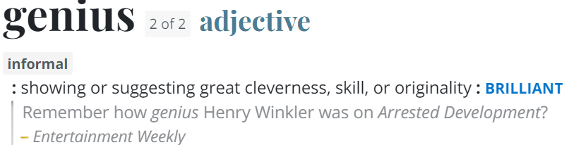
Questions
Image Credit: https://ffden-2.phys.uaf.edu/webproj/211_fall_2014/Adam_Kurzbard/Adam_Kurzbard/Page4.html

