Slide 1
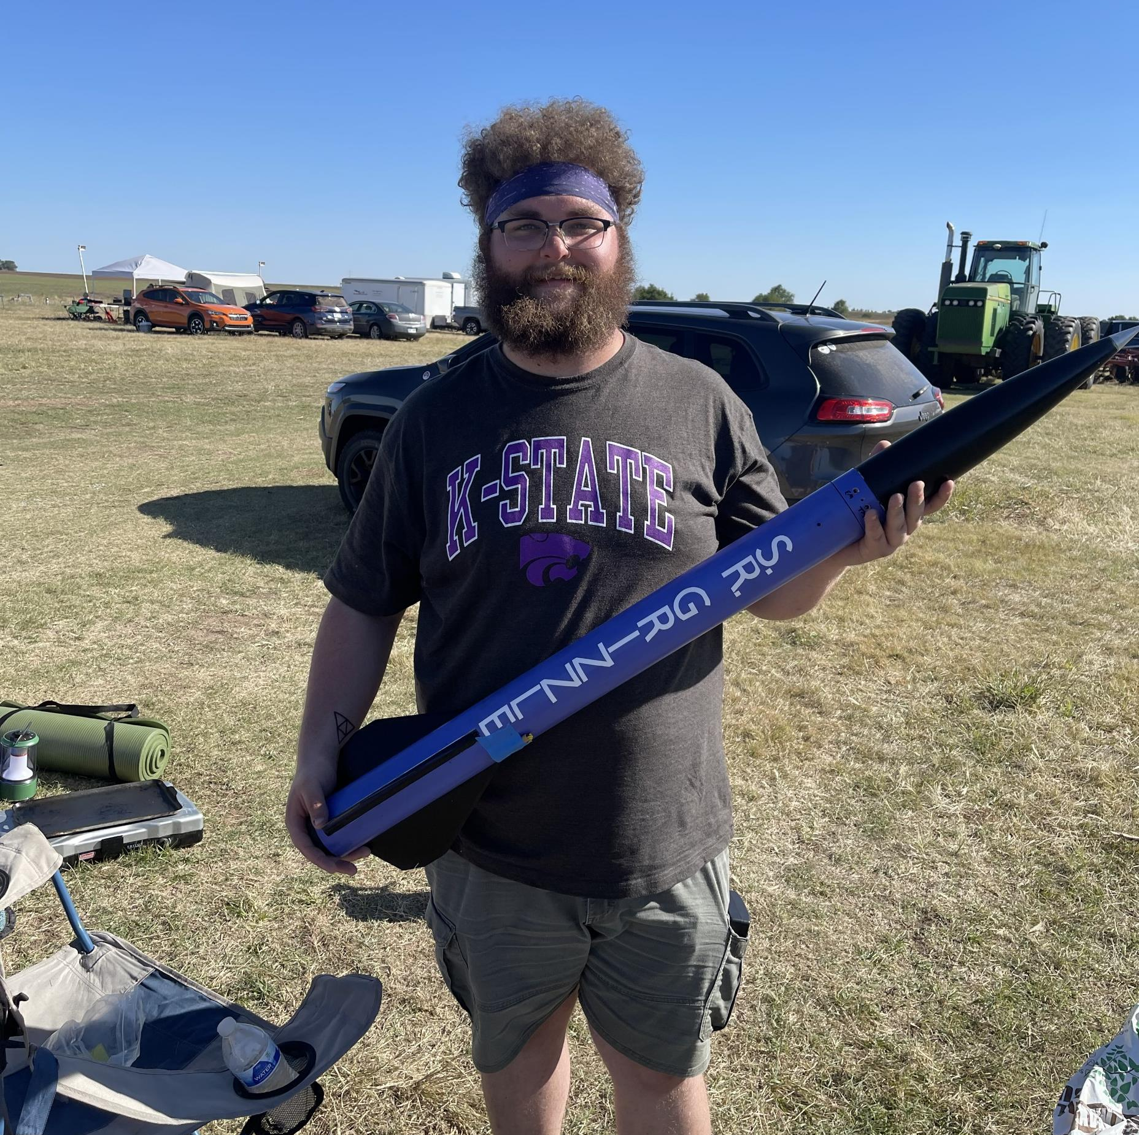
Rocket Flight Computer
Team Apogeenius
Tannyr Singleterry (L)(CMPEN)
Gannon Bird (EE)
Ethan Benne (EE)
Nathan Emerson (CMPEN)

Slide 2
Problem Statement

Slide 3
Purpose and Objective
What, Why, Who

Slide 4
Customer and System Requirements
Requirements Table goes here c:

Slide 5
Design Concept 1: Microcontroller

Slide 6
Design Concept 2: FPGA

Slide 7
Microcontroller Options

Slide 8
Design Criteria Table

Slide 9
Final Score and Selected Design

Slide 10
Block Diagram
We need a block diagram c:

Slide 11
Interfaces
USB?

Slide 12
Cost/Budget
Money go brrrr

Slide 13
Feasibility Assessment/Risks
Temp

Slide 14
Conclusion
We’re just better

Slide 15
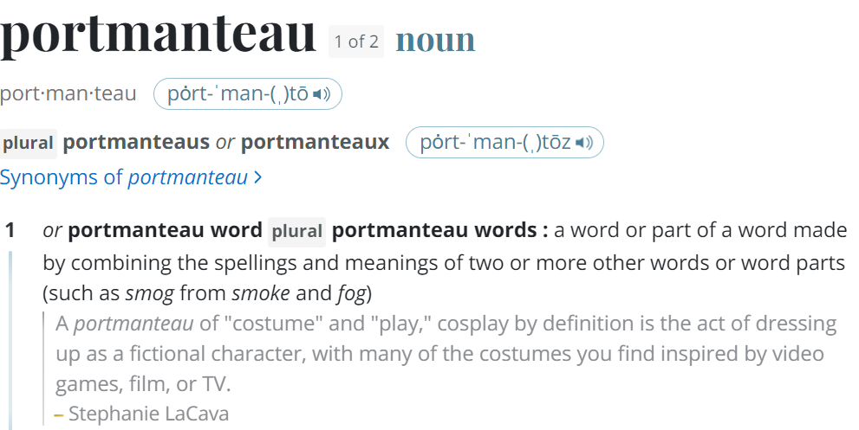
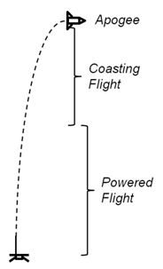
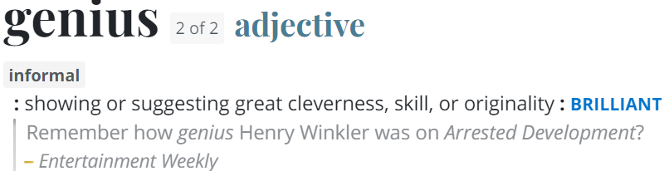
Questions
Image Credit: https://ffden-2.phys.uaf.edu/webproj/211_fall_2014/Adam_Kurzbard/Adam_Kurzbard/Page4.html

