Slide 1
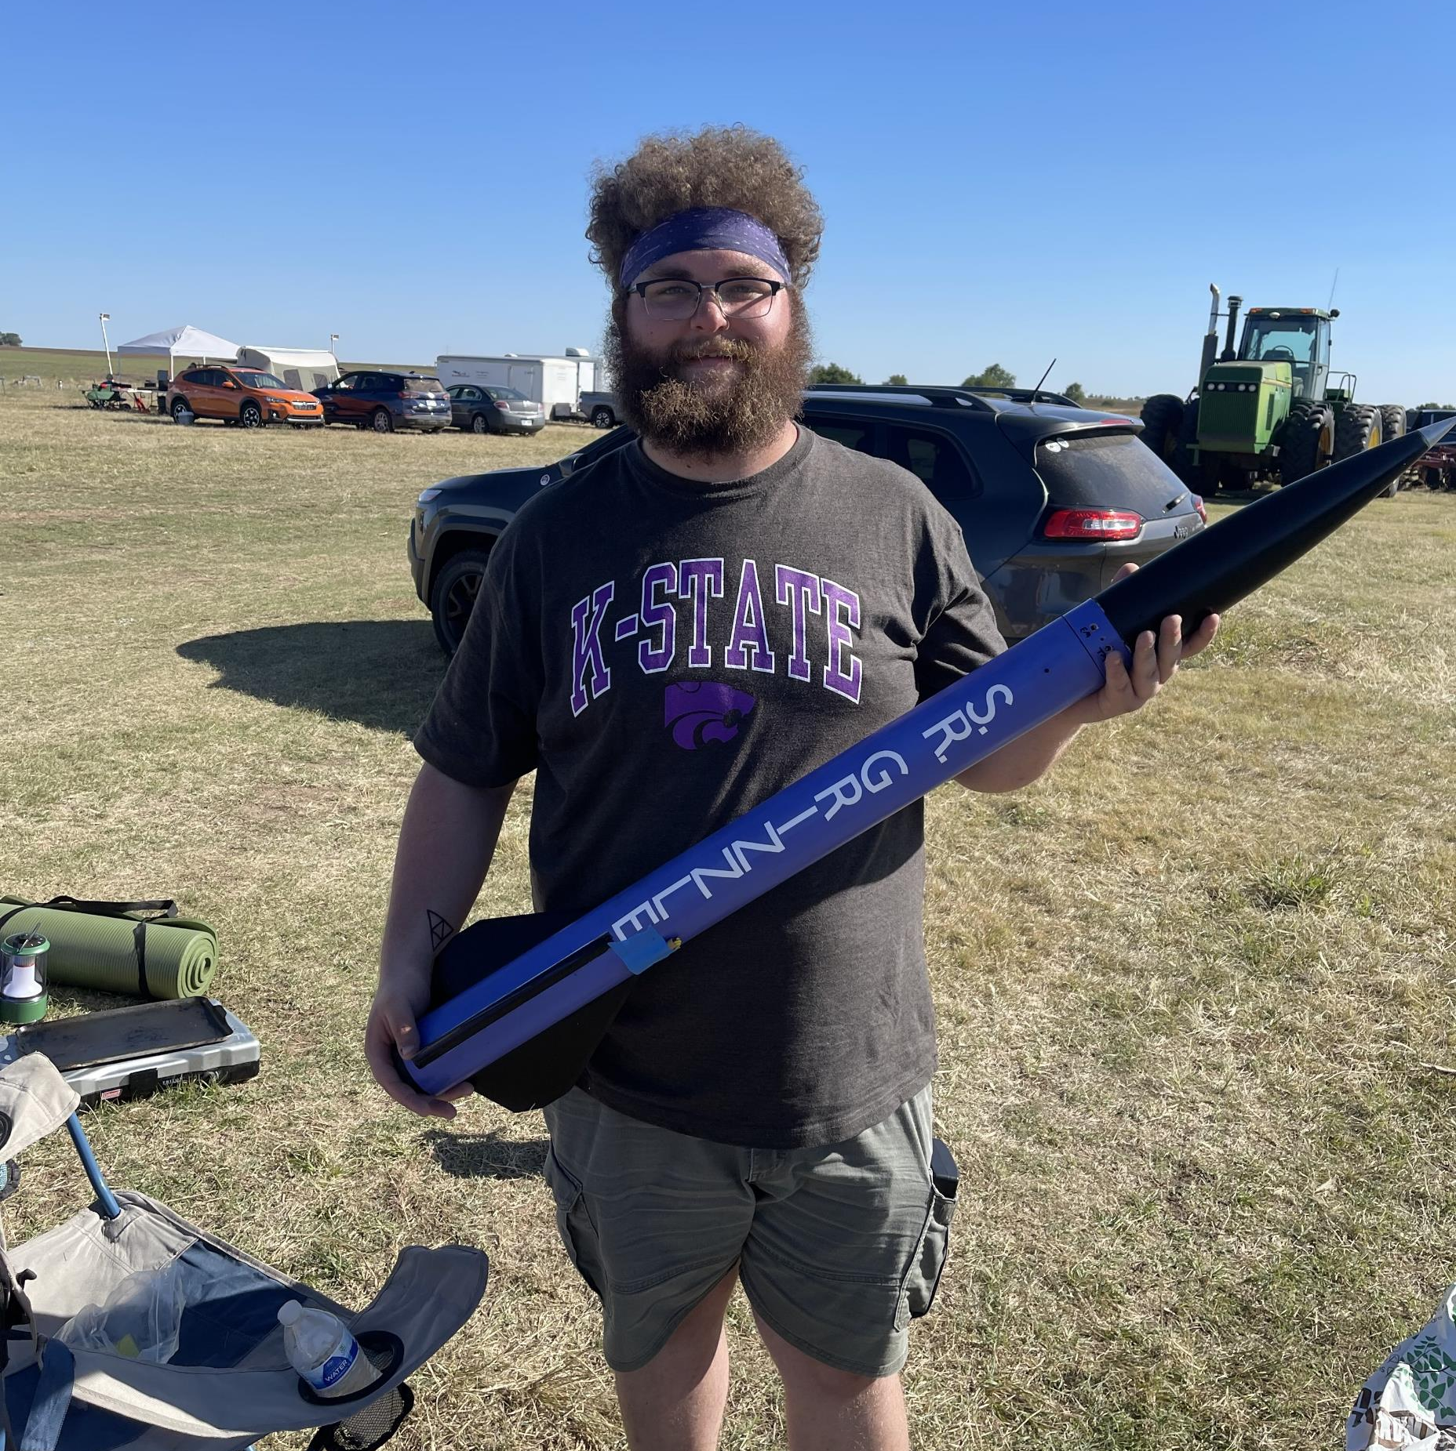
Rocket Flight Computer
Team Apogeenius
Tannyr Singleterry (L)(CMPEN)
Gannon Bird (EE)
Ethan Benne (EE)
Nathan Emerson (CMPEN)

Slide 2
Problem Statement
Rocketry tried doing flight computer before and it never saw to completion.
Would be nice for rocketry to have its own customizable flight computer using this as a baseline

Slide 3
Purpose and Objective
Build a mf flight computer
Do it well lmao

Slide 4
Customer and System Requirements
ID | Requirement | Description
1.0 | Input Voltage and Current | 2S LiPo
1.a | Minimize Power Use | Desgin Goal: The longer we can power the board the better. Minimum of 2 hours of battery life. Would like 3-4 hours
2.0 | Weight | Maximum 100 grams
3.0 | Size | Maximum 3 in width, 4 in length
4.0 | Cost | $200 or less
5.0 | Data Logging | Store at least three flights worth of data
5.a | Data Processing | Be able to process data from sensors into readable flight data
5.b | Data Export | Be able to export that data over serial or visualize over WiFi

Slide 5
Verification
ID | Requirement | Analysis | Demonstration | Inspection | Test
1.0 | Input Voltage and Current |  |  |  | X
1.a | Minimize Power Usage |  |  |  | X
2.0 | Weight |  |  | X
3.0 | Size |  |  | X
4.0 | Cost | X
5.0 | Data Logging |  |  |  | X
5.a | Data Processing |  |  |  | X
5.b | Data Export |  | X

Slide 6
Design Concept 1: Microcontroller
Description:
Microcontrollers are powerful small computers used on a single integrated circuit. They can range rapidly in variety when it coms to processing power, input/output capabilities, and data storage.
Pros:
Easy to use
Lower power consumption
Cons:
Serial execution
Internal peripherals can limit scope.

Slide 7
Design Concept 2: FPGA
Description:
FPGAs are a configurable integrated circuit that can be repeatedly programmed after manufacturing. FPGAs contain logic blocks and allow a programmer to connect these blocks and configure them.
Pros:
Can be programmed at logic level (parallel processing).
Can be reprogrammed.
Cons:
More complex coding
No control of power consumption.

Slide 8
Design Criteria Table
Need | Engineering Requirement | Weight (1-10) | Base line | Concept 1 | Concept 2
Lightweight | Weight < 100 grams | 3 | 5 | 5 | 5
Lower Power Consumption | Minimum 2 hours battery life | 5 | 5 | 3 | 5
Data storage | Can store multiple flights worth of data | 7 | 5 | 7 | 5
Ease of use | Easy to use interface | 7 | 5 | 9 | 3
Affordability | Unit production cost < $200 | 3 | 5 | 7 | 3
Connectivity | Be able to output data via serial | 5 | 5 | 5 | 5
Reliability | Produces data consistantly | 10 | 5 | 4 | 6
Compact | 3 inches width, 4 inches length | 10 | 5 | 7 | 5
Accuracy | Produces accurate data | 7 | 5 | 4 | 7
Efficiency | Is effcient with the power it uses. | 4 | 5 | 4 | 10
Total |  |  | 305 | 342 | 329

Slide 9
Final Score and Selected Design
Final Scores:
Microcontroller: 342
FPGA: 329
We have decided to go with a microcontroller as the main chip in our flight computer.
But which microcontroller?

Slide 10
Microcontroller Options
ESP32-C6:
Pros: User friendly, wireless connectivity, imbedded flash module built in
Cons: Higher Power Consumption, takes up more board space.
STM32F042F6:
Pros: Lower Power Consumption, Takes up small board space
Cons: Slower Clock Rate, low number of GPIO
ATMMEGA328P:
Pros: Takes up small board space, lower power consumption, same chip used in Arduino uno.
Cons: 8-bit Processor, Only decent number of GPIO

Slide 11
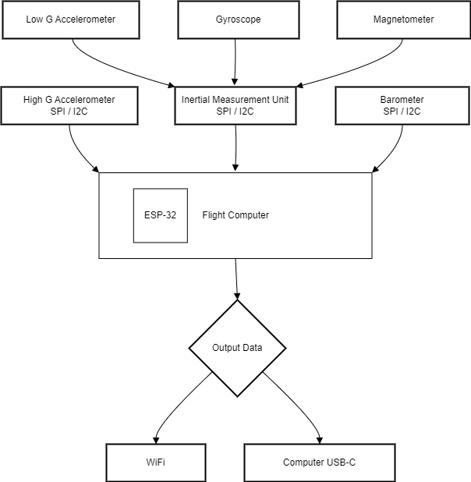
Block Diagram

Slide 12
Interfaces
USB –
Microcontroller – ESP32 built in transceiver
Sensors – SPI and I2C

Slide 13
Cost/Budget
Two board revisions
First one cheap with buttons for debugging
Second not cheap to hopefully fly
List budget

Slide 14
Feasibility Assessment/Risks
Feasibility
This project is feasible in our eyes. We must make sure to communicate well and stay on top of everything
We have a good group that covers each other weaknesses.
Risks
Batteries
Overheating and damage to batteries can be a fire hazards.

Slide 15
Conclusion
Our Choice:
Design 1: Microcontroller (ESP-32)
Friendly
Reliable
Familiar to our group

Slide 16
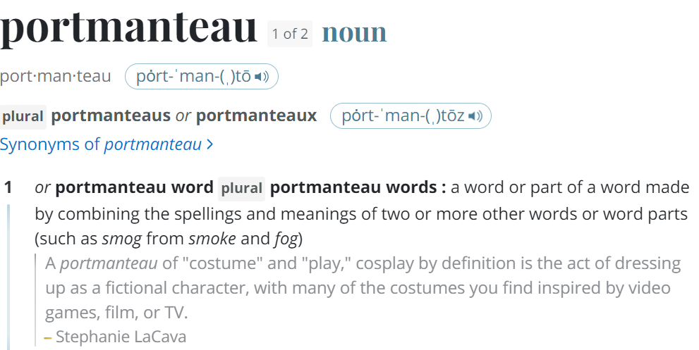
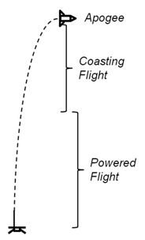
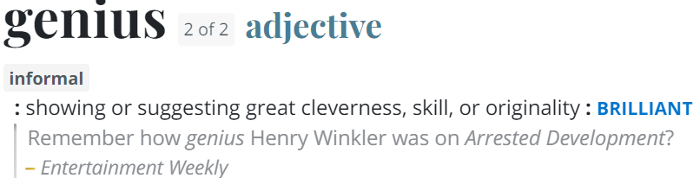
Questions
Image Credit: https://ffden-2.phys.uaf.edu/webproj/211_fall_2014/Adam_Kurzbard/Adam_Kurzbard/Page4.html

