Slide 1

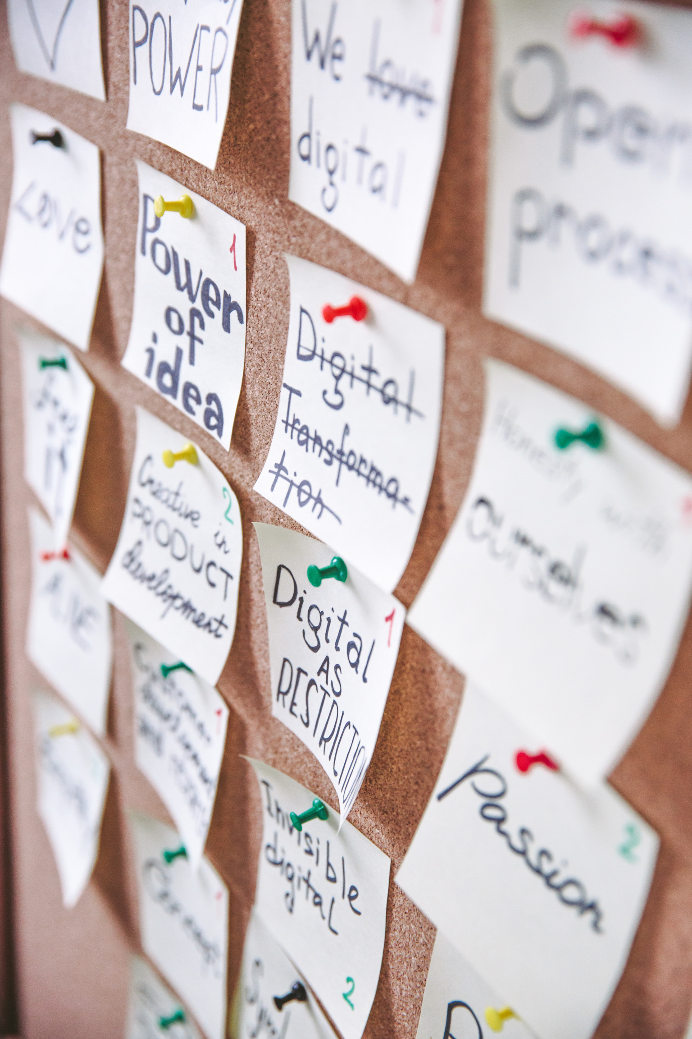


GROUP 9
IFTTT by group 9
Development of If this then that

Slide 2





Our tools
IDE:
IntelliJ Idea with JDK 21
GitHUb
JUnit

Slide 3
First sprint planning
Sprint velocity: 52
As a user
i want to create a new rule in any moment by using a GUI
so that the application can check it
As a user
i want to specify the trigger for my new rule by using a GUI
so that the rule can be fired under certain conditions
As a user
i want to specify the action for my new rule by using a GUI
so that a specific operation can be performed when the related rule is fired
As a user
i want to specify timestamp based triggers
so that related rules can be fired in a specific moment

Slide 4
First sprint planning
Sprint velocity: 52
As a user
i want to specify an action whereby a specified audio file is played
so that i can customize the auditory experience within the application
As a user
i want to specify an action whereby a message is displayed on screen
so that i have to explicitly close it when prompted.
As a user
i want to deactivate an existing rule by using a GUI
so that it’s not checked by the program but is still present.
As a user
i want my rules to be saved on a file
so that they get automatically reloaded when the application is restarted

Slide 5
DEFINITION OF DONE
GROUP 9
-Code is implemented and reviewed.
-Unit tests are written, executed, and passed;
- Each criterion accepted at least one associated test case;
-The user story has been peer-reviewed.
-User interface is updated to accommodate new features.
-Documentation is updated to reflect changes.
-Stress and load tests were performed to evaluate the system's ability to handle high loads.
-All team members accept the implemented features.

Slide 6
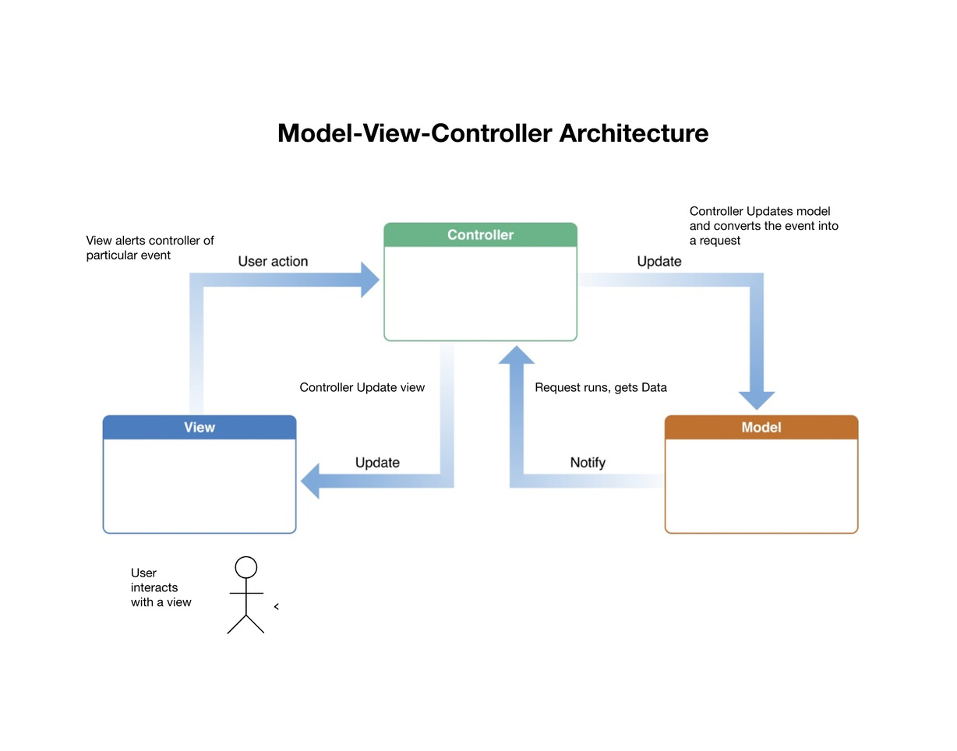

GROUP 9
Architecture
Model (manages data and business logic),
View (presents data and handles UI),
Controller (mediates between Model and View), promoting modular and maintainable code. User input flows from View to Controller, updating the Model, and then refreshing the View.

Slide 7
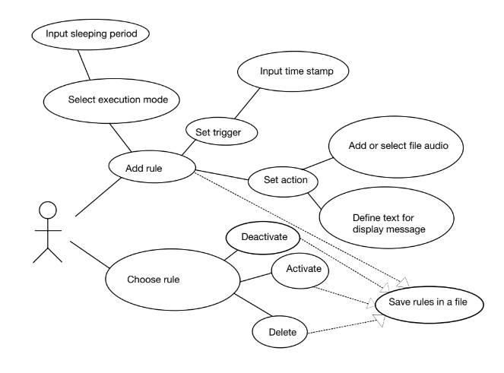
GROUP 9
USE CASES

Slide 8
GROUP 9
Thanks for your attention

