Slide 1
SLOW VENTURES CREATOR FUND · AI HACKATHON 2026
Zero to Deployed
A beginner’s guide to building a live web app with AI

Slide 2
Today’s Agenda
Concept talks interleaved with hands-on setup
1. Anatomy of a web app — the building blocks
2. How data flows — the request/response cycle
3. Development workflow — how code gets to users
4. Hands-on setup — terminal, Claude Code, Git, IDE, database
5. Run it locally — your app on localhost
6. Deploy to production — your app live on the internet
7. Build a feature — using Claude Code to add something new
8. Authentication, APIs, and what’s possible — the bigger picture

Slide 3
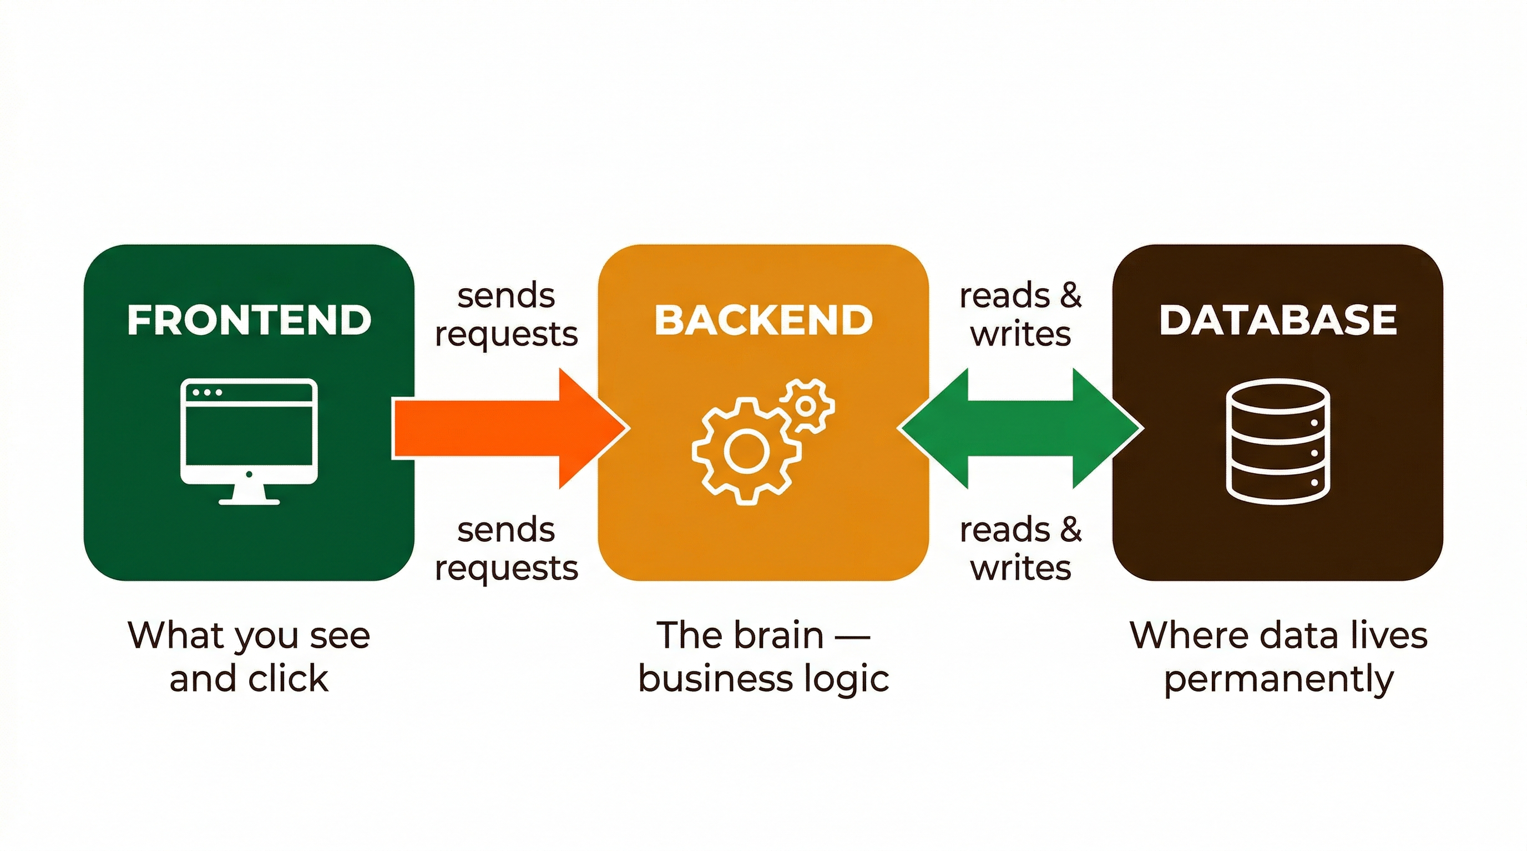
Anatomy of a Web Application
Instagram, Shopify, your banking app — same building blocks
Frontend
what the user sees and clicks. Built with HTML, CSS, and JavaScript.
Backend
the brain. Receives requests, runs logic, talks to the database.

Slide 4
T3 Stack - Our Application Framework
What professional teams do (and what we’re simplifying today)
1. Check out the latest code from GitHub
2. Create a feature branch (a safe copy to work on)
3. Write code in an IDE
4. Run automated tests
5. Create a Pull Request (ask teammates to review)
6. Push to staging for QA testing
7. Deploy to production (make it live)

Slide 5
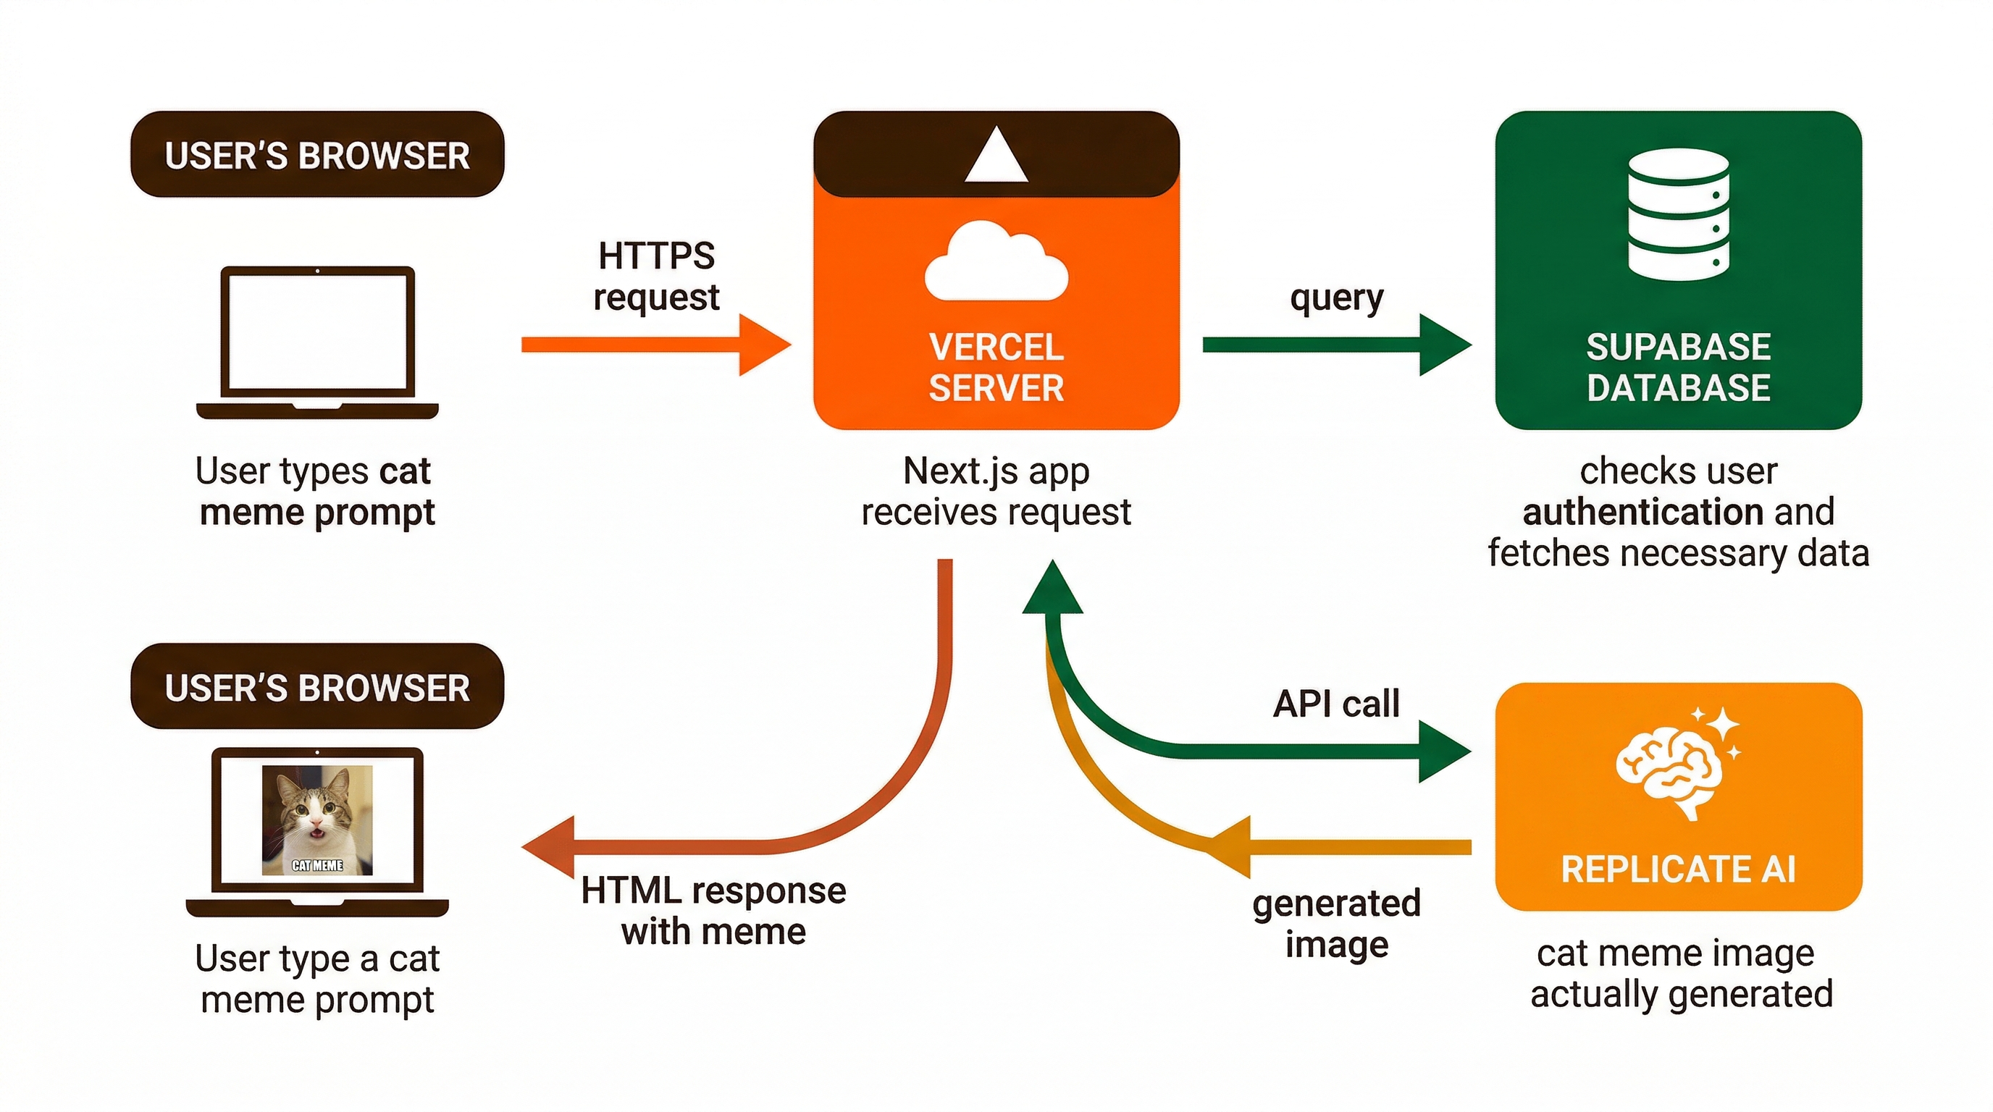
What Happens When Someone Uses Your App
Every click follows this path — here’s a real example using a cat meme generator

Slide 6
Vercel - Application server
What professional teams do (and what we’re simplifying today)
1. Check out the latest code from GitHub
2. Create a feature branch (a safe copy to work on)
3. Write code in an IDE
4. Run automated tests
5. Create a Pull Request (ask teammates to review)
6. Push to staging for QA testing
7. Deploy to production (make it live)

Slide 7
Neon - Database
What professional teams do (and what we’re simplifying today)
1. Check out the latest code from GitHub
2. Create a feature branch (a safe copy to work on)
3. Write code in an IDE
4. Run automated tests
5. Create a Pull Request (ask teammates to review)
6. Push to staging for QA testing
7. Deploy to production (make it live)

Slide 8
Traditional Software Development
What professional teams do (and what we’re simplifying today)
1. Check out the latest code from GitHub
2. Create a feature branch (a safe copy to work on)
3. Write code in an IDE
4. Run automated tests
5. Create a Pull Request (ask teammates to review)
6. Push to staging for QA testing
7. Deploy to production (make it live)

Slide 9
Our Hackathon Workflow
Same idea, simplified for speed
1. Write code (by talking to Claude Code)
2. Test it locally (open localhost:3000 in your browser)
3. Save your progress with git (/snapshot)
4. When it’s working, deploy to Vercel (/deploy)
LOCAL (your laptop)
localhost:3000 Dev database
GITHUB (code backup)
Saves your code Safety net
VERCEL (production)
yourapp.vercel.app Prod database
→
→
git push
auto-deploy

Slide 10
Claude Code
Not a chatbot — an AI agent that takes action
Lives in your terminal — you describe what you want, it writes the code
It can read files, write files, run commands, and search the web
You approve what it does — it asks before making changes
CLAUDE.md tells Claude about your project (already set up in the template)
Slash commands: pre-built prompts for common tasks
Type claude in your terminal to start it.

Slide 11
Working with Claude
Same idea, simplified for speed
1. Write code (by talking to Claude Code)
2. Test it locally (open localhost:3000 in your browser)
3. Save your progress with git (/snapshot)
4. When it’s working, deploy to Vercel (/deploy)

Slide 12
Tips for Talking to Claude
Better prompts = better results
Be specific: "Add a grid of 3 cards showing the meme image, caption, and date"
Give context: "I’m building a cat meme generator for creators"
Iterate: "Make it bigger" → "Change the font" → "Add a spinner"
Use screenshots: paste a design you like and say "make it look like this"
When stuck: paste the error message — Claude is great at debugging
Think of Claude as a smart collaborator, not a magic box.

Slide 13
Your Loop
Same idea, simplified for speed
Research
Requirements
Plan
Execute

Slide 14
Let’s Get Set Up!
Follow along — we’ll do each step together
https://github.com/TanookiLabs/hackathon-starter-nextjs

Slide 15
Getting Help
You’re not alone — we’re here all day
Raise your hand — TAs are circulating and happy to help
Ask Claude — paste your error, describe what’s wrong, it’ll debug
Check the README — setup guides and reference docs
Talk to each other — someone nearby might have hit the same issue
The only bad question is the one you don’t ask.

