Slide 1
SLOW VENTURES CREATOR FUND · AI HACKATHON 2026
Zero to Deployed
A beginner’s guide to building a live web app with AI

Slide 2
Today’s Agenda
Concept talks interleaved with hands-on setup
1. Anatomy of a web app — the building blocks
2. How data flows — the request/response cycle
3. Development workflow — how code gets to users
4. Hands-on setup — terminal, Claude Code, Git, IDE, database
5. Run it locally — your app on localhost
6. Deploy to production — your app live on the internet
7. Build a feature — using Claude Code to add something new
8. Authentication, APIs, and what’s possible — the bigger picture

Slide 3
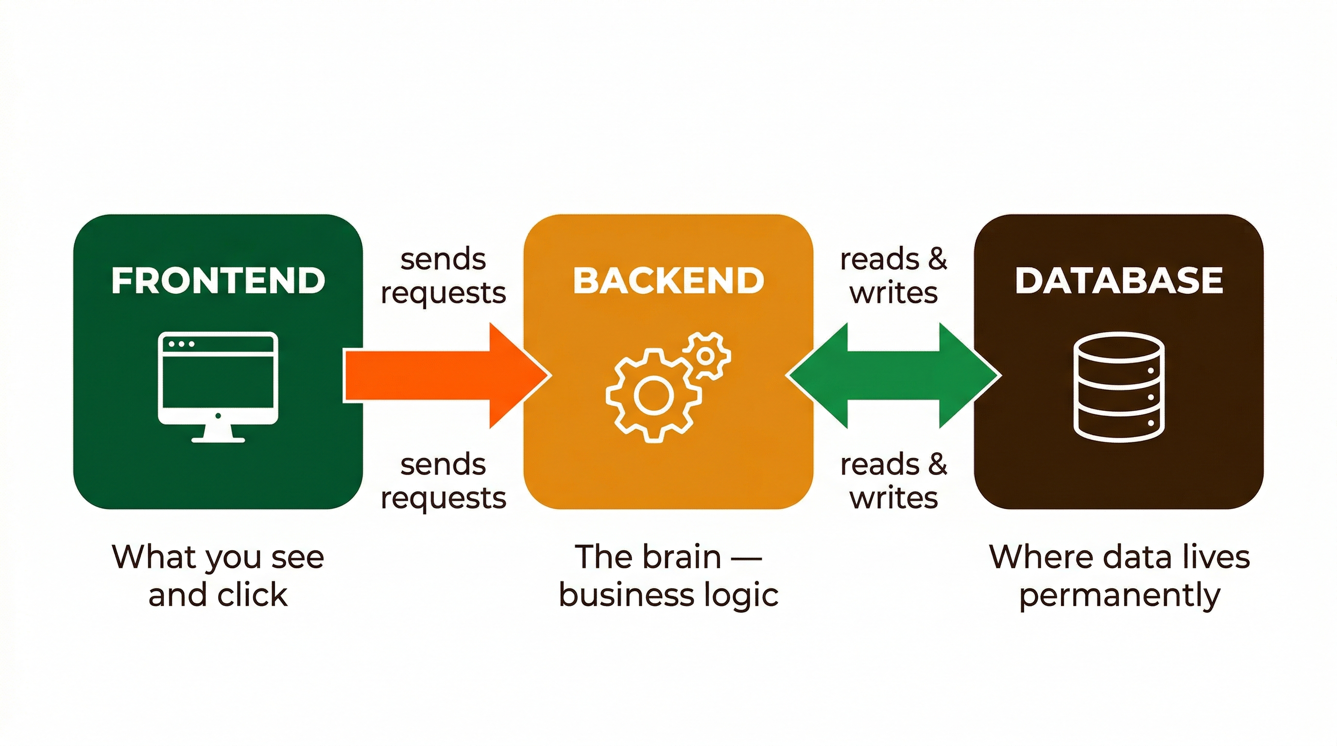
Anatomy of a Web Application
Instagram, Shopify, your banking app — same building blocks
Frontend
what the user sees and clicks. Built with HTML, CSS, and JavaScript.
Backend
the brain. Receives requests, runs logic, talks to the database.

Slide 4
The T3 Stack — Our Application Framework
A modern, full-stack toolkit that helps us build and ship quickly
1. Next.js — builds the pages, server logic, and API routes
2. TypeScript — catches common mistakes before users see them
3. Tailwind CSS — helps us design polished interfaces quickly
4. Prisma — makes database work readable and type-safe
5. PostgreSQL + Neon — stores our app data safely online
6. Better Auth — handles sign-up, sign-in, and secure sessions
7. Vercel — publishes the app to a live HTTPS URL

Slide 5
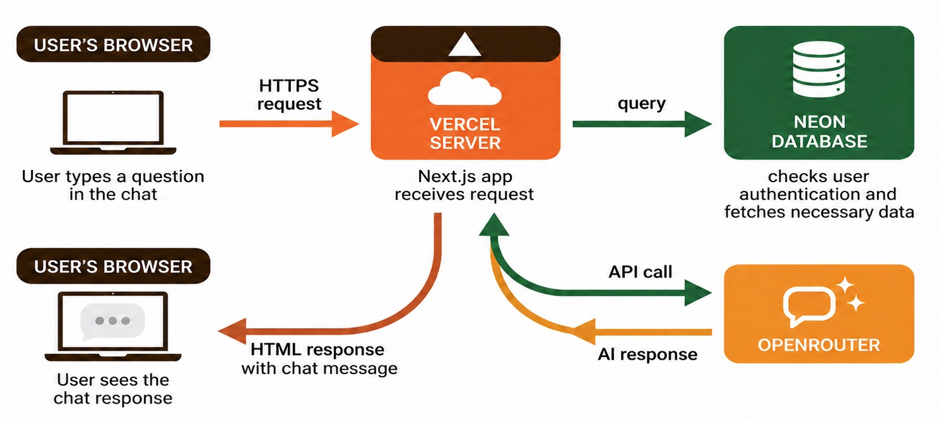
What Happens When Someone Uses Your App
Every chat follows this path — here’s a real example using an AI chatbot

Slide 6
Vercel — Your App on the Internet
Vercel is a cloud platform that builds, hosts, and securely delivers our Next.js app to people on the internet.
1. Hosts our app — turns our code into a live website
2. Builds from GitHub — uses the approved version of our code
3. Runs server-side code — logic and API calls stay off the browser
4. Keeps environment variables private — secrets never go in Git
5. Gives us HTTPS — a secure URL that people can visit
6. Shows deployment logs — helps us understand errors
7. Publishes production — the version we choose to share with users

Slide 7
Neon — Your App’s Database
Neon is a managed cloud PostgreSQL database that safely stores the information our app needs to remember.
1. Stores accounts, chat messages, and other app data
2. Remembers data after the browser is closed
3. Uses PostgreSQL — data is organized in connected tables
4. Works with Prisma — our app reads and writes data safely
5. Connects to Vercel securely — the browser never gets database access
6. Keeps local and production data separate
7. Uses reviewed migrations — safely evolves the data structure

Slide 8
OpenRouter — Your AI Model Gateway
OpenRouter is one API that gives our app access to many AI models for text, images, and other AI-powered features.
1. Connects our app to many AI models through one API
2. Lets us choose the right model for each feature
3. Can generate text for chatbots, writing, and summaries
4. Can generate images and support other AI capabilities
5. Keeps model API keys on the Vercel server, not in the browser
6. Gives us a consistent way to switch or compare models
7. Returns the model response for our app to show the user

Slide 9
Traditional Software Development
What professional teams do (and what we’re simplifying today)
1. Check out the latest code from GitHub
2. Create a feature branch (a safe copy to work on)
3. Write code in an IDE
4. Run automated tests
5. Create a Pull Request (ask teammates to review)
6. Push to staging for QA testing
7. Deploy to production (make it live)

Slide 10
Our Hackathon Workflow
Same idea, simplified for speed
1. Write code (by talking to Claude Code)
2. Test it locally (open localhost:3000 in your browser)
3. Save your progress with git (/snapshot)
4. When it’s working, deploy to Vercel (/deploy)
LOCAL (your laptop)
localhost:3000 Dev database
GITHUB (code backup)
Saves your code Safety net
VERCEL (production)
yourapp.vercel.app Prod database
→
→
git push
auto-deploy

Slide 11
Claude Code
Not a chatbot — an AI agent that takes action
Lives in your terminal — you describe what you want, it writes the code
It can read files, write files, run commands, and search the web
You approve what it does — it asks before making changes
CLAUDE.md tells Claude about your project (already set up in the template)
Slash commands: pre-built prompts for common tasks
Type claude in your terminal to start it.

Slide 12
Working with Claude
Same idea, simplified for speed
1. Write code (by talking to Claude Code)
2. Test it locally (open localhost:3000 in your browser)
3. Save your progress with git (/snapshot)
4. When it’s working, deploy to Vercel (/deploy)

Slide 13
Tips for Talking to Claude
Better prompts = better results
Be specific: "Add a grid of 3 cards showing the meme image, caption, and date"
Give context: "I’m building a cat meme generator for creators"
Iterate: "Make it bigger" → "Change the font" → "Add a spinner"
Use screenshots: paste a design you like and say "make it look like this"
When stuck: paste the error message — Claude is great at debugging
Think of Claude as a smart collaborator, not a magic box.

Slide 14
Your Loop
Same idea, simplified for speed
Research
Requirements
Plan
Execute

Slide 15
Let’s Get Set Up!
Follow along — we’ll do each step together
https://github.com/TanookiLabs/hackathon-starter-nextjs

Slide 16
Getting Help
You’re not alone — we’re here all day
Raise your hand — TAs are circulating and happy to help
Ask Claude — paste your error, describe what’s wrong, it’ll debug
Check the README — setup guides and reference docs
Talk to each other — someone nearby might have hit the same issue
The only bad question is the one you don’t ask.

