Slide 1
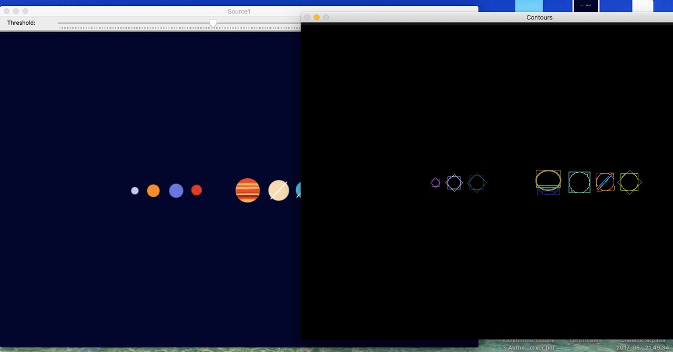
Contour detection
Nakipbekova Bayan 3En03B
Suleyman Demirel University
Motivation
Overview of algorithms
We use contour detection
for multiple purposes:
For correct image segmentation
As a radar for car number identification
To recognize objects in video and etc
Steps:
Load image
Convert to gray-scale.
Remove noise by blurring with a Gaussian filter
Create new window
Add trackbar to the window
Detect Canny edges
Find contours
Find the rotated rectangles and ellipses for each contour
Draw contours, rotated rectangles and ellipses
Description
Result
Briefly , my project at first fits an ellipse
around a set of 2D points and then finds
a rotated rectangle of the minimum area
enclosing the input 2D point set.

