Slide 1


On the convergence speed of AMSGRAD and beyond
Tao Tan, Shiqun Yin, Kunling Liu, Man Wan
School of Computer and Information Science
Southwest University, Chongqing, China
Email: 1169311978@qq.com

Slide 2

On the convergence speed of AMSGRAD and beyond
  Contents
1
2
INTRODUCTION
RELATED WORK
3
4
ACADG ALGORITHM
EXPERIMENTS
5
CONCLUSION

Slide 3

1
INTRODUCTION

Slide 4





Introduction
Deep learning is applicable to many domains of science, and the performance of a neural network depends on its structure and learning algorithms.
The existing learning algorithms are mainly based on the idea of SGD algorithm, and can be divided into two categories.
One is the momentum method, such as Momentum and NAG algorithms.
The other is the adaptive method, which mainly includes RMSPROP, ADAGRAD, ADADELTA, ADAM and AMSGRAD algorithms.

Slide 5
Introduction
This paper ﬁnds two problems in AMSGRAD algorithm. Firstly, the AMSGRAD algorithm is easy to oscillate. Secondly, the AMSGRAD algorithm converges slowly.
In order to solve the above two problems, we proposes the ACADG algorithm, which is a new adaptive learning rate optimization algorithm.

Slide 6
2
RELATED WORK

Slide 7
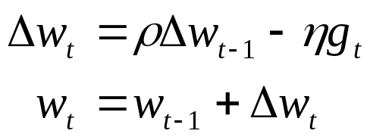
Momentum algorithm
In physics, people use momentum to simulate the inertia of an object as it moves. Through derivation, it is found that the momentum idea can be used in the deep learning optimization algorithm to improve the convergence speed. Then the Momentum algorithm is proposed, and the update rules of model weights are designed as follows:

Slide 8
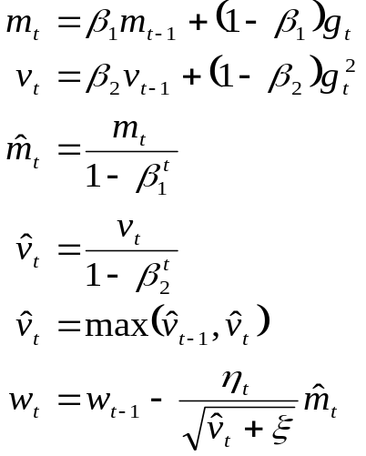
AMSGRAD algorithm
algorithm is a new exponential moving average gradient optimization algorithm, and its purpose is to solve the convergence problem of ADAM algorithm.
AMSGRAD

Slide 9
3
ACADG ALGORITHM

Slide 10

Disadvantages of the AMSGRAD algorithm
Through the derivation of mathematical formulas, the AMSGRAD algorithm proves that it can overcome the non-convergence problem in ADAM algorithm, and guarantees that the optimization algorithm converges with the increase of the number of iterations. However, this paper ﬁnds the following two problems from the convergence process of the AMSGRAD algorithm:

Slide 11
Disadvantages of the AMSGRAD algorithm
In order to ensure the convergence of the AMSGRAD algorithm, the AMSGRAD algorithm must record the historical maximum of the unbiased second-order moment estimate of the parameter gradient, and use it to calculate the adaptive learning rate. However, the adaptive learning rate of the AMSGRAD algorithm is lower than that of the ADAM algorithm during the iterative process, which will increase convergence time, reduce convergence speed.

Slide 12
Disadvantages of the AMSGRAD algorithm
When g_{t−1}g_{t} ≤ 0, the angle between the parameter gradient vector in the previous step and the parameter gradient vector in the current step is greater than 90 degrees. Using the AMSGRAD algorithm to update the model weights will cause the unbiased ﬁrst-order moment estimate of the parameter gradient in the previous step to have a negative effect on the current parameter gradient vector. Sometimes, this negative effect will last for a long time, and even cause the objective function to experience severe oscillations during convergence.

Slide 13
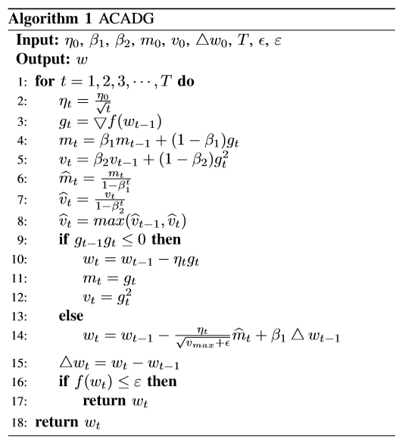
The ACADG algorithm
where η₀ is the initial learning rate, β₁ and β₂ are the coefﬁcient of the ﬁrst-order and second-order moment estimation of parameter gradient, m₀ and v₀ are the initial ﬁrst-order and second-order moment estimation of parameter gradient, ∆w₀ is the initial value of the model weights differences, T is the number of iterations, ⋴ is a constant and used to prevent the denominator from being 0, ε is the minimum loss value that satisﬁes the stopping condition, w is the model weights.

Slide 14
The performance of ACADG algorithm
When g_{t−1}g_{t} > 0, the momentum term has a positive effect on the ﬁrst-order moment estimation of the parameter gradient in the current steps. Through the momentum term, the ACADG algorithm can speed up the decline of the loss function, and make the loss function quickly reach a satisfactory local optimal solution. Therefore, the ACADG algorithm accelerates the convergence speed of the model.
01

Slide 15
The performance of ACADG algorithm
When g_{t−1}g_{t} ≤ 0, whether the AMSGRAD algorithm or the ADAM algorithm, the ﬁrst-order moment estimation of the parameter gradient in the previous steps will have a negative effect on the parameter gradient vector in the current steps. Sometimes, this negative effect will last for a long time, and even cause the objective function to experience severe oscillations during convergence. In this case, the ACADG algorithm uses the SGD algorithm to update the model weights. Regardless of the negative effect, the ACADG algorithm will not be affected. Therefore, the ACADG algorithm reduces the oscillation amplitude of the loss function.
02

Slide 16
4
EXPERIMENTS

Slide 17
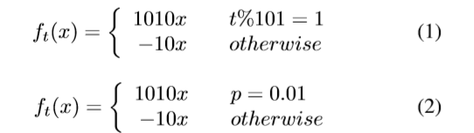

Synthetic experiment
In order to verify the convergence, convergence speed and oscillation amplitude of ACADG algorithm in synthetic experiment. This paper designs two different objective functions, and as follows:
Where x belongs to a constraint set and x∈[−1,1], t is the number of iteration steps, p is the probability and p∈[0,1]. As can be seen from the above settings, whether the ﬁrst objective function or the second objective function, the minimum value is obtained at x = −1. In the ACADG algorithm, the relevant experimental parameters η₀, β₁, β₂, m₀, v₀, ∆w₀, T, ⋴, ε are set as 0.01, 0.9, 0.999, 0, 0, 0, 1e7, 1e-8, 1e-9, respectively.

Slide 18
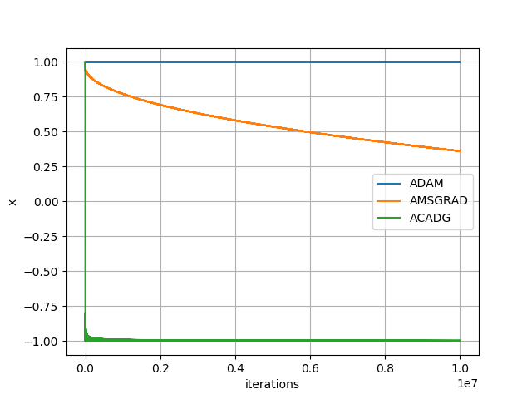
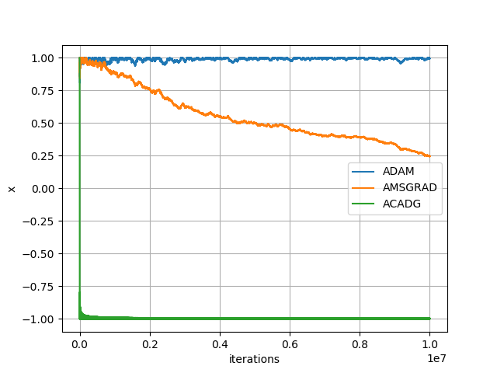
Synthetic experiment
Figure1. The performance of the three algorithms on the synthetic data.
与IT行业和传统行业相比，电子商务行业对于工作年限较短的人才更为青睐。

Slide 19
Synthetic experiment
As can be seen from Figure1, the three algorithms have the following three phenomena in the first objective function and the second objective function:
As the number of iterations increases, the ADAM algorithm converges to 1, but both the AMSGRAM algorithm and ACADG algorithm converge to -1.
The convergence speed of the objective function in the ACADG algorithm is significantly faster than that of the AMSGRAD algorithm.
During the convergence process, the oscillation amplitude of the AMSGRAD algorithm is much larger than that of the ACADG algorithm.

Slide 20
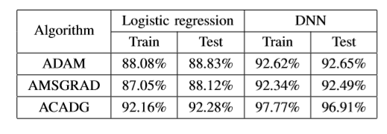
Logistic regression and DNN experiment
In order to verify the performance of ACADG algorithm on convex optimization problem and non-convex optimization problem. This paper uses the Mnist data set to perform experiments on logistic regression model and DNN model, respectively.
Logistic regression model has only the input layer of 784 and the output layer of 10. DNN model has a hidden layer in addition to the input layer and the output layer in Logistic regression model, where the number of nodes is 100.

Slide 21
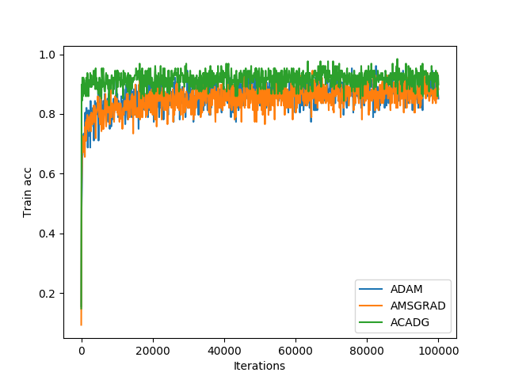
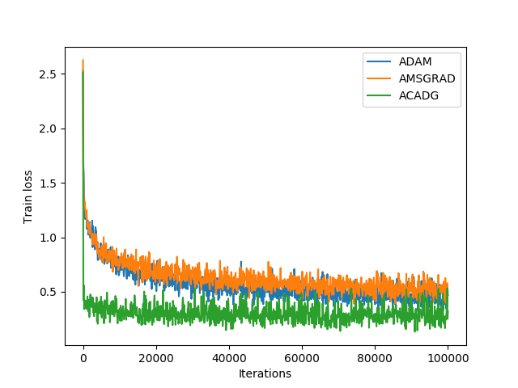
Logistic regression and DNN experiment
Figure2. The training performance of the three algorithms on logistic regression model
与IT行业和传统行业相比，电子商务行业对于工作年限较短的人才更为青睐。

Slide 22
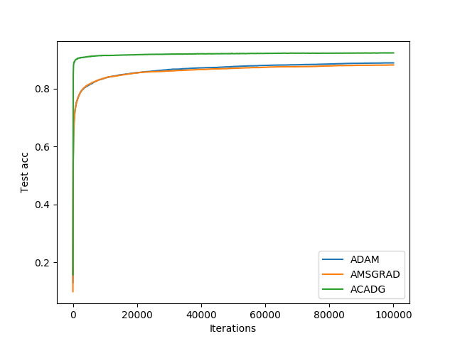
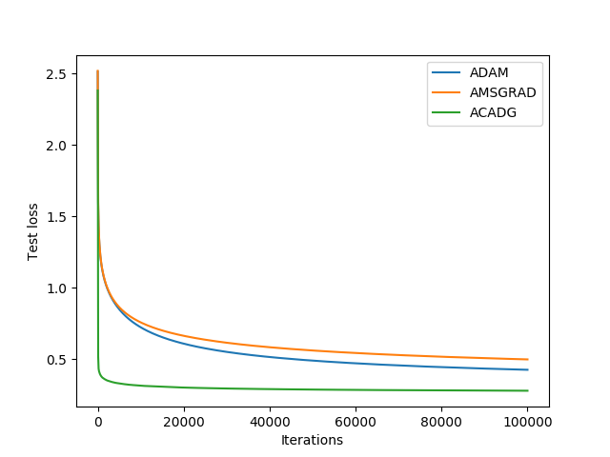
Logistic regression and DNN experiment
Figure3. The test performance of the three algorithms on logistic regression model
与IT行业和传统行业相比，电子商务行业对于工作年限较短的人才更为青睐。

Slide 23
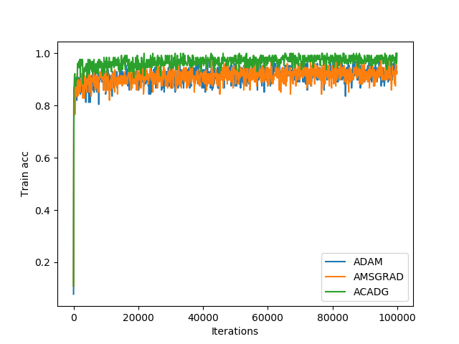
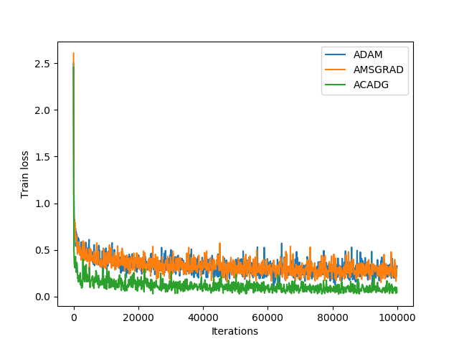
Logistic regression and DNN experiment
Figure4. The training performance of the three algorithms on DNN model
与IT行业和传统行业相比，电子商务行业对于工作年限较短的人才更为青睐。

Slide 24
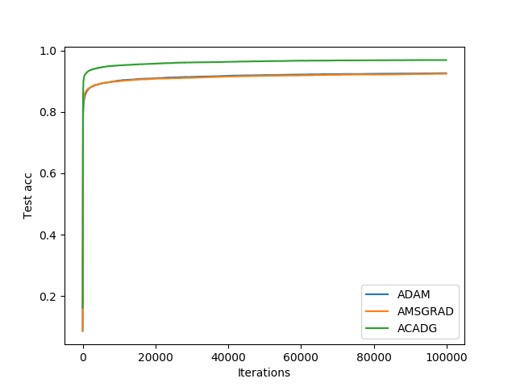
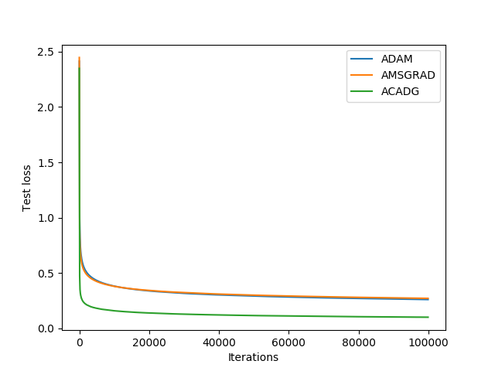
Logistic regression and DNN experiment
Figure5. The test performance of the three algorithms on DNN model
与IT行业和传统行业相比，电子商务行业对于工作年限较短的人才更为青睐。

Slide 25
Logistic regression and DNN experiment
From the above figure, whether it is a convex optimization problem or a non-convex optimization problem, the ACADG algorithm is superior to AMSGRAD and ADAM algorithms in terms of the convergence speed, the oscillation amplitude, the accuracy of training and test data sets.

Slide 26
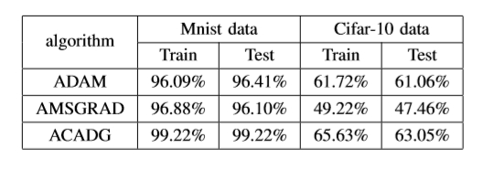
CNN experiment
In order to verify the performance of ACADG algorithm on complex neural networks. This paper performs experiment on CNN model using the Mnist and Cifar-10 data sets, respectively.
On the Mnist data set, the CNN model is composed of input[-1, 28, 28, 1], convolution[5, 5, 1, 32], pooling[2*2], convolution[5, 5, 32, 64], pooling[2*2], ﬂat[7*7*64], hidden layer[1024], output[10];
On the Cifar-10 data set, the CNN model is composed of input[-1, 32, 32, 3], convolution[5, 5, 3, 16], pooling[2*2], convolution[5, 5, 16, 32], pooling[2*2], ﬂat[8*8*32], hidden layer[100], dropout(0.5), output[10].

Slide 27
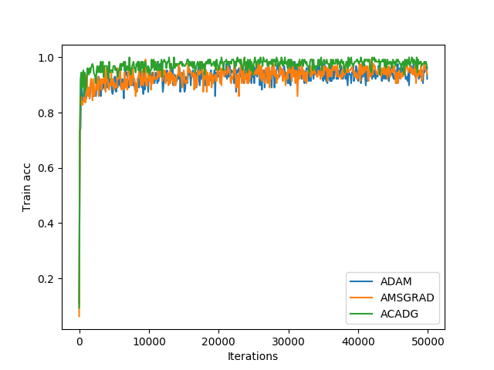
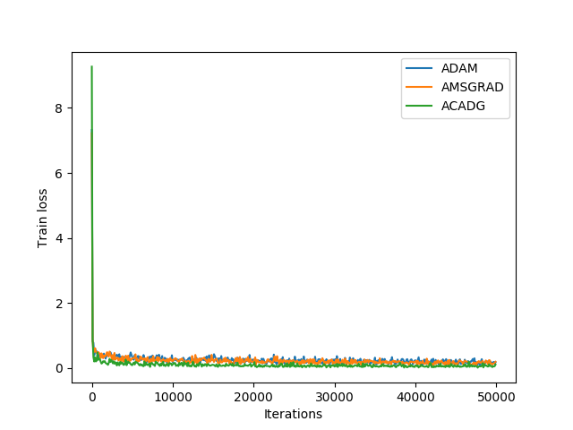
CNN experiment
Figure6. The Mnist training performance of the three algorithms on CNN model
与IT行业和传统行业相比，电子商务行业对于工作年限较短的人才更为青睐。

Slide 28
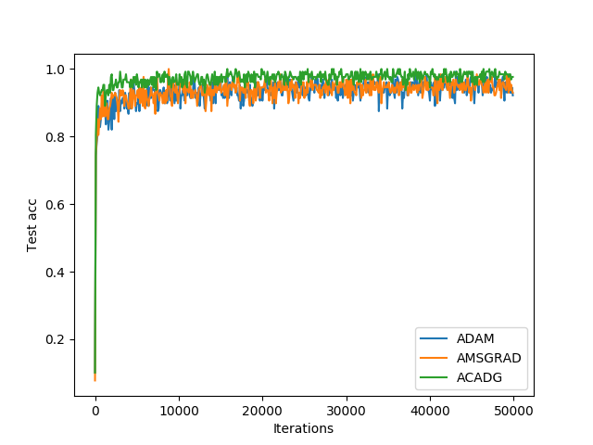
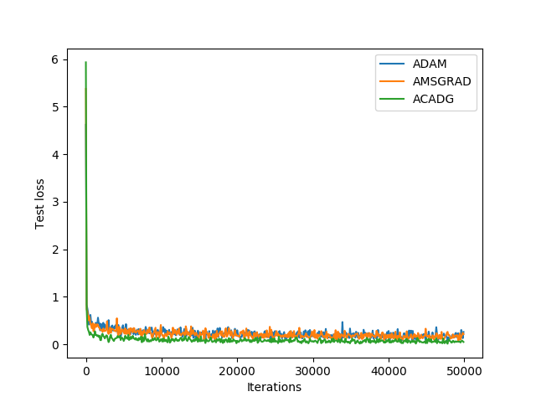
CNN experiment
Figure7. The Mnsit test performance of the three algorithms on CNN model
与IT行业和传统行业相比，电子商务行业对于工作年限较短的人才更为青睐。

Slide 29
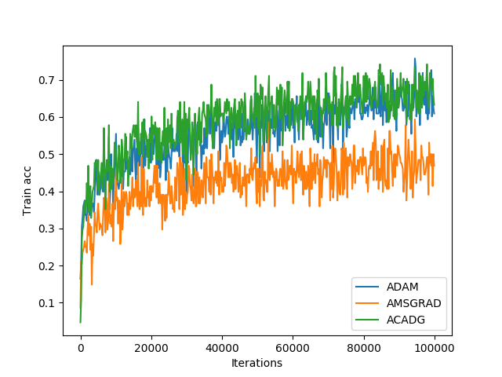
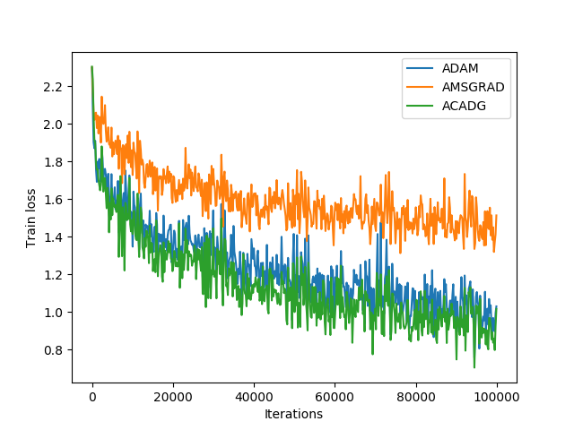
CNN experiment
Figure8. The Cifar-10 training performance of the three algorithms on CNN model
与IT行业和传统行业相比，电子商务行业对于工作年限较短的人才更为青睐。

Slide 30
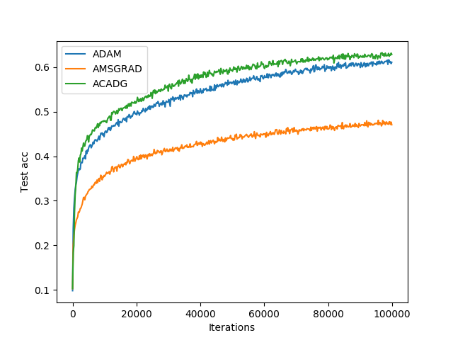
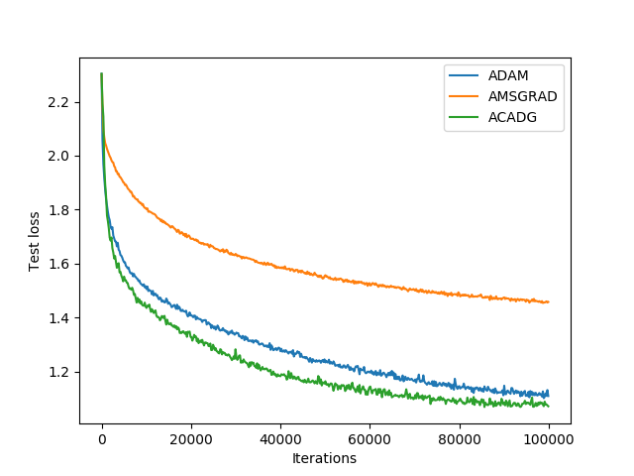
CNN experiment
Figure9. The Cifar-10 test performance of the three algorithms on CNN model
与IT行业和传统行业相比，电子商务行业对于工作年限较短的人才更为青睐。

Slide 31
CNN experiment
From the above figure, whether it is Mnist or Cifar-10, the ACADG algorithm is superior to AMSGRAD and ADAM algorithms in terms of the convergence speed, the oscillation amplitude, the accuracy of training and test data sets.

Slide 32
5
CONCLUSION

Slide 33

Conclusion
1
This paper ﬁnds that there are two problems in the convergence process of AMSGRAD algorithm, one is oscillation amplitude, the other is convergence speed.
This paper proposes ACADG algorithm, which is an adaptive gradient optimization algorithm. The ACADG algorithm not only can improve the convergence speed, suppress the oscillation amplitude of objective function, but also can improve the accuracy of training and test data sets.
2
3
Through some comparative experiments, it is found that ACADG algorithm is superior to AMSGRAD and ADAM algorithms in the convergence speed, the oscillation amplitude, the accuracy of training and test data sets, whether it is convex optimization problems or non-convex optimization problems.

Slide 34


2nd priority initiatives
Conclusion
Thanks for your time
1
Evaluate whether offer DT store more margin is possible
2
Email: 1169311978@qq.com
Together with other strong brands, communicate “Unilever” company brand more
3
Optimize our promotion pack allocation policy
4
Optimize island display in Northern area, pay more attention to season differences
5
Add more POSMs to more outlets. Using multiple ways to communicate with consumers

