Slide 1

National Institute Of Technology Sikkim
Team Members:
Abhishek Majumder
Samir Chauhan
Mohan Tanti
Submitted to:
Dr. Pankaj Kumar Keserwani
Assistant Professor
Department Of Computer Science and Engineering
National Institute Of Technology Sikkim

Slide 2
Contents-
Introduction
Objectives
Flow diagram
Packages
Output
Conclusion

Slide 3
Introduction
This project was developed with the motivation to the face escalating environmental challenges, the Forest Fire Prediction application stands as a powerful tool in the battle against the devastating impact of forest fires. This innovative web-based platform harnesses the capabilities of cutting-edge Machine Learning algorithms to forecast and preemptively detect potential outbreaks of wildfires By analyzing a myriad of environmental factors such as temperature, humidity, wind speed, and vegetation density

Slide 4
Objectives
Develop a robust web app integrated with machine learning model to analyze environmental data and predict potential forest fire outbreaks.
Implement a system for continuous monitoring of critical environmental factors, including temperature, humidity and oxygen.
Design an intuitive and accessible user interface

Slide 5
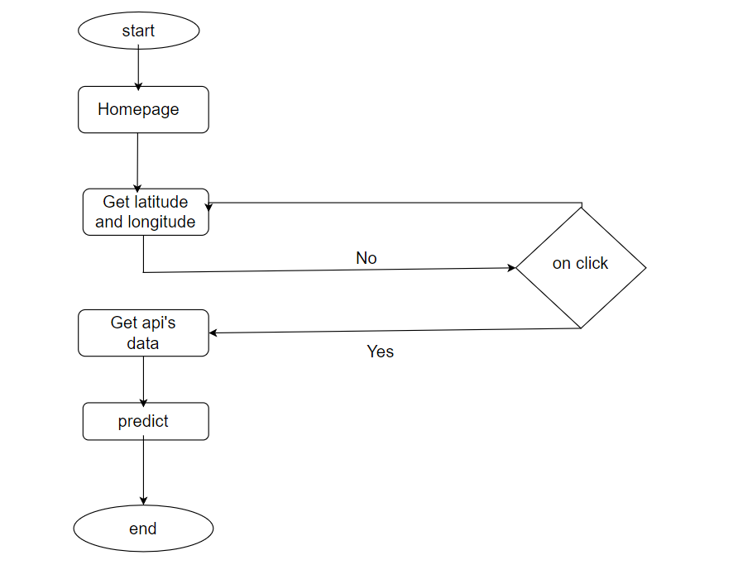
Flow Diagram

Slide 6
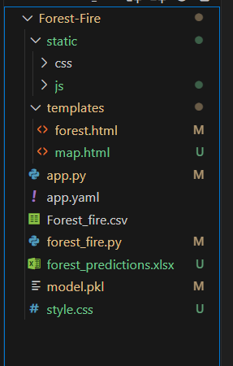
Packages - Dependencies and Setup
This is the folder structure –
We implemented frontend using HTML,CSS and
Javascript
and backend using Flask

Slide 7
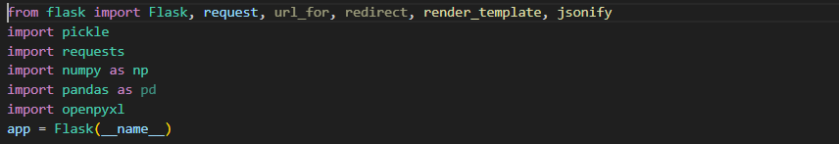
Packages used in backend
Flask: Micro web framework for Python, facilitates web app development with simplicity and flexibility.
request: Accesses data from incoming HTTP requests in Flask applications.
url_for: Generates URLs for specified routes in Flask applications.
redirect: Redirects the client's browser to a different route or URL.
render_template: Renders HTML templates with dynamic content in Flask views.

Slide 8
jsonify: Converts data into JSON format for HTTP responses in Flask routes.
pickle: Serializes and deserializes Python objects for storage or transmission.
requests: Sends HTTP requests to external servers for data retrieval or interaction.
numpy: Library for numerical operations and arrays, used for data manipulation.
pandas: Data manipulation library in Python, used for structured data handling.
openpyxl: Library for reading and writing Excel files in Python applications.

Slide 9
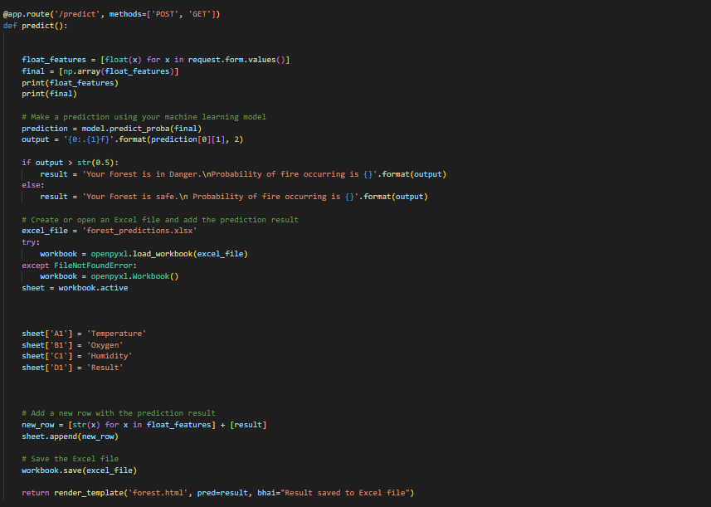
Routes
The server has three routes: /predict , /update_location and /(on loading homepage)
/predict- it will predict the results
/update_location-it will give real time data (humidity,temperature) according to latitude and longitudes

Slide 10
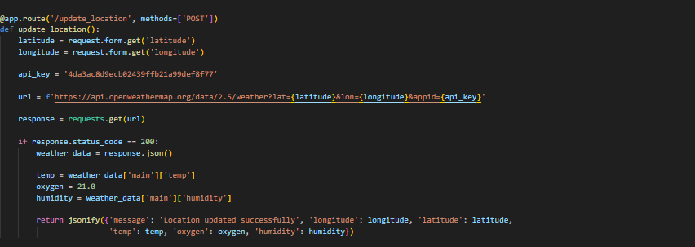
update_location route

Slide 11
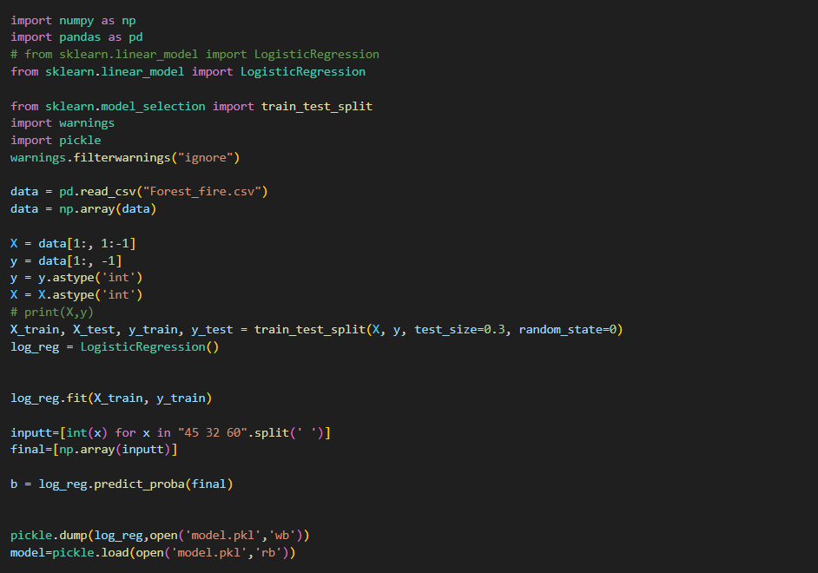
Machine learning model

Slide 12
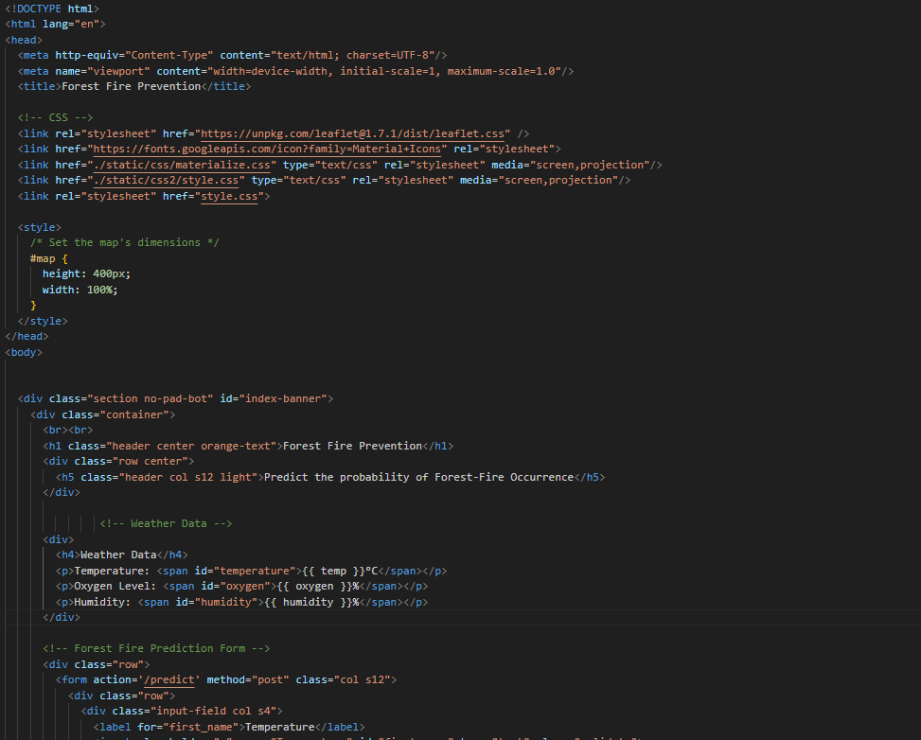
Frontend code for UI:

Slide 13
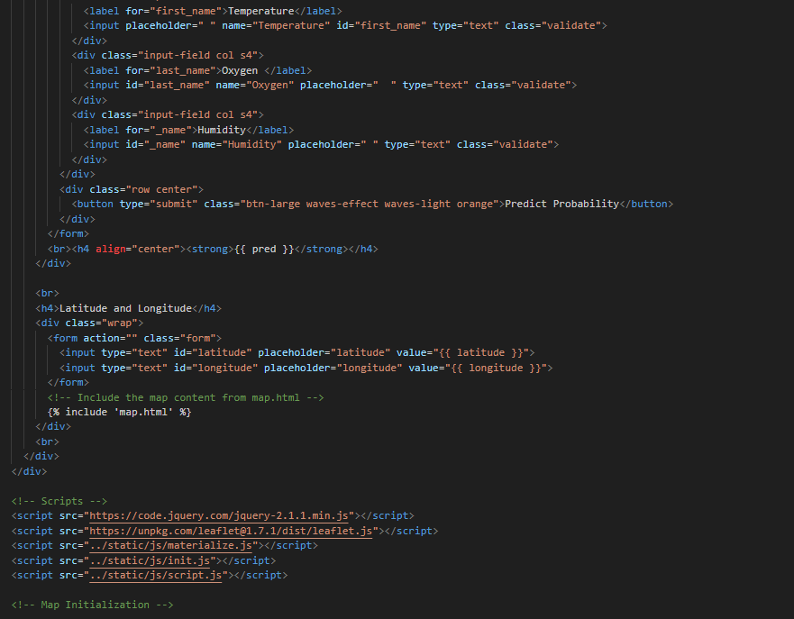

Slide 14
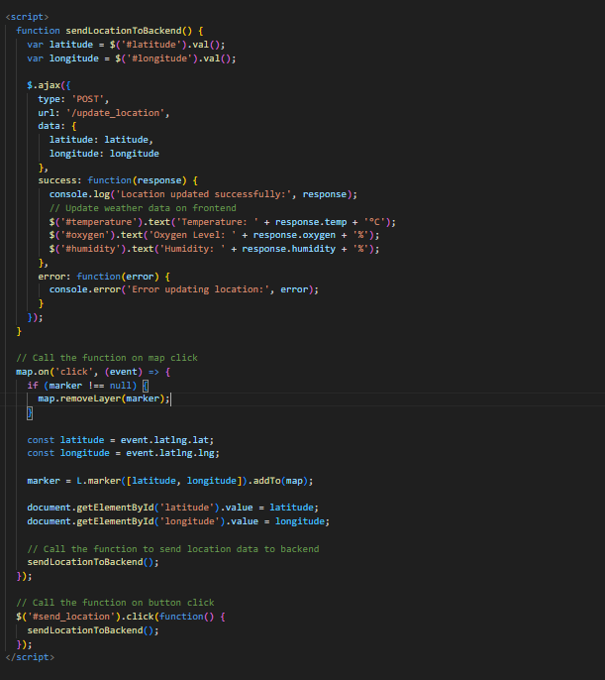

Slide 15
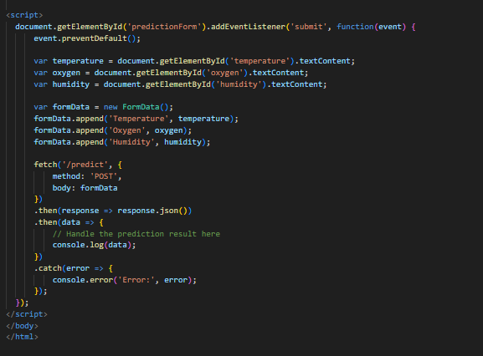

Slide 16
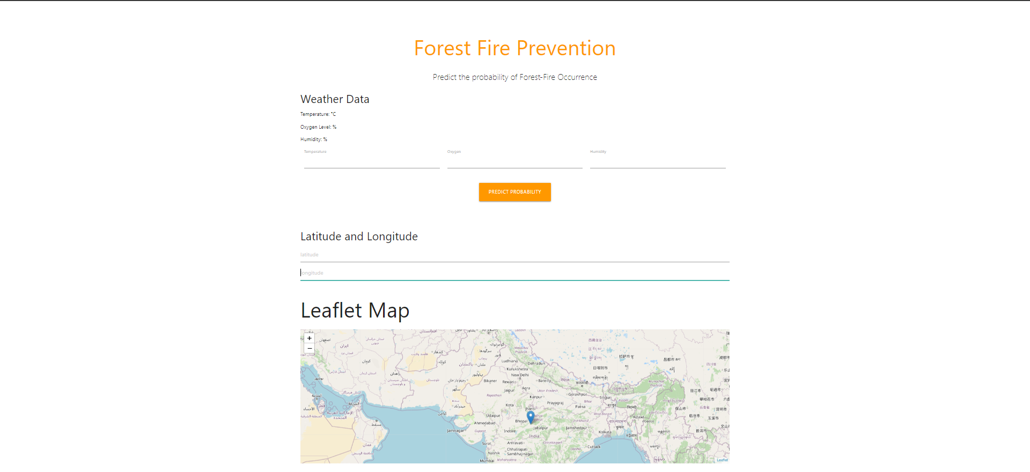
Output-

Slide 17
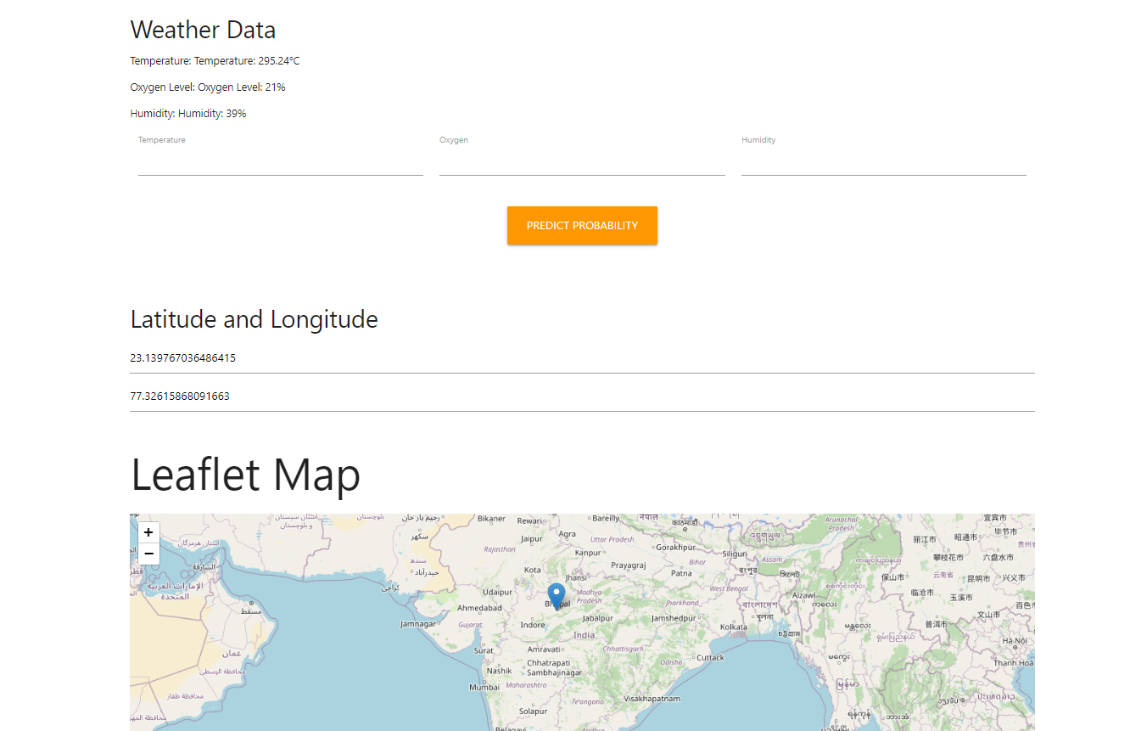

Slide 18
Conclusion
In conclusion, the development of the Forest Fire Prediction web-based application represents a crucial step forward in proactive forest fire management and prevention. By harnessing the power of machine learning and real-time environmental data analysis, the application provides accurate and timely predictions of potential wildfire outbreaks. This innovation empowers authorities and communities to take preemptive measures, ultimately reducing the devastating impact of forest fires on both human lives and natural ecosystems.

