Slide 1
Information Modelling Lab 4
Tantoluwa Heritage Alabi
IF2000084

Slide 2
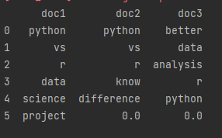
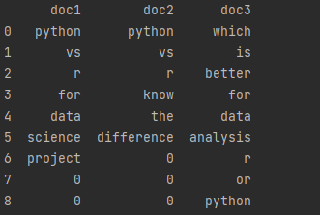
Stopwords
Stopwords has been removed
From my documents, I have extracted terms and all I am left with is to remove the stopwords present.
I used the "nltk" package in python to remove it.
For this model, I work with documents that have stopwords removed
Document with terms

Slide 3
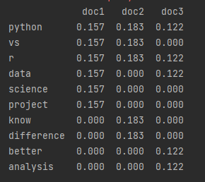
TF-IDF Model
Term frequency from 3 documents
Term Frequency-Inverse Document Frequency is a model that uses the frequency of words to determine its relevance in the document. We find the TF-IDF score.
First ,we calculate term frequency.
Term frequency = number of occurrences of the term / total terms in a document
The terms that have frequency 0, means they are not present in those documents

Slide 4
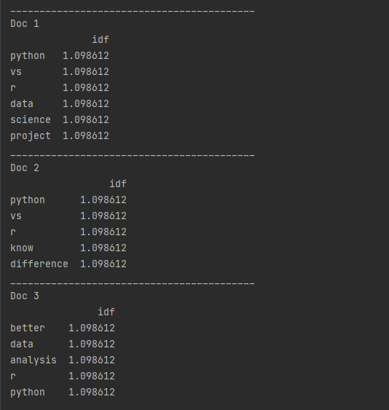
IDF
The second thing to find is the inverse document frequency
Inverse document frequency = log(number of documents in the collection of term / number of occurrences of the term)
The image shows the idf values from different document

Slide 5
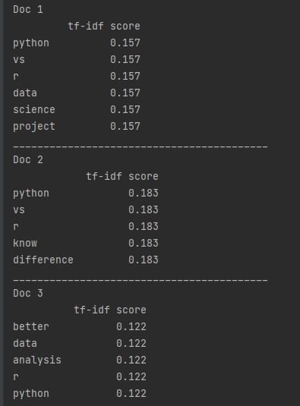
TF-IDF score
Now that the term frequency and inverse document frequency is calculated, we compute the tf-idf score.
Tf-idf score = tf * idf
The image shows the tf-idf score of each term from all documents

Slide 6
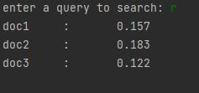
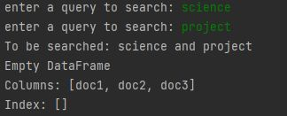
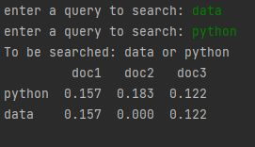
Testing it out with queries
Now that we have the tf-idf score, we can search the keywords and it returns the score and the document.
The images show the results of one key word search, two keywords using the "or" operator, two keywords using "and" operator.

Slide 7

Conclusion
The "or" operator words better than the "an" operator, and with the tf-idf score we can see which keywords is present

