Slide 1
IBM University Engagement Project Submission
“Exploring the Power of Agentic AI with IBM Granite and IBM Bob”

Slide 2

Project Tile – Smart Home Energy Advisor Agent
Domain of Project – Home Appliances
Student Name | Recent Passport Photo | Email ID | Mobile number [WhatsApp]
Tanu Mishra |  | t.mishra1103@gmail.com | 9009988133

Slide 3
Problem Statement -
Electrical Engineering:
Problem Statement No.16 – Smart Home Energy Advisor Agent
The Challenge
Rising electricity demand and energy costs make it difficult for households to understand how their daily habits impact power consumption. Most users only receive monthly bills, which provide limited insight into appliance-level energy usage. As a result, people often waste electricity unknowingly, highlighting the need for an AI-powered system that analyzes usage patterns and provides actionable energy-saving recommendations.
The Objective
Build an AI-powered Smart Home Energy Advisor Agent that analyzes household electricity consumption data and provides intelligent recommendations to optimize energy usage.
Energy Consumption Analysis – Analyze household electricity usage patterns from smart meters or appliance usage logs.
Personalized Energy Recommendations – Suggest energy-saving actions based on the user's consumption behavior and daily routines.
Appliance Usage Insights – Identify appliances that consume the most electricity and recommend optimal usage strategies.
Electricity Bill Estimation – Predict monthly electricity bills based on current usage patterns and tariff structures.
Energy Efficiency Suggestions – Recommend simple practices such as reducing peak-hour usage, scheduling heavy appliances, or upgrading to energy-efficient devices.
Tech Stack (Mandatory)
IBM Langflow / IBM Orchestrate + IBM Models

Slide 4
Proposed Solution -
The Smart Home Energy Advisor Agent is an edge-to-cloud multi-agent decision support system designed to turn raw electricity consumption logs into practical, cost-saving household habits. Built on the mandatory IBM tech stack, the architecture uses IBM Langflow or IBM watsonx Orchestrate paired with IBM Granite models to coordinate specialized analytical agents.
The pipeline begins with a Consumption & Disaggregation Agent that ingests smart meter or smart plug telemetry, isolates phantom standby loads, and applies Non-Intrusive Load Monitoring (NILM) signatures to separate heavy continuous draws like air conditioning from deferrable appliances like washing machines. In parallel, a Bill Estimation & Tariff Agent evaluates real-time energy use against local Time-of-Use (ToU) utility pricing and tiered slabs to project end-of-month costs. A dedicated Advisory & Peak-Shifting Agent then correlates these runtimes with peak tariff windows to generate prioritized, quantified recommendations—such as shifting high-load cycles to off-peak hours, nudging thermostat setpoints, and calculating return-on-investment for energy-efficient hardware upgrades. Finally, an interactive dashboard provides homeowners with clear energy gauges, bill forecasts, and automated smart-plug schedules to lower expenses and reduce peak grid strain.

Slide 5
Technology Used
Core AI & Orchestration Layer (Mandatory Stack)
* Agentic Orchestration: IBM Langflow for visually assembling the agent graph, parameter prompts, and tool nodes; IBM watsonx Orchestrate for enterprise agent management, skills routing, and automated triggering.
* Foundation Models: IBM Granite Models (such as ibm/granite-3-8b-instruct or ibm/granite-13b-instruct on watsonx.ai) for structured reasoning, appliance data parsing, and cost calculations.
* Knowledge Base & RAG: IBM watsonx Discovery or Milvus / ChromaDB vector stores to index local utility tariff books, Time-of-Use (ToU) slabs, and energy-efficiency standards (such as BEE/Energy Star).
Data Ingestion & Disaggregation Engine
* Data Sources & Protocols: Ingestion from smart meter APIs (Green Button data format), IoT smart plugs (Tuya/Shelly/Tasmota via MQTT/REST), or CT clamp monitors.
* Disaggregation Analytics: Non-Intrusive Load Monitoring (NILM) Python toolkits (such as NILMTK) to separate total household active power into individual appliance signatures.
* Data Processing: Python (pandas, numpy) for time-series aggregation, peak-hour energy binning, and power factor calculations.
Backend & Integration Services
* Runtime & APIs: Python (FastAPI or Flask) to expose endpoints between the Langflow processing graph, IoT data collectors, and user interfaces.
* Database & Storage: Time-series database (e.g., InfluxDB or TimescaleDB) for historical sensor telemetry, paired with PostgreSQL or MongoDB for user preferences and tariff configurations.
Frontend & Action Dashboard
* UI Framework: Streamlit, React.js with Tailwind CSS, or the IBM Carbon Design System for a responsive, accessible interface.
* Data Visualization: Plotly or Chart.js for real-time load curves, peak vs. off-peak split graphs, and projected monthly cost gauges.

Slide 6
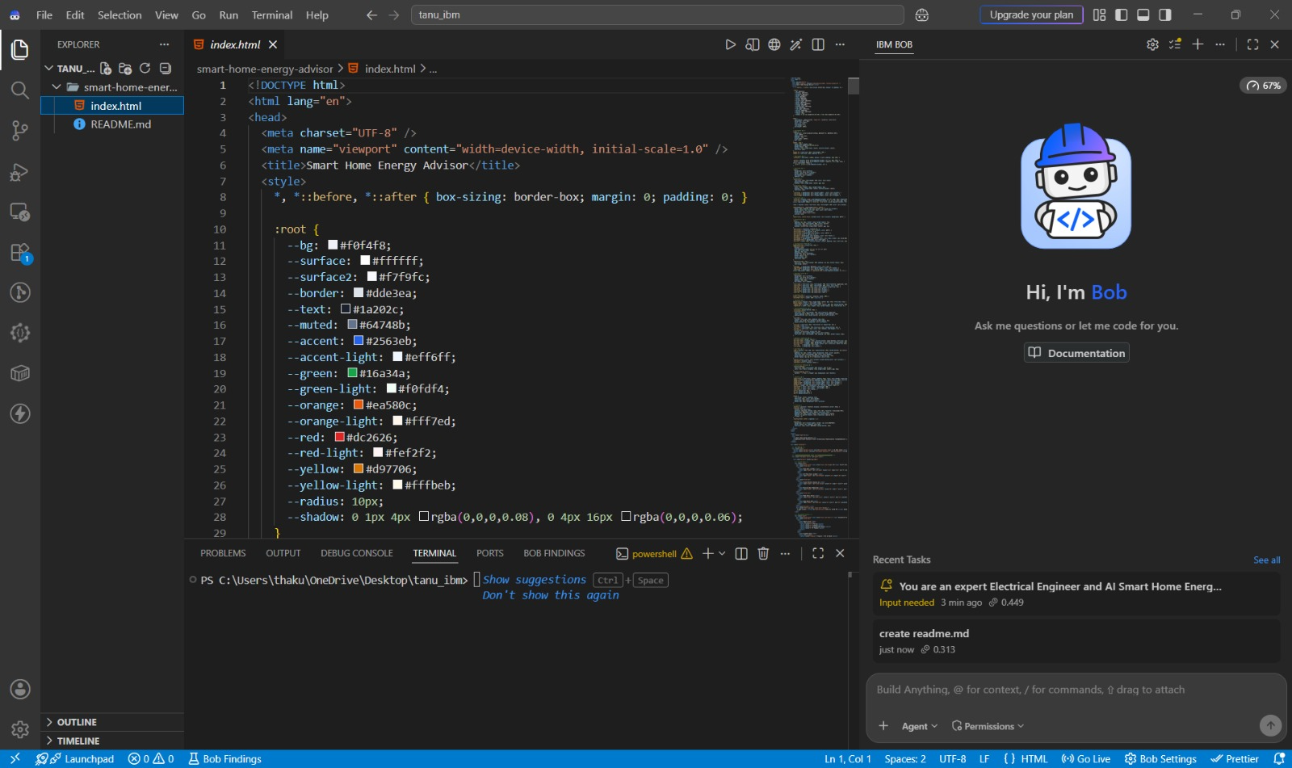
IBM Bob Screenshots:

Slide 7
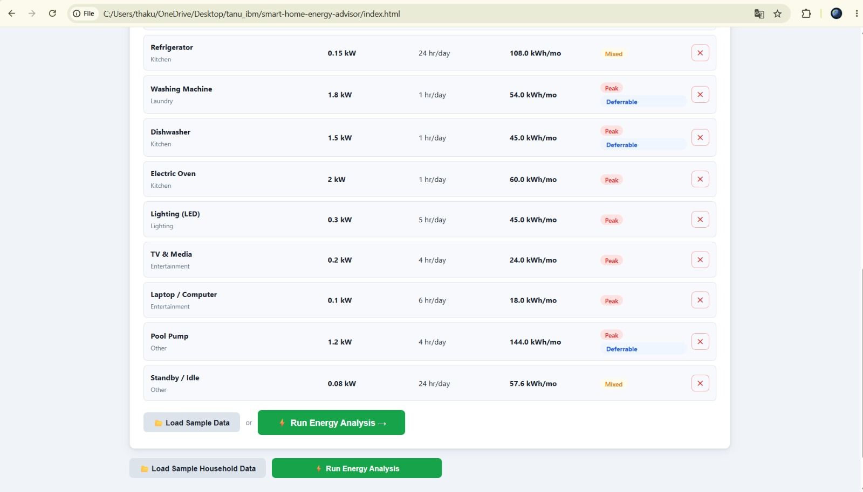

Slide 8

Role of Agentic AI in the solution
In this project, Agentic AI transforms the Smart Home Energy Advisor from a passive reporting dashboard into an autonomous, goal-driven energy optimization system. Instead of requiring a user to manually inspect kilowatt-hour figures and calculate rate tariffs, the agent continuously runs a Perceive \rightarrow Reason \rightarrow Act loop to actively drive down energy costs and peak grid strain.
1. Autonomous Perception & Closed-Loop Ingestion
* Rather than waiting for human prompts, the system autonomously listens to live smart meter feeds, smart plug telemetry, and dynamic utility rate updates.
* It detects deviations in real time—such as an unexplained jump in continuous standby wattage (vampire load) or an energy-intensive appliance starting up during a peak tariff window.
2. Multi-Agent Task Decomposition & Orchestration
Instead of relying on a single, brittle LLM prompt to handle parsing, physics, tariff arithmetic, and behavioral advice simultaneously, Agentic AI divides the system into specialized workers managed by IBM Langflow or watsonx Orchestrate:
* Data Disaggregation Agent: Isolates individual appliance signatures from total power draws using Non-Intrusive Load Monitoring (NILM) patterns.
* Tariff & Cost Estimation Agent: Executes mathematical tools to project monthly billing trajectories under multi-tiered, Time-of-Use (ToU) rates.
* Advisory & Scheduling Agent: Synthesizes behavioral nudges, identifies shifting opportunities, and calculates return on investment (ROI) for energy-efficient retrofits.
* Master Coordinator: Orchestrates inter-agent handoffs, aggregates outputs, and resolves conflicting priorities (e.g., maximizing financial savings vs. maintaining user comfort preferences).

Slide 9
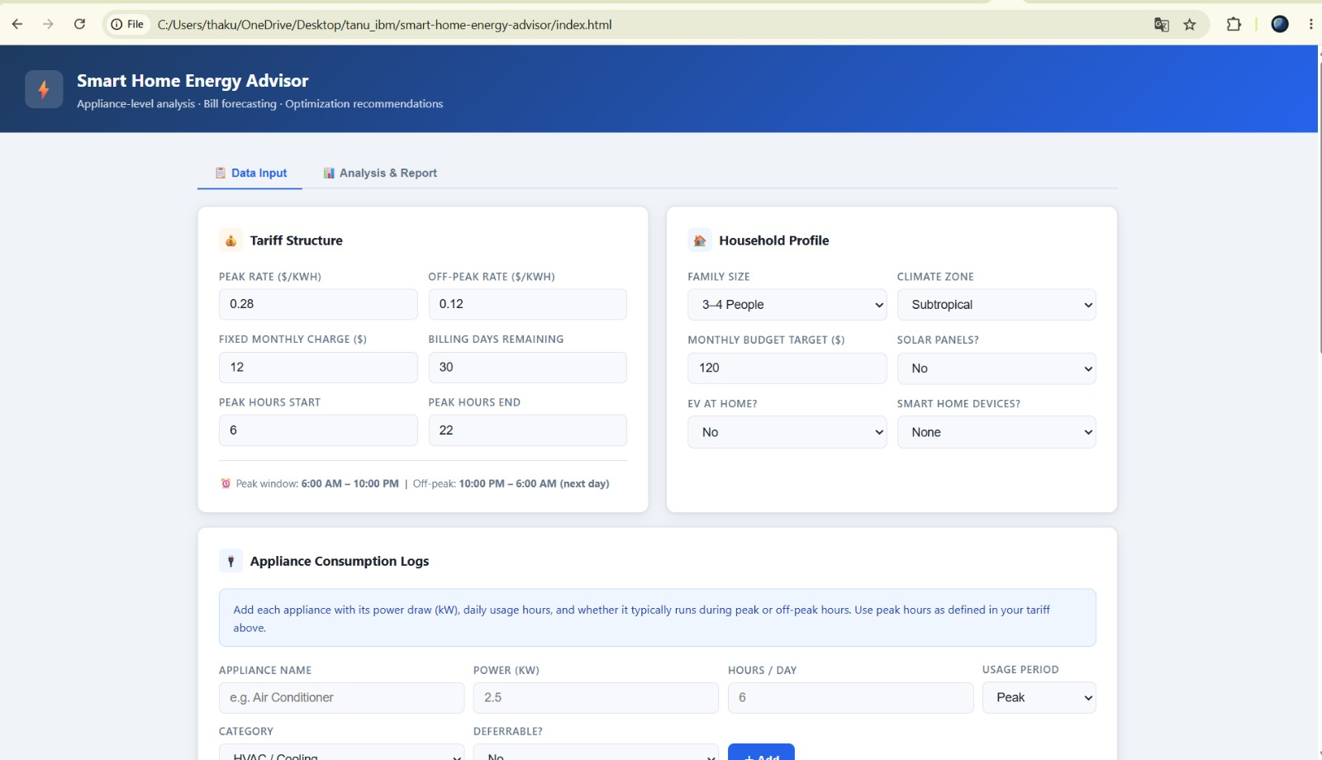
Project Output Screenshot
Please put IBM Bob output screenshots with 2-3 prompts.
You can take 2-3 more slides for each screenshot
·
·
·

Slide 10
Novelty and Uniqueness
Novelty (Technical Highlights)
* Autonomous Closed-Loop Pipeline: Continuously monitors live smart meter telemetry and acts before peak rates hit, rather than waiting for manual user prompts.
* Hybrid Math & AI Engine: Uses deterministic Python scripts inside IBM Langflow for exact multi-slab tariff math, while IBM Granite handles context-aware reasoning and behavioral advice.
* Virtual Sub-Metering (NILM): Separates composite home power into individual appliance signatures (HVAC, EV, geyser) without needing smart plugs on every single outlet.
Uniqueness (Key Differentiators)
* Prescriptive, Dollar-Quantified Actions: Gives exact savings per action (e.g., "Shift laundry to 11 PM to save ₹400/month") instead of vague energy-saving tips.
* Active Time-of-Use (ToU) Shifting: Automatically reschedules deferrable heavy appliances out of expensive peak-rate windows.
* RAG-Powered Retrofit Audits: Calculates realistic payback periods for upgrading to 5-star/inverter appliances based on real household usage logs.
* Vampire Load Detection: Isolates hidden standby power leaks and triggers smart-plug shutdowns for idle electronics.

Slide 11
Git Hub Link
https://github.com/Tanu-1103/ibm-project.git
·
·
·

Slide 12
Future Scope
1. Vehicle-to-Home (V2H) and Bidirectional EV Integration
Expanding the agent from static household loads into mobile storage assets. During peak tariff hours, the agent can orchestrate bidirectional electric vehicle (EV) charging—discharging EV battery capacity back into the home to power heavy loads (peak-shaving) and recharging during super-off-peak or negative-pricing night hours.
2. Distributed Energy Resources (DER) & Prosumer Microgrid Trading
Integrating rooftop solar generation, residential battery energy storage systems (BESS), and smart inverters. The agent can evolve into an automated energy trader that decides in real time whether to self-consume generated solar power, store it in batteries, or sell excess generation back to the grid via peer-to-peer (P2P) blockchain or local transactive energy markets.
3. Direct Matter & Thread IoT Standard Actuation
Moving from passive recommendations to direct hardware actuation using modern interoperability protocols like Matter and Thread.
·
·
·

Slide 13
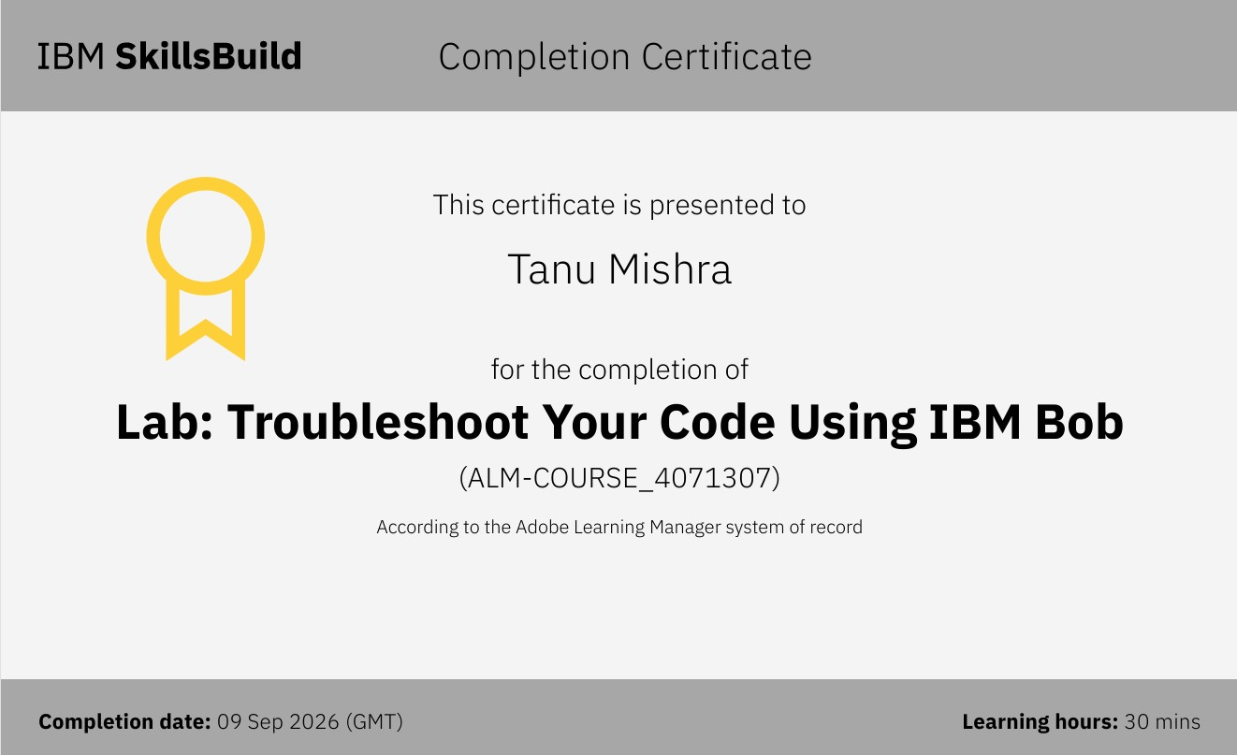
Certificates Earned:​

Slide 14


