Slide 1
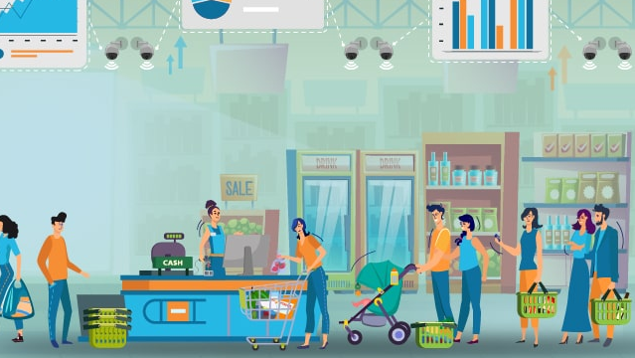
Retail Analytics
Notes:
NOTE: Want a different image on this slide? Select the picture and delete it. Now click the Pictures icon in the placeholder to insert your own image.

Slide 2

Project Team Members
Ashvini Patidar (NUID: 002747763)
Ritwik Giri (NUID: 002873045)
Tanuja Mahajan (NUID:002221239)

Slide 3

Overview
In an increasingly digital and price-conscious world, consumers are constantly seeking ways to optimize their spending on essential items. A comprehensive price comparison platform for groceries and electronics emerges as a valuable solution to address this need. This platform is designed to provide consumers with a user-friendly, efficient, and insightful way to make informed purchasing decisions across two crucial categories of products: groceries and electronics.

Slide 4
Views
Product_Details_View
Price_Comparison_View
Shopping_Cart_View
Store_Inventory_View
Price_Update_View

Slide 5
Product_Details_View
This view combines product information with corresponding prices and store names, sourced from the Product, Prices and Store tables.
It provides a snapshot of product details aiding in decision making and analysis.

Slide 6
Price_Comparison_View
This view joins Product, Prices and Store tables and aims to present key information such as Product ID, Name, Category, Price, Store name, Location and Last update date for prices.
It basically provides perspective on product prices across different stores.

Slide 7
Shopping_Cart_View
This view consolidates data from Cart, Cart_Items, Product and Prices table including details such as Cart and Cart Item IDs, product information, Quantity, Price and Total price.
Provides a representation of the shopping cart contents, aiding in tracking and analyzing items for a seamless shopping experience.

Slide 8
Store_Inventory_View
This view provides a consolidated perspective on store inventory, merging information on Store ID, name, location and associated product details with their respective prices.
It provides essential data for effective inventory management and pricing analysis across different stores.

Slide 9
Price_Update_View
This view combines product, prices and store data and aims to provide a snapshot of Product ID, name, category, price, Store ID, store name and the last updated date.
It consolidates and presents updated pricing information for products across different stores.

Slide 10
Team Member Contributions
Ashvini
Task description
Task description
Task description
Task description
Ritwik
Task description
Task description
Task description
Tanuja
Created Users
Created some tables
Task description
Task description

Slide 12
Add a Slide Title - 5

