Slide 1
Project Title: “Creed Perfume Sales & Customer Insights Dashboard”
Subtitle: “Analyzing luxury fragrance sales across regions, demographics, and purchase channels”
Tools: Python (Faker), BigQuery, Power BI
Author: [Tanmay Sharma]

Slide 2
Aim: To simulate and analyze sales performance of Creed perfumes using synthetic data.
Scope:
Sales revenue trends
Customer demographics & preferences
Country-wise market reach
Purchase channel distribution
Value: Enables data-driven decision-making for luxury retail strategies.

Slide 3
Data Generation (Python)
Used Faker library to create synthetic perfume sales dataset.
Dataset: creed_perfume_sales.csv
Key fields:
CustomerID, Gender, AgeGroup, City, Country
PerfumeName, FragranceFamily, Price, Quantity, Discount(%), TotalAmount
PurchaseChannel, PurchaseDate
Size: 500 records (scalable).

Slide 4
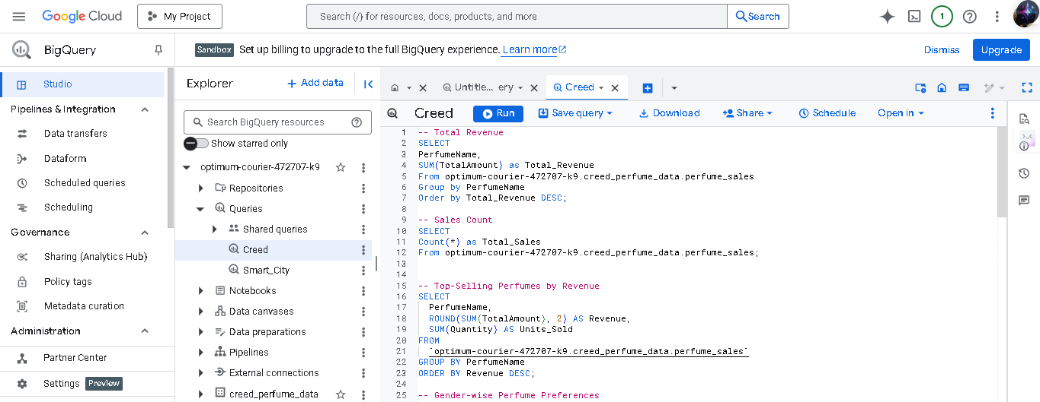
Data Storage (BigQuery)
Dataset Name: creed_perfume_data
Table Name: perfume_sales
Queries Implemented:
Top-Selling Perfumes by Revenue
Gender-wise Perfume Preferences
Country-wise Sales
Monthly Sales Trend
Purchase Channel Distribution

Slide 5
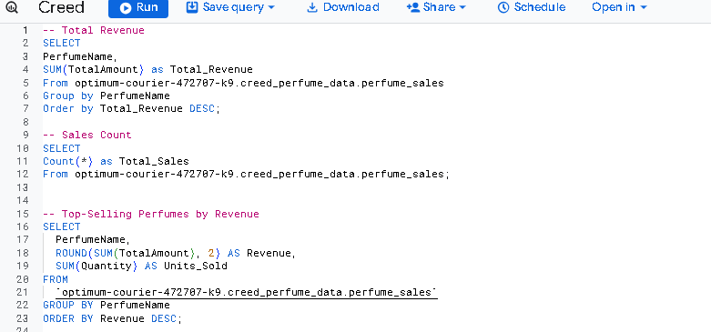
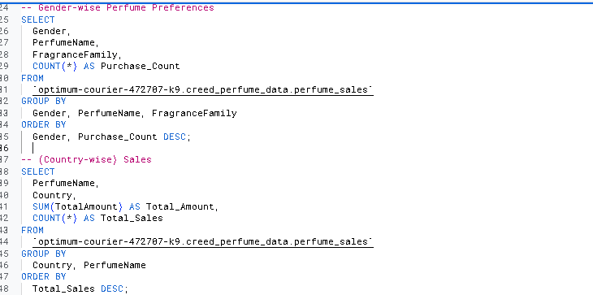

Slide 6
Dashboard Design (Power BI)
Visuals Used:
KPI Cards:
Total Revenue
Total Units Sold
Top Perfume by Revenue
Top Country by Sales
Bar Chart: Top-Selling Perfumes
Stacked Column Chart: Gender-wise Preferences
Pie Chart: Purchase Channel Distribution
Line Chart: Monthly Sales Trend
Map Visual: Country-wise Sales
Matrix Table: Perfume × FragranceFamily × Revenue

Slide 7
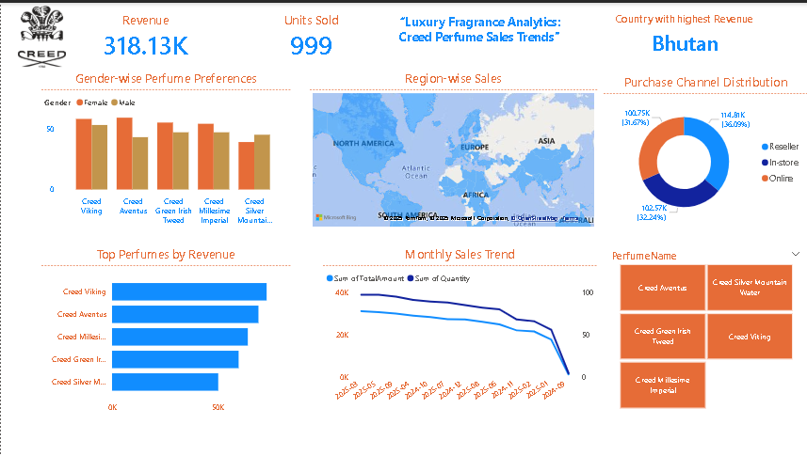

Slide 8
Insights
Revenue Drivers: Aventus & Green Irish Tweed lead sales.
Gender Preference: Females prefer floral & fresh families, males prefer woody & spicy.
Geography: Strong sales in European countries.
Purchase Channels: Online dominates, but in-store sales are higher in luxury segments.
Trends: Seasonal spikes (holidays, festive months).

Slide 9
Business Impact
Helps identify top-performing perfumes and optimize inventory.
Reveals gender & age preferences for targeted marketing.
Country-wise insights enable global expansion strategies.
Channel distribution guides online vs offline investments.

Slide 10
Future Enhancements
Integration with real POS/CRM systems.
Forecasting using time series models (Prophet, ARIMA).
Customer segmentation with clustering (K-Means).
Sentiment analysis on customer reviews (text data).

Slide 11
Conclusion
This project demonstrates the power of synthetic data + cloud warehouse (BigQuery) + BI visualization (Power BI) in analyzing luxury retail sales. It showcases how data-driven strategies can support business decisions in niche markets like luxury perfumes.

Slide 12
Thank You
LinkedIn: https://www.linkedin.com/in/tanmay-sharma-800599373/
Git hub: https://github.com/Tanu272004/-Creed-Perfume-Sales-Customer-Insights-Dashboard-.git

