Slide 1
Project Title: “Income, Mortgage & Housing Insights: A State & City Analysis”
Name: Tanmay Sharma
, Role: Data/Business Analyst
Date: 2025-09-13

Slide 2
Problem Statement
Housing affordability issue in US cities & states
Why mortgage rates + income matter
Objective: “To analyze state & city housing trends and affordability using data analytics.”

Slide 3
Data Sources
BigQuery (mention dataset used: housing, income, mortgage rates)
Data size / structure (States, Cities, Years, Metrics)
Python used for preprocessing

Slide 4
Methodology / Workflow
Flowchart (BigQuery → Python Cleaning → Calculations → Power BI Dashboard)
Key processing: Median house price, Avg income, Affordability Index = Price ÷ Income

Slide 5
Exploratory Data Workflow
Step 1: Synthetic Data (Python)
Created synthetic datasets (Housing, Demographics, Mortgage)
Exported them as CSV for further use
Step 2: Cloud Data Management (BigQuery)
Imported CSVs into Google BigQuery
Wrote SQL queries to aggregate & join datasets
Example: Avg House Price by State
Example: Household Income distribution
Step 3: Visualization (Power BI)
Imported processed BigQuery tables into Power BI
Built interactive dashboards (KPIs, Trends, Drillthroughs)

Slide 6

BigQuery Part :-
Title: Data Aggregation & Analysis (BigQuery)
Imported synthetic datasets (housing_prices, demographics, mortgage_rates) from CSV into BigQuery tables.
Used SQL queries for:
State-wise Average House Price Trends
Top 10 Expensive Cities (Avg Price)
Income vs House Price Correlation
Mortgage Rate Impact on House Prices
Affordability Index (Price ÷ Income)
Ensured queries are sandbox-friendly (optimized, grouped, aggregated).
Exported processed tables → directly connected to Power BI.

Slide 7
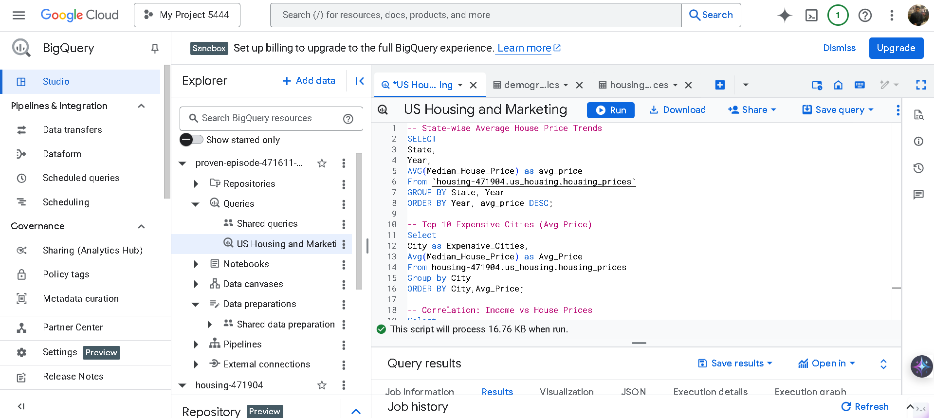

Slide 8
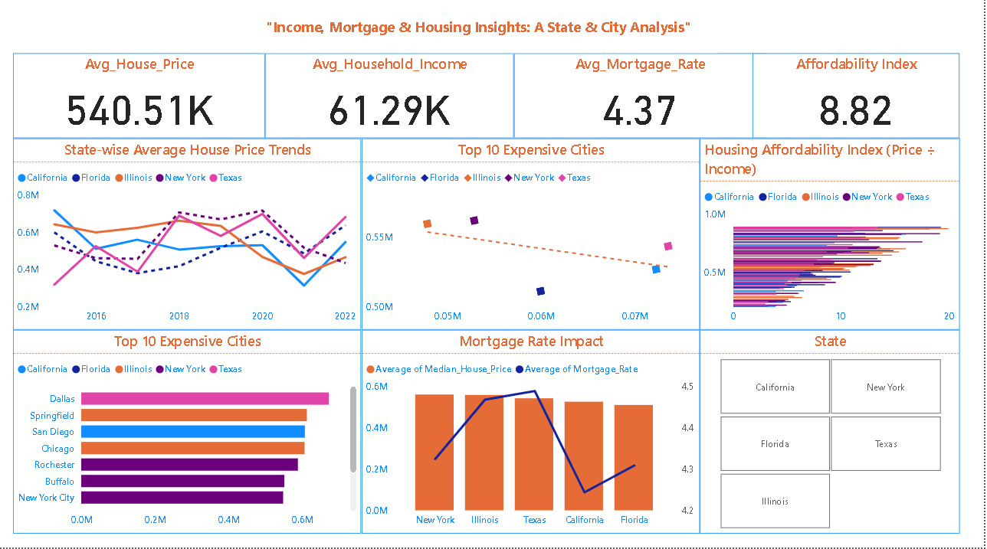
Dashboard (Power BI):-
Interactive Dashboard for State & City-level Housing Insights”

Slide 9
Key Insights
California & New York = High house price, lower affordability
Texas & Florida = Relatively better affordability
Mortgage rate fluctuations impact affordability differently across states

Slide 10
Conclusion
Summary of findings
Real-world implication: Policy, investment, affordability planning
Next step: Add predictive modeling (future extension idea)

Slide 11
References
Tools: BigQuery, Python (Pandas, Matplotlib), Power BI
Dataset source

Slide 12


Thank You (Lets Connect):
LinkedIn: https://www.linkedin.com/in/tanmay-sharma-800599373/
Git hub: https://github.com/Tanu272004
Project Link: US Mortgage Housing Analytics With Affordability Index

