Slide 1
Title: Predictive Healthcare Insights: Patient Readmission Analysis
Subtitle: End-to-End Data Analytics Workflow (Python → Azure → MySQL → Power BI)
Name: Tanmay Sharma
Role: Data/Business Analyst
Date: 2025/08/27

Slide 2
Problem Statement
Content:
Hospitals face high readmission rates, increasing cost and reducing patient care quality.
Goal: Predict which patients are likely to be readmitted and analyze patterns.

Slide 3
Objectives
Predict patient readmissions using historical data
Analyze cost, length of stay
Build interactive dashboards for hospital management
Store and retrieve data efficiently using Azure + MySQL

Slide 4
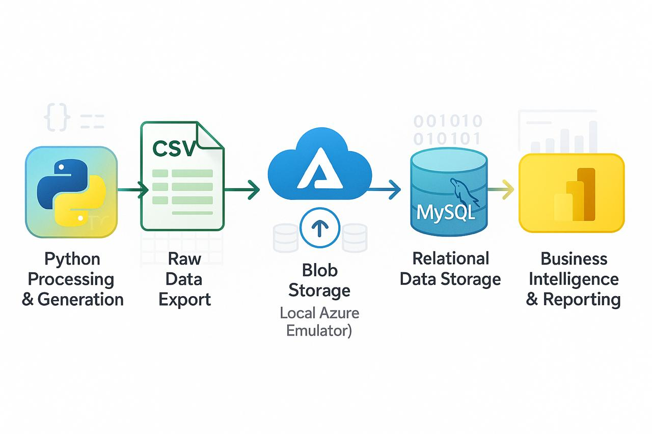
Data Sources
Hospital Admissions CSV: Generated via Python (age, stay length, tests, cost, previous admissions, readmission)
Database: MySQL (centralized storage)
Cloud Storage: Azure Blob Storage (secure storage & integration)
Power BI Dashboard: For visualization & decision-making

Slide 5
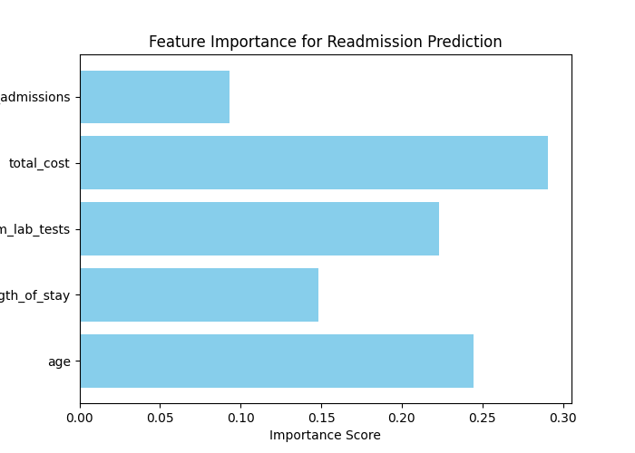
Python Data Processing
Steps:
Generate / Clean Dataset (hospital_admissions.csv)
Feature Selection → age, length_of_stay, num_lab_tests, total_cost, prev_admissions
Train-Test Split → test_size=0.2, random_state=42, stratify=y
Pipeline → Imputer + Scaler + RandomForestClassifier
Predictions → Actual vs Predicted + Readmission Probability
Insight:
Feature importance shows Length of Stay and Previous Admissions most predictive
Visual: Feature importance bar chart

Slide 6
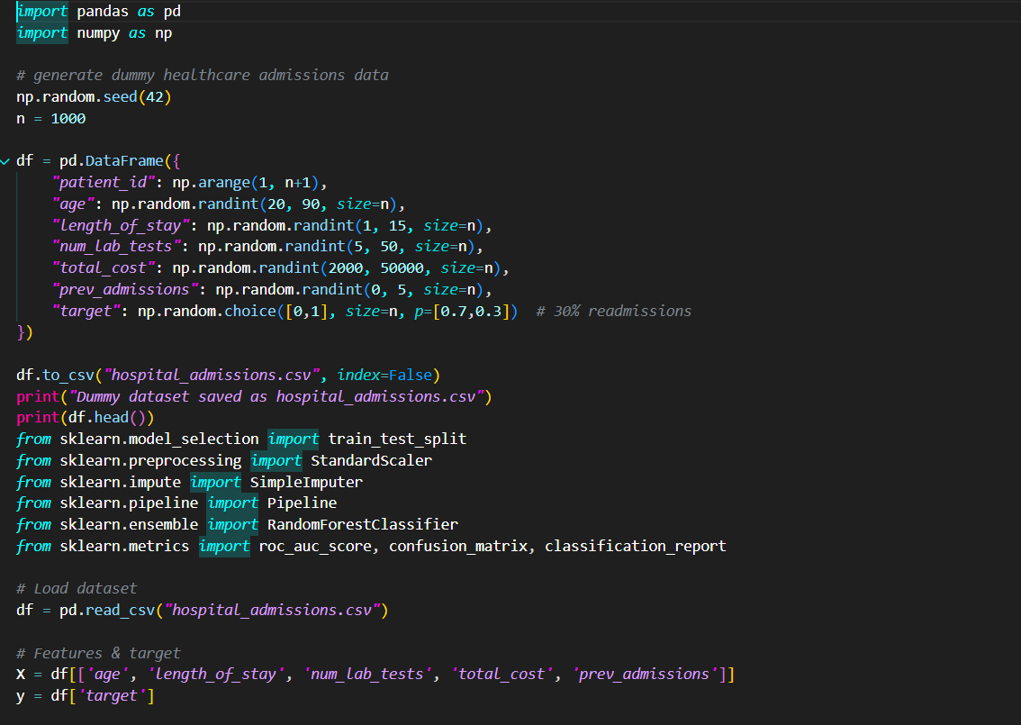

Script.py

Slide 7
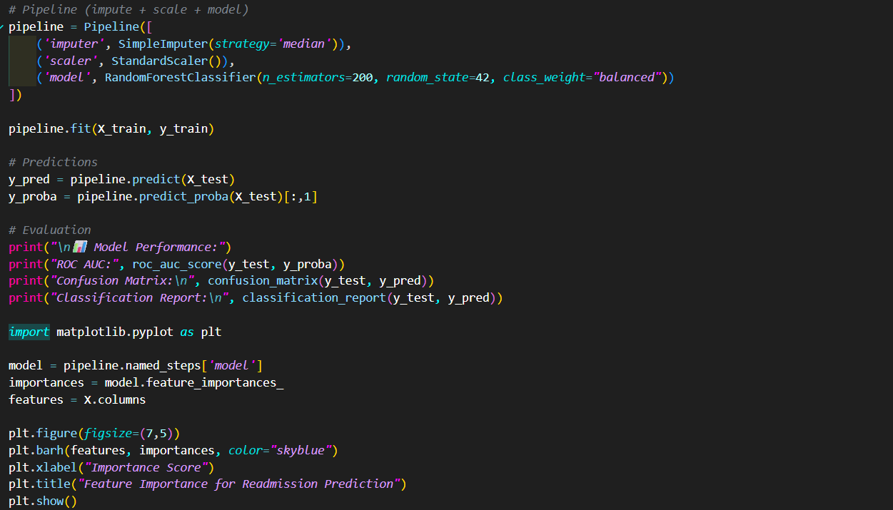
ML Evaluation
Metrics:
ROC-AUC → Model discrimination power
Confusion Matrix → True Positive / False Positive insights
Classification Report → Precision, Recall, F1-Score
Insight: 30% patients predicted likely readmission → helps hospital focus resources
Visual: Confusion Matrix heatmap

Slide 8
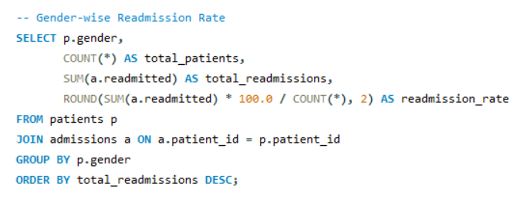
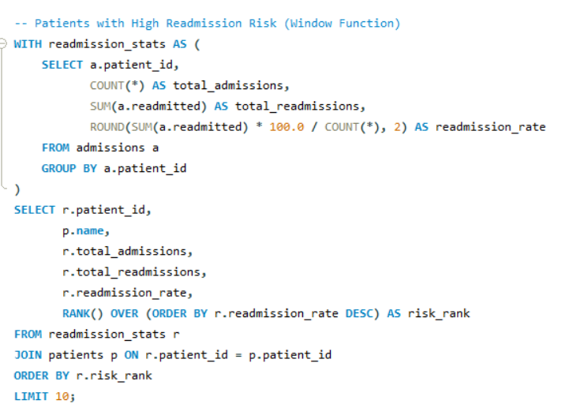

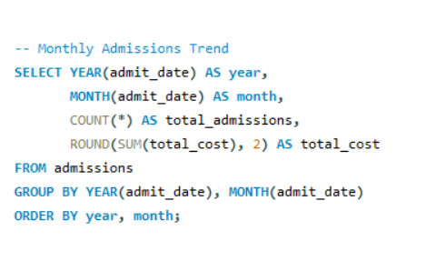
SQL & MySQL Analysis
Queries:
Average Length of Stay per Patient
Readmission Rate
Cost Analysis (Length of Stay vs Total Cost)
Gender-wise Readmission Rate
Monthly Admissions Trend
Insight:
Readmission higher in patients with longer stay or frequent previous admissions

Slide 9
Azure Blob Storage
Content:
Python CSV uploaded to Azure Blob Storage
Enables secure cloud access for dashboards
Integrated with Power BI for live updates
Insight: Cloud storage ensures scalable, central, and secure dataset

Slide 10
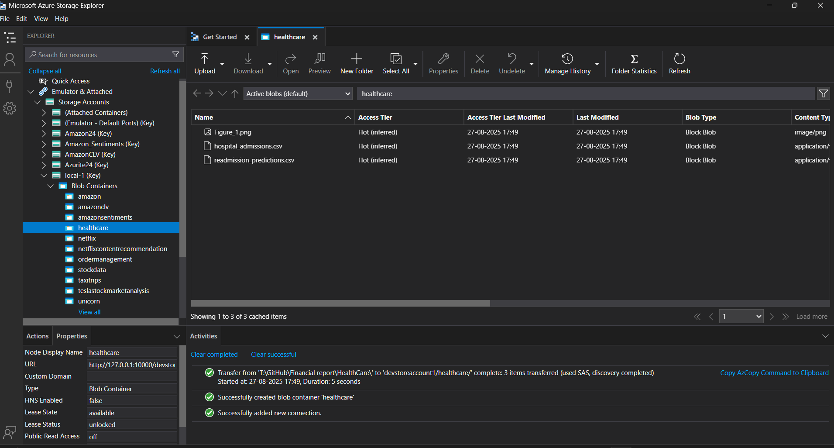

Slide 11
Power BI Dashboard
Visuals Included:
KPI Cards → Total Patients, Total Readmissions, Avg Length of Stay, Readmission Rate
Pie/Donut → Readmission vs No Readmission
Bar Chart → Readmission by Gender / Top 5 Costly Diagnoses
Line Chart → Monthly Admission Trends
Table → Patient-level Predictions (Actual vs Predicted + Probability)
Insight:
Management can identify high-risk patients and allocate resources proactively

Slide 12
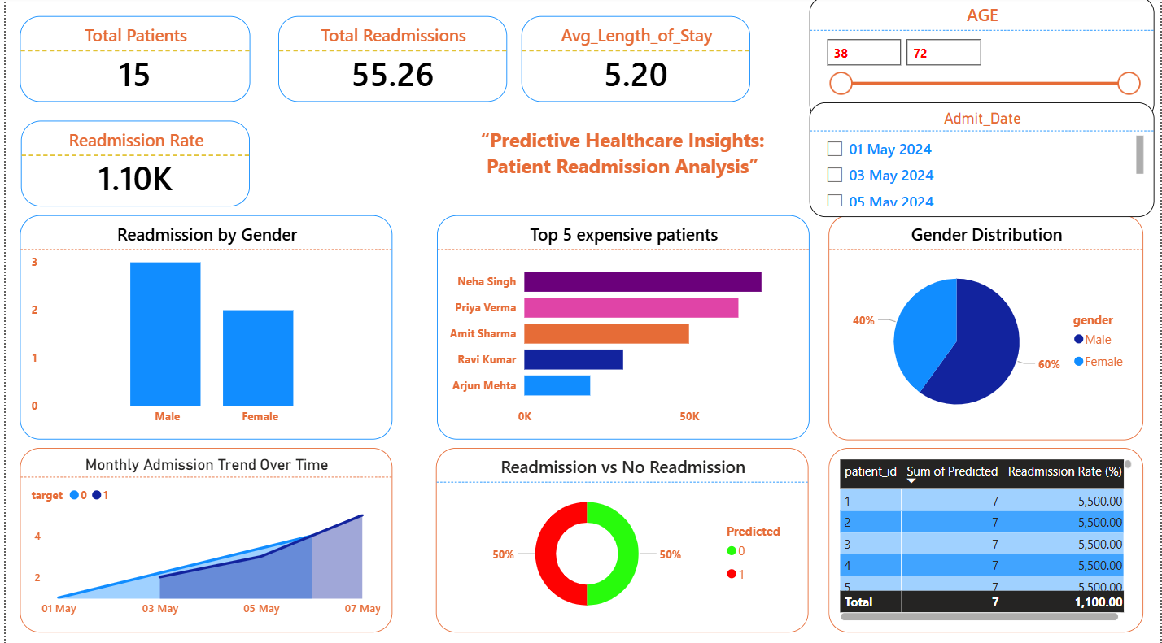


Slide 13
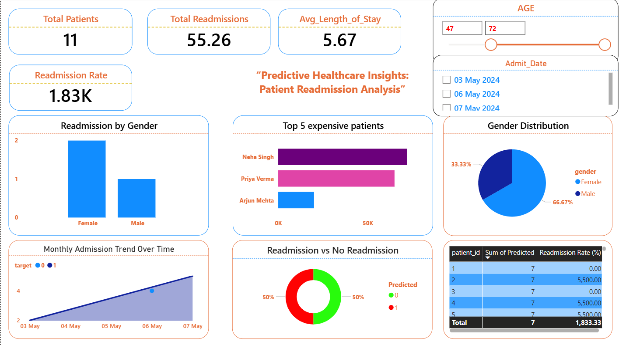

Slide 14
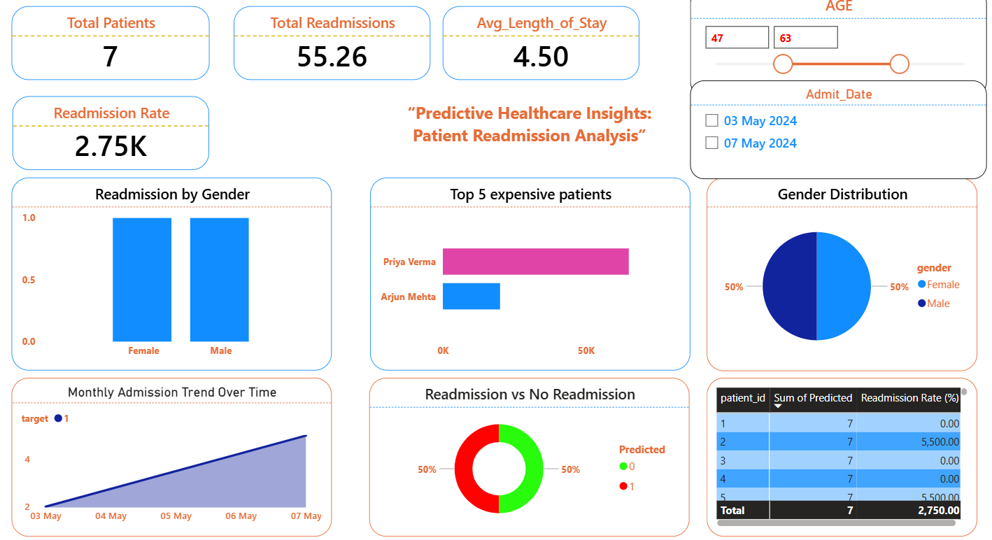

Slide 15
Key Insights
Readmission risk higher for patients with longer stays and previous admissions
Gender distribution shows small differences in readmission patterns
Cost correlates with length of stay → enables cost optimization
Interactive dashboards help real-time decision making
Challenges & Learnings
Challenges:
Imbalanced dataset → handled via stratify=y
Missing / inconsistent data → handled with SimpleImputer
Integrating Python → Azure → MySQL → Power BI pipeline
Learnings:
End-to-end workflow mastery
Cloud integration (Azure Blob) for scalable analytics
MAANG-level data storytelling with dashboards

Slide 16
References / Tools
Python: Pandas, Numpy, Scikit-learn, Matplotlib
SQL: MySQL Workbench
Cloud: Azure Blob Storage
BI: Power BI
Dataset: Synthetic Healthcare Data

Slide 17
Conclusion
Built predictive model + dashboard for hospital management
Enables better patient care and resource optimization
Ready to extend for real-world healthcare deployment

Slide 18


Thank You/Let’s Connect:
LinkedIn: http://www.linkedin.com/in/
Git hub: https://github.com/Tanu272004
Website: https://tanmayportfolio52.wordpress.com/

