Slide 1

SNAP Algorithm
For Graph Summarization

Slide 2
Contents
Aim
Definitions
Data Structures
SNAP
Examples

Slide 3
Aim
Understand characteristics of large graphs
Effective graph summarization method to extract the underlying information
Input: a graph G;
a set of node attributes A;
a set of relationships R.
Output: a summary graph G_{snap}
based on user-selected
attributes A and relationships R.

Slide 4
Definitions
A-compatible
Every node in each group has the same values for the set of attributes A.
Neighbor-groups
For edge (u, v), the group node v belongs is a neighbor group of node u.
(A, R)-compatible
All nodes in same group are homogeneous in terms of both attributes A and relationships in R.

Slide 5
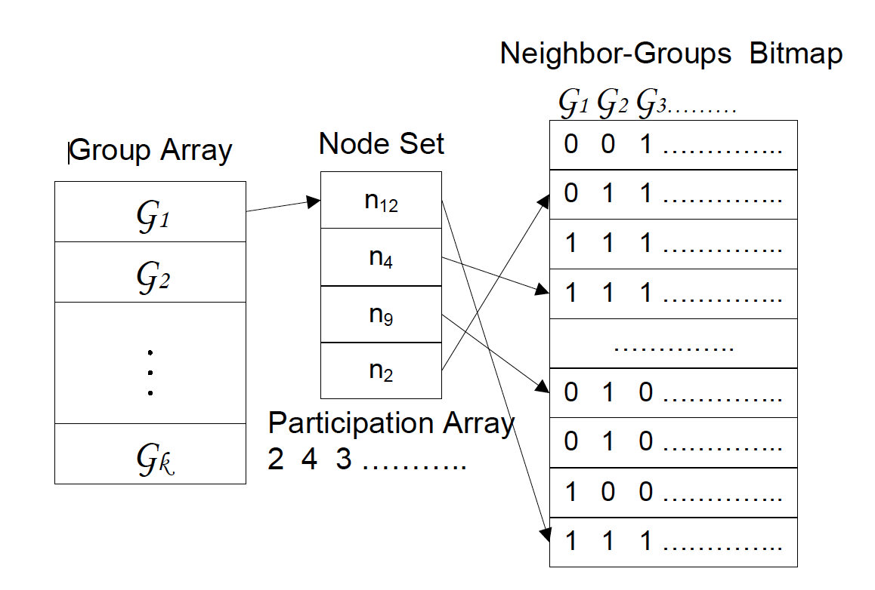
Data Structures
g₁
n₁₂ n₄ n₉ n₂
g₂
g₃

Slide 6
Data Structures
Relationship compatible
Data structure characteristics
All nodes have the same values in their rows of the bitmap
Participation array of each group only contains values 0 or the size of the group
All nodes in a group have the same set of neighbor-groups
Split into subgroups
-- sorting nodes based on bitmap

Slide 7
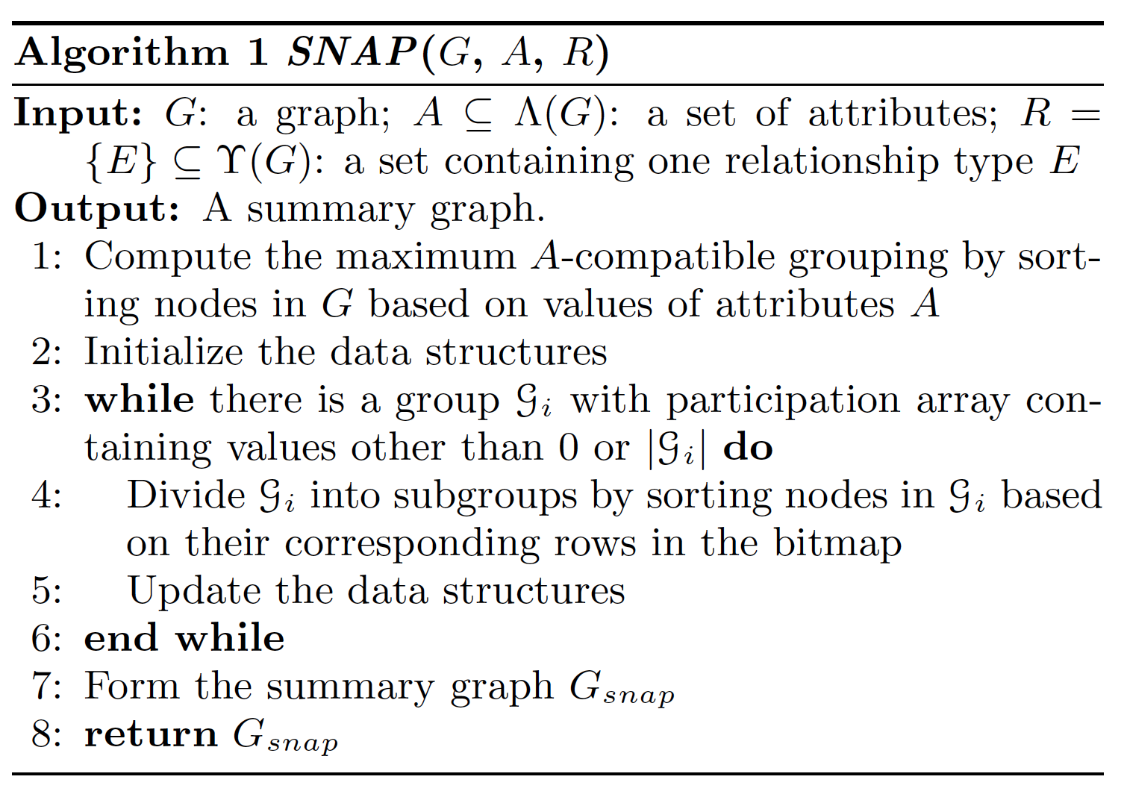
SNAP Algorithm

Slide 8
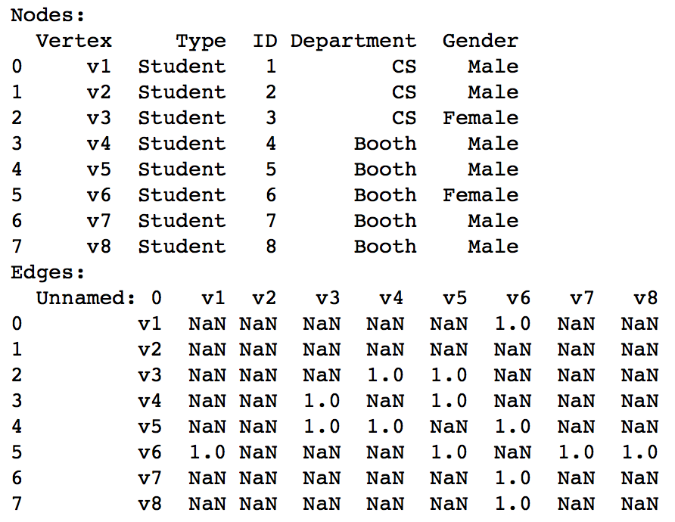
Examples
V₂
[1] (CS, M)
V₁
[0] (CS, M)
V₆
[5] (B, F)
V₄
[3] (B, M)
V₅
[4] (B, M)
V₇
[6] (B, M)
V₈
[7] (B, M)
V₃
[2] (CS, F)

Slide 9
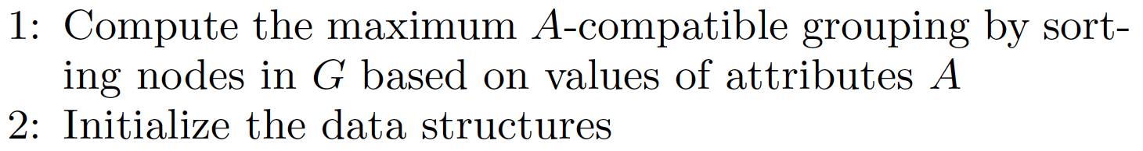
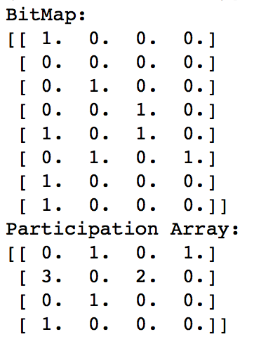
Example
V₂
[1] (CS, M)
V₁
[0] (CS, M)
V₆
[5] (B, F)
V₄
[3] (B, M)
V₅
[4] (B, M)
V₇
[6] (B, M)
V₈
[7] (B, M)
V₃
[2] (CS, F)

Slide 10
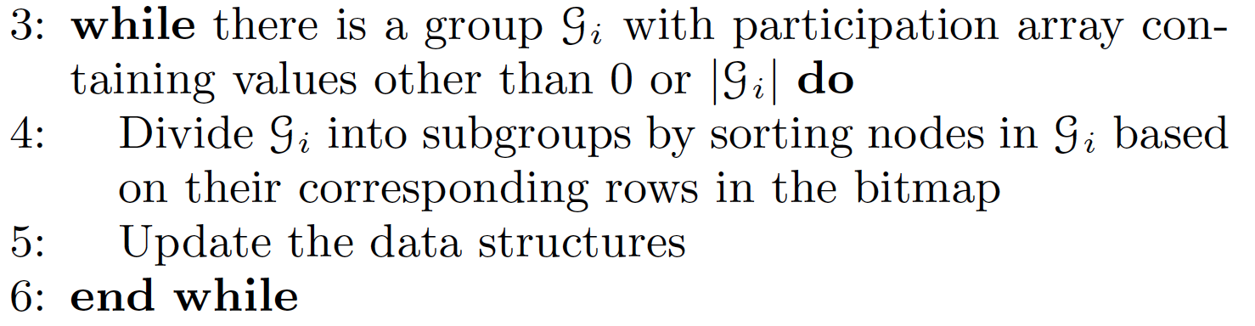
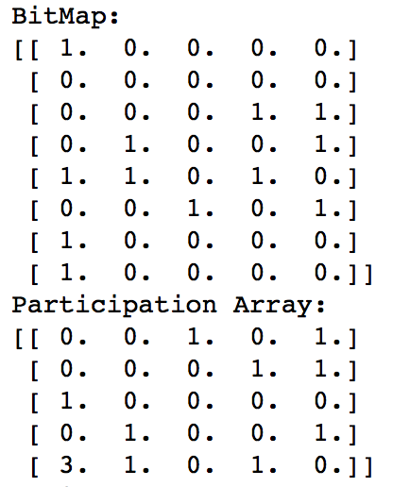
Example
V₂
[1] (CS, M)
V₁
[0] (CS, M)
V₆
[5] (B, F)
V₄
[3] (B, M)
V₅
[4] (B, M)
V₇
[6] (B, M)
V₈
[7] (B, M)
V₃
[2] (CS, F)

Slide 11
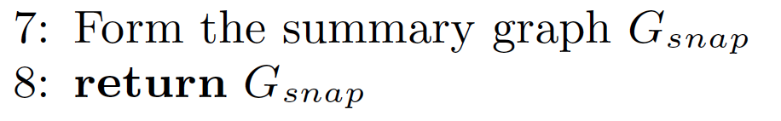
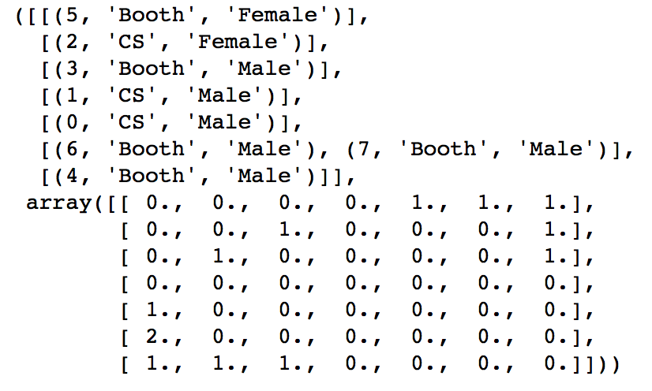
Example
V₂
[1] (CS, M)
V₁
[0] (CS, M)
V₆
[5] (B, F)
V₄
[3] (B, M)
V₅
[4] (B, M)
V₇
[6] (B, M)
V₈
[7] (B, M)
V₃
[2] (CS, F)

Slide 12
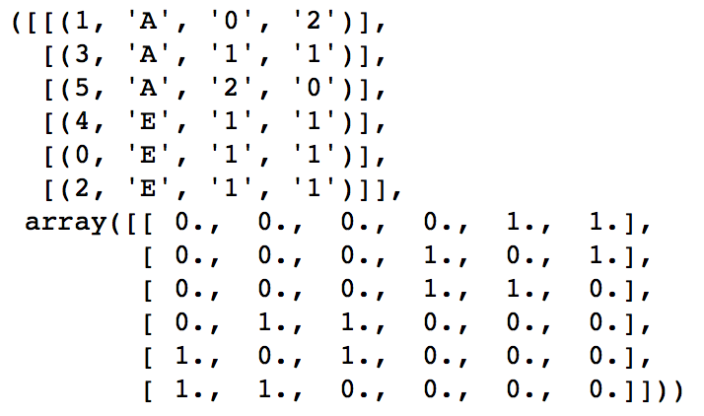
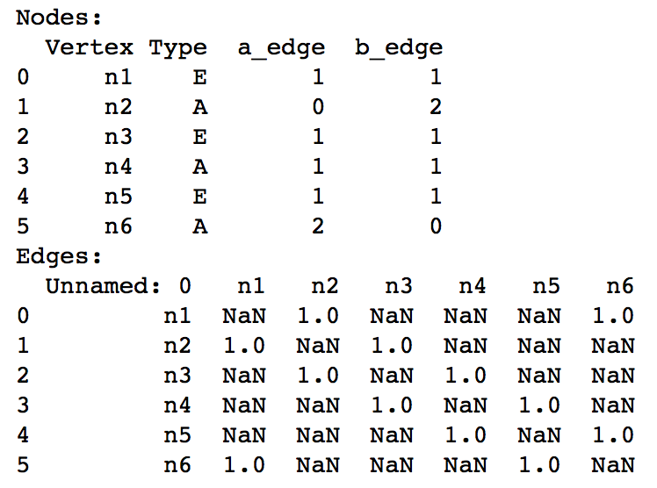
Problem
Attributes = [‘Type’, ’a_edge’, ‘b_edge’]
n₆
[5] (A)
E₂
E₂
n₁
[0] (E)
n₅
[4] (E)
E₁
E₁
n₂
[1] (A)
n₄
[3] (A)
E₁
E₂
n₃
[2] (E)

Slide 13
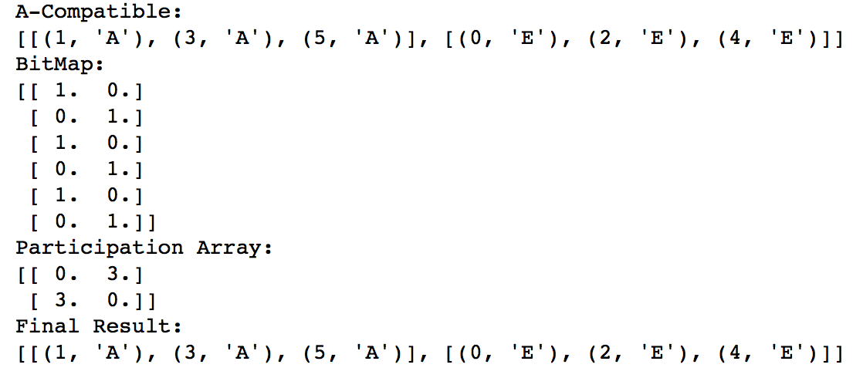
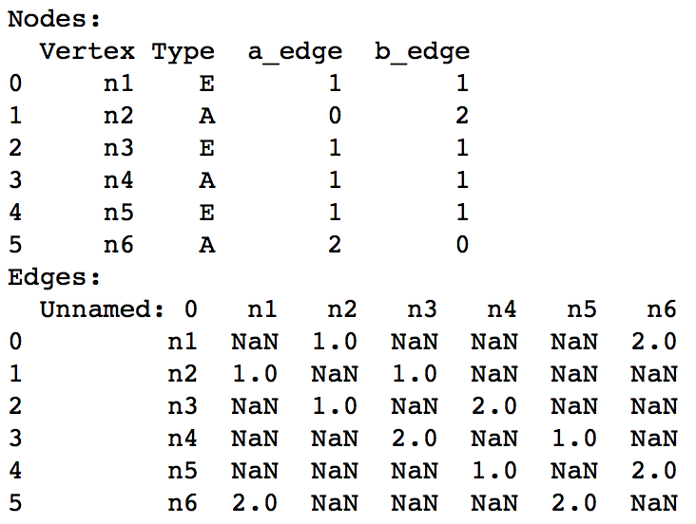
Problem
n₆
[5] (A)
E₂
E₂
Attributes = [‘Type’]
n₁
[0] (E)
n₅
[4] (E)
E₁
E₁
n₂
[1] (A)
n₄
[3] (A)
E₁
E₂
n₃
[2] (E)

Slide 14
Thank You

