Slide 1
Google form Result Analysis
Survey on New Fairness Cream Launch by “mamaearth”
Submitted by Tanu Roy(DBA20013)

Slide 2
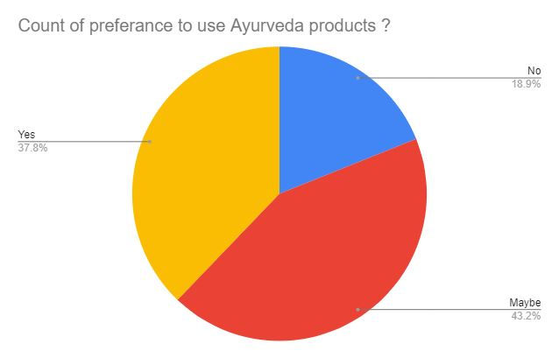
Percentage of people choosing Ayurveda products
Fig 1.1

Slide 3
Analysis(fig 1.1)
37.8% People are ready to choose Ayurveda products in their daily life.
18.9% People are not ready to accept Ayurveda products in their day to day schedule.
It is a high percentage that 43.2% People are neither rejected nor accepted Ayurveda products which means they would give it a chance. So we need to target these audience and let’s check what kind of products are they using.

Slide 4
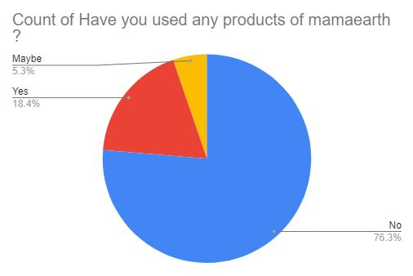
Percentage of people choosing Mamaearth
Fig 1.2

Slide 5
Analysis(fig 1.2)
There is a huge problem in approaching the brand to the consumers. If we compare with fig 1.1, 37.8% People were ready to choose Ayurveda products in their daily life. But only 18.4% people have used Mamaearth Ayurveda products.
76% people haven’t used any of Mamaearth products, So It is very much vital that We should approach them first.

Slide 6
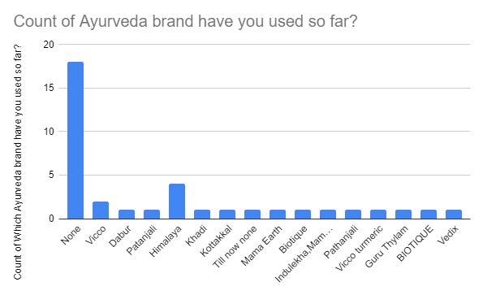
Knowing the Competitor
Fig 1.3

Slide 7
Analysis(fig 1.3)
This Graph is supposed to show the competitor of Mamaearth. Apparently we get to see that there are huge number of people who choose none of the Ayurveda cream. The Possible reason could be either they prefer cosmetic cream or they don’t use anything at all.
In case of each possible reason, it would be a best time to introduce this Ayurveda product into market while we could show an affection towards Indian product as well as Ayurveda is the traditional glory of India.

Slide 8
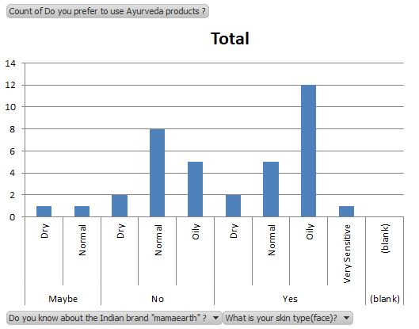
Knowing the features
Fig 1.4

Slide 9
Analysis(fig 1.4)
According to the graph, We can have more number of consumers with the skin type Oily who would prefer to try an Ayurveda product, so We should take this feature unto consideration about the new Fairness Cream Launch that It is more effective for the Oily Skin.

Slide 10
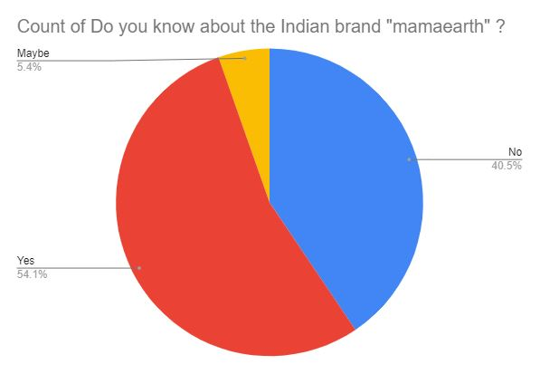
Brand Awareness
Fig 1.5

Slide 11
Analysis(fig 1.5)
A huge percentage of people are not aware of the brand Mamaearth, which is 40% & 54% are aware of this while 5% are not sure about it.
Well, The basic criteria of getting a survey creating a better product according to the market is the brand awareness. There are big number of people who should get to know about this so that they can give feedback regarding this.

Slide 12
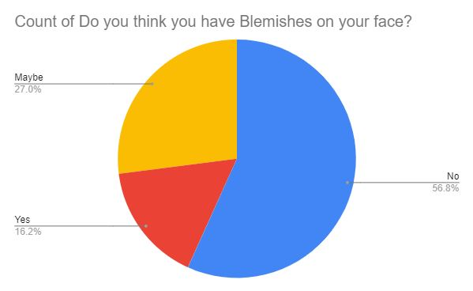
Blemishes on face
Fig 1.6

Slide 13
Analysis(fig 1.6)
According to the survey, we have 16% people who has blemishes on their face, 57% people are not having blemishes & 27% people are not sure about the blemishes.
We should consider having a fairness cream because there are less number of people who would prefer taking Bye Bye Blemishes cream as maximum number of people would be considering a normal fairness cream.

Slide 14
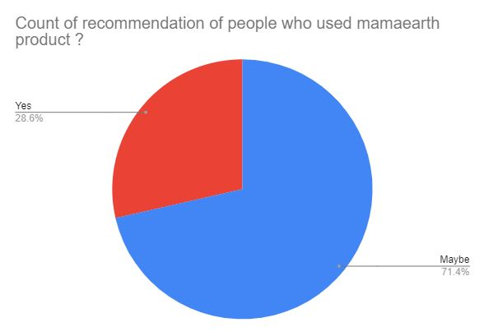
People who used Mamaearth before recommending Mamaearth
Fig 1.7

Slide 15
Analysis(fig 1.7)
71% of consumer isn’t sure about recommending Mamaearth to anybody which could be possibly because of quality issue/ price. We need to pay attention in this issue and make sure people who are using the product are happy with the quality.
29% consumer is recommending Mamaearth to their relatives or friends & that is a very less in count, We definitely need positive review and recommendation which brings us more customers.

Slide 16
The End

