Slide 1
Laptop Company Survey
Assignment 2
Submitted by Tanu Roy(DBA20013)

Slide 2
Insights of a survey for a new Laptop company
We featured the laptop into 4 attributes with 2-3 levels in each attributes.
We need to know the important factors where we should invest significant amount of money with respect to product development.
Using Conjoint analysis in R, we got the following insights in next few slides.

Slide 3
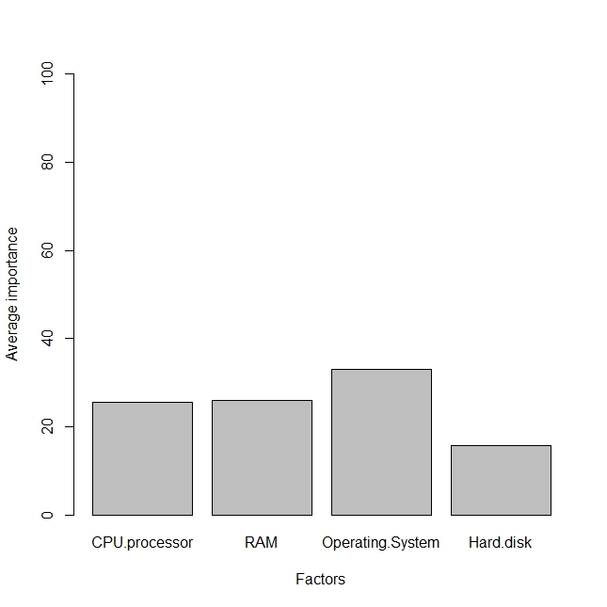
Important Factors to fund in: Operating system :at the most, hard disk: at the end

Slide 4
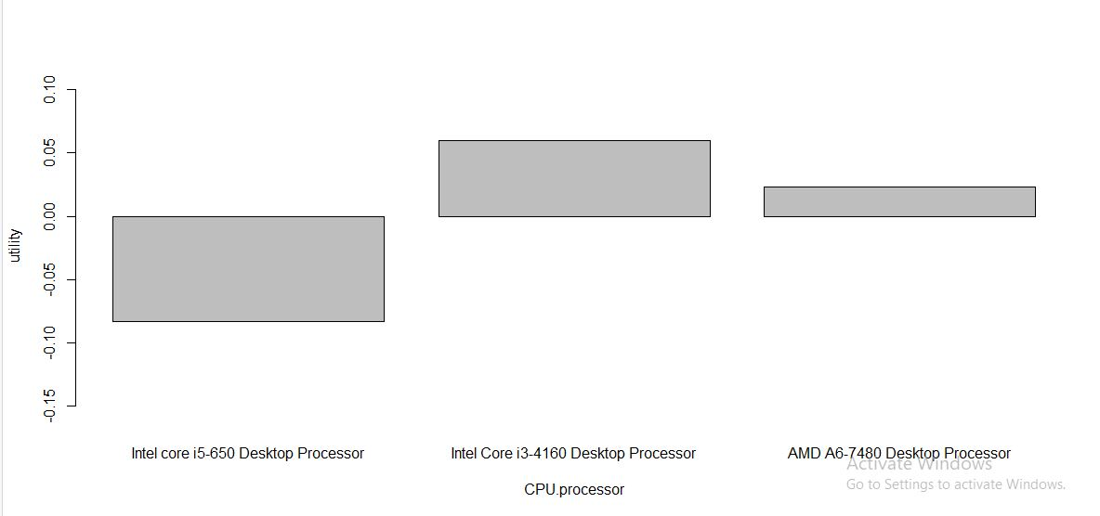
Utility of CPU Processors: Intel core i3-4160 is the most important to fund in

Slide 5
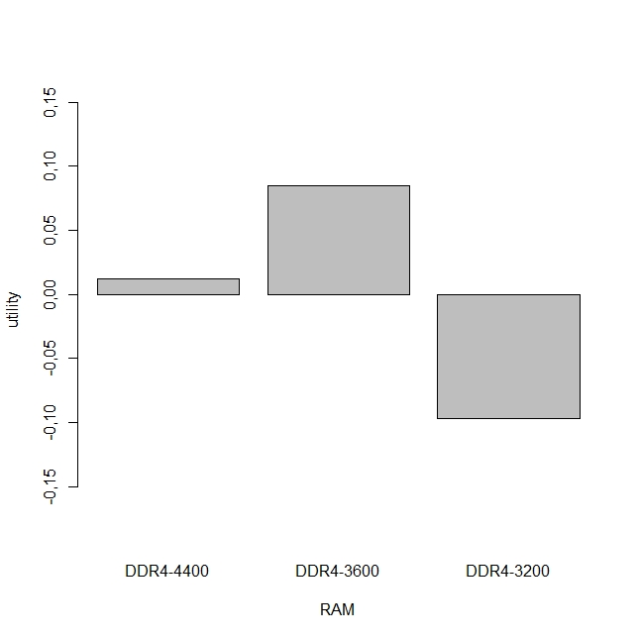
Utility of RAM : DDR4-3600 is much impactful.

Slide 6
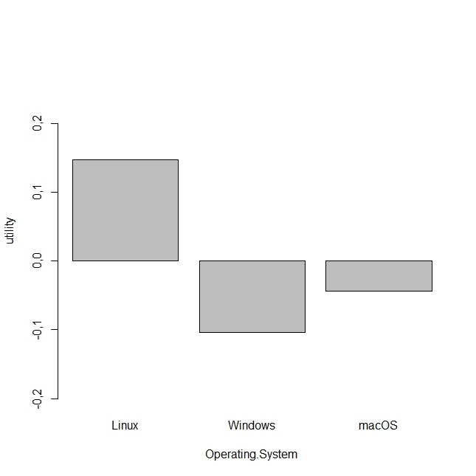
Utility of Operating System: Linux is preferable

Slide 7
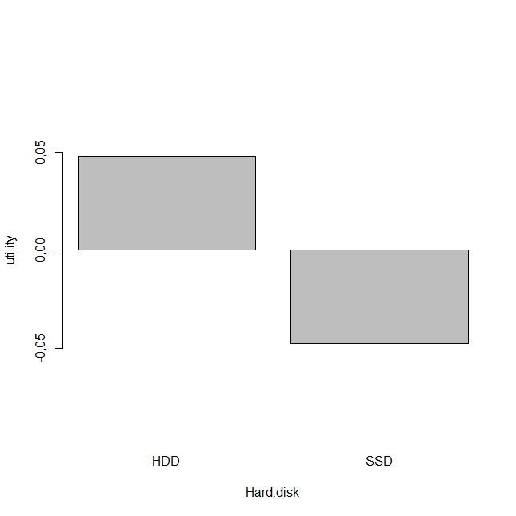
Utility of Hard Disk: HDD is preferable to invest on

