Slide 1

COVID-19
- 21st Century’s Pandemic
Submitted by
Tanu Roy, Sharran Baskar, Cyril Oliver, Lionel Prince

Slide 2
ABSTRACT
The outbreak of COVID-19 brought social and economic life to a standstill. In this study the focus is on assessing the factors which causes such an outbreak.
The objective is to analyze the data through quantitative measurements such as total number of confirmed cases, recovered cases, deaths/1M and many more.
Having an enhanced understanding of this data can help to make decisions on critical issues, such as lifting social distancing measures, lockdowns and reopening businesses.

Slide 3
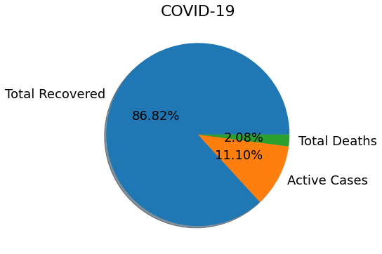
WORLDWIDE COVID CASES ANALYSIS
DATASET SOURCES:
Towards data science
Kaggle
Dataworld
From the above analysis Mortality rate is low when compared to Recovery rate which relatively high.

Slide 4
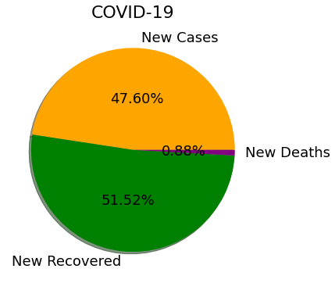
WORLDWIDE NEW COVID CASES ANALYSIS
Relatively the number of newly recovered cases is higher than newly affected cases
The number of new deaths is one percent of all the total affected cases
Total cases = New recovered + New cases + New Deaths
Last updated data by 12th May

Slide 5
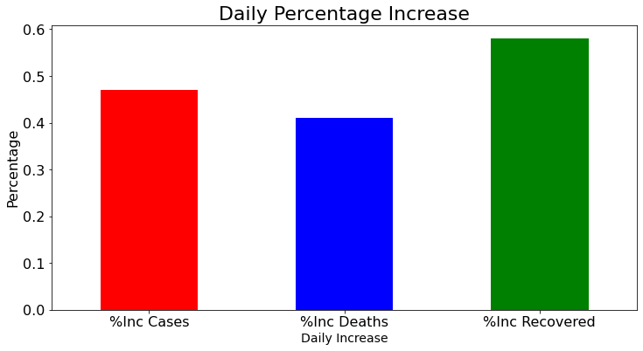
WORLDWIDE
The positive percentage indicates daily growth of pandemic wave.
%Inc Recovered > %Inc Cases
Indicates the improvement in medical facility worldwide.
Last updated data by 12th May

Slide 6
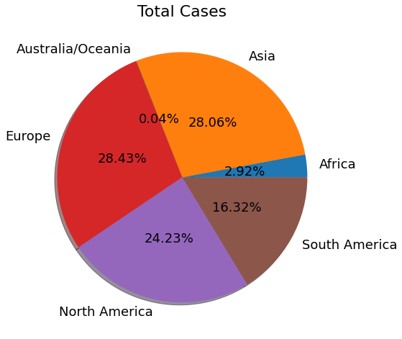
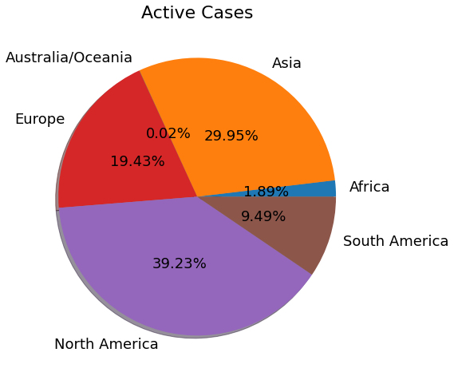
WORLDWIDE CONTINENT WISE TOTAL CASES VS ACTIVE CASES
Lowest Total Cases – Australia Continent
indicates best governance and awareness among people
Highest Total Cases – Europe & Asia
indicates poor governance – improper lockdown
Lowest Active Cases – Australia Continent
indicates best medical facilities
Highest Active Cases – North America & Asia
indicates poor medical facilities

Slide 7
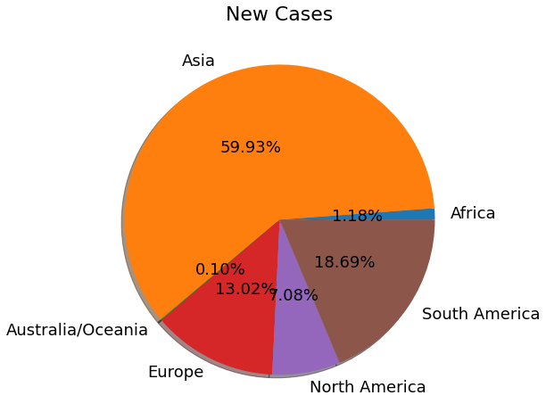
WORLDWIDE CONTINENT WISE NEW CASES ANALYSIS
The highest vs lowest new cases continent wise
Lowest New Cases:
Australia records the lowest number of new cases which indicates they got better containment policies and governance which enables their economy to perform on a regular basis
Highest New Cases:
Asia holds the record for the highest number of newly recorded cases which indicates they need better containment policies such as strict lockdown & social distancing policies should be maintained

Slide 8
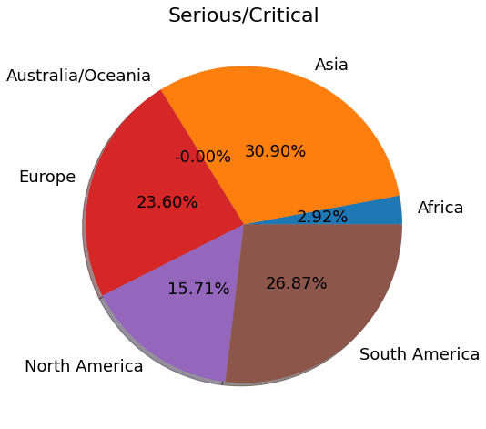
WORLDWIDE CRITICALLY AFFECTED CONTINENT ANALYSIS
Highest Critical Cases:
Asia & South America holds the record for the highest number of critically recorded cases and are struggling to control the spread of covid which indicates deficiency of medical facilities like – no. of beds, ventilators, oxygen supply, etc.

Slide 9
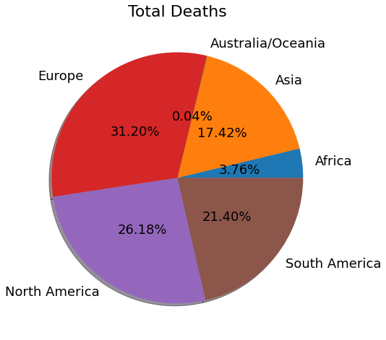
CONTINENT WISE TOTAL DEATH
Highest Total Deaths: Europe & North America
Across the globe, Europe and North America where the first continents to fall victim to the pandemic after China(first wave).
Unknowing the nature of virus, people were unaware of precautions, treatments and medical support.

Slide 10
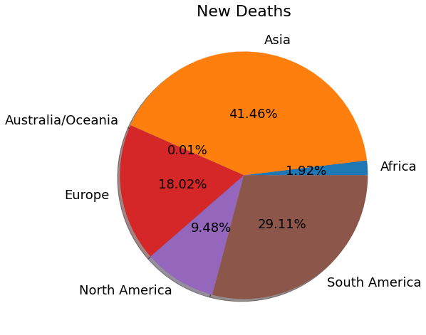
CONTINENT WISE NEW DEATH
Highest Total New Deaths:
Asia & South America holds the record for the highest recorded new deaths due to covid which indicates failure of the health care system and government policies the second wave is more aggressive than the first wave

Slide 11
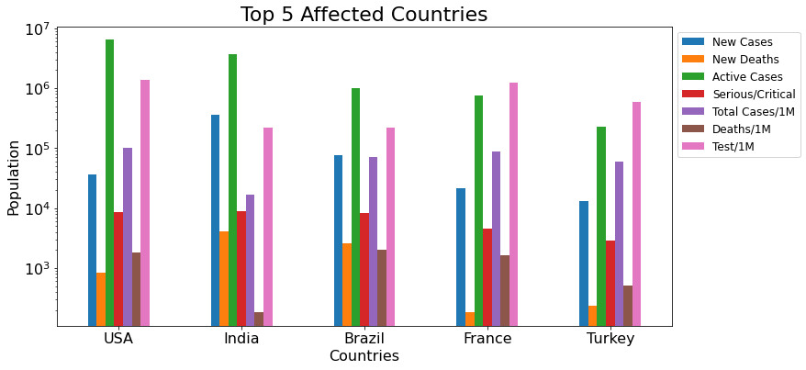
Countries
Highest Active Cases – India & USA
Highest New Cases – India
Highest Test/1M – USA & France
Highest Deaths/1M – USA, Brazil, France
All the 5 countries have considerably equal number of Total Cases/1M, which makes them all equally affected by pandemic.

Slide 12
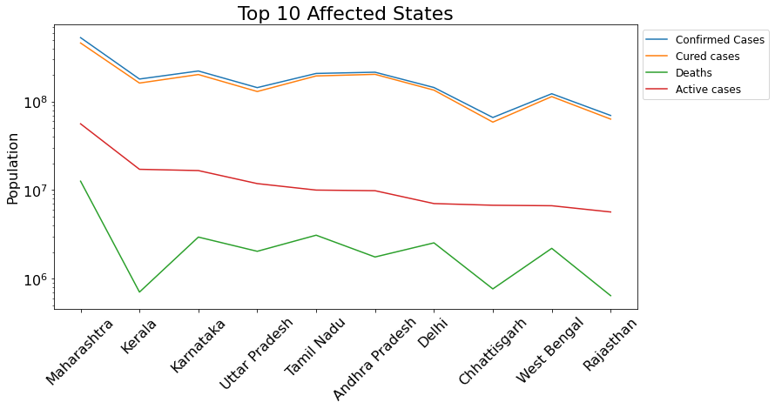
COVID ANALYSIS OF INDIA (STATE WISE)
From the above graph Maharashtra holds the highest affected covid cases followed by Karnataka ,Kerala, Uttar Pradesh, Tamil Nadu etc..

Slide 13
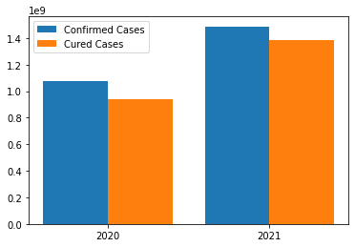
Year-wise Confirmed vs cured
COVID ANALYSIS OF INDIA YEAR WISE
From the given bar graph we can conclude that India had less impact during the first wave of COVID due to proper counter measures like lock down and social distancing
The second wave had a really high impact as the virus got mutated with new attributes
Although the confirmed cases has shot up in year 2021 the cured cases are also getting higher
Treatments for COVID seems to be more effective

Slide 14
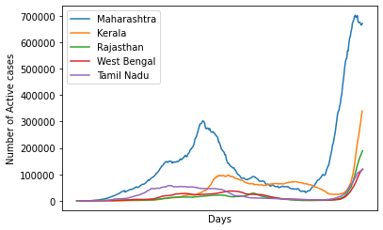
Active Cases Day-wise
ACTIVE COVID CASES (STATE wise)
The spikes start rising early for Maharashtra and Tamil Nadu on the first wave.
Kerala peaks a bit late in the first phase and they are having a hard time to control the situation
After counter-measures like lockdown we can see a drop in the curve
The second wave has impacted Maharashtra in a drastic way.

Slide 15
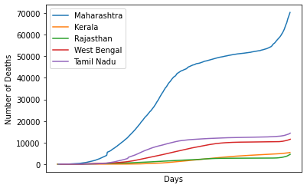
Death Cases Day-wise
DEAth RATE DUE TO COVID(STATE WISE)
Due to the high number of active cases in Maharashtra there is also high death toll, this is mostly due to lack of medical infrastructure and significantly higher population
The death rate is higher in Tamil Nadu and West Bengal irrespective of less active cases than other states.
Even though when Kerala has higher cases they have managed to keep the death toll to minimum .

Slide 16
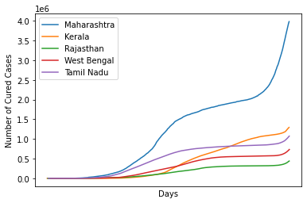
CURED COVID CASES (STATE wise)
Maharashtra, holds the highest number of recovery rate as well as active rate
The recovery rate is second highest in Kerala followed by Rajasthan
Recovery rate is relatively less in Tamil Nadu irrespective of less active
cases than other states.

Slide 17
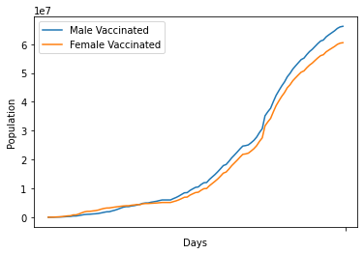
OVERALL VACCINATION COUNTRY WISE(INDIA)
From the above graph it is clear that both male and female individuals are getting vaccinated at the same rate.
This implies that their is a good level of awareness among people and the government is providing the essential vaccination to control the spread of disease

Slide 18
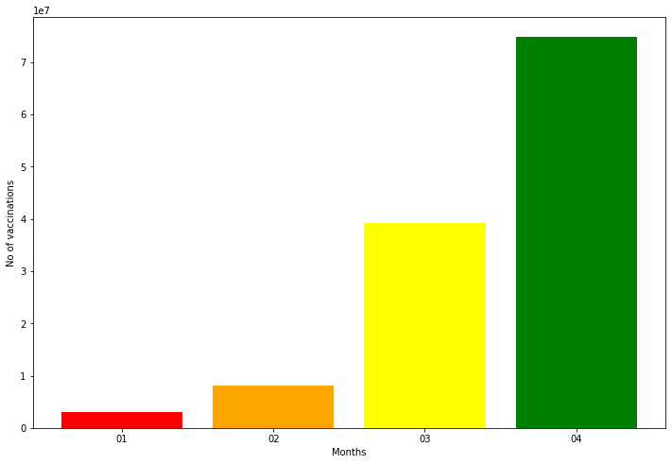
MONTH WISE VACCINATION RATE
The above graph denotes the drastic increase in vaccination rate over the past couple of months.
India has fully vaccinated only 1.8% of its 1.38 billion population till April 2021, while the US has already vaccinated near 30% of its population which implies India should provide better vaccination policies

Slide 19
CONCLUSION:
The spiraling and pervasive COVID-19 pandemic has distorted the world’s thriving economy in unpredictable and ambiguous terms.
While the unprecedented situation has caused a great damage to the economy, especially during periods of lockdown, the nation will have to work its way through it, by introduction of fiscal measures, countries in which lockdowns are essential to control the spread rate are advised to remain under lockdown
The economic activity must begin gradually after screening of the labor force. Strict preventive measures should be implemented by the industry in order to safeguard the health of the workers and people who can work from home are advised to WFH until the spread rate decreases.

Slide 20


