Slide 1


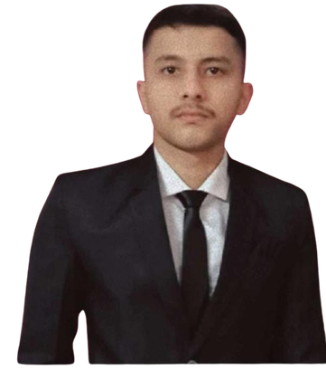
TENSOR FLARE
Mentor : Mr. Abhishek Thapa
TEAM
BIZ
TANISH OHRI ( LEADER )
STUDENT ID : 24151282
ROLE : BACKEND & AI/ML
BOY
SHIVENDRA RAWAT
STUDENT ID : 2105416
ROLE : DATA & DATABASE
SOHIT SINGH RAWAT
STUDENT ID : 2105434
ROLE : FRONTEND & DESIGN

Slide 2
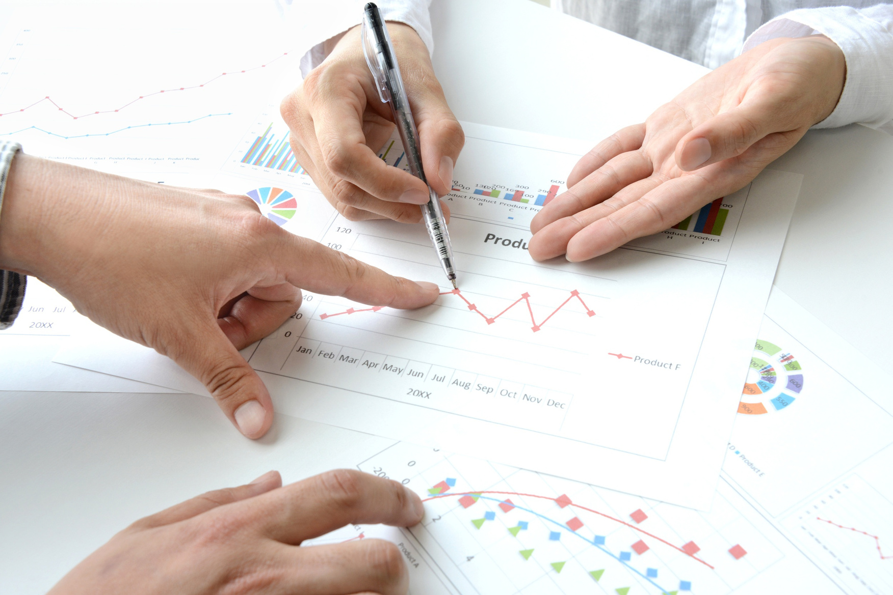
INTRO
DUCTION
An intelligent system designed to help businesses understand, analyze, and improve their performance.
Uses Data Analytics, Machine Learning, Deep Learning, NLP, and LLMs.
Provides:
  Business dashboard
  Data analysis
  Predictions and forecasting
  Customer interest analysis
  Trend predictions
  Business recommendations
Accepts business data such as:
  Sales and revenue
  Profit and expenses
  Products and customers
  Regions and locations
  Marketing data
  Customer feedback
  Historical business data

Slide 3

PROBLEM
STATEMENT
  Businesses generate large amounts of data but may not know how to use it effectively.
  Manual analysis of sales, expenses, customers, and marketing data is time-consuming.
  Traditional dashboards mainly display data but do not explain what actions should be taken.
  Difficult to identify:
  Sales trends
  Customer interests
  Profitable products
  Weak-performing regions
  Future demand
  Customer feedback is often available but not properly analyzed.
  Business owners may need multiple tools for at a place:
    Analytics
    Prediction
    Analysis Forecasting
    Alerts

Slide 4
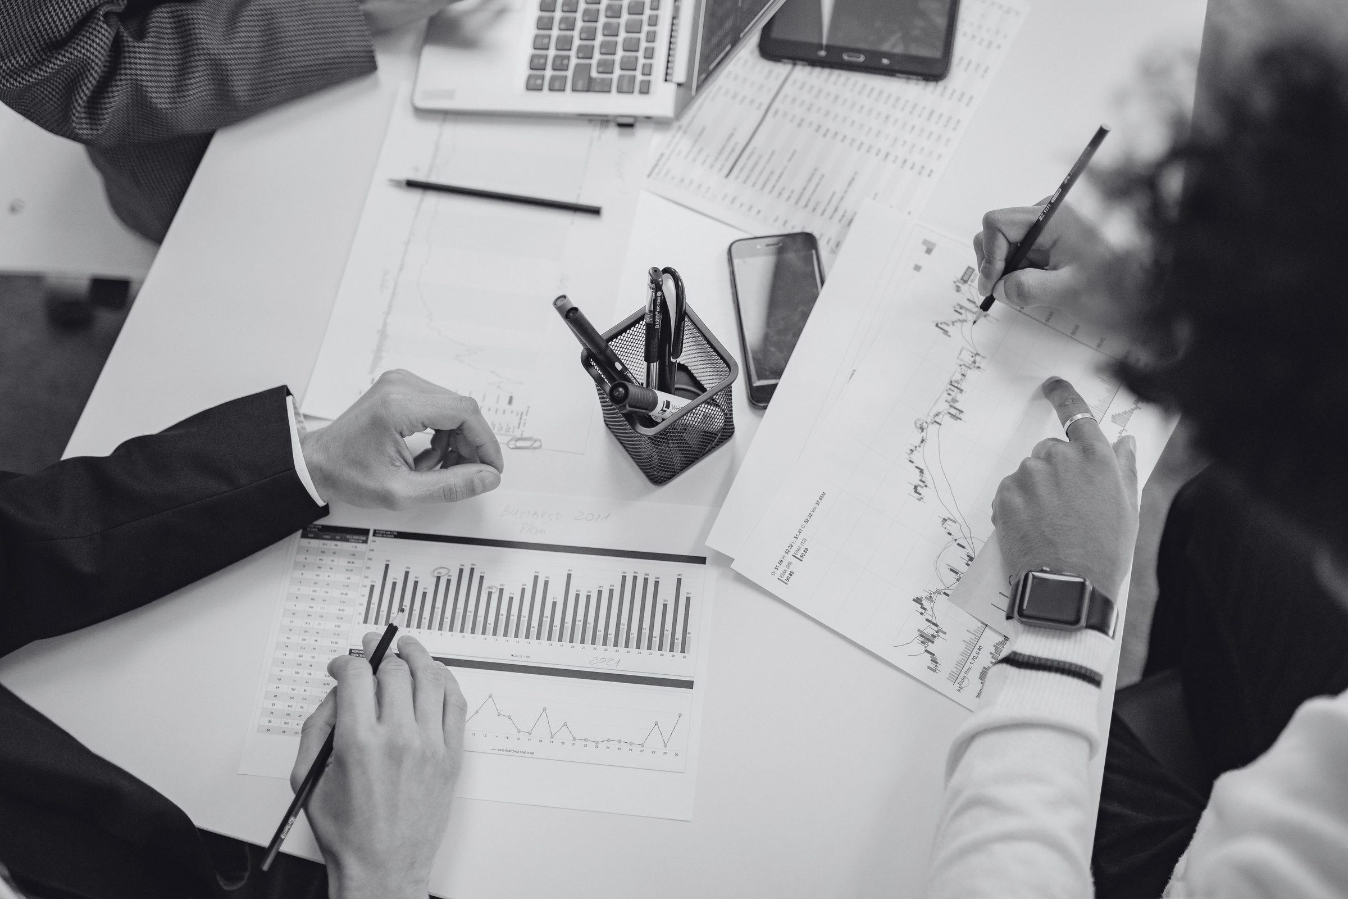
  📊 Analyze business data automatically.
  📈 Create an interactive business dashboard.
  🤖 Predict future sales, revenue, and demand using ML.
  👥 Analyze customer behavior and interests.
  📉 Detect important business trends and unusual changes.
  💡 Generate data-driven business recommendations.
  🔐 Store and manage business data securely using Supabase/PostgreSQL.
OBJECTIVES

Slide 5

1. Business Intelligence (BI)
  Traditional BI systems use dashboards and reports for business analysis.
  Mainly focus on visualization and historical data.
2. Machine Learning
  ML techniques can be used for:
    Sales prediction
    Customer segmentation
    Demand forecasting
    Churn prediction
LITERATURE
REVIEW

Slide 6
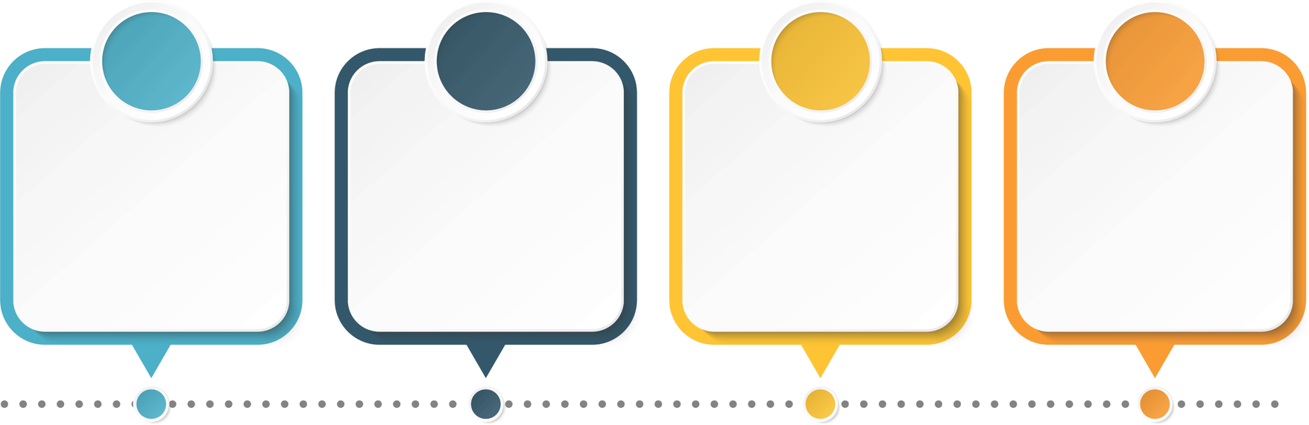
PROPOSED
METHODOLOGY
Step 1 — Data Collection
Collect:
  Sales data
  Revenue/profit
  Expenses
  Products
  Customers
  Regions
  Marketing data
  Customer feedback
  Historical data
Step 2 — Data Processing
Using:
  Python
  Pandas
  NumPy
  SQL
Perform:
  Data cleaning
  Missing-value handling
  Data transformation
  Feature engineering
Step 3 — Data Analysis
Analyze:
  Sales performance
  Profitability
  Expenses
  Products
  Regions
  Customer behavior
  Marketing performance
Step 4 — ML
Build models for:
  Sales forecasting
  Demand prediction
  Customer segmentation
  Revenue prediction

Slide 7

Data Science
  Pandas
  NumPy
  Matplotlib
  Plotly
  Scikit-learn
Frontend
Web:
  HTML
  CSS
  JavaScript
Backend
  Flask
  Database
TECHNOLOGY STACK
ML / DL
  Scikit-learn
  PyTorch
  NLP
Programming
  Python
  JavaScript
  HTML
  CSS

Slide 8
SYSTEM ARCHITECTURE
┌─────────────────────────────────────────┐
│ USER / ADMIN │
└─────────────────────────────────────────┘
│
▼
┌─────────────────────────────────────────┐
│ WEB FRONTEND │
└─────────────────────────────────────────┘
│
▼
┌─────────────────────────────────────────┐
│ DATA RETRIEVAL │
└─────────────────────────────────────────┘
│
▼
┌─────────────────────────────────────────┐
│ FLASK BACKEND │
└─────────────────────────────────────────┘
│
▼
┌─────────────────────────────────────────┐
│ SUPABASE POSTGRESQL │
└─────────────────────────────────────────┘
│ │
▼ ▼
┌──────────────────┐ ┌──────────────────┐
│ ML PREDICTIONS │ │ ANALYTICS ENGINE │
└──────────────────┘ └──────────────────┘
│ │
▼ ▼
┌──────────────────┐ ┌──────────────────┐
│ PREDICTIONS │ │ DASHBOARD │
└──────────────────┘ └──────────────────┘

Slide 9
EXPECTED OUTCOME
  Provide a centralized business dashboard.
  Automatically analyze historical business data.
  Predict future sales and demand.
  Identify customer interests and segments.
  Identify important business trends.
  Highlight potential business problems.
  Generate personalized business recommendations.
  Help users make data-driven decisions.
Example Output
"Sales increased by 14% this month, mainly due to Product A and the North region. Customer feedback shows high satisfaction with Product A. Based on current trends, sales are expected to increase next month. Consider increasing marketing investment in this product and region."

Slide 10
FUTURE SCOPE
  📊 Automatically analyze business data and generate meaningful insights.
  📈 Provide interactive dashboards to monitor business performance.
  🤖 Predict future sales, revenue, and product demand using machine learning.
  👥 Analyze customer behavior, purchasing patterns, and interests.
  📉 Identify business trends, sales fluctuations, and unusual activities.
  💡 Generate intelligent, data-driven business recommendations.
  🔮 Improve forecasting accuracy by machine learning models.
  📦 Optimize inventory and production planning based on predicted demand.
  🔐 Securely store and manage business data using Supabase and PostgreSQL.

Slide 11
  Business Intelligence – ScienceDirect
  Machine Learning for Time Series Forecasting – Springer
  Customer Segmentation using K-Means – IEEE Xplore
REFERENCES

Slide 12

THANK YOU

