Slide 1
Amazon Sales Analytics Dashboard
Submitted by:- Tanuja Holkar
Internship:- Technosignia Software Institute
Tools:- Power BI, Power Query, DAX

Slide 2
Project Objective
Analyse Amazon sales data using Power BI.
Clean and transform raw sales data using Power Query.
Build an interactive and user-friendly sales dashboard.
Generate business insights and recommendations to improve sales performance.
Support data-driven decision-making through visual reports and dashboards.

Slide 3
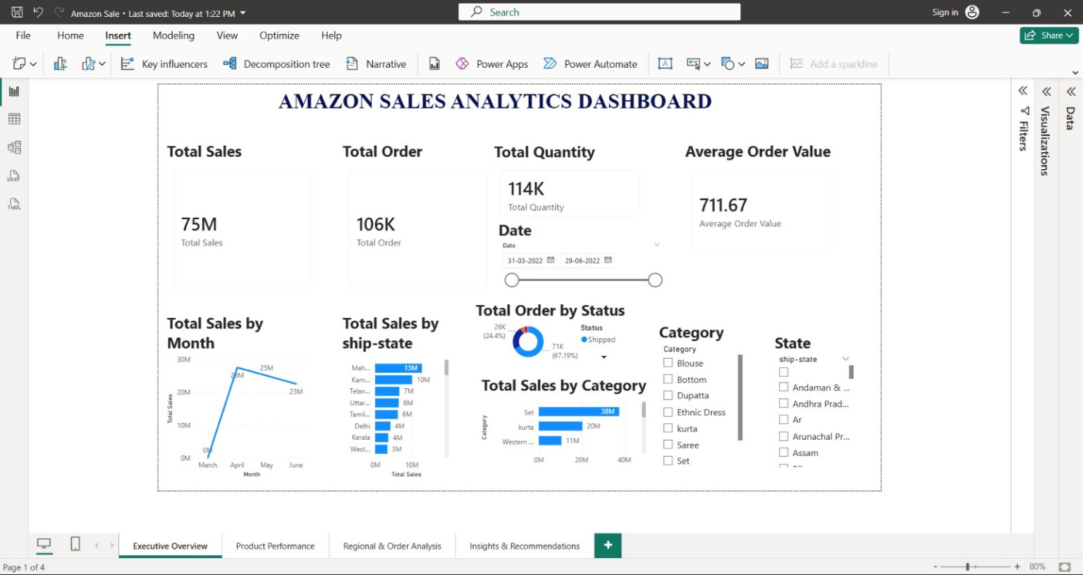
Executive Overview
KPIs and overall sales performance.
• Total Sales: 75M
• Total Orders: 106K
• Total Quantity:114K
• Average Order Value:711.67
• April highest sales; Maharashtra top state

Slide 4
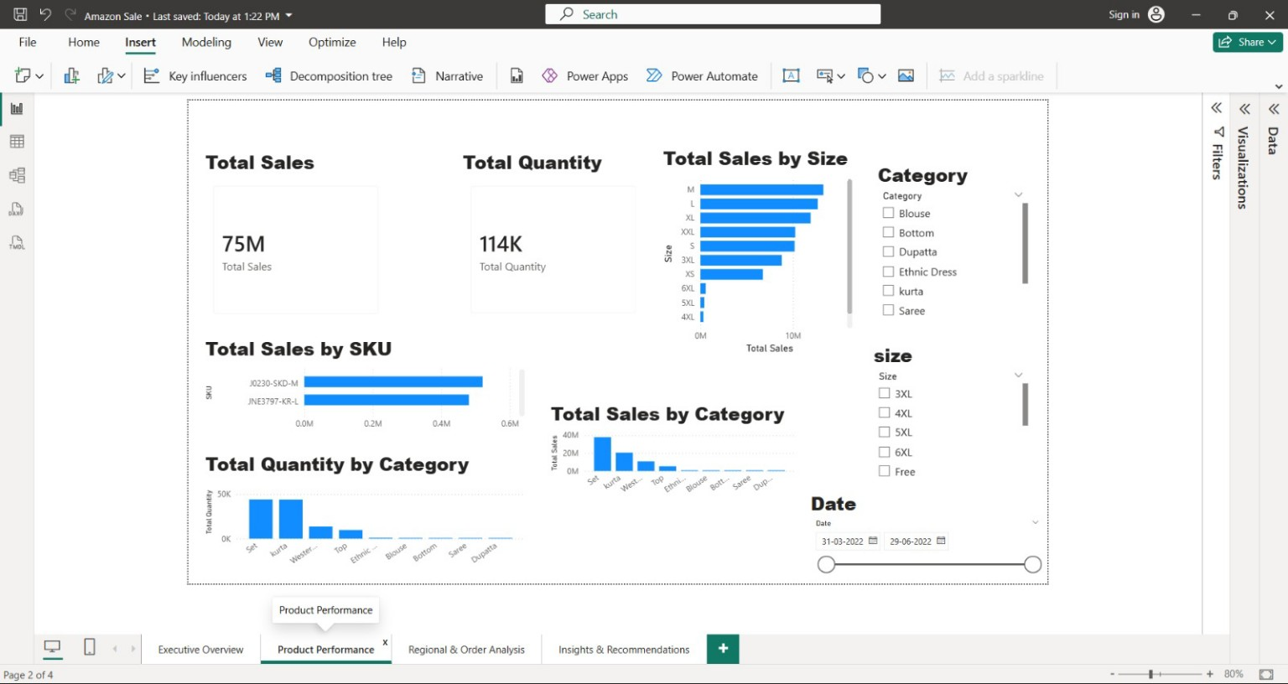
Product Performance
Category, SKU and Size analysis.
Set category leads sales.
Medium/Large sizes perform best.
Top SKU contributes highest sales.

Slide 5
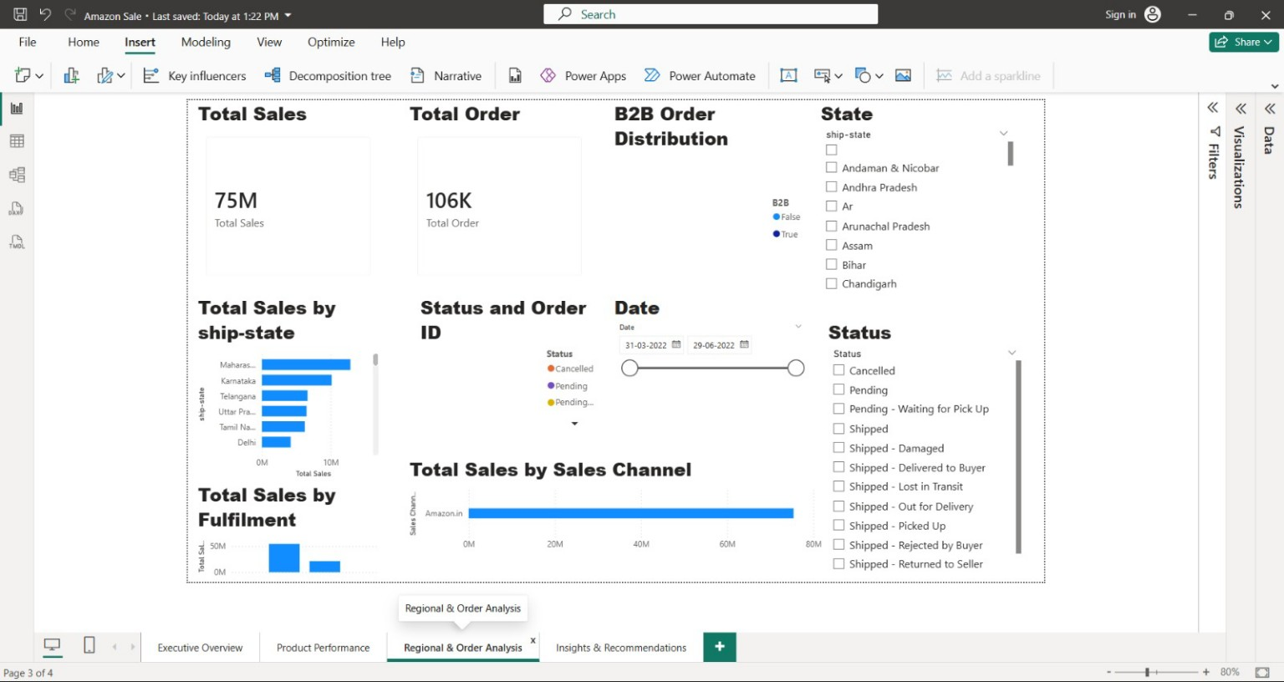
Regional & Order Analysis
State-wise and fulfillment analysis.
• Amazon.in is primary sales channel.
• Shipped orders dominate.
• Monitor cancelled/pending orders.

Slide 6
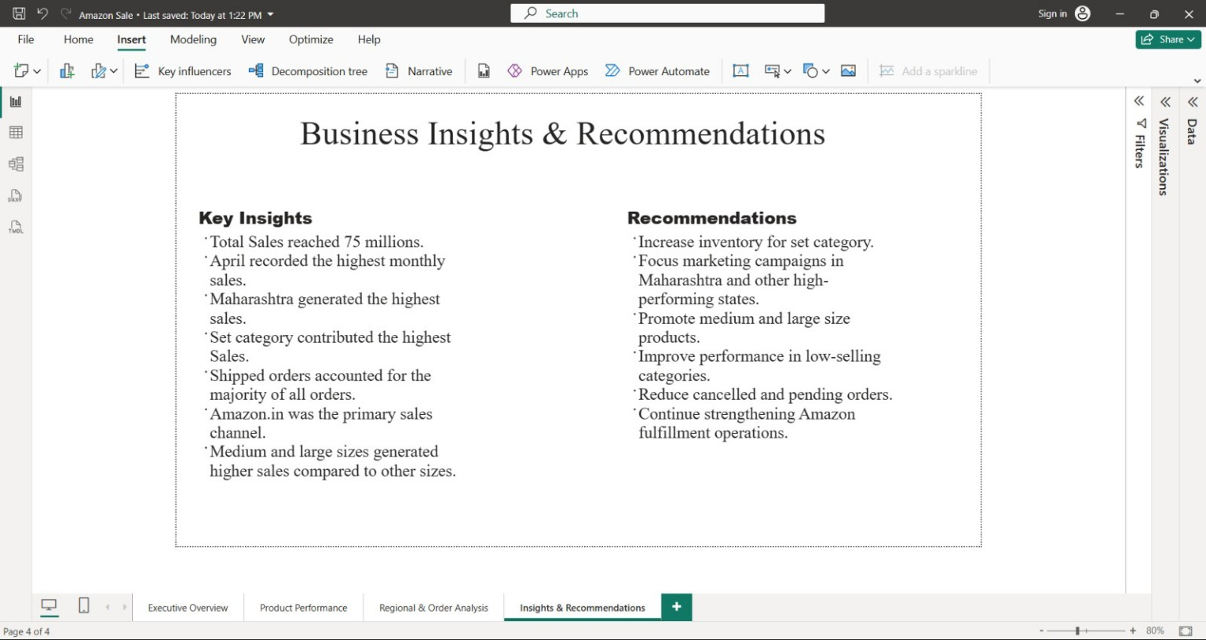
Business Insights & Recommendations
Key findings and business actions
• Sales reached 75M.
• Focus inventory on Set category.
• Increase marketing in Maharashtra.
• Improve low-selling categories.
• Reduce cancelled orders.

Slide 7
Conclusion
Successfully analysed the Amazon Sales dataset using Power BI.
Created an interactive dashboard with KPIs, charts, and slicers.
Identified key sales trends, top-performing categories, and high-performing states.
Business insights and recommendations were provided to support better decision- making.
This dashboard enables stakeholders to monitor sales performance efficiently and make data-driven business decisions.

