Slide 1
IoT for Waste Management:
By
HackerLoL
Tanuj Chaudhuri (AIML) Ambar Roy (AIML)
Nilanjan Bhattacharya (AIML)
Tushsrika Mandal (IOT CSBT)

Slide 2
Introduction:- A waste management system or waste disposal is a streamlined process that organizations use to dispose of, reduce, reuse, and prevent waste. It is an approach where companies implement comprehensive strategies to efficiently manage wastes from their origin until their final disposal.

Slide 3
Objective:- - MINIMIZE THE PRODUCTION OF WASTE - REDUCE POLLUTION EFFECTS - PROTECT GROUNDWATER SOURCES - PROMOTE PUBLIC AWARENESS

Slide 4
Importance:- Waste management reduces the effect of waste on the environment, health, and so on. It can also help reuse or recycle resources, such as; paper, cans, glass, and so on. There is various type of waste management that include the disposal of solid, liquid, gaseous, or hazardous substances. There are many things that need to be taken into consideration when discussing waste management, such as disposal methods, recycling methods, avoidance and reduction methods, and transportation of waste. The process of waste management involves treating solid and liquid waste. During the treatment, it also offers a variety of solutions for recycling items that aren’t categorised as trash.

Slide 5
Data Collection and Analysis:- - Admin can add and modify data related to waste management across different cities. - Admin can rate the cities.

Slide 6
Technology Used:- Software:- - Scripting language for backend development: Python. - Front-end development: HTML, CSS, JavaScript. Hardware:- - Server for hosting the database. - Client devices (computers or tablets) for data input and retrieval.

Slide 7
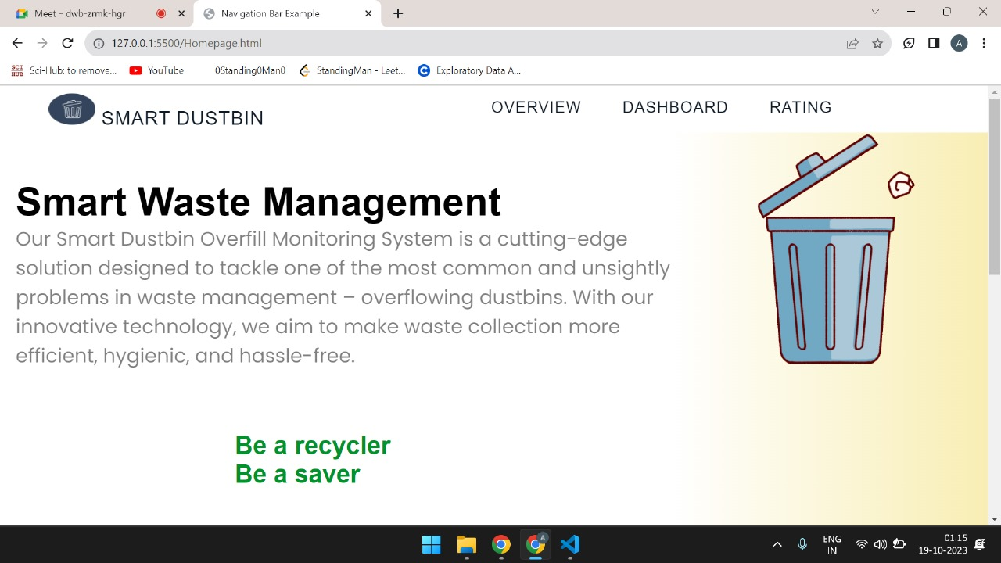
Landing Page Interface:-

Slide 8
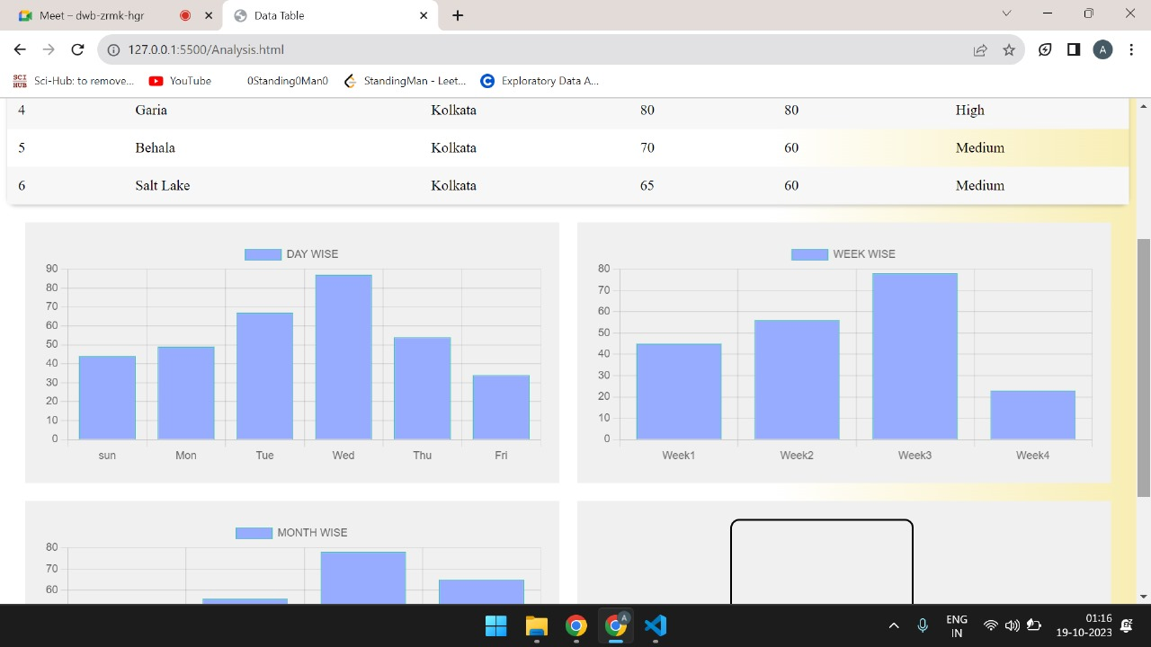
Dashboard:-

Slide 9
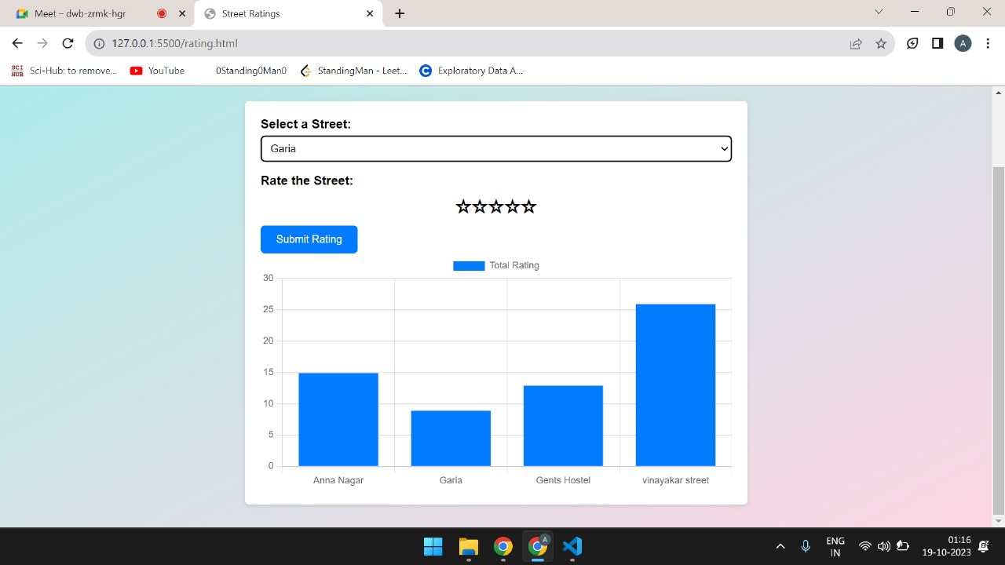
City Ratings:-

Slide 10
THANK YOU

