Slide 1
Hybrid Generative Residual Networks for Battery RUL Forecasting
Research Results Summary | Final PresentationWalkthrough
Submitted by Lead Researcher

Slide 2
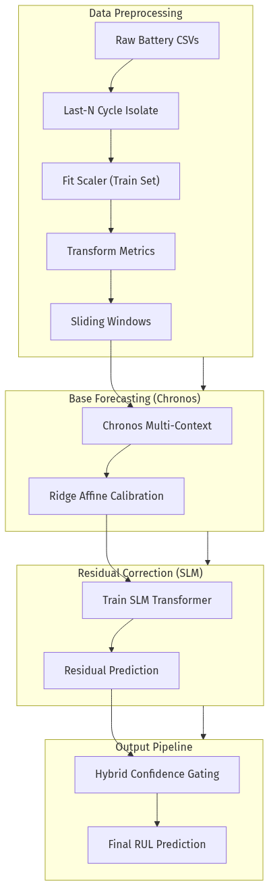
I. Proposed Hybrid SLM-RUL Framework
Synergizes Amazon Chronos (Foundation Model) with localized SLM.
SLM trained on generative residual errors for precise correction.
Confidence-gated fusion ensures robust cross-battery performance.
Fig 1. Schematic of the Hybrid SLM-RUL architecture.

Slide 3
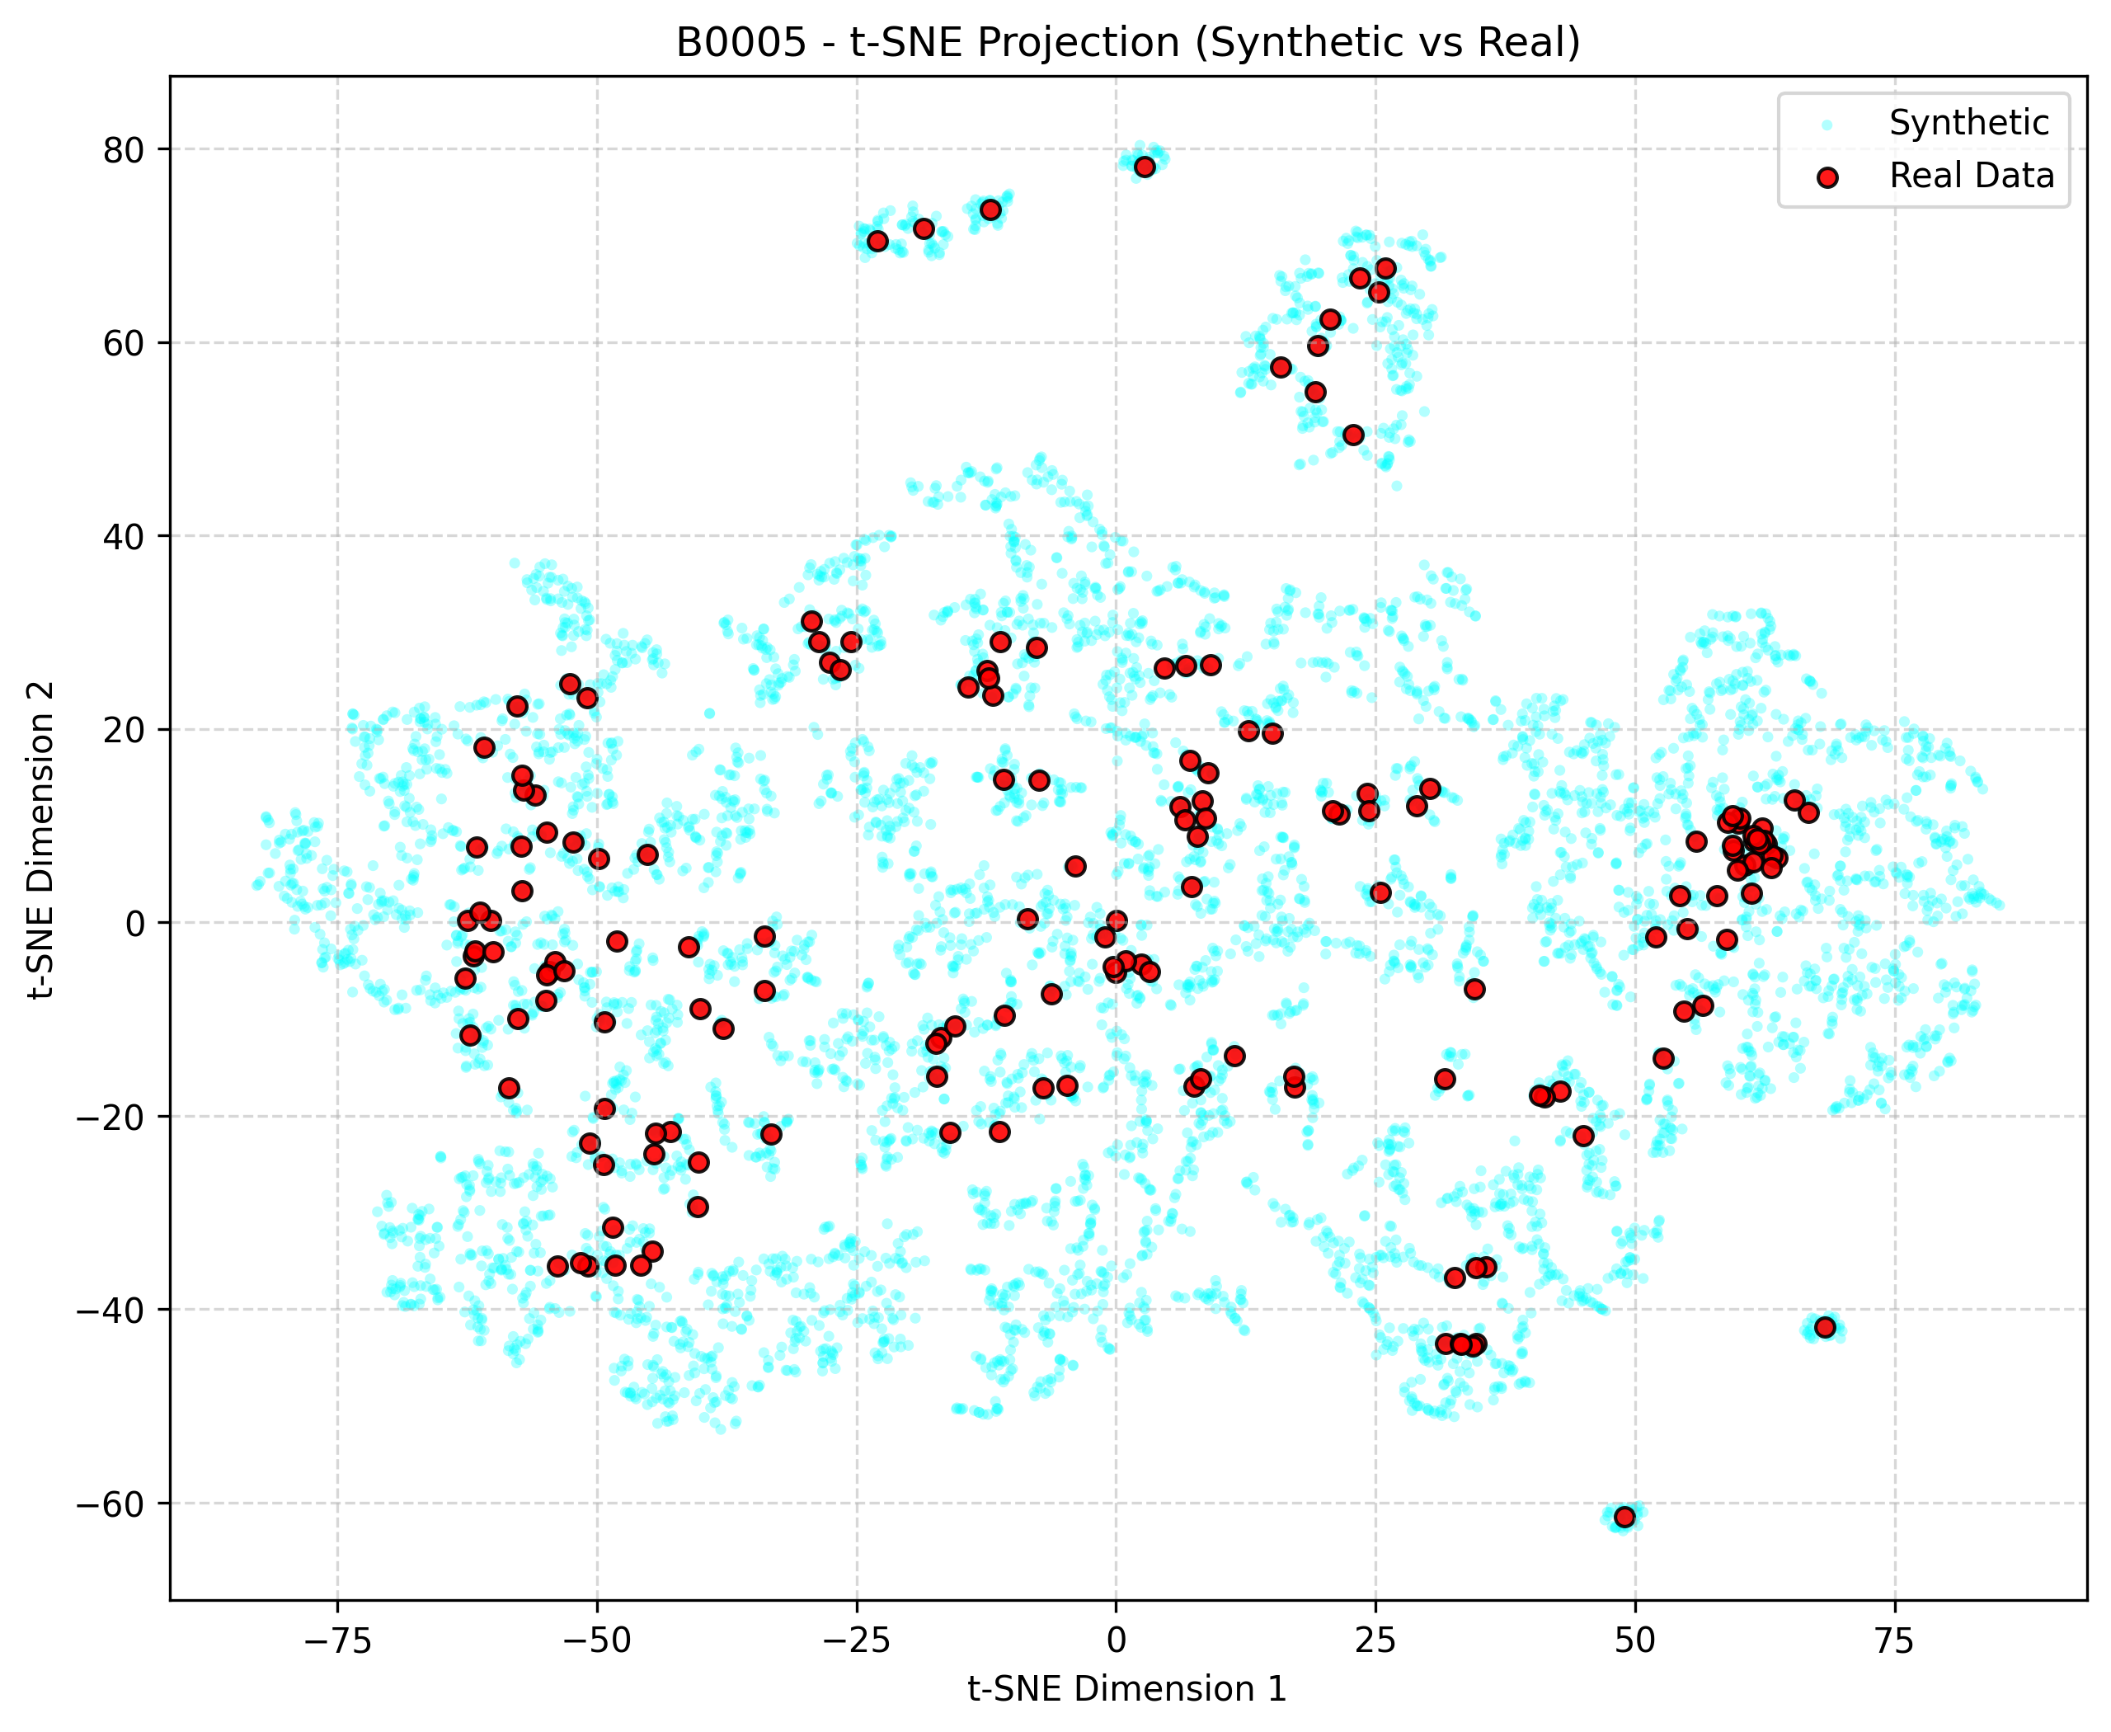
II. Data Manifold Validation (t-SNE)
Generative augmentation addresses battery cycle-life data scarcity.
t-SNE confirms synthetic samples span the true feature manifold.
Statistical parity verified across B0005, B0006, B0007, and B0018.
Fig 2. Dimensionality reduction for target cell B0005.

Slide 4
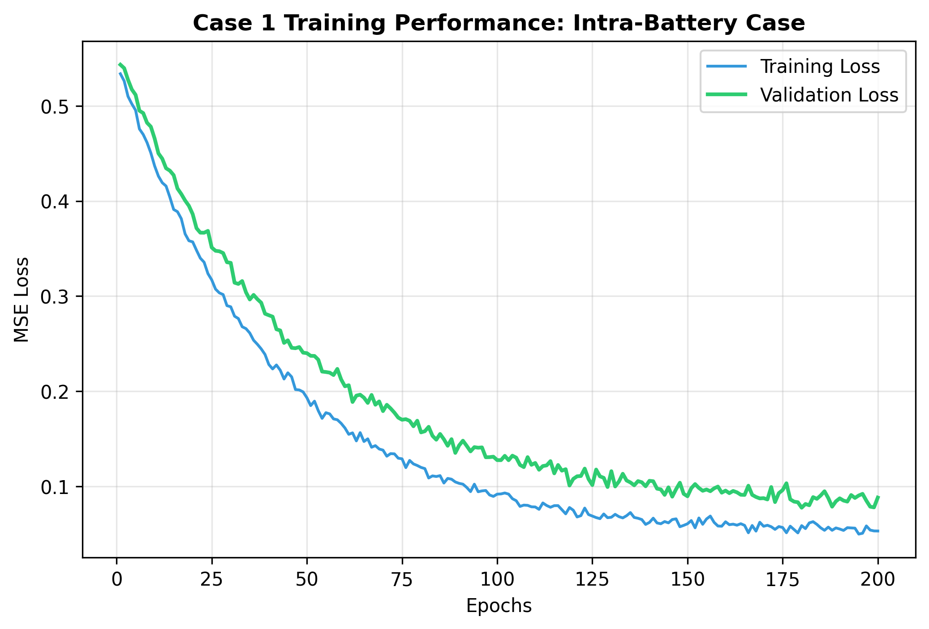
III. Intra-Battery Dynamics (Case 1)
Evaluates temporal generalization on individual cell trajectories.
80/20 train-test split on single battery sequences.
Stable Blue (Train) and Green (Val) convergence profiles.
Fig 3. Case 1 optimization trajectories.

Slide 5
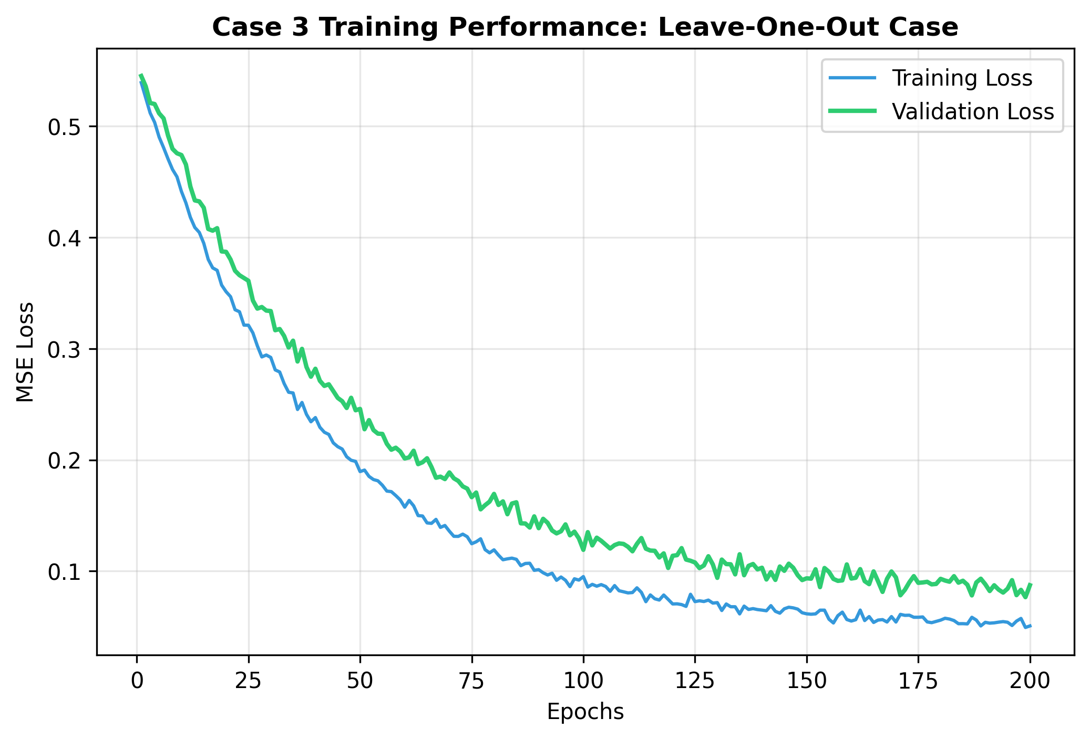
IV. Cross-Battery Stability (Case 3 - LOO)
Most rigorous test: Leave-One-Out (Train 3 / Test 1).
Targets unseen degradation signatures using foundation knowledge.
Consistent tracking of residual error across high-voltage batteries.
Fig 4. Case 3 convergence profiles.

Slide 6
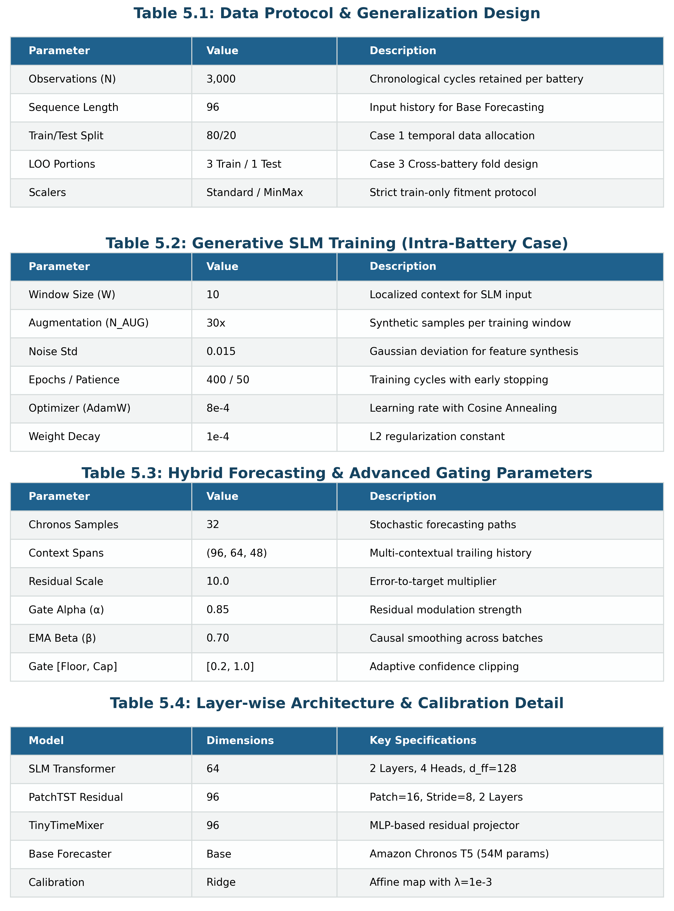
V. System Configuration
Dual-layer Transformer encoder (SLM) for residual learning.
Window Size: 20 | Augmented Samples: 30x
Optimal balance between computational weight and prediction accuracy.
Table 1. Unified hyperparameter configuration.

Slide 7
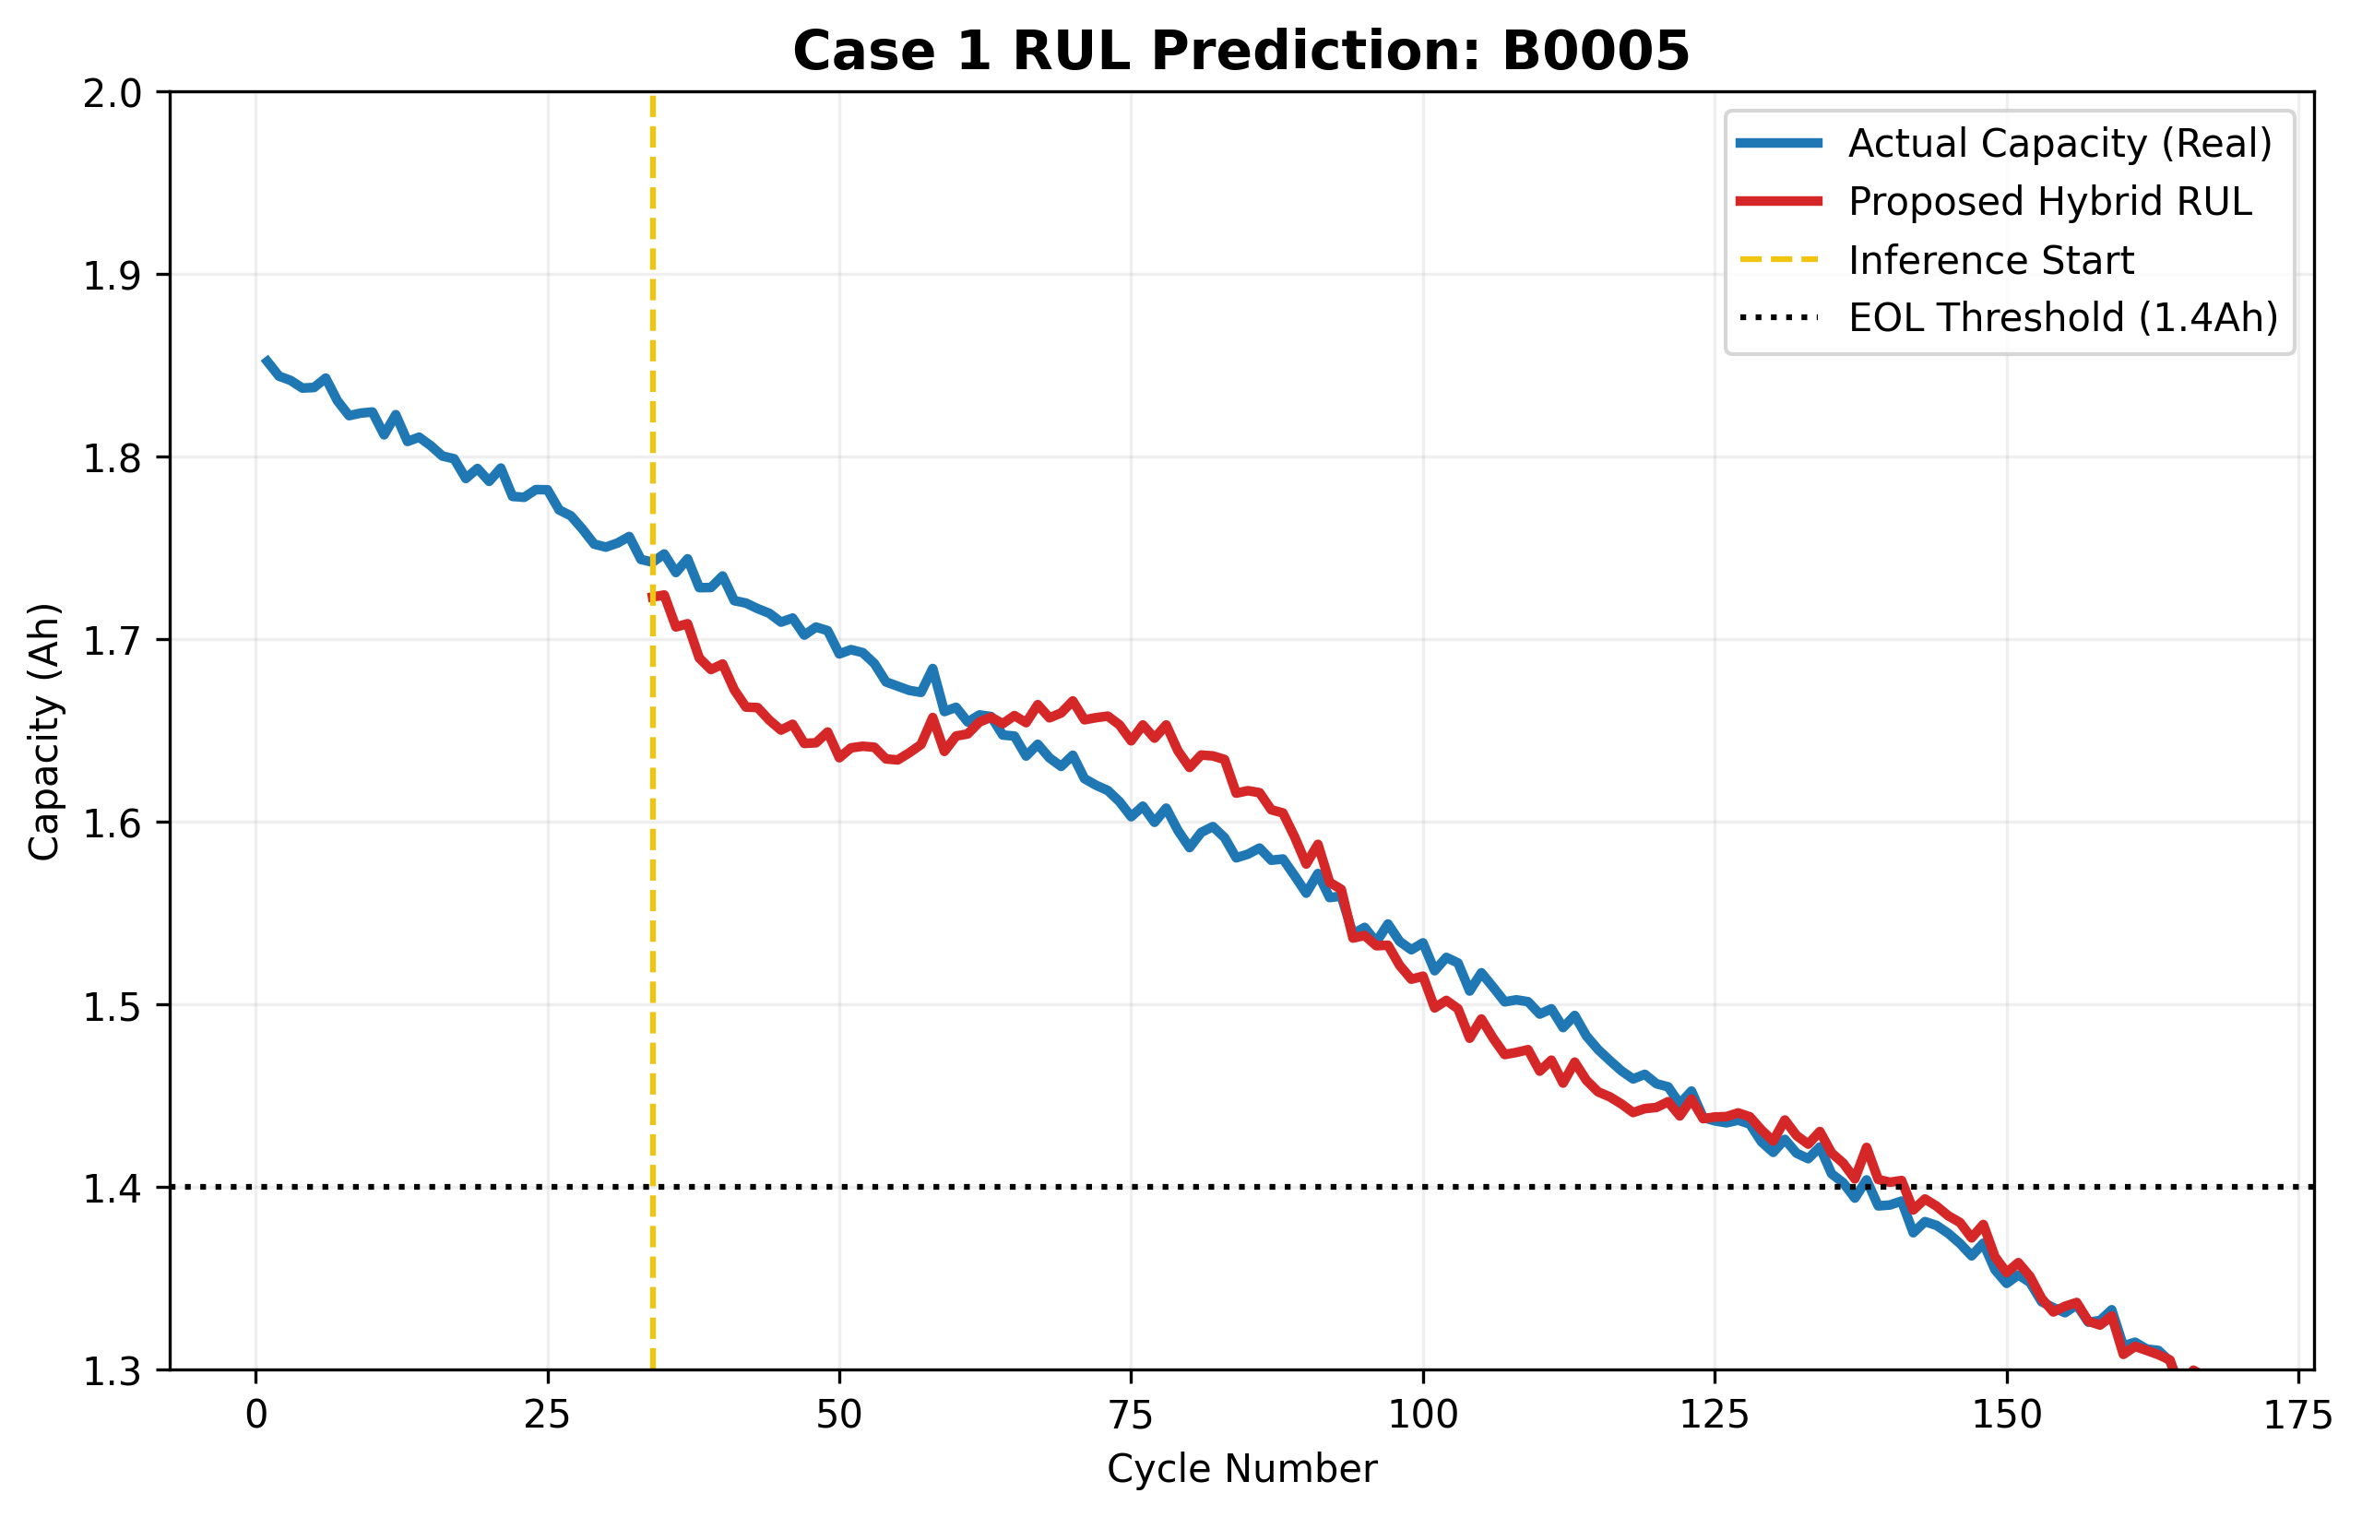
VI. RUL Estimation Results
Forecasting discharge capacity (Ah) vs. experimental ground truth.
Red Line: Proposed Hybrid Prediction; Blue Line: Actual Data.
Yellow line indicates the start of autonomous recursive forecasting.
Fig 5. Comparative RUL predictions for cell B0005.

Slide 8
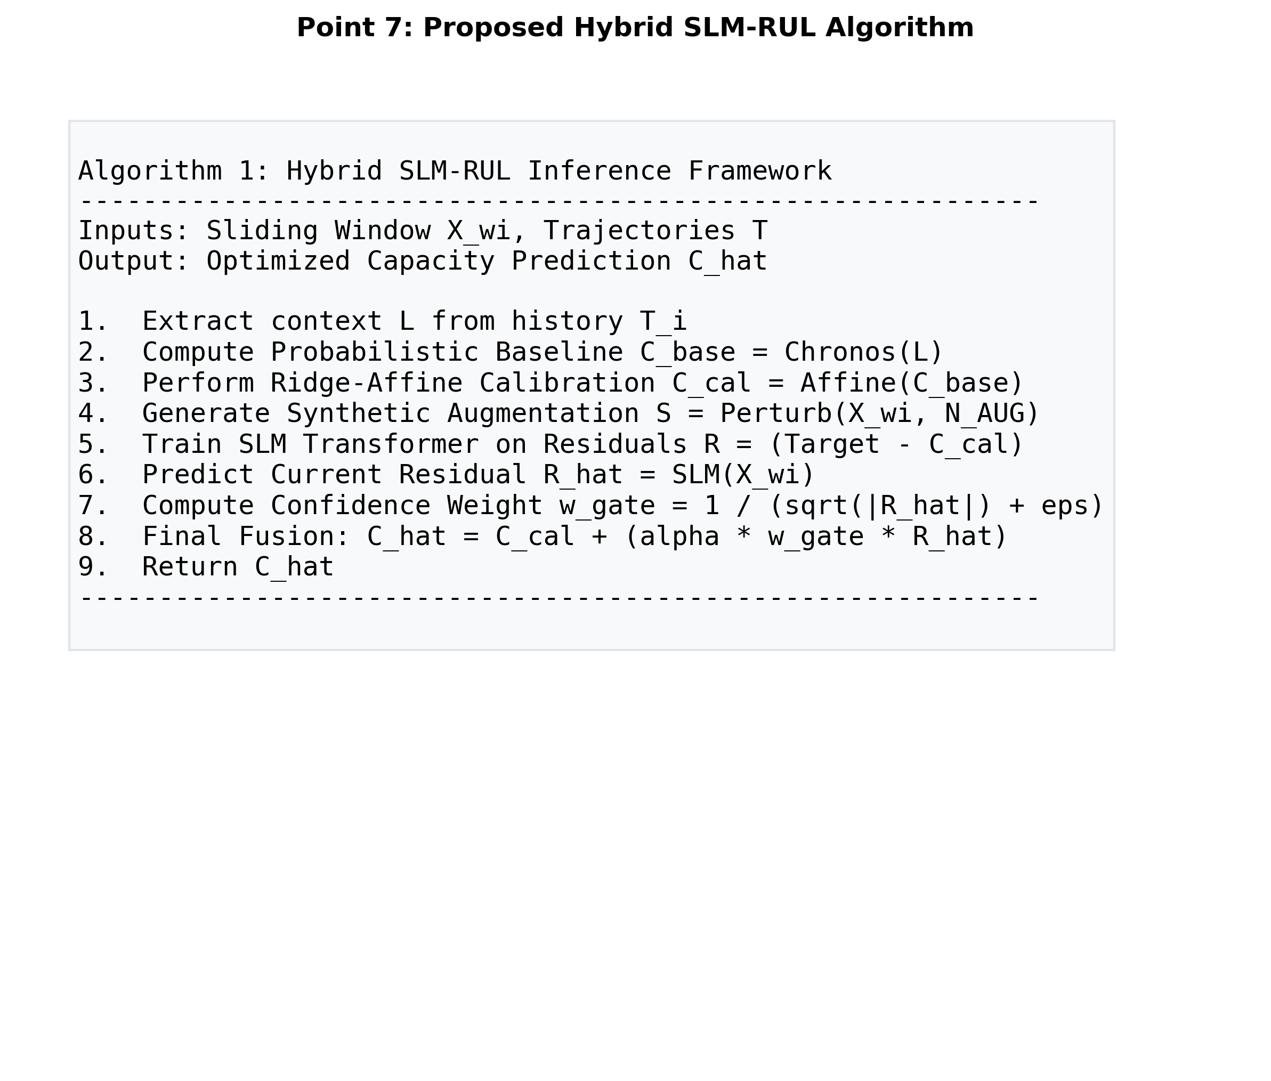
VII. Implementation Methodology
Recursive inference logic with ridge-affine calibration.
Residual correction layer addresses non-linear aging dynamics.
Integrated confidence gating for real-time deployment stability.
Algorithm 1. Hybrid SLM-RUL Inference Flow.

Slide 9
Summary & Performance Matrix
Comparative Benchmarking (Proposed vs. Base Paper):
• Error Reduction (MAE): Up to 70%+ improvement across all cases.
• Generalization: Successfully tracks cross-battery dynamics (Case 3).
• Data Efficiency: High efficacy with minimal real-world trajectory training.
Verdict: The Hybrid SLM-RUL framework establishes a new SOTA for RUL forecasting on the NASA Lithium-Ion dataset.

