Slide 1

BEE Continuous Evaluation – II
Learn Sphere
Submitted to : Submitted by :
Mrs. Gurtej Kaur Tanuj Thour 2310991147
Aditya Kochhar 2310991511
Jashanpreet Kaur Aujla 2310991522
Parul Rana 2310992333

Slide 2
Table of Content
Introduction
Objectives
Problem Statement
Features
Future scope
References
Conclusion

Slide 3
Introduction
The proposed project is a central platform where students and teachers can upload, manage, and share study materials in one organized place. In many colleges, notes and assignments are shared on WhatsApp, Google Drive, or emails, which makes it hard for students to find the right material when they need it. This platform solves that problem by keeping all study resources arranged properly by semester, subject, and course for quick and easy access.
The system includes several features to make it faster and more helpful. Redis caching helps the website to load study materials quickly, and WebSockets send real-time notifications to students when new notes are uploaded. Students can also use advanced search and filters to find notes easily. Features like file preview, download history, dark mode, reporting broken files, and version control make the platform more user-friendly.
The platform also provides secure login, role-based access, and session management to keep the system safe. Admins can upload and update materials, see activity logs, and view useful statistics through an analytics dashboard. Students can simply view or download the notes they need without confusion.
By keeping all resources in one place and adding good tools that improve speed, security, and convenience, this platform makes digital learning easier and more organized for everyone.

Slide 4
Objectives
To provide easy access to course materials for students and teachers.
To create a secure storage system with role-based access (admin & student).
To enable quick upload, download, and search functionality.
To maintain a well-structured repository of academic resources.
To promote digital learning and collaboration.
To provide instant updates without page refresh.

Slide 5
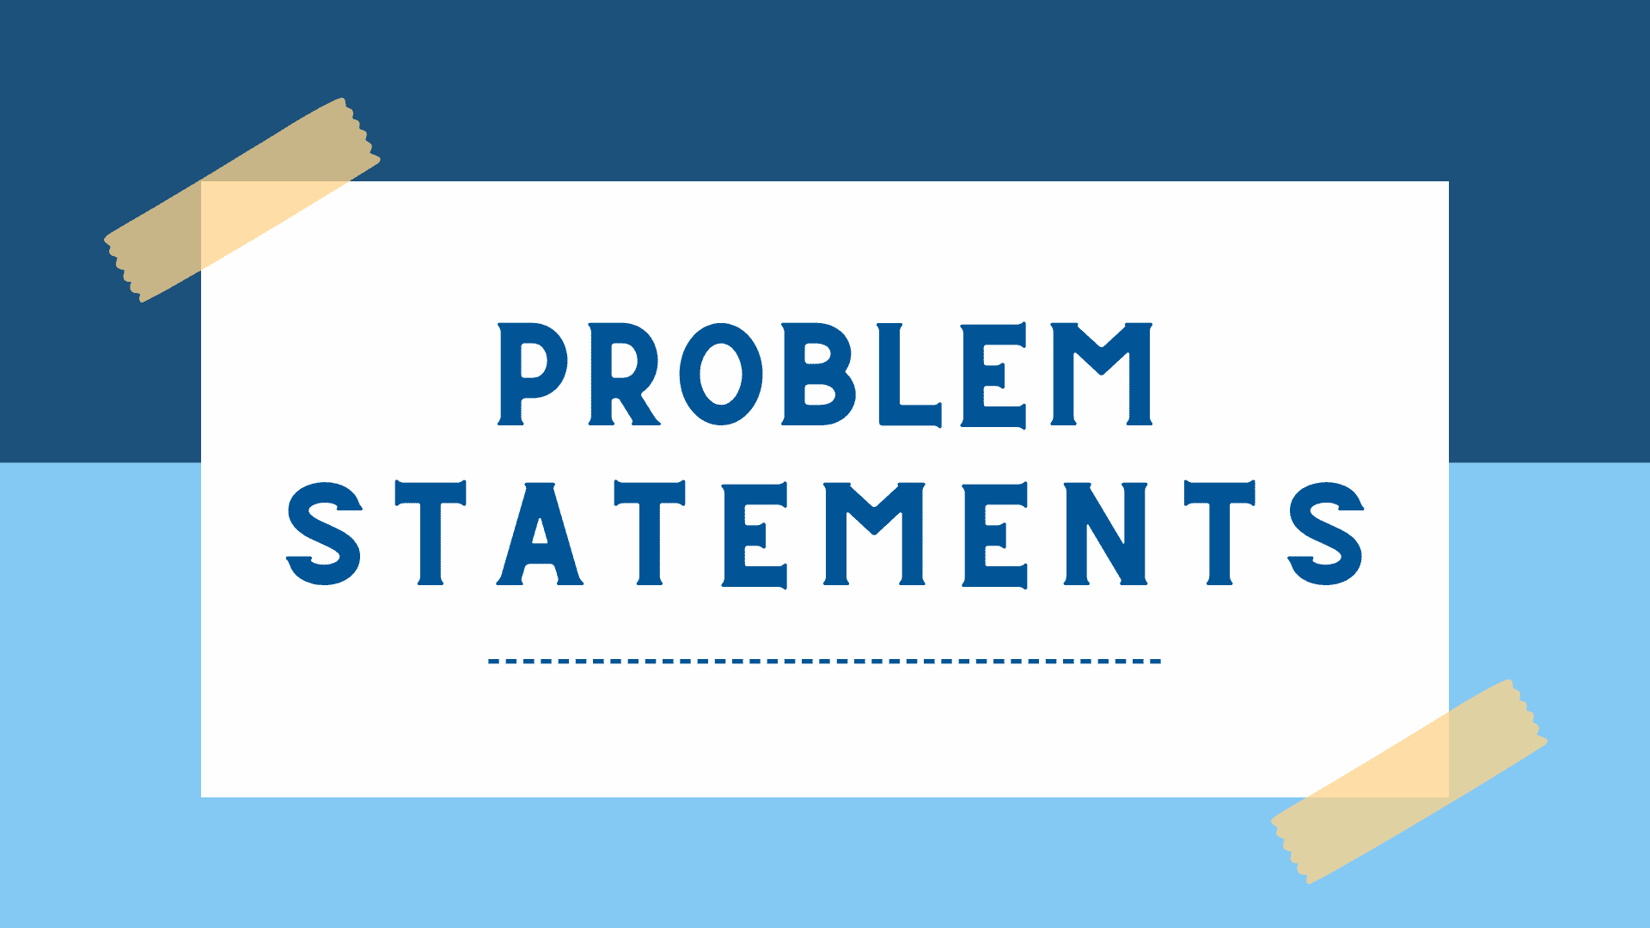
Problem Statement
Students face difficulty in collecting and managing study materials from multiple sources (WhatsApp, Drive, emails, etc.).
Lack of a centralized platform leads to disorganization and time wastage.
Traditional sharing methods (pen drives, group chats) are inefficient.
No proper version control or update mechanism for study materials.

Slide 6
Features
User Authentication (JWT, bcrypt) → secure login for students/admins.
Role-based Access → admins can Perform CURD operations , students can view/download the notes.
File Upload/Download → PDFs, docs, slides, videos links.
Categorization → by semester, subject.
Responsive UI (EJS/Bootstrap) for smooth access across devices.
Error Handling & Security → prevent unauthorized file access.
Caching → To store frequently used data .

Slide 7
Features
Redis → for faster content retrieval and to reduced load on MongoDB.
HTTPS (SSL Certificate Integration) → to run backend securely on HTTPS encrypted communication between client & server.
WebSocket → for real-time instant updates without page refresh.
Local Storage → to persist user preferences and authentication state in LearnSphere, ensuring a seamless experience even after browser refresh
Session Storage → to temporarily holds sensitive session-based data in LearnSphere, providing secure and isolated user interactions during an active session

Slide 8
Future Scope
AWS Deployment – Host the platform on the cloud for better scalability and availability.
Admin Editing Option – Allow administrators to edit uploaded study materials directly.
Q/A Section – Enable discussion forums or comment sections for collaboration.
Academic Calendar Integration – Highlight exams, assignments, and events.
Quote of the Day – Display motivational or educational quotes daily.
Cloud Storage for Files – Use AWS S3 or Google Drive for storing uploaded materials.

Slide 9
References
Express.js. (n.d.). Express - Node.js web application framework. Retrieved from https://expressjs.com
EJS. (n.d.). Embedded JavaScript templating. Retrieved from https://ejs.co
MDN Web Docs. (n.d.). HTML, CSS, and JavaScript tutorials. Retrieved from https://developer.mozilla.org
MongoDB. (n.d.). The database for modern applications. Retrieved from https://www.mongodb.com
Node.js. (n.d.). Node.js documentation. Retrieved from https://nodejs.org/en/docs
W3Schools. (n.d.). Web development tutorials. Retrieved from https://www.w3schools.com
LetsHelp.co.in – Centralized Academic Resource Platform. Used as a reference for platform structure and file-sharing functionality.
For express retrieval : https://expressjs.com/
https://www.geeksforgeeks.org/web-tech/what-is-web-socket-and-how-it-is-different-from-the-http/
https://www.geeksforgeeks.org/system-design/caching-system-design-concept-for-beginners/
Class Notes :- https://docs.google.com/presentation/d/1da1QsYgiCDtB_Sn93A6lm_LHhIYJ1pmi/view?slide=id.p1#slide=id.p1

Slide 10
Conclusion
The project successfully provides a digital repository for course materials.
It reduces dependency on scattered platforms like WhatsApp or Google Drive.
Enhances organization, accessibility, and collaboration in learning.
Can be scaled into a full-fledged learning management system (LMS) in future.

Slide 11


