Slide 1

Supply Chain Anomaly Monitoring & Hazard Event Logging Pipeline
Nexus Ops Solutions | Tanuja N | Rashmi P
Automating Supply Chain Risk Monitoring using n8n, AI Agents, Google Sheets, and Lovable Dashboard

Slide 2





Business Challenge
Organizations receive shipment updates and operational incident reports from multiple fragmented sources — creating critical blind spots in supply chain risk management.
Strategic Goal
Build an AI-powered workflow that automatically detects risks, prioritizes incidents and presents executive insights through modern dashboards — eliminating manual overhead and accelerating decision velocity.
Manual Monitoring
Delayed Notifications
Shipment delays and operational incidents tracked by hand, prone to error and latency.
Management alerts lag behind real-time events, slowing response time significantly.
Slow Hazard Identification
Time-Consuming Decisions
High-risk events surface too late for proactive intervention.
Analysts spend hours aggregating data instead of acting on insights.
No Centralized Visibility
Siloed data across systems with no unified operational view.

Slide 3
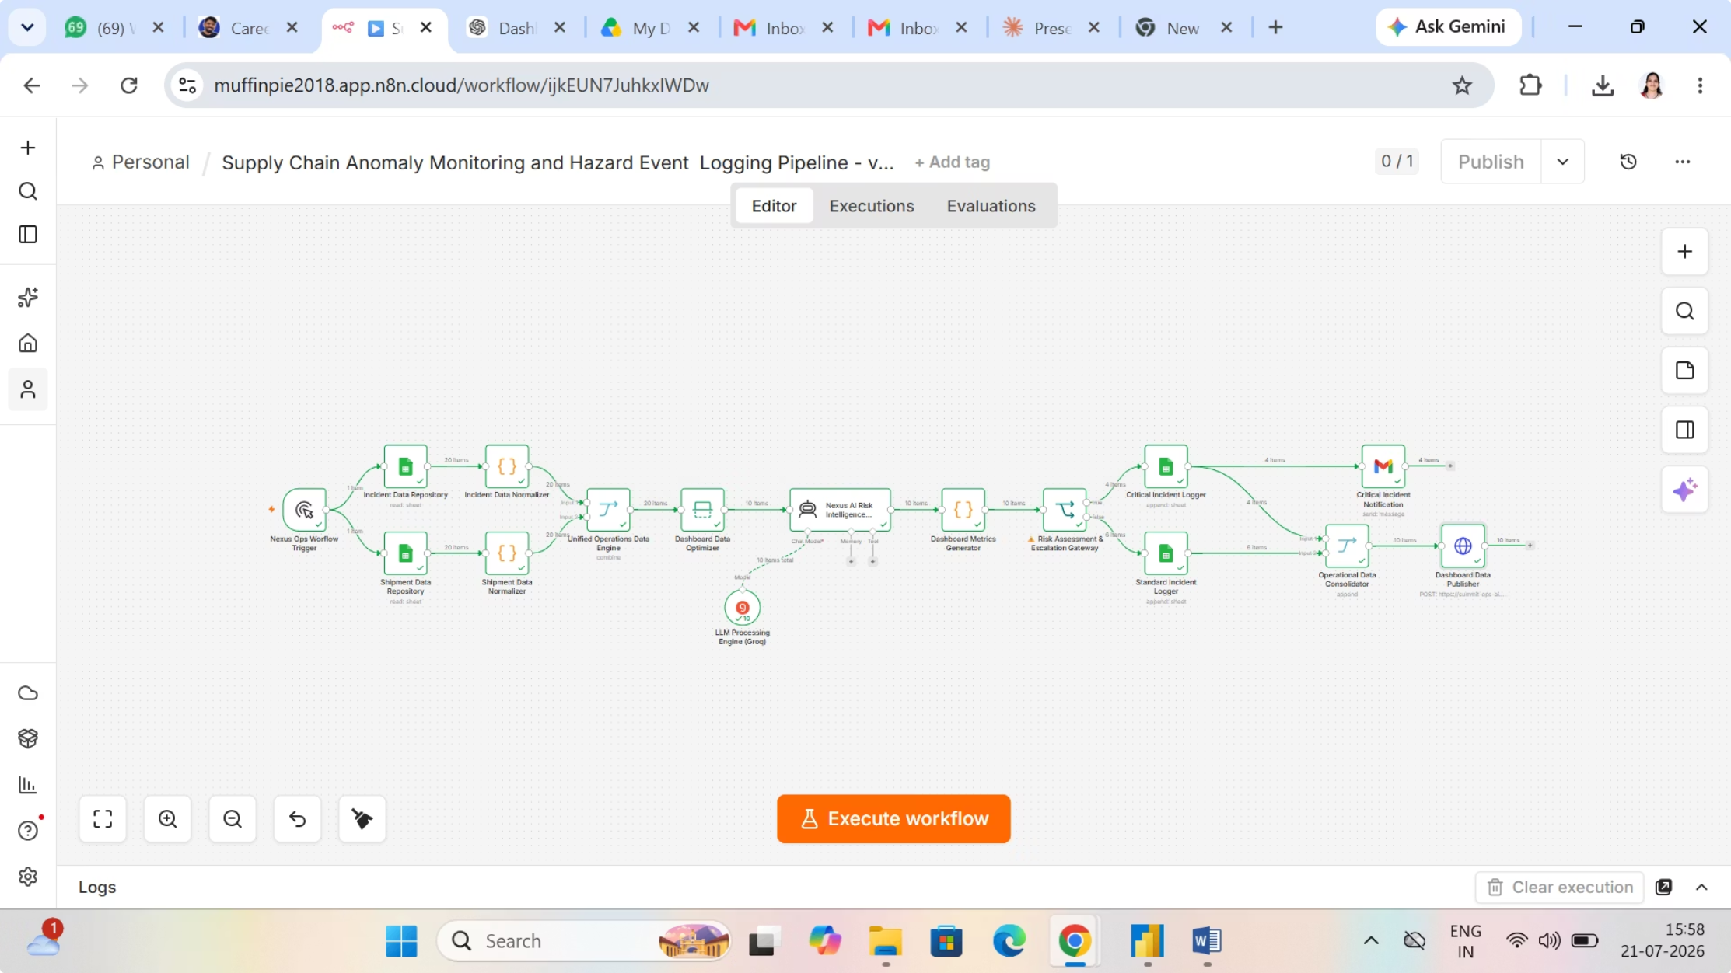
End-to-End AI Workflow
Automated Pipeline Architecture
Key Technologies
01
Orchestration
Data Layer
Google Sheets
n8n workflow automation
Google Sheets, JavaScript
Ingests raw shipment and incident data from operational sources
02
AI Engine
Notifications
Data Cleaning & Normalization
Groq LLM
Gmail
JavaScript transforms and standardizes records
Dashboards
03
Lovable
Unified Operations Engine
Merges supply chain and hazard event streams
04
AI Risk Assessment (Groq LLM)
Scores each incident for severity and priority
05
Risk Classification
Categorizes events: Critical / High / Medium / Low
06
Critical Incident Notification
Automated Gmail alerts dispatched to stakeholders
07
Executive Dashboard Publishing
Processed data pushed to Lovable

Slide 4
Real-time incident intelligence, supply chain risk & AI recommendations
Operational Overview — Executive Summary
TOTAL
INCIDENTS
CRITICAL
INCIDENTS
OPEN
INCIDENTS
CLOSED
INCIDENTS
HIGH RISK
SHIPMENTS
AI RISK
SCORE
AVG RES.
TIME (hrs)
ACTIVE AI
RECOS
20
1
15
5
4
42/100
42
17
▼12% vs last wk
▲5% vs last wk
▼8% vs last wk
▲14% vs last wk
▲3% vs last wk
▼4% vs last wk
▼9% vs last wk
▲22% vs last wk
EXECUTIVE INSIGHT (AI-GENERATED): Incident volume down 12% w/w. PLANT-B is the top hotspot, with critical incidents requiring immediate escalation.
Incident Trend
Severity by Location
Hazard Distribution
Facility × Hazard Risk (avg score)
Recent Incidents (Top 4)
Key Takeaways & Next Steps
 | Corr. | Flam. | N-Haz | Toxic
PLANT-A (5) | 43 | 24 | 26 | 23
PLANT-B (5) | 72 | 53 | 46 | 29
WH-01 (3) | — | — | — | 52
WH-02 (7) | — | 16 | 49 | 43
Incident | Facility | Hazard | Sev.
FL-2026-0020 | PLANT-B | Fire Risk | Critical
FL-2026-0019 | PLANT-B | Chemical Spill | High
FL-2026-0018 | WH-01 | Gas Leak | High
FL-2026-0017 | WH-02 | Equip. Malfunction | High
1
Escalate PLANT-B Highest concentration of critical & high-severity events.
2
Contain gas leak trend Toxic class dominates hazard mix — audit WH-01 & PLANT-B.
3
Adopt AI recommendations 17 active recos queued; adoption trending +22% w/w.
4
Sustain momentum Volume down 12% w/w; resolution time improved 9%.
Low risk → High risk
All 20 incidents currently under investigation status.
Prepared for executive review • July 21, 2026

Slide 5

Thank You
Nexus Ops Solutions | Tanuja N & Rashmi P
AI-Powered Supply Chain Anomaly Monitoring & Hazard Event Logging Pipeline
Automation
n8n Workflow Engine
Intelligence
Groq LLM AI Agent
Visibility
Lovable
Impact
42 Incidents Monitored

