Slide 1
SQL CONCEPTS
By P. Tanuja

Slide 2

Introduction
Data → raw facts
Example: 101, Ravi, 22
Information → processed/meaningful data
Example: “Ravi is 22 years old”
In databases:
Data is stored in tables
Information comes from queries

Slide 3
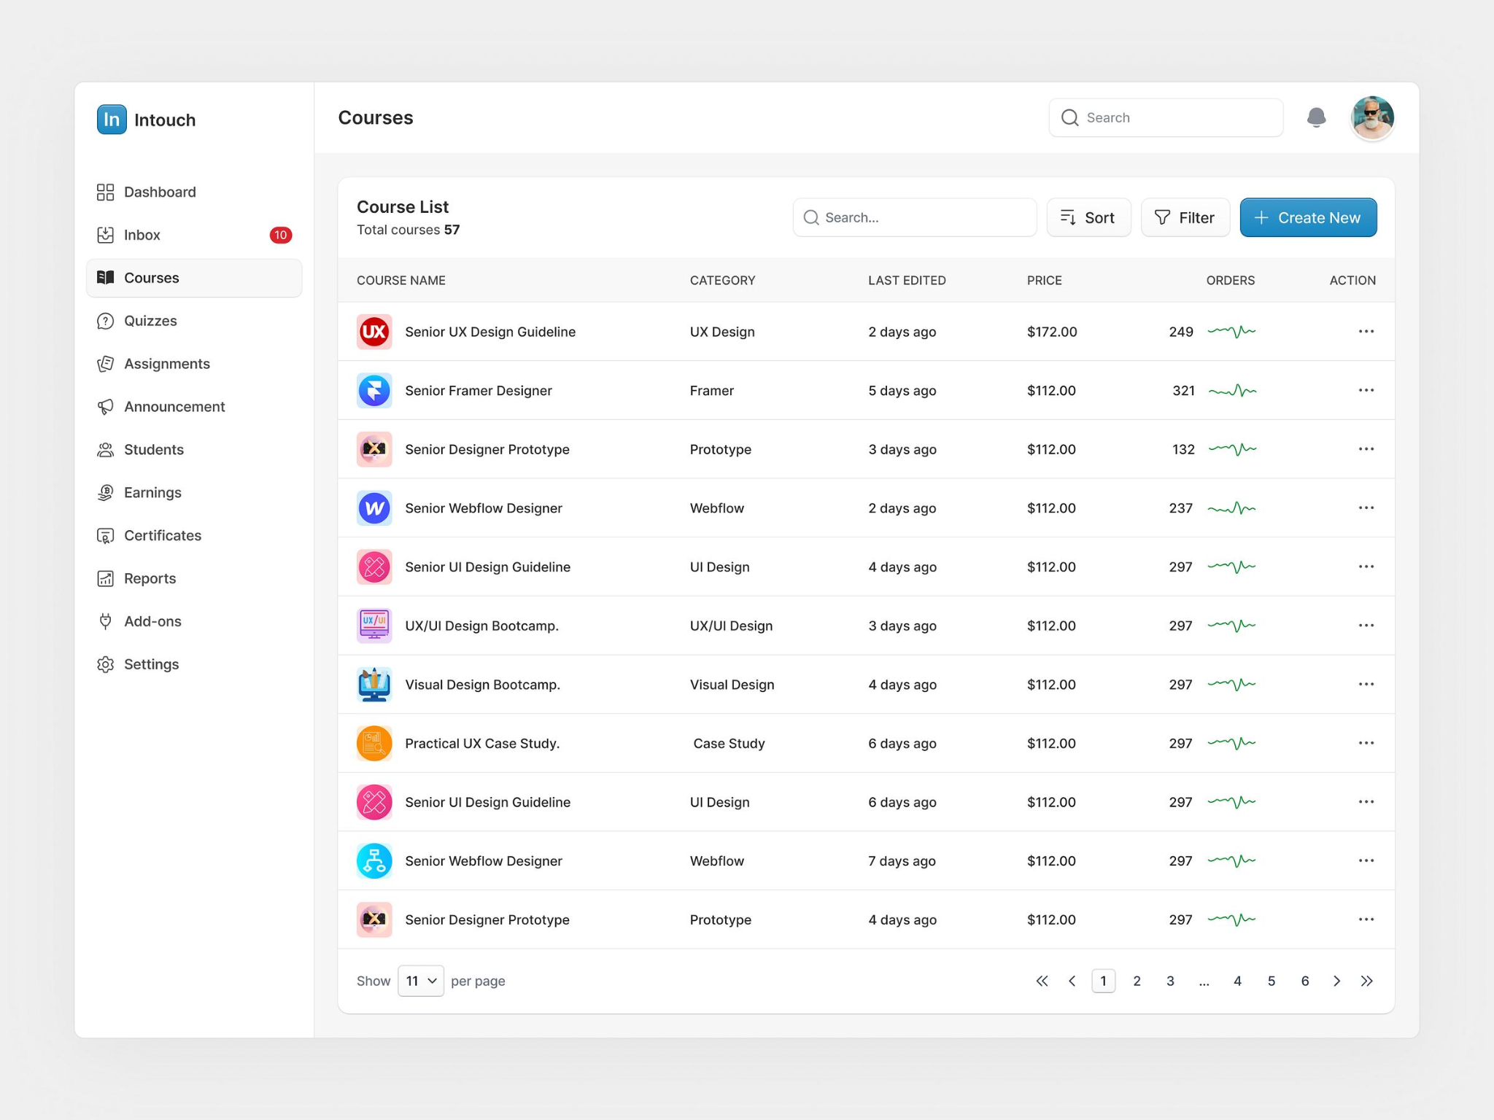
2. What is a DBMS?
A Database Management System (DBMS) is software that helps you:
Store data
Retrieve data
Manage large datasets safely
Popular DBMS tools:
MySQL
PostgreSQL
SQLite
Oracle Database

Slide 4
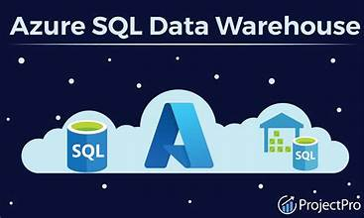
Real World Example
Think of a college system:
Tables:
Students
Courses
Enrollments
Example Table: Students
👉 This is how real companies store data (Amazon, banks, etc.)

Slide 5
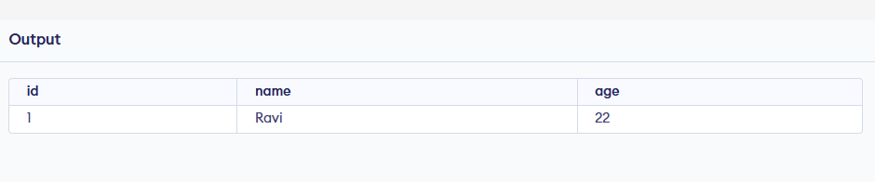
4. SQL Basics
SQL = Structured Query Language
🟢 Create Table
CREATE TABLE Students (
id INT,
name VARCHAR(50),
age INT
);
INSERT INTO Students VALUES (1, 'Ravi', 22);

Slide 6
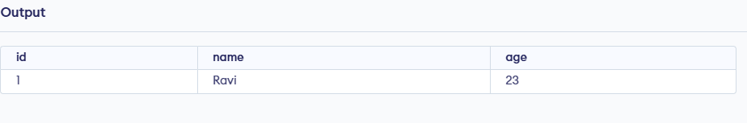
🟢 Update Data
UPDATE Students SET age = 23 WHERE id = 1;
🟢 Delete Data
DELETE FROM Students WHERE id = 1;
Relationships (Real DB Thinking)
In real-world DBs, tables are connected.
Example:
Students ↔ Courses
CREATE TABLE Enrollments ( student_id INT, course_id INT);

Slide 7

How Real DBMS Works
1. Storage Engine
Data stored in files on disk
2. Query Processing
SQL → converted into execution plan
3. Indexing (VERY IMPORTANT)
Makes search fast
CREATE INDEX idx_name ON Students(name);

Slide 8
Thank You!
Do you have any questions?

