Slide 1
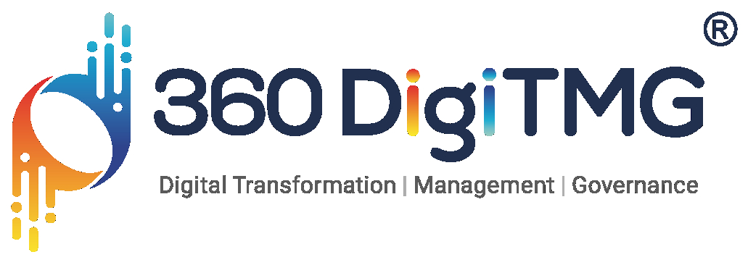

Optimization of Raw Materials to Achieve Efficient Grades of Steel

Slide 2
Contents
Project Overview and Scope
Business Problem
Business Objective & Constraints
CRISP-ML(Q) Methodology
Technical Stacks
Project Architecture - Data Flow Diagram
Data Collection and Understanding
Data Dictionary
System Requirements
Exploratory Data Analysis
Data Preprocessing
Data Import
Missing Values , Outliers & Outlier handlings
Auto-EDA Libraries
Data Visualization
Notes:
Change

Slide 3
Project Overview and Scope
Data is extracted from primary data. Data will be collected to use in the visualization. Around 312 records are extracted.
Certainly! Here's a concise data overview for optimizing raw materials in steel manufacturing:
1. Raw Material Composition: Elemental data from iron ore, coal, and alloying elements.
2. Sourcing and Procurement: Supplier performance metrics and cost analysis.
3. Production Efficiency: Yields, waste metrics (scrap, emissions), and energy consumption.
4. Environmental Impact: Carbon footprint, water usage, and sustainability metrics.
5. Predictive Analytics: Historical production data and demand forecasting.
6. Operational Data: Equipment performance and process parameters.
These data points are crucial for analyzing, optimizing, and improving resource efficiency, cost-effectiveness, and environmental sustainability in steel manufacturing processes.

Slide 4
Business Problem
Steel manufacturing industry faces significant challenges in identifying the optimal combination of raw materials and energy inputs necessary to produce high-quality steel efficiently.

Slide 5
Business Objective & Constraints
Business Objective : Maximize Steel Quality, Minimize Costs
Business Constraints : Minimize Energy Costs

Slide 6
CRISP-ML(Q) Methodology
CRISP-ML(Q) (Cross-Industry Standard Process for Machine Learning with Quality) is an extension of the CRISP-DM framework, specifically tailored for machine learning projects. It incorporates additional considerations for ensuring the quality and robustness of machine learning models throughout their lifecycle. Here's an overview of the phases and the focus on quality it consists of six phases:
Business & Data Understanding: Understanding the project objectives and requirements from a business perspective. Collecting and exploring the data to understand its content, quality, and initial insights.
Data Preparation: Preparing the data for analysis by cleaning, transforming, and integrating it as needed.
Model Building: Building and selecting appropriate models and algorithms to use for the analysis.
Notes:
Keep observations

Slide 7
Technical Stacks
A variety of technical stacks can be used depending on the scope, complexity, and specific requirements of the project. Here are some commonly used stacks in data analytics:
Python-Based Stack:
Python is a popular language for data analytics due to its simplicity and the vast ecosystem of libraries and tools.
Programming Language: Python
Libraries and Frameworks:
Data Manipulation: pandas, NumPy
Data Visualization: Matplotlib, Seaborn, Plotly
Machine Learning: Scikit-learn, TensorFlow, Keras, PyTorch
Statistical Analysis: SciPy, Statsmodels
Development Environment: Jupyter Notebook, JupyterLab, PyCharm
Data Storage: SQL databases (e.g., PostgreSQL, MySQL), NoSQL databases (e.g.MongoDB), CSV/Excel files
Notes:
Keep observations

Slide 8
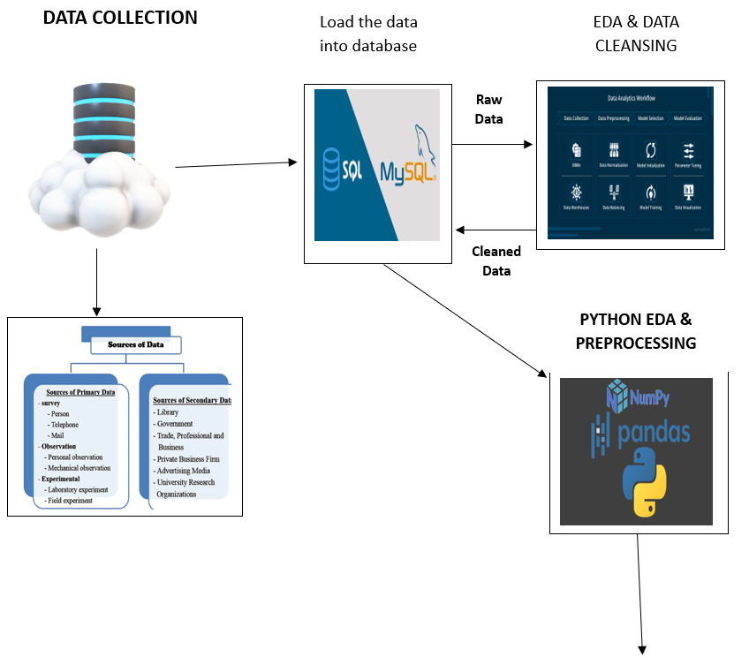
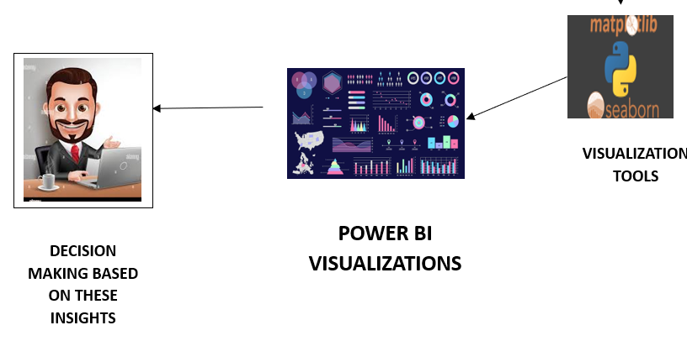
Project Architecture
Notes:
Keep observations

Slide 9
Data Collection and Understanding
The data is collected from primary data source EXCEL which is in the form of raw data, this raw data is loaded into the data base.
The raw data is loaded into the data base which is MySQL or Python.
EDA and Data cleansing is done for raw data from the data base. The cleaned data is given to data visualization tools to visualize the data in the form of dashboards. Overall both the raw data and SQL output is used to run the visualization.
By implementing a comprehensive and well-designed dashboard, steel manufacturers can optimize raw material usage, improve production efficiency, and ensure high-quality steel production while meeting financial and sustainability goals.
Notes:
Keep observations

Slide 10
Data Dictionary
Steel Grade: The specific grade or quality of steel being produced.
Chemical Composition:
Carbon (%): The carbon content in the steel, influencing its strength and hardness.
Phosphorus (%): The phosphorus content in the steel, affecting its mechanical properties.
Raw Materials Usage:
Scrap Steel (%): Percentage of recycled steel scrap used in the production process.
DRI or Pig Iron (%): Percentage of Direct Reduced Iron (DRI) or Pig Iron used as raw material.
Iron Ore (%): Percentage of Iron Ore used as raw material.
Production Process:
Blast Furnace (BF) Parameters:
Cycle Time: Time taken for the Blast Furnace stage.
Electricity Consumption (kWh): Total electricity consumed during the Blast Furnace stage.
Electric Arc Furnace (EAF) Parameters:
Cycle Time: Time taken for the Electric Arc Furnace stage.
Electricity Consumption (kWh): Total electricity consumed during the Electric Arc Furnace stage.
Ladle Refining Furnace (LRF) Parameters:
Cycle Time: Time taken for the Ladle Refining Furnace stage.
Electricity Consumption (kWh): Total electricity consumed during the Ladle Refining Furnace stage.
Quality Metrics: Yield: Efficiency of production output relative to input materials.
Cost and Efficiency Metrics:
Total Cycle Time: Total time taken for the entire production process.
Total Electricity Consumption (kWh): Total electricity consumption for the entire production process.
Production Volume: Volume of steel produced within a specific timeframe.
Cost per Ton ($): Cost per ton of steel produced, factoring in all relevant expenses.

Slide 11
System Requirements
SQL (Structured Query Language):
Database Management System: Choose a SQL-based DBMS such as MySQL, PostgreSQL, SQL Server, or Oracle Database.
Python Environment:
Python Version: Latest stable version of Python (e.g., Python 3.9).
IDE or Editor: Choose an IDE or editor such as PyCharm, Jupyter Notebook, or VS Code.
System Requirements: Python itself is lightweight, but resource requirements depend on the complexity of your scripts, data processing tasks, and machine learning models.
Power BI / Tableau:
Operating System: Power BI Desktop and Tableau Desktop are available for Windows and macOS. Power BI also has a web-based service.
Integration and Collaboration:
Ensure compatibility and integration between SQL databases, Python scripts for data manipulation and analysis, and visualization tools like Power BI or Tableau.
Notes:
Keep observations

Slide 12
Exploratory Data Analysis [EDA]
Statistical Insights
Business Insights
Descriptive statistics: To summarize the main characteristics of raw material compositions and process variables. Compute measures such as mean, median, mode, standard deviation, range, and quartiles.
Correlation Analysis: Perform correlation analysis to identify relationships between input variables (e.g., raw material compositions, furnace parameters) and output variables (e.g., steel quality metrics like tensile strength, hardness). Calculate correlation coefficients (e.g., Pearson correlation coefficient) and visualize correlations using scatter plots or correlation matrices.
Distribution Analysis: Assess the distribution of key variables using histograms, box plots, or probability plots. Understanding the distribution shapes (e.g., normal, skewed) helps in determining appropriate statistical tests and modeling approaches.
Outlier Detection: Identify outliers in the dataset that may indicate data recording errors or unusual process conditions. Use statistical methods such as Z-score analysis, box plots (for visual detection), or robust statistical techniques like Tukey's method for outlier detection.
Data-Driven Decision Making: Utilize comprehensive data analytics to monitor and optimize every stage of the steel production process.
Advanced Process Control: Implement advanced process control technologies to enhance the precision and efficiency of steel production.
Optimal Raw Material Selection: Selecting the right blend of raw materials (scrap steel, DRI, pig iron, iron ore) based on their availability, cost, and quality parameters is crucial.
Energy Efficiency Measures: Implement energy-efficient technologies and practices throughout the production process.
Continuous Improvement and Innovation: Foster a culture of continuous improvement and innovation within the organization.
Quality Assurance and Customer Satisfaction: Prioritize quality assurance measures to ensure that the produced steel meets stringent industry standards and customer requirements.
Supply Chain Optimization: Streamline the supply chain to minimize lead times, reduce inventory costs, and improve overall operational efficiency.
Notes:
EDA is used for seeing what the data can tell us before the modeling task.
Change

Slide 13
Data Preprocessing
Data Acquisition and Integration:
Sensor Data: Collect real-time data from sensors monitoring raw material compositions and process parameters.
ERP Integration: Integrate data from Enterprise Resource Planning (ERP) systems for seamless data flow across production stages.
Data Preprocessing:
Cleaning: Handle missing values and outliers in raw material data to ensure data quality.
Normalization: Normalize and scale data for uniformity in statistical analysis and modeling.
Data Analysis and Modeling:
Statistical Analysis: Utilize tools like Python with libraries such as Pandas and NumPy for statistical insights.
Notes:
Keep observations

Slide 14
Data Import
Using SQL Server Management Studio (SSMS):
Open SSMS and connect to your SQL Server instance.
Right-click on the database where you want to import data and select Tasks > Import Data.
Follow the Import Wizard steps to specify the data source (e.g., CSV file, Excel spreadsheet, another database), configure settings, map columns, and initiate the import process.
After importing the data we have to check the Outliers, Missing Values, Handling Errors, Normalization.
Exporting Data from SQL to Python:
Using Python Libraries (pyodbc, pandas):
Install the pyodbc library to connect to SQL databases from Python.
Use pandas to fetch SQL query results into a DataFrame for further analysis.
Using SQLAlchemy:
SQLAlchemy is a Python SQL toolkit and Object-Relational Mapping (ORM) library that provides a unified interface for various SQL databases.
Data Analysis and Manipulation in Python:
Once data is imported into Python (e.g., as a pandas DataFrame), you can perform various data analysis, manipulation, visualization, and Modeling tasks using libraries like NumPy, Matplotlib/Seaborn, Scikit-Learn, etc.
Considerations:
Data Types and Formats: Ensure compatibility between SQL data types and Python data structures (e.g., DataFrame).
Performance: Optimize data transfer processes, especially for large datasets, using batch processing or incremental loading strategies.
Security: Use secure connection methods and follow best practices for handling sensitive data.
Notes:
Keep observations

Slide 15
Missing Values , Outliers & Outlier handlings
Handling Missing Values in SQL:
In SQL, you can identify missing values using NULL values.
Replace missing values with defaults or specific values using COALESCE or ISNULL functions.
Update missing values based on conditions or calculated values.
Handling Missing Values in Python (using pandas):
Use isnull() or notnull() methods in pandas to identify missing values.
Replace missing values using fillna() method with a default value or a calculated value.
Handling Outliers in SQL:
Handling Outliers in Python (using Pandas):
Use statistical methods or visualization techniques to detect outliers.
Handling Outliers:Winsorize outliers by capping them at a specified percentile range.
.
Notes:
Keep observations

Slide 16
Auto-EDA Libraries
Definition: Automated tools for rapid exploratory data analysis (EDA) without manual intervention.
Features:
Automated data summaries and visualizations.
Missing data handling and outlier detection.
Correlation and data quality checks.
Benefits:
Saves time and effort in initial data exploration.
Standardizes EDA processes across datasets.
Facilitates quick insights for decision-making.
Examples: pandas-profiling, AutoViz, SweetViz, dtale.
Applications: Data preparation, feature selection, model readiness.
Future Trends: Integration with AI for enhanced insights.
Notes:
Keep observations

Slide 17
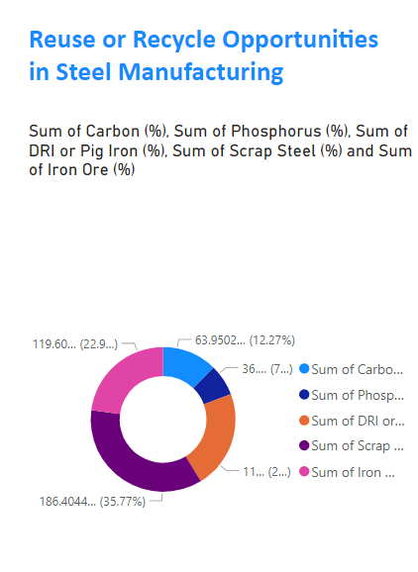
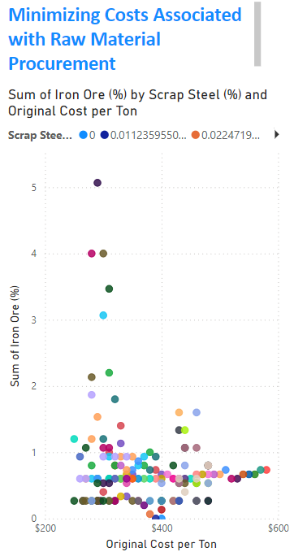
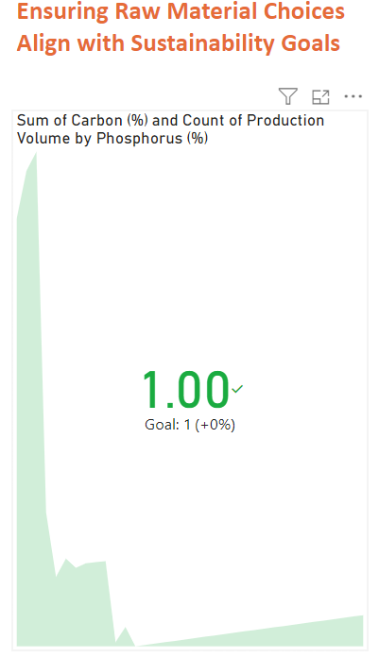
Power BI Visualization
Notes:
Add graphical

Slide 18
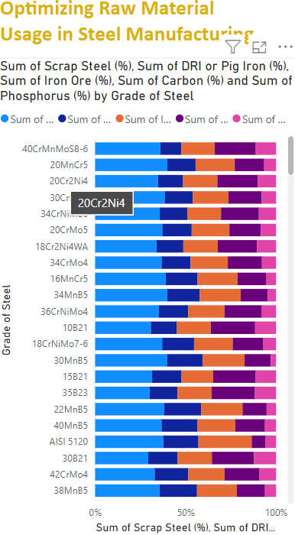
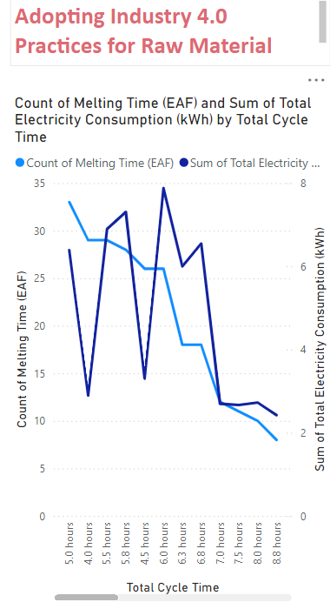
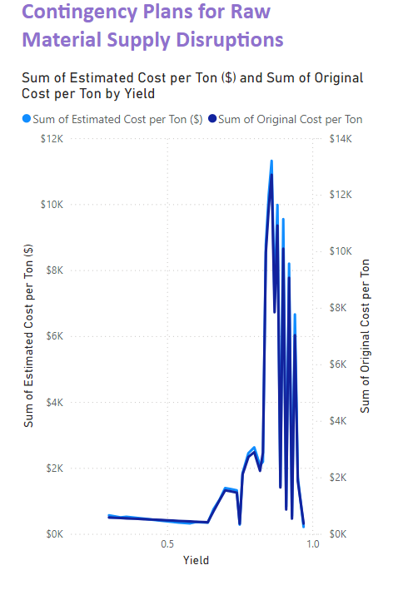
PowerBI Visualization
Notes:
Keep observations

Slide 19
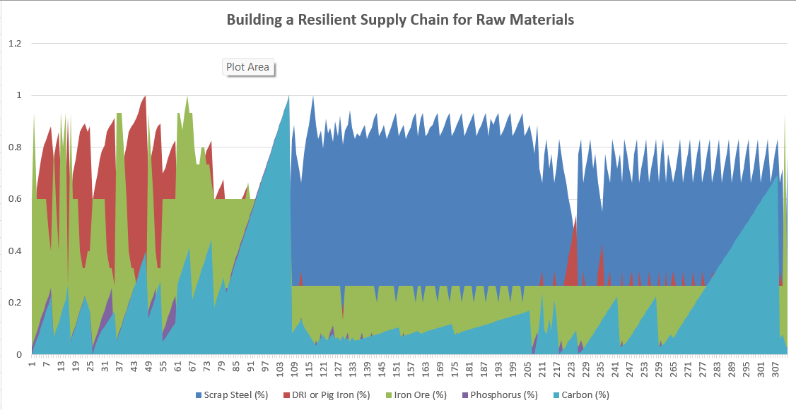
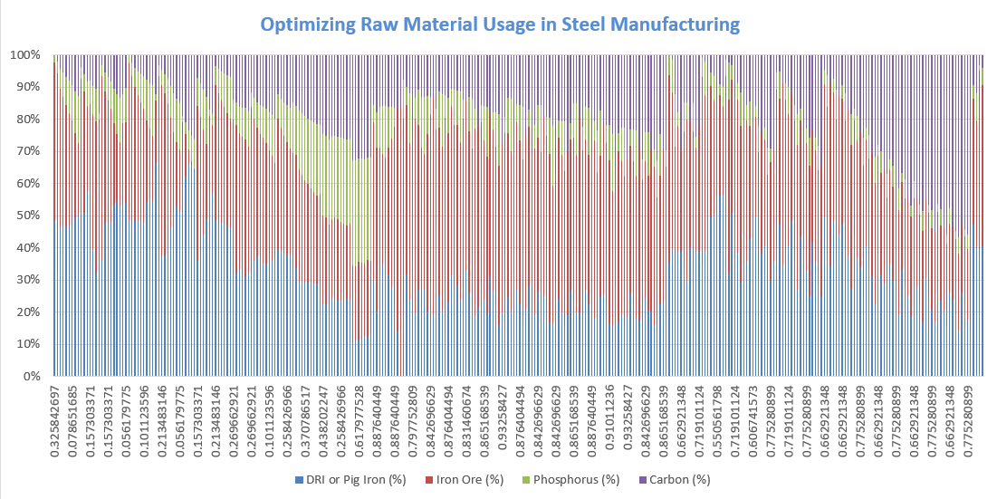
Excel Visualization

Slide 20
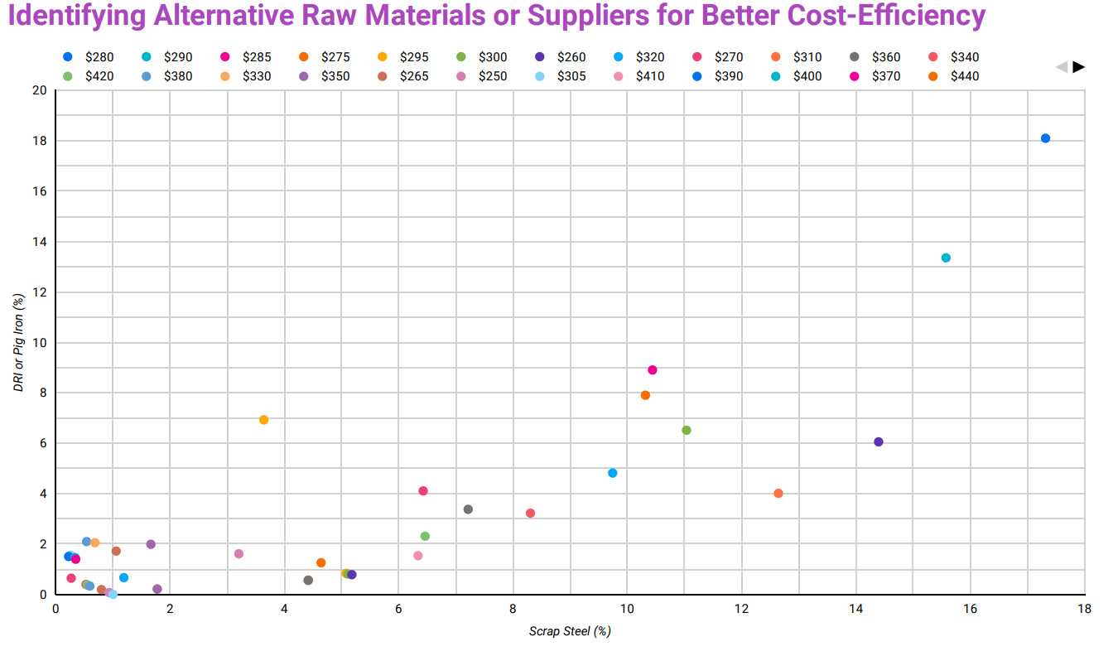
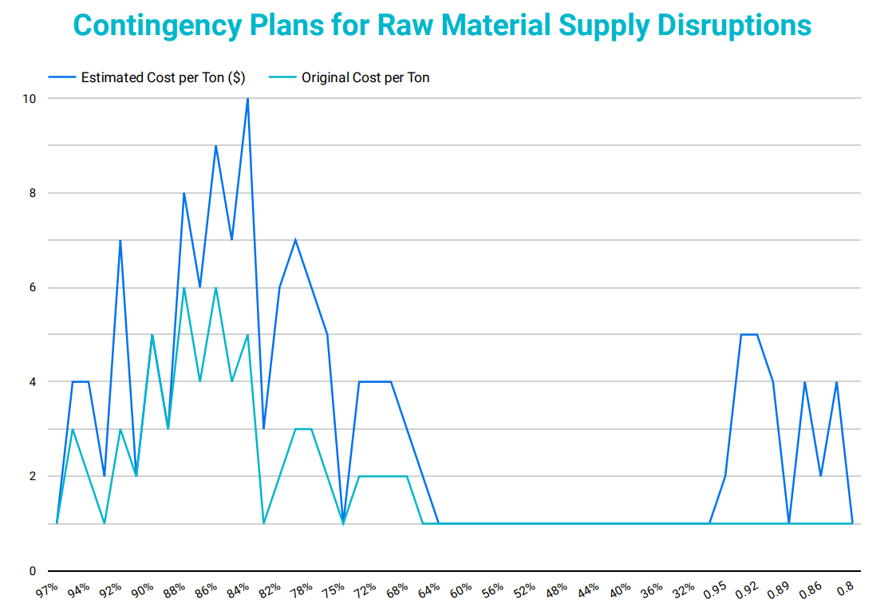
Looker Studio Visualization

Slide 21


