Slide 1
BHARATKART
India E-Commerce Sales & Customer Analytics
A Python Data Analytics Case Study | FY2024–25
13,522 Orders • ₹110.2M Sales • 17 States • 25 Cities
Data Analytics Project | September 2026

Slide 2
Executive Overview
A single-page view of the business performance behind this analysis
13,522
₹110.2M
₹7.3M
6.63%
Total Orders
Total Sales
Total Profit
Profit Margin
3,021
17 / 25
₹8,148
3.95 days
Unique Customers
States / Cities
Avg. Order Value
Avg. Delivery Time
Bottom line: Electronics drives half of all revenue, five states account for a disproportionate share of sales, and UPI dominates payments — while profit margins vary sharply by geography and season.
BharatKart E-Commerce Analytics
2

Slide 3
Business Problem & Objectives
The Problem
Project Objectives
Leadership needs a single, data-driven view of where revenue and profit actually come from — by category, region, state, city, payment method and time period — so marketing, inventory and logistics investment can be targeted rather than spread evenly across a large, geographically dispersed customer base.
Load, inspect and clean a deliberately messy transactional dataset
Engineer time, customer and pricing features
Compute core KPIs management needs on one page
Run structured exploratory data analysis
Quantify which categories, products, regions & customers drive revenue
Measure the impact of discounting on profitability
Map revenue & profitability geographically across India
BharatKart E-Commerce Analytics
3

Slide 4
Dataset & Data Cleaning
13,522 clean order lines across 29 columns, 17 states and 25 cities
1
Remove nulls & duplicates
109 duplicate rows identified and dropped
2
Standardise text fields
Gender, Payment_Method labels unified (e.g. Cod → Cash On Delivery)
3
Fix data types
Order_Date → datetime, Age → integer
4
Remove invalid records
Negative/zero Quantity, Age outside 15–90, Rating outside 1–5
5
Trim whitespace
Consistent grouping & joins across all text columns
Result: 13,522 valid order lines • 8 product categories • 17 states • 25 cities • Jan 2024 – Dec 2025
BharatKart E-Commerce Analytics
4

Slide 5
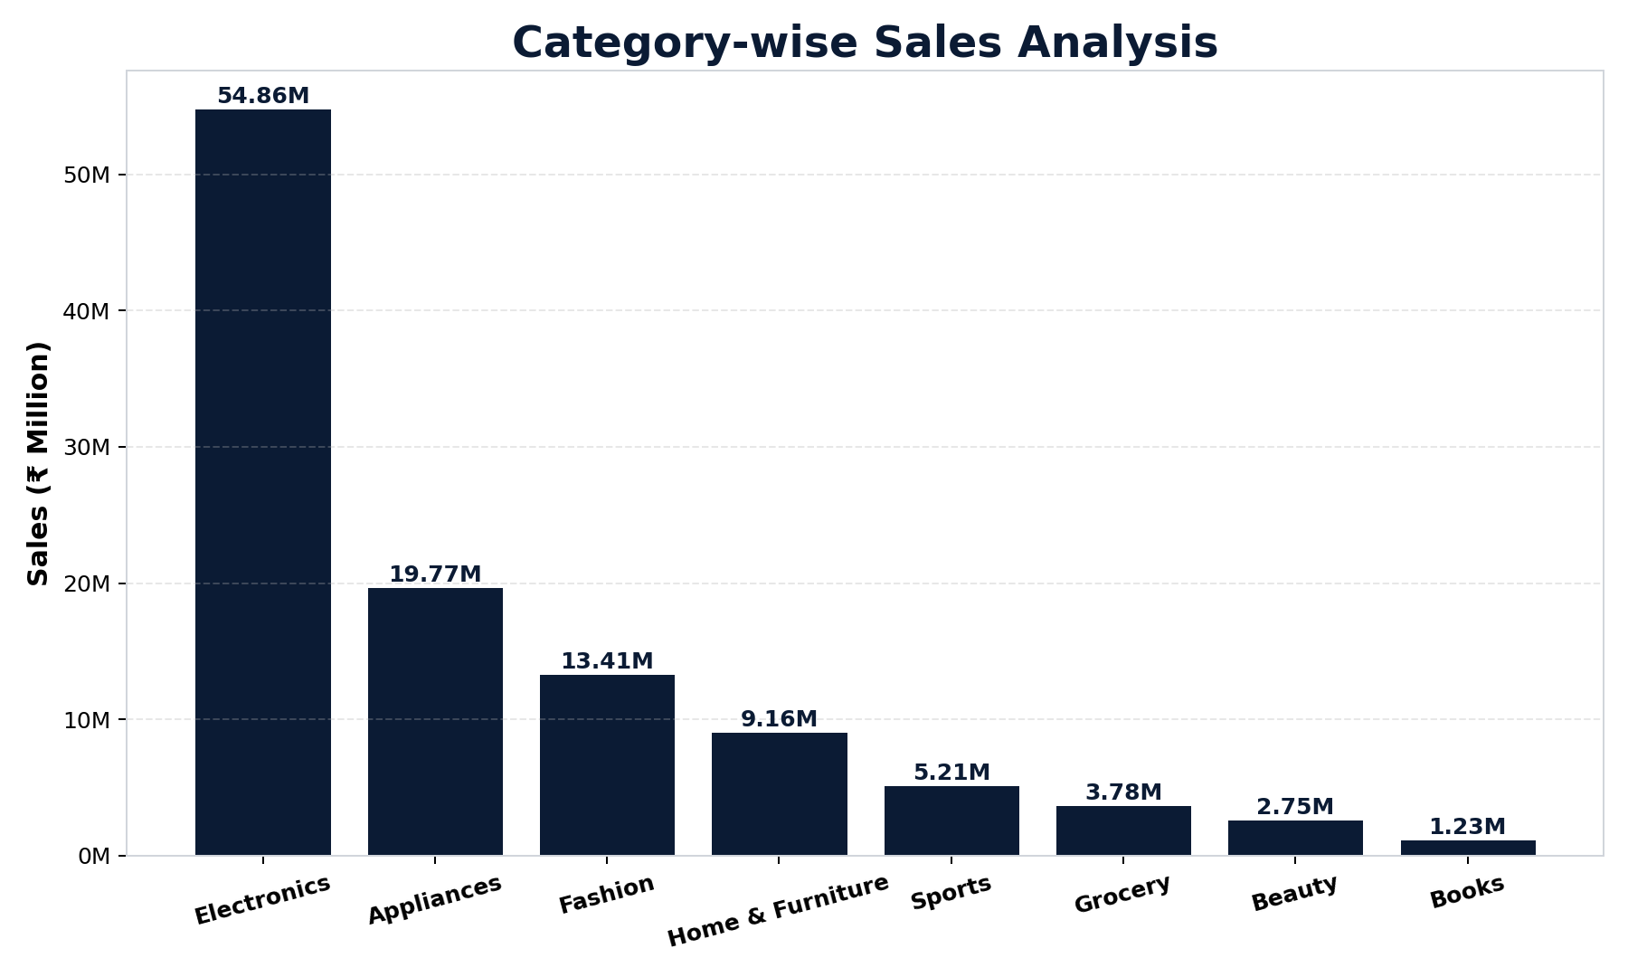
Category-wise Sales
Electronics dominates revenue despite lower order frequency
BharatKart E-Commerce Analytics
5

Slide 6
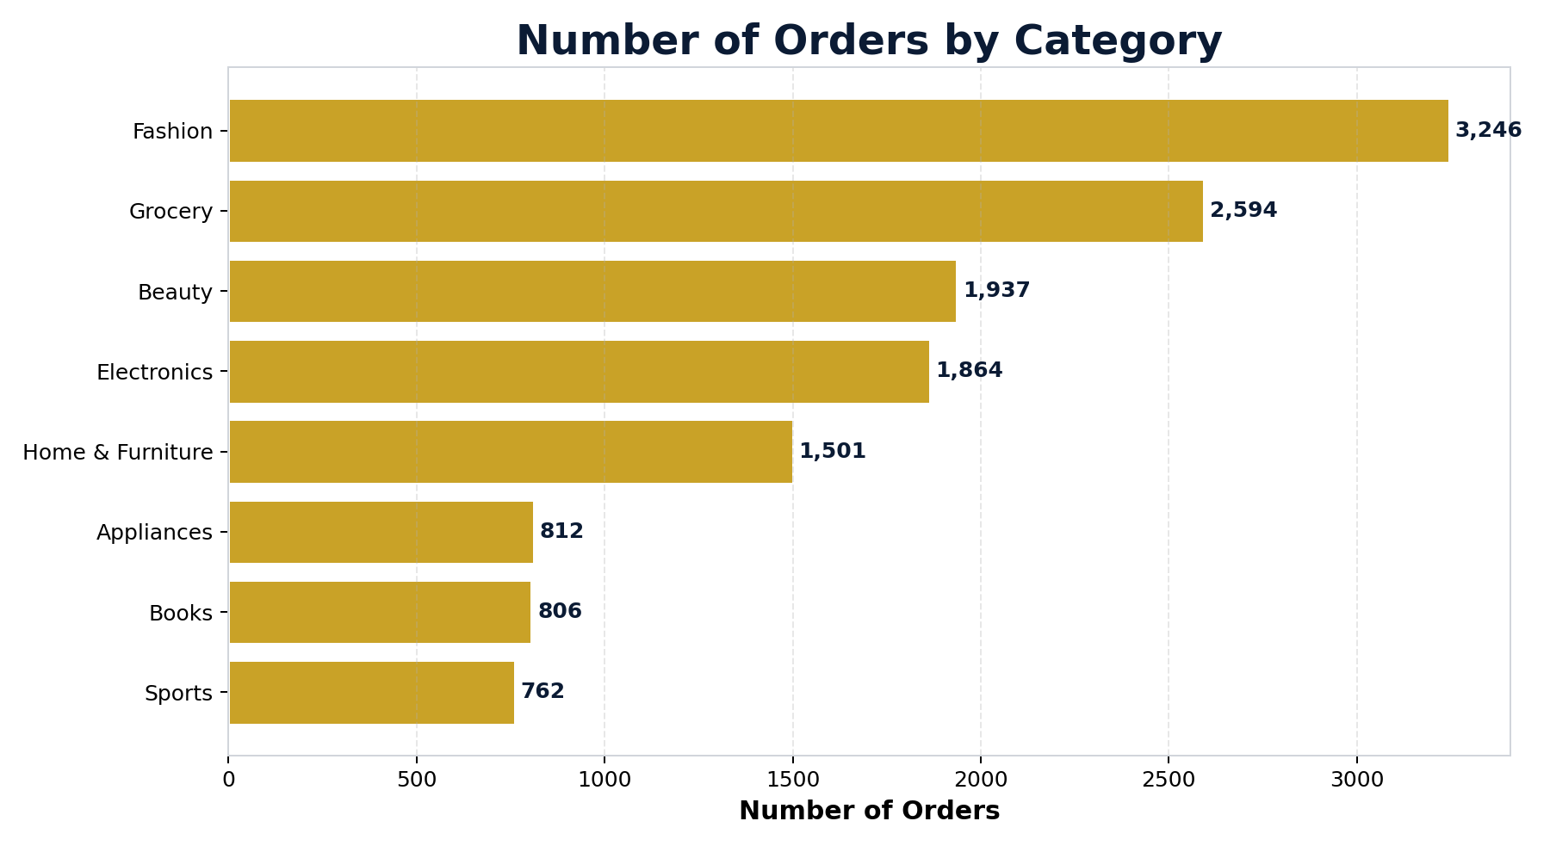
Purchase Frequency vs. Revenue
Fashion sells most often; Electronics earns the most per order
Insight
Fashion generates the highest order frequency (3,246 orders), but Electronics produces the highest sales revenue (₹54.86M). This confirms Electronics carries a much higher average order value than high-frequency, lower-ticket categories like Fashion and Grocery.
BharatKart E-Commerce Analytics
6

Slide 7
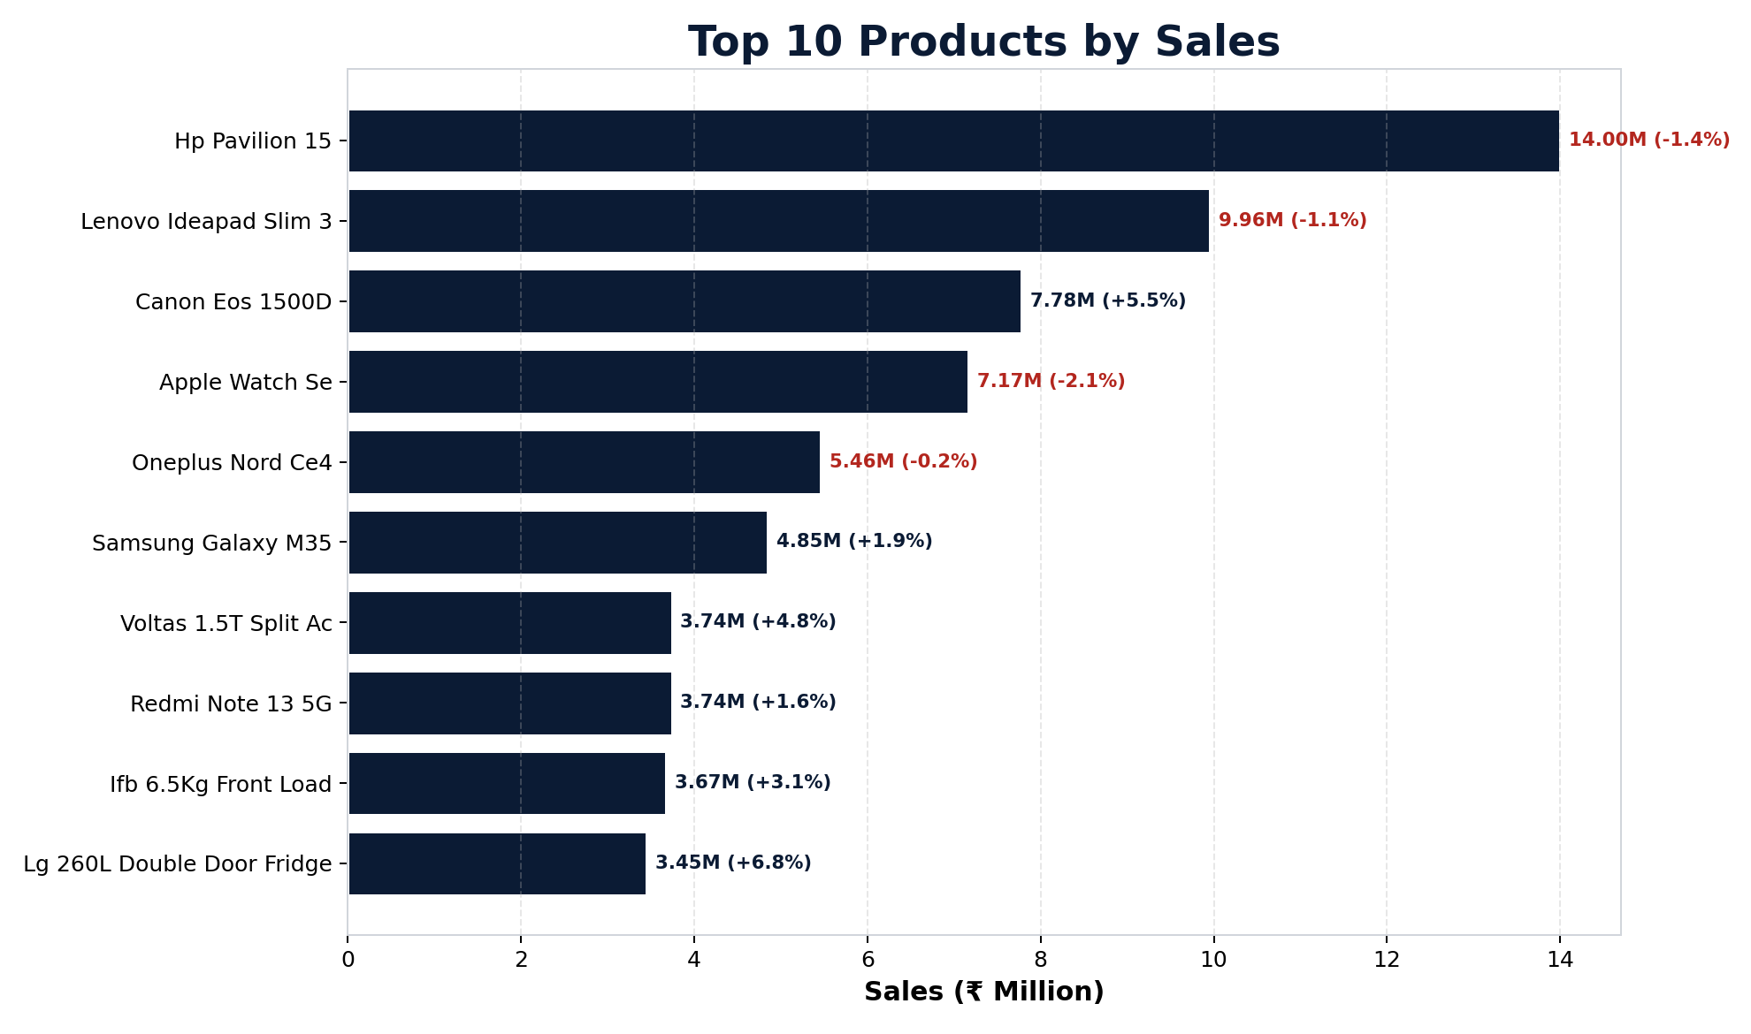
Top 10 Products by Revenue
High sales don't always mean high profitability
BharatKart E-Commerce Analytics
7

Slide 8
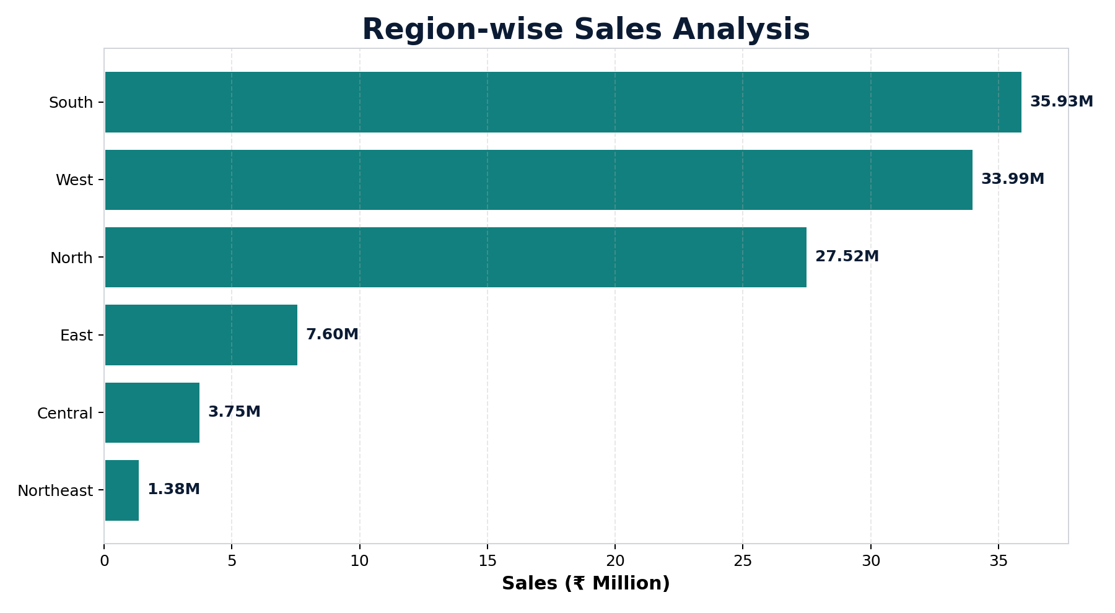
Region-wise Sales
South and West together drive over 60% of total revenue
BharatKart E-Commerce Analytics
8

Slide 9
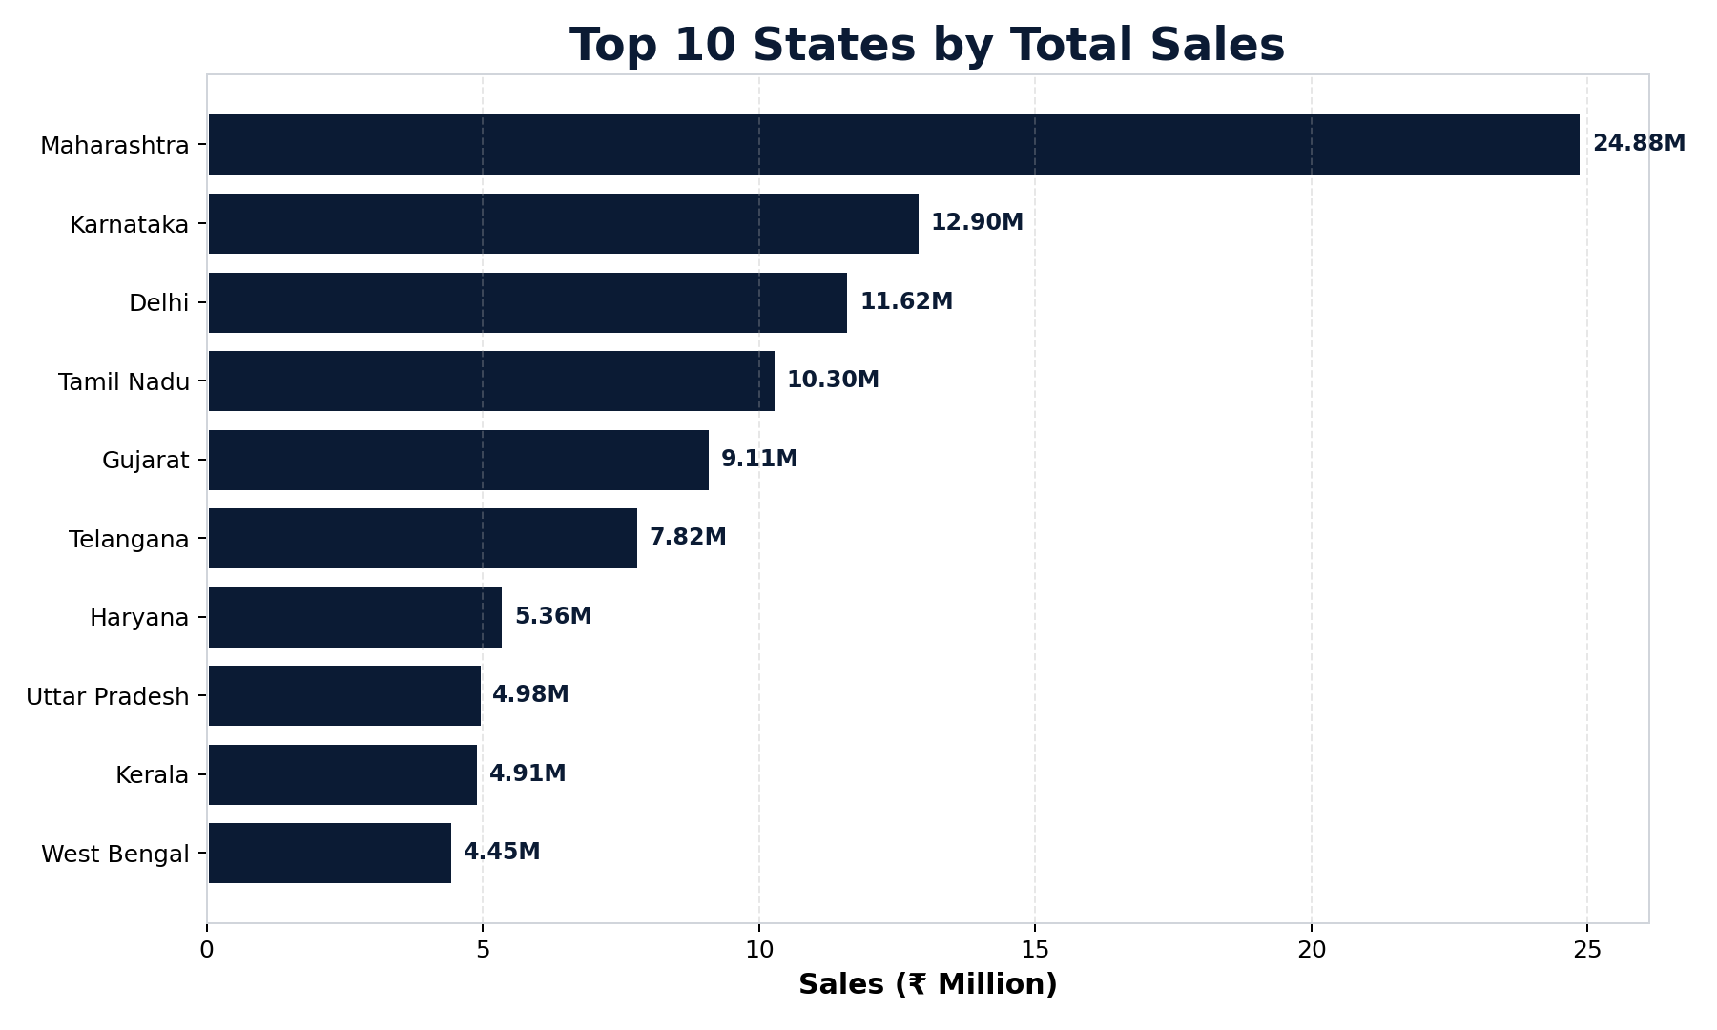
Top 10 States by Sales
Maharashtra leads with ₹24.9M — nearly double the next state
BharatKart E-Commerce Analytics
9

Slide 10
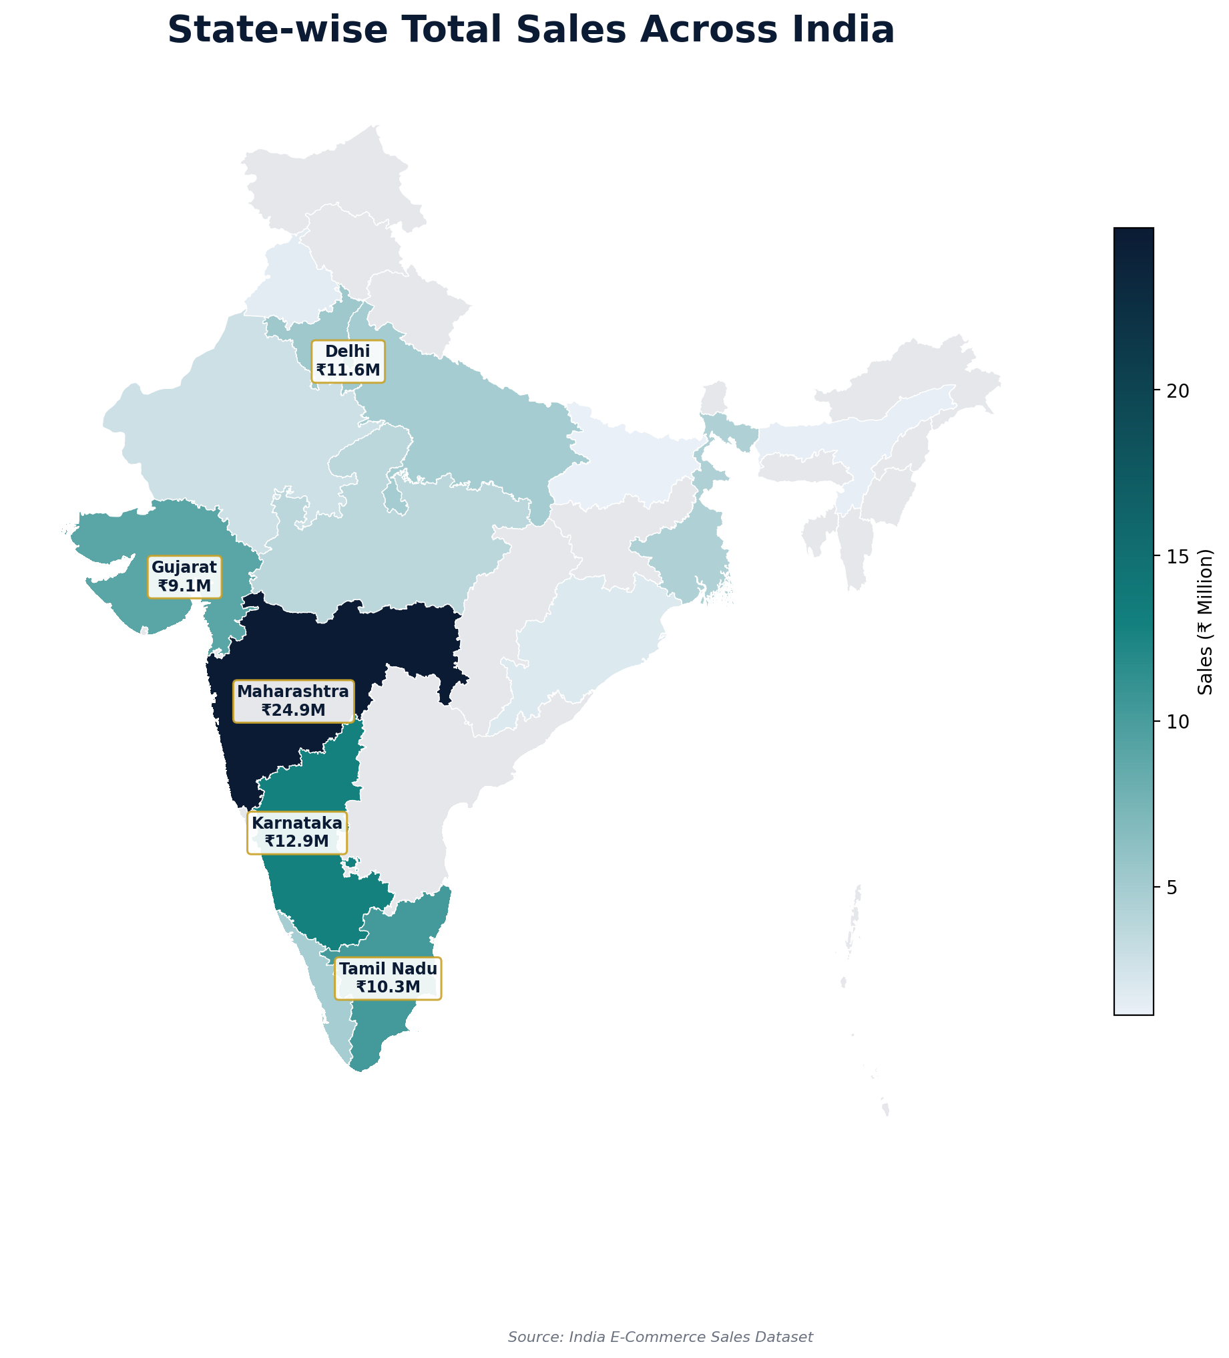
Geographic Analysis: State-wise Sales
Revenue is concentrated in five leading states
BharatKart E-Commerce Analytics
10

Slide 11
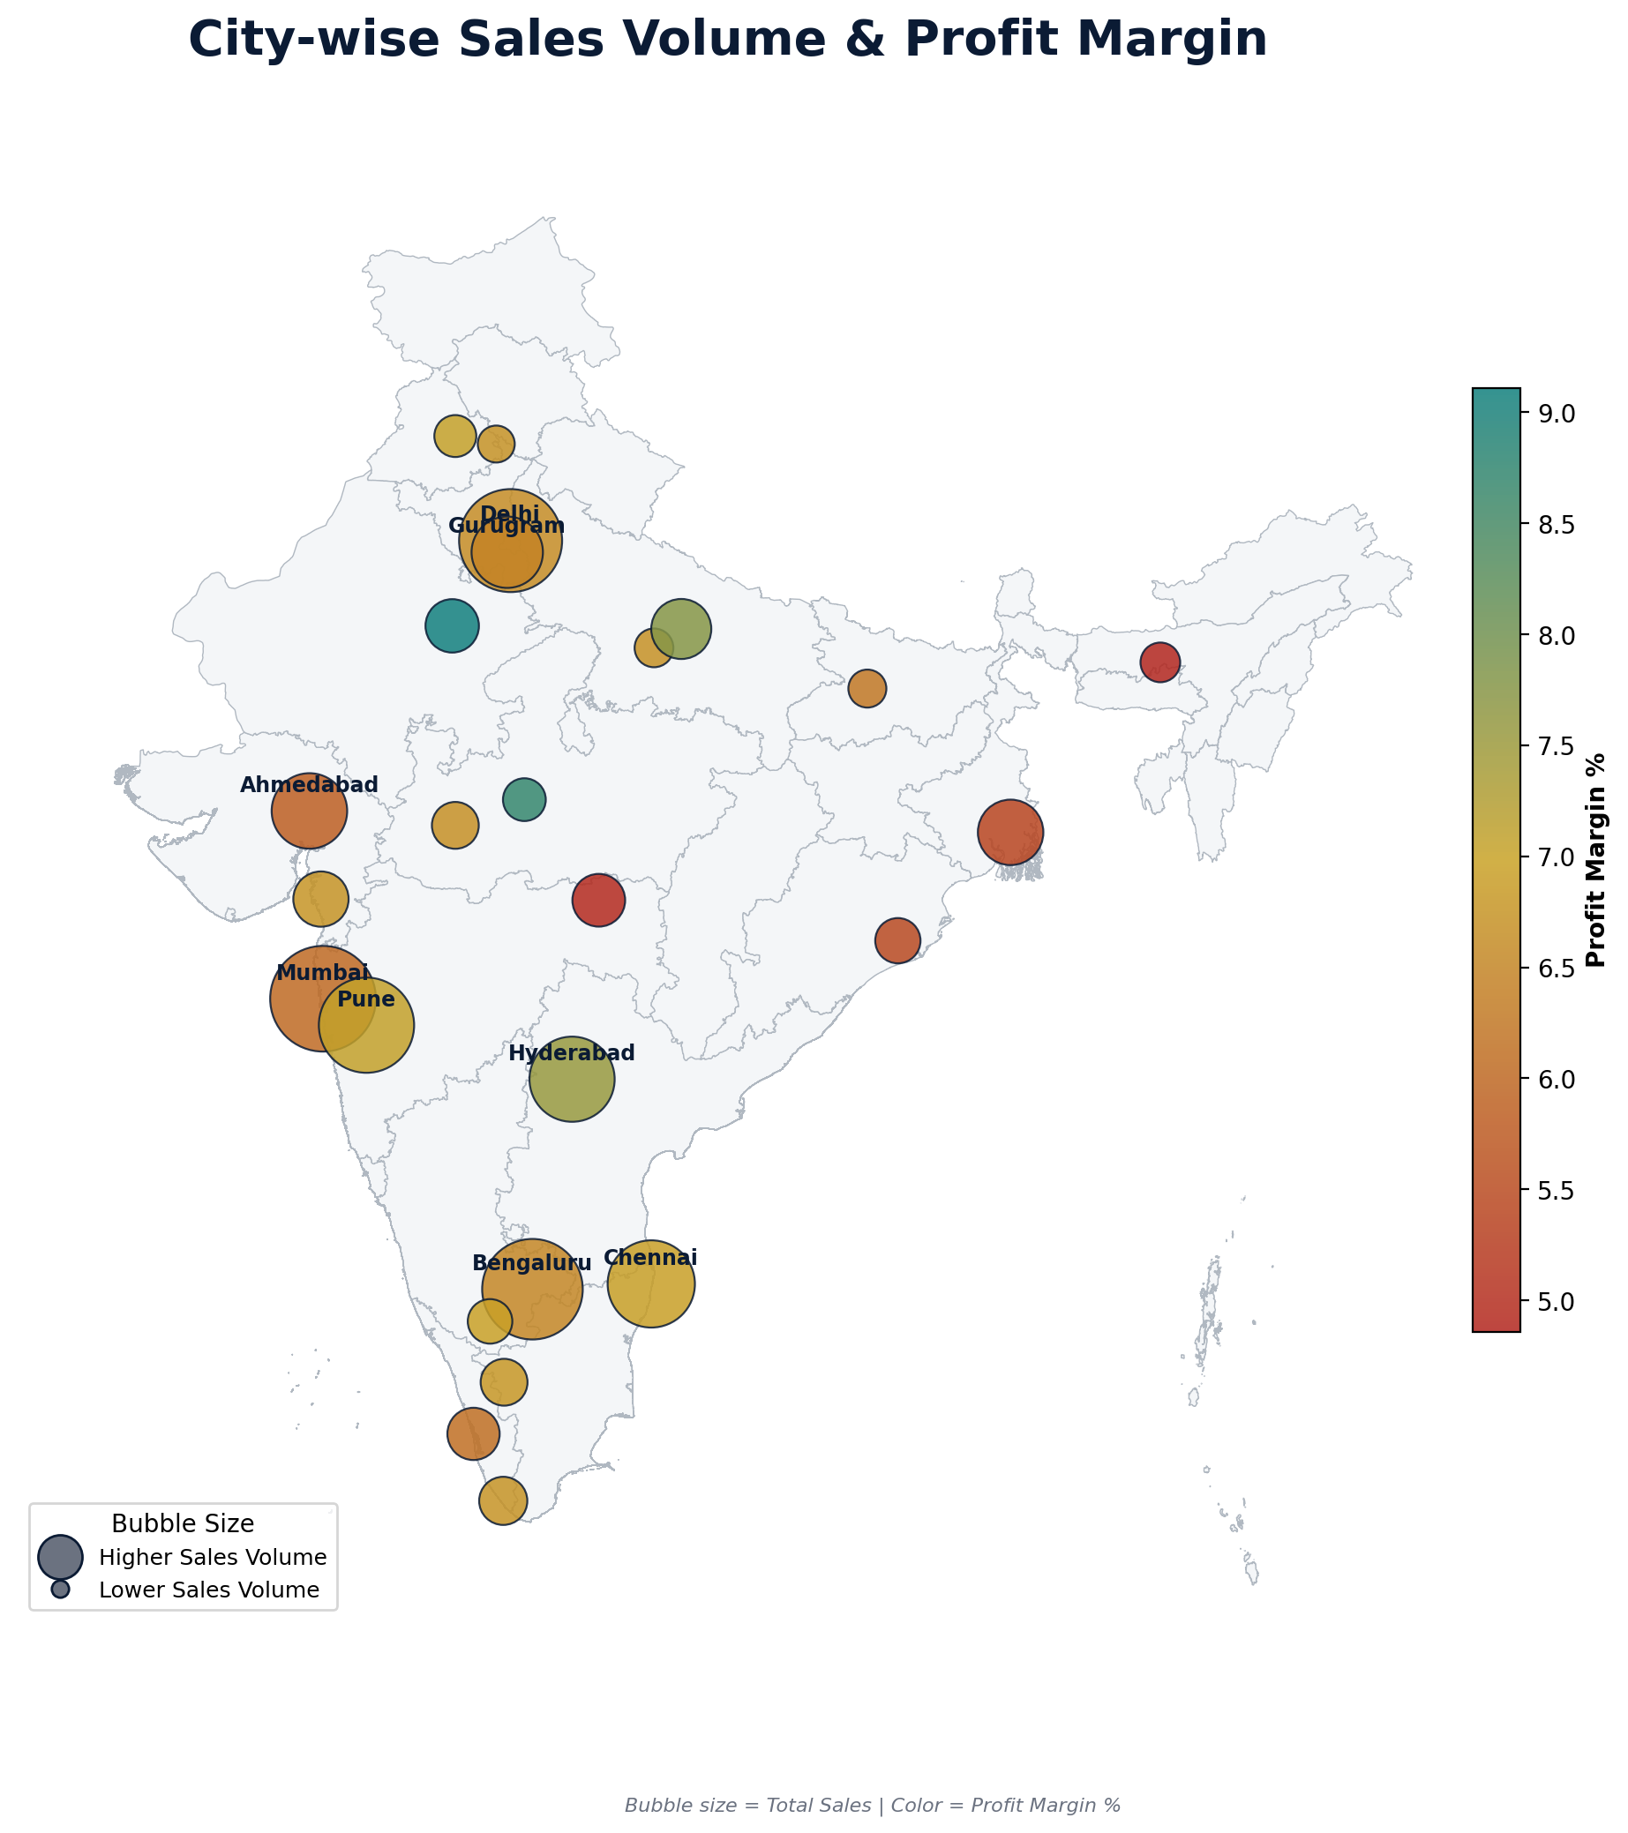
Geographic Analysis: City-wise Volume & Margin
Bubble size = total sales | Color = profit margin %
Key Finding
Lucknow (7.75%) and Hyderabad (7.56%) post stronger margins than high-volume metros like Mumbai (6.03%) and Ahmedabad (5.83%) — metro discounting may be eroding margin more than it drives profit.
BharatKart E-Commerce Analytics
11

Slide 12
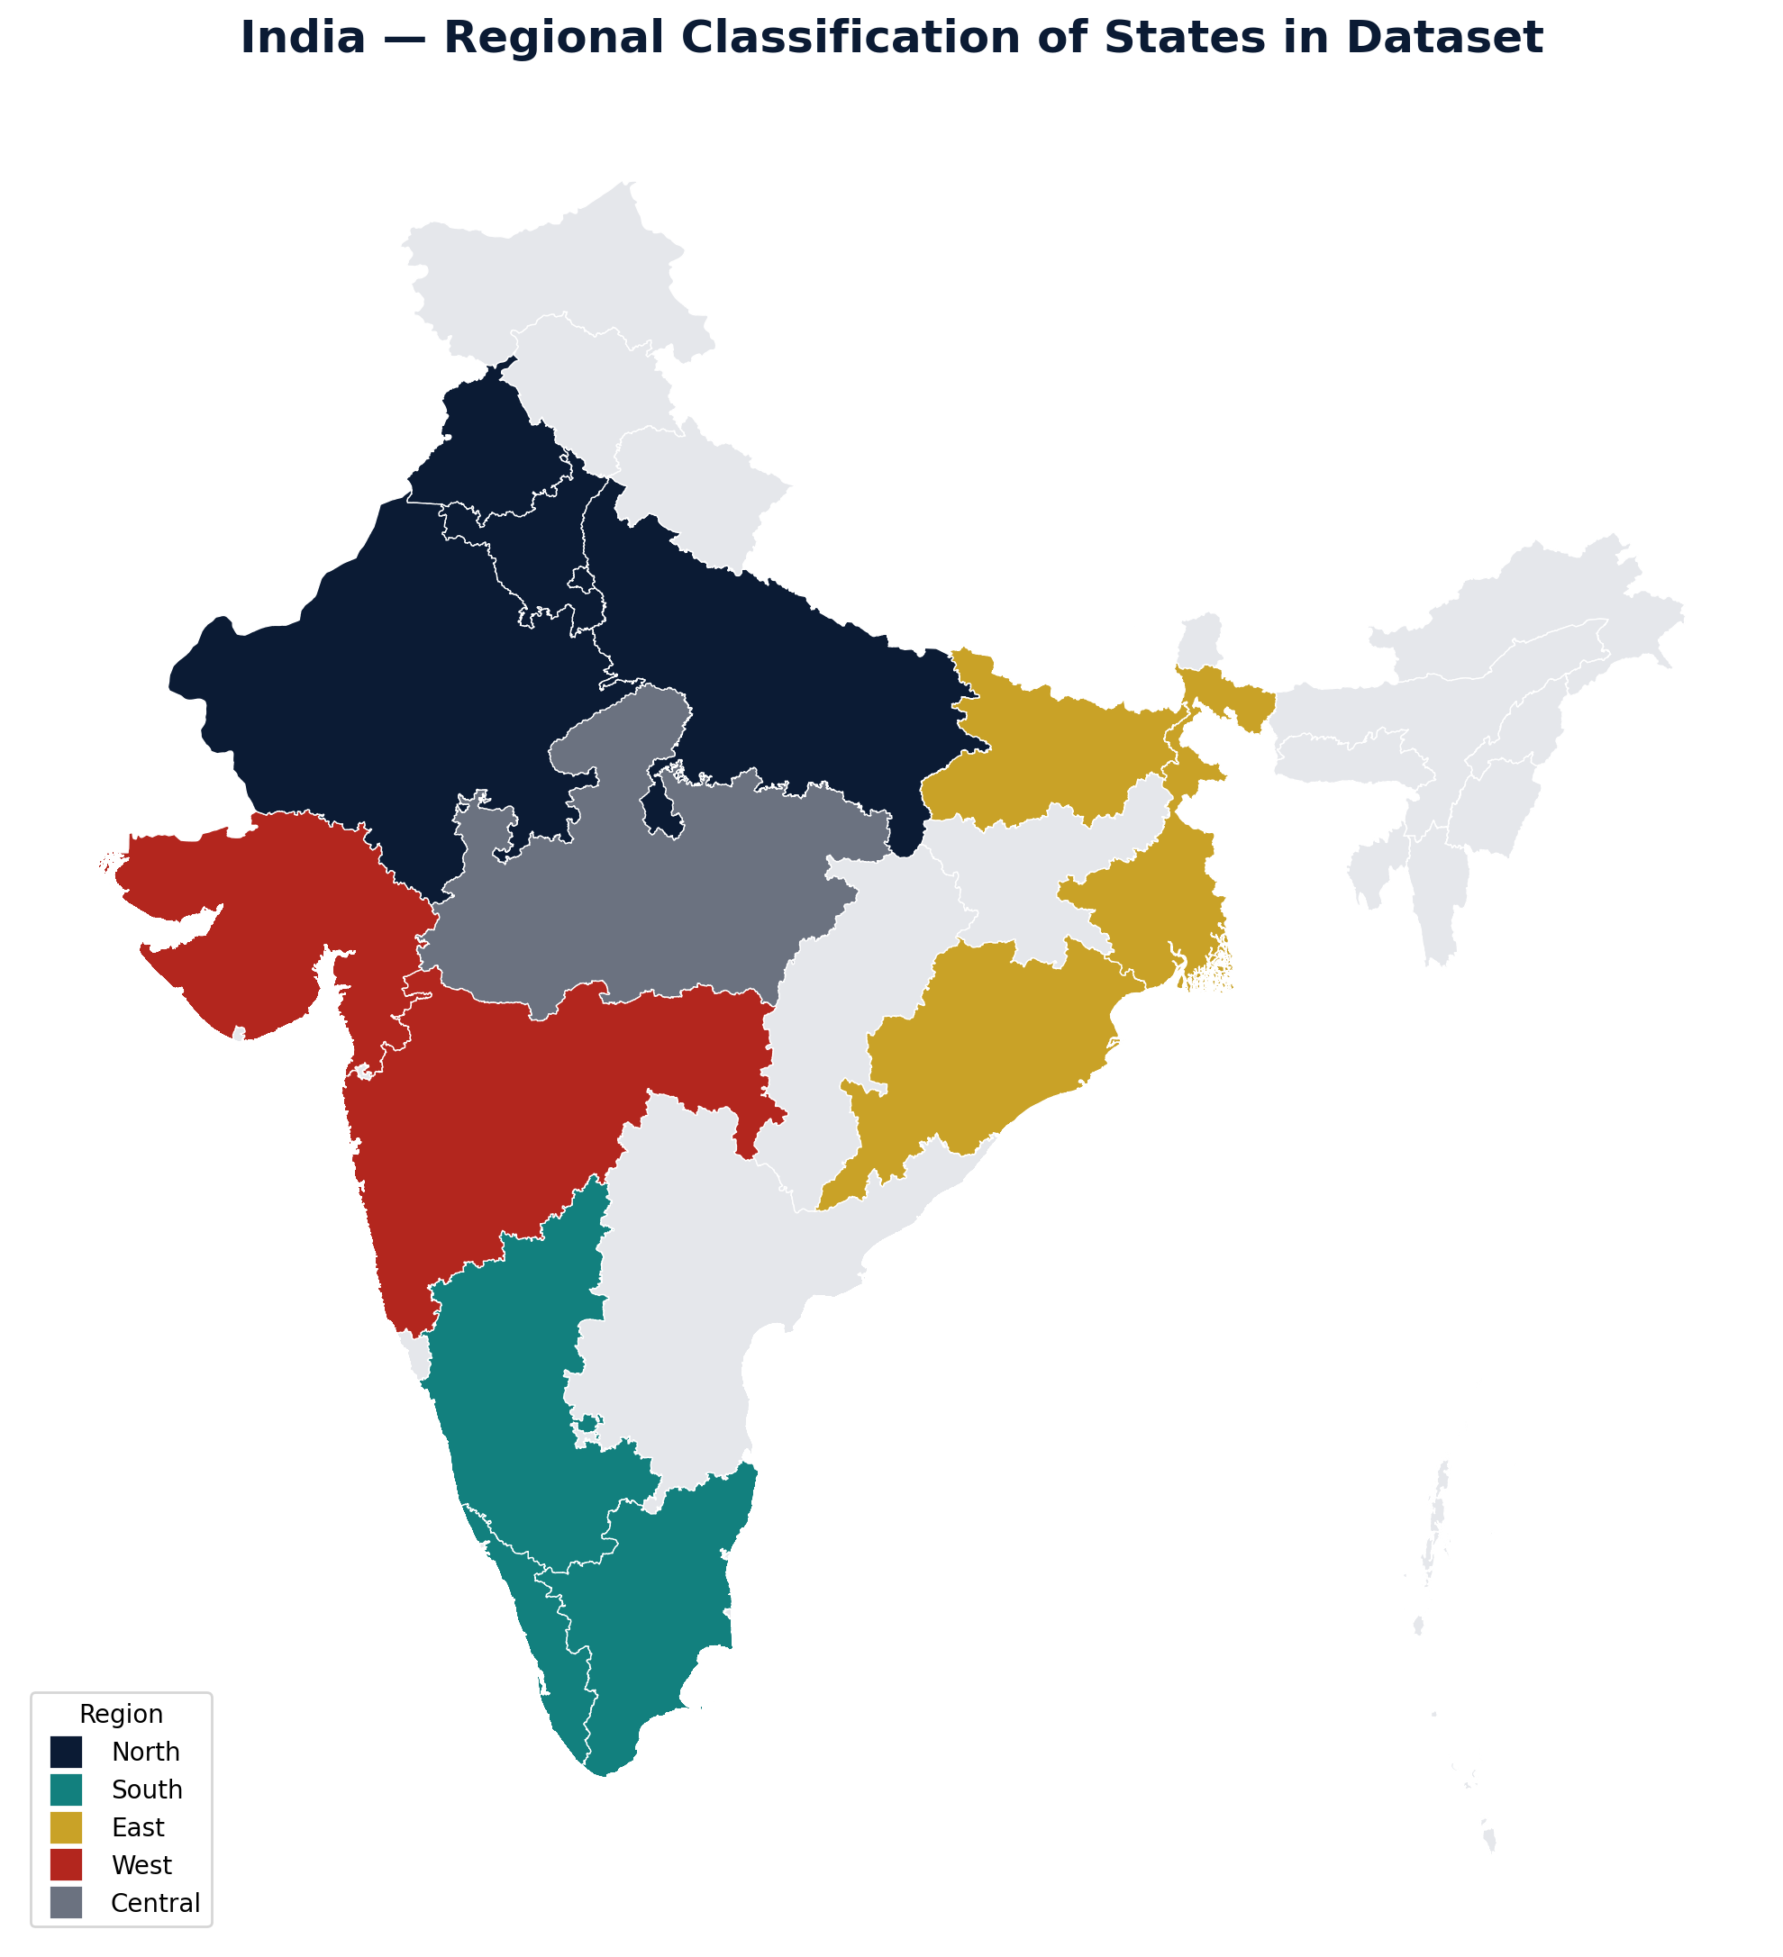
Geographic Analysis: Regional Classification
How the 17 dataset states roll up into 4 business regions
BharatKart E-Commerce Analytics
12

Slide 13
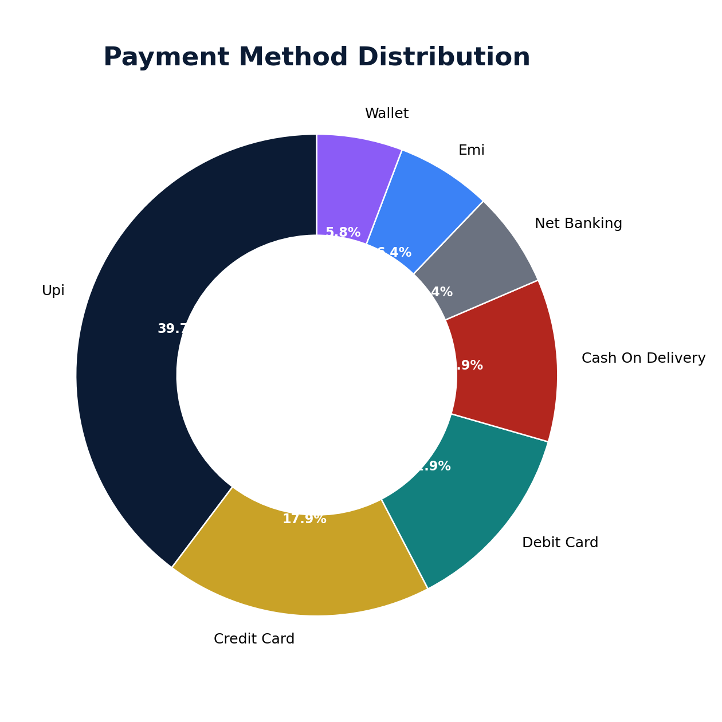
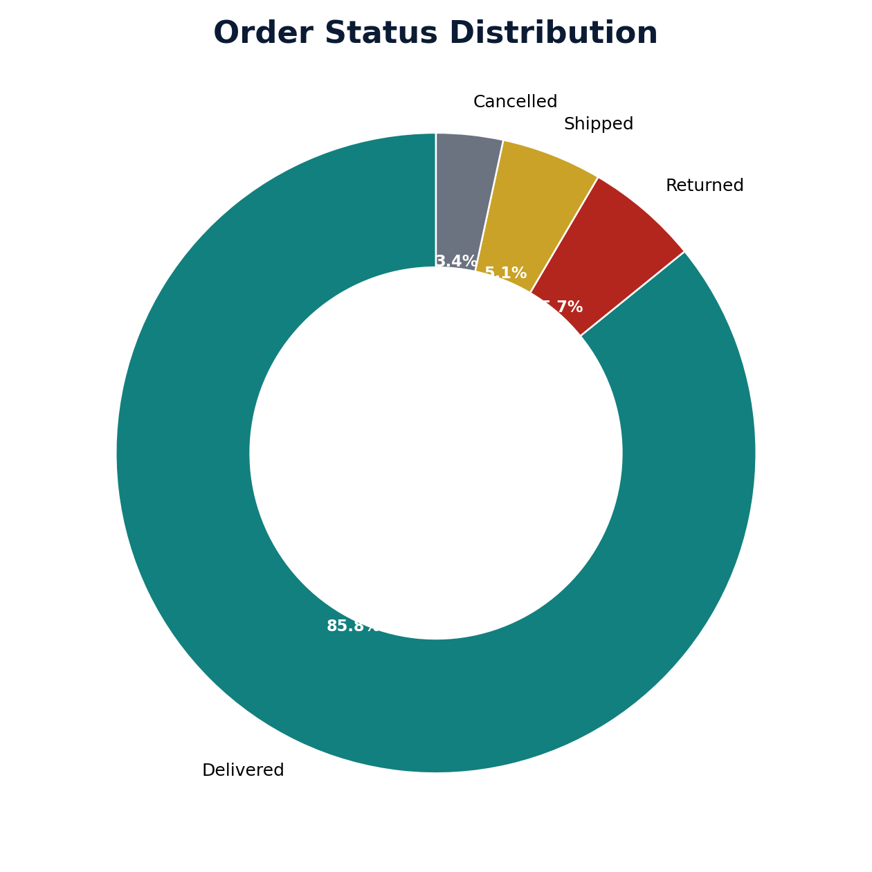
Payments & Fulfilment
UPI leads digital payments; delivery performance is strong
BharatKart E-Commerce Analytics
13

Slide 14
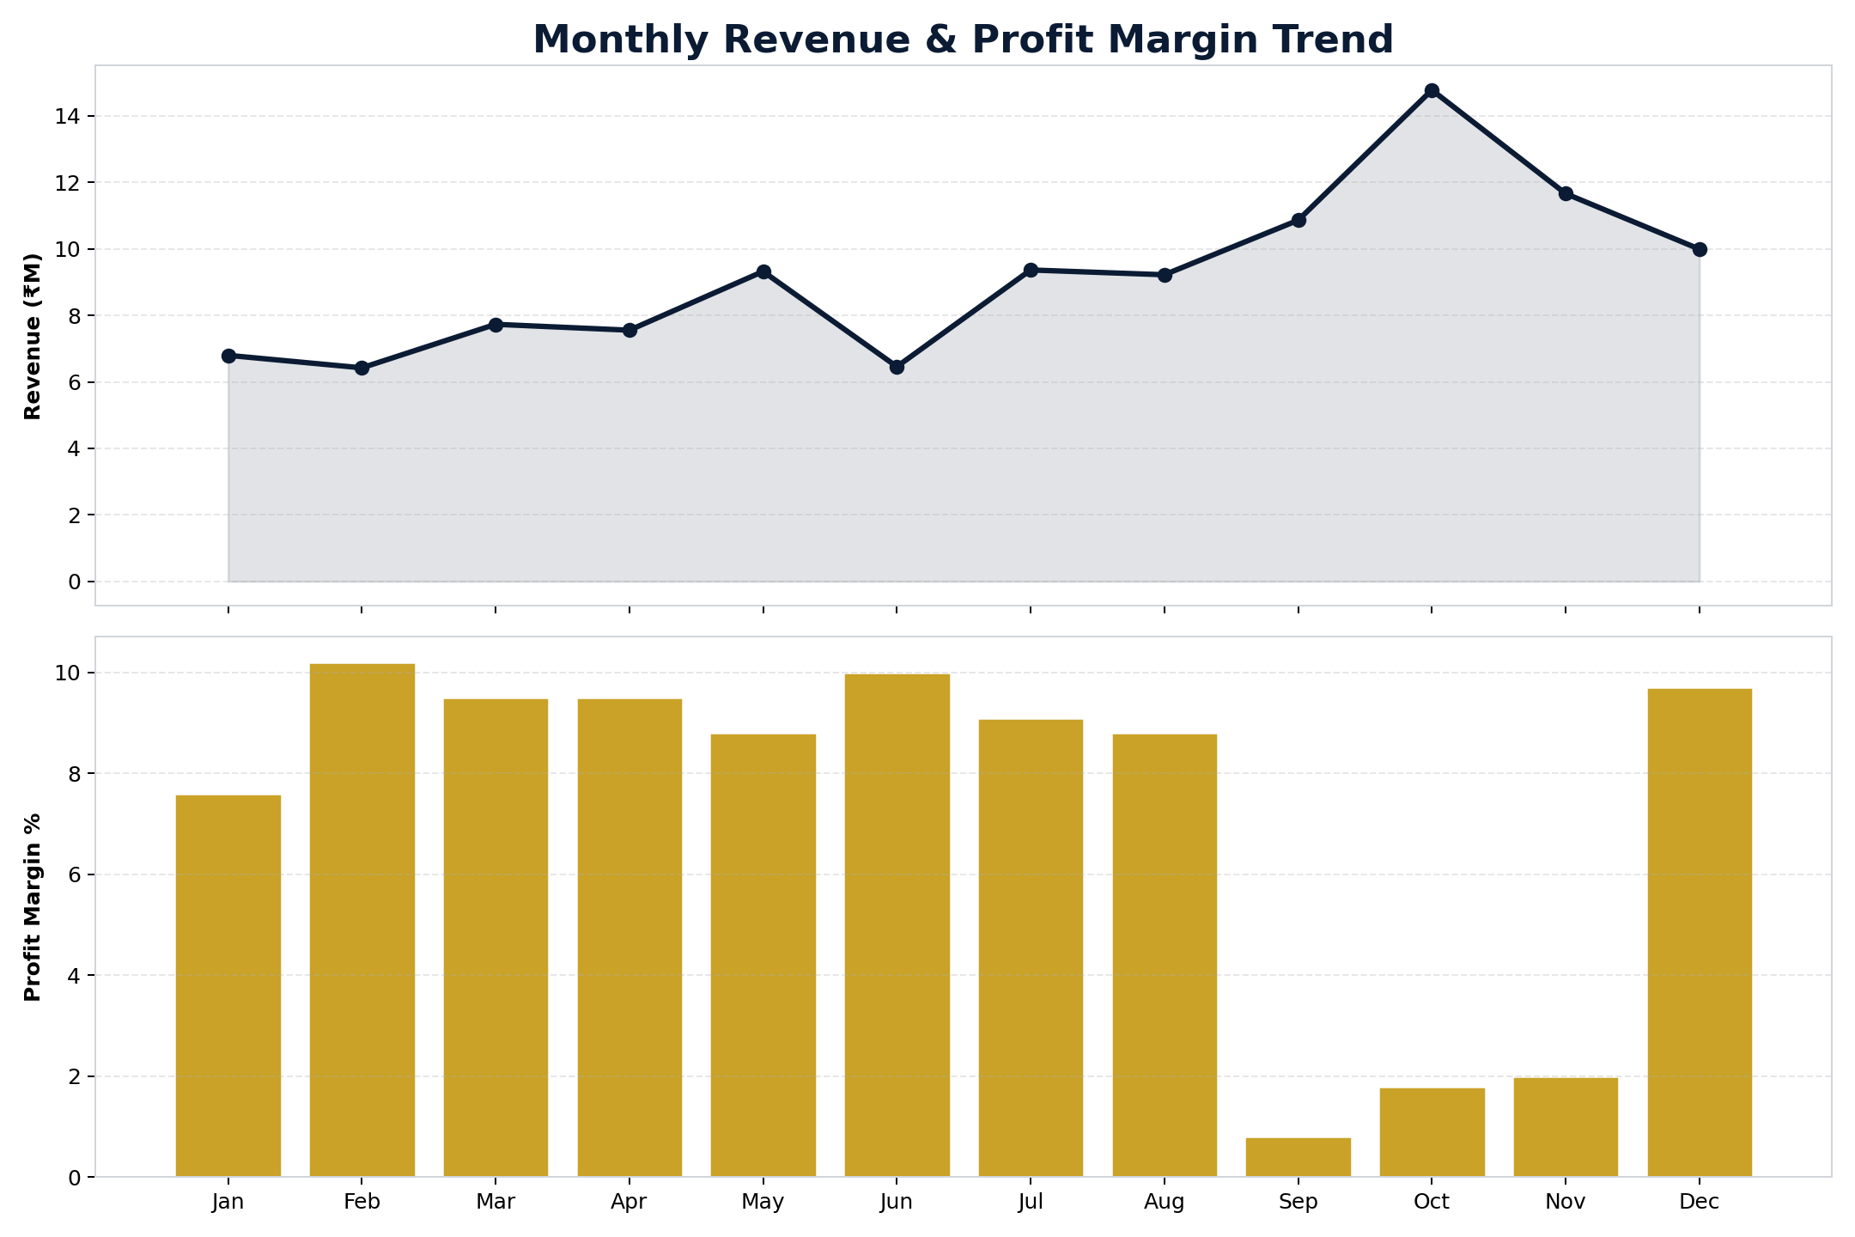
Monthly Revenue & Margin Trend
Festive season (Sep–Nov) shows revenue peaks with margin compression
BharatKart E-Commerce Analytics
14

Slide 15
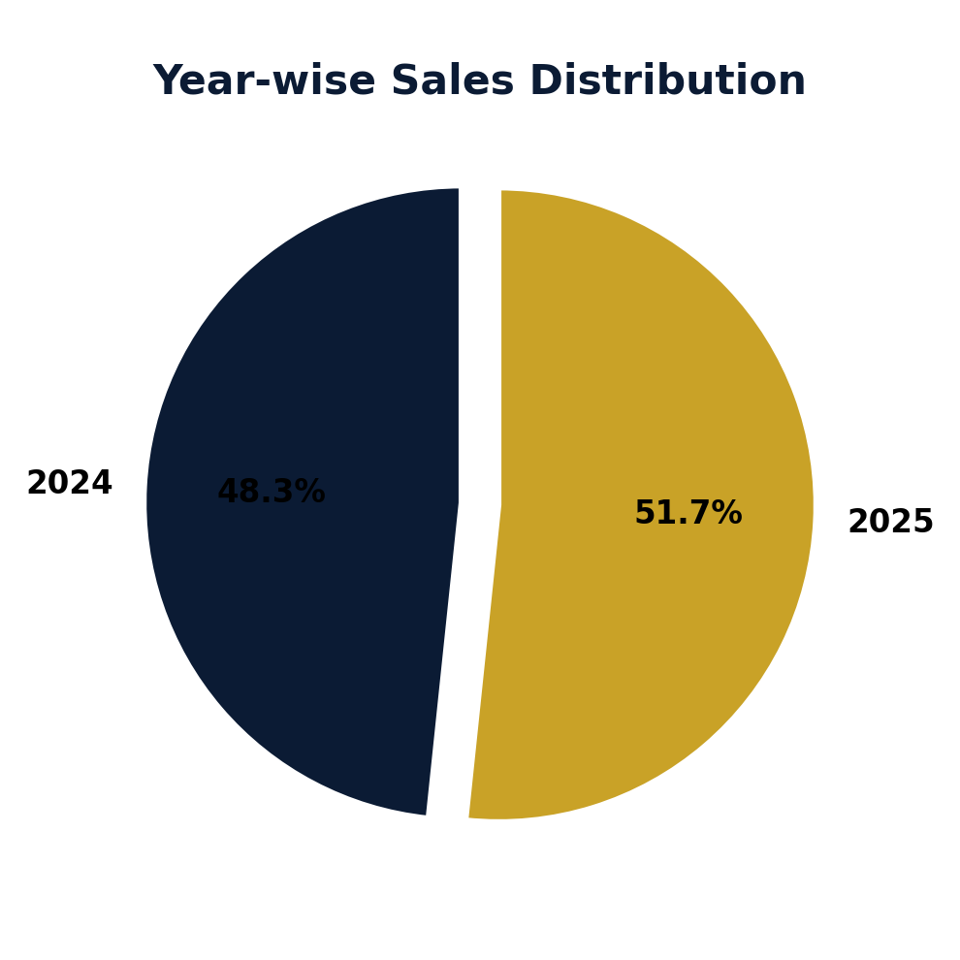
Year-wise Sales Split
Performance held broadly stable between 2024 and 2025
2024 contributed ~50.9% of total sales vs. 49.1% in 2025 — a small year-on-year decline, suggesting stable but not growing performance.
BharatKart E-Commerce Analytics
15

Slide 16
Recommendations
1
Protect the core, grow the edge
2
Fix low-margin bestsellers
Defend Maharashtra/Karnataka/Delhi/TN/Gujarat while targeting East & North for diversification
Review discount depth on HP Pavilion 15 and similar high-revenue, negative-margin SKUs
3
Lean into Tier-2 profitability
4
Investigate the 5.7% return rate
Invest in Lucknow, Hyderabad, Pune — healthier margins than saturated metros
Focus on Fashion and Electronics: sizing, quality, or delivery damage
5
Cap festive discount depth
6
Extend UPI-first + EMI options
Set margin floors for Sep–Nov promotions to protect profitability
Reduce affordability barriers on high-ticket Electronics/Appliances
BharatKart E-Commerce Analytics
16

Slide 17
Thank You
BharatKart E-Commerce Sales & Customer Analytics
Questions & Discussion

