Slide 1
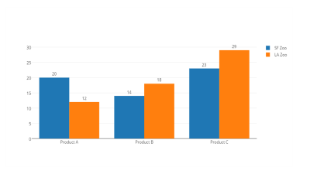
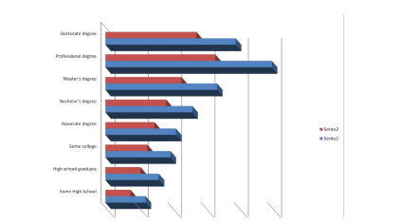
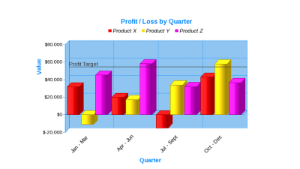

Slide 2






WINNER
To know
click icon!

Slide 3
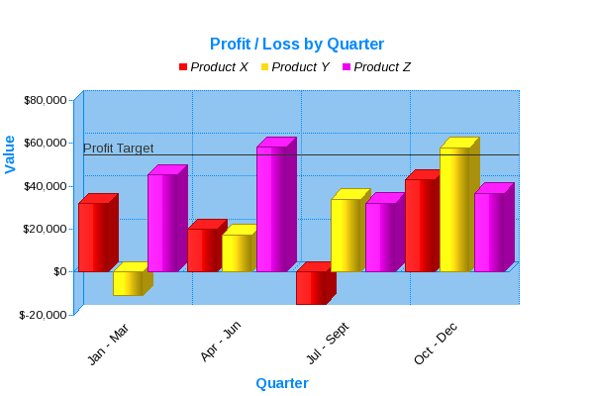

Slide 4
MORE INFO ON A

Slide 5
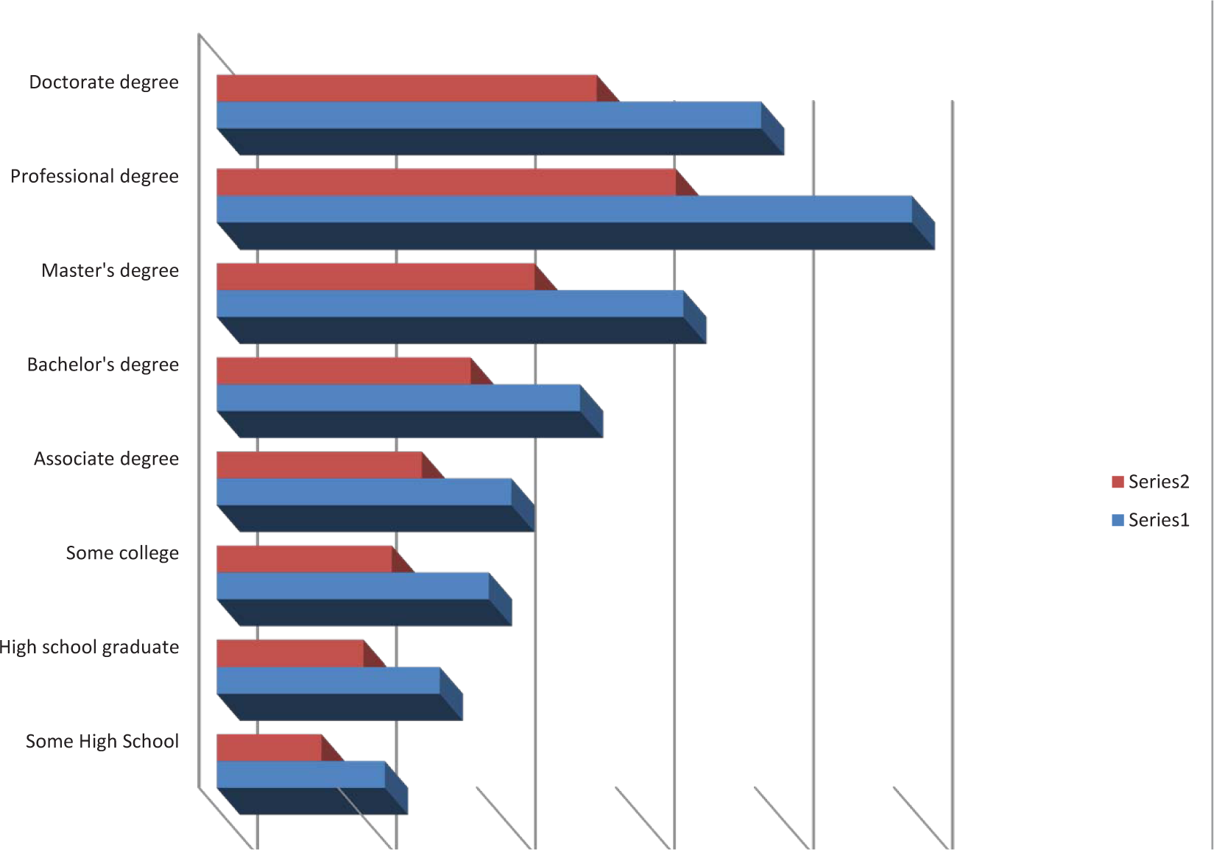

Slide 6
MORE INFO ON B

Slide 7
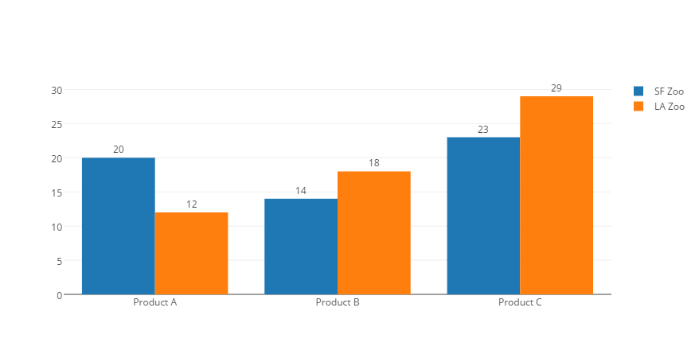

Slide 8
MORE INFO ON C

Slide 10
SIMPLE SLIDES WEBSITE & ROADMAP CONCEPT

