Slide 1
Recent advances in multilingual and code-mixed models for streaming end-to-end ASR systems
Vikas Joshi, Senior Researcher, Microsoft

Slide 2
Outline
Challenges in Indic language data
Transfer Learning
2-stage TL
Multilingual RNN-T models
Multilingual vanilla vs 1hot vs multisoftmax
Continual learning methods
LID-free multi-softmax models
Multilingual TL
Low resource, multiple dialects, code-mixing, noisy, multiple langauges
Notes:
Challenges prominent n the Indic languages – such as …
Different methods proposed to address these challenges can be categorized like TL learning to primarily address low resource and noisy data
Multilingual models not only improve on low resource but also provide maintenance benefits. A single model to train and deploy for much langauges. More streamlined
Continual learning methods, that consider code-mixing as a new task and aim to improve on them while not forgetting the previous task

Slide 3
Challenges in Indic language data
Relatively smaller amount of training data
American English: 100K – 200K hours
European languages: 20K – 50K hours
Indian languages: < 10 K hours
Notes:
Need to get the data-stats

Slide 4
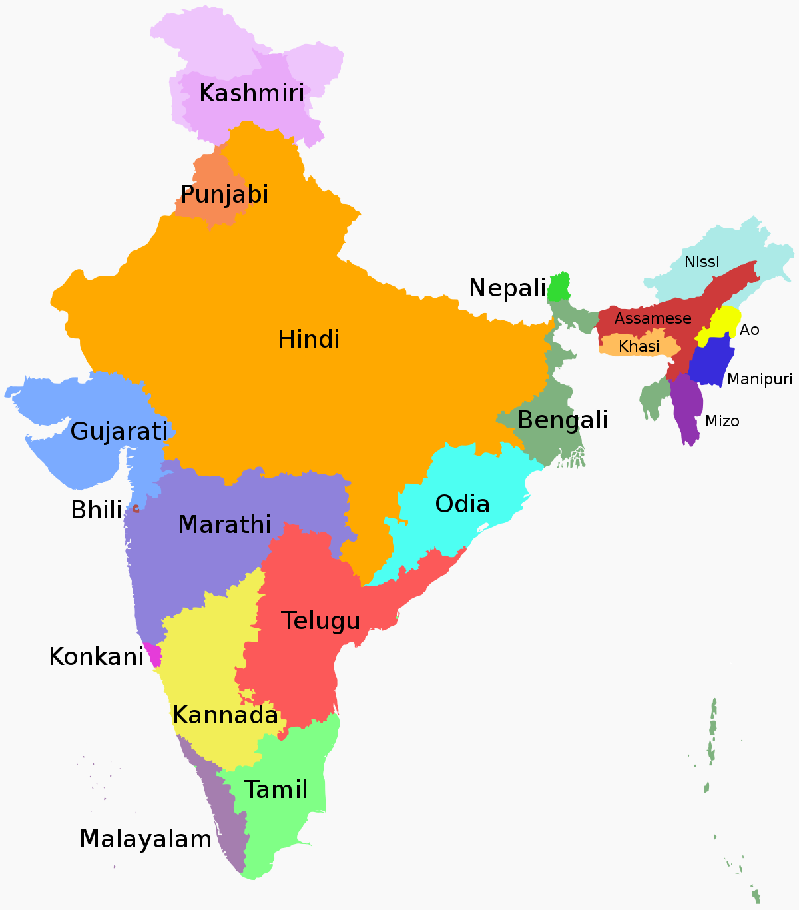
Challenges in Indic language data
Relatively smaller amount of training data
Multiple dialects
22 official languages
546+ dialects
From https://en.wikipedia.org/wiki/List_of_languages_by_number_of_native_speakers_in_India
Notes:
Within each langauge there are multiple dialects

Slide 5
Challenges in Indic language data
Relatively smaller amount of training data
Multiple dialects
Higher code-mixed data
Type of Utts | Hi-IN | En-IN
Monolingual | 22% | 84%
Code-mixed | 78% | 16%
Notes:
We observe more code-mixing in Indian languages. For example in our sets we see 78% code-mixed in our Hindi sets, compared to 16% in English data

Slide 6
Challenges in Indic language data
Relatively smaller amount of training data
Multiple dialects
Higher code-mixed data
Noisy data
Notes:
Need to get the data-stats on En-US rather than en-IN

Slide 7
How do they affect the ASR modeling?
Convergence issues
Higher WER on low resource languages
Need for a single LID-free multilingual model
Maintain multiple models
Higher WER on CM and noisy utts
Notes:
All the challenges discussed manifest into different problems or needs in our ASR training.
1. Convergence issues: We often face difficulty to train models with Indian languages compared to English models for say.
2. Convergence issues are more prominent with low resources and also considering that the training is small, low resource models perform poorly.
3. We also observe models often don’t do well whenever an English words are used for say in Hindi model. Also as expected, we see higher WER on noisy utterances
4. In our natural conversations, most of us use more than one language interchangeably. We feel more comfortable like that.
5. Maintenance: Training and deployment involves cost. So, number of langauges increase, it becomes more and more tedious.

Slide 8
Explored methods
Transfer learning
Multilingual Training
Continual learning and Specialized CM methods for CM
Data augementation
Leverage data
Better convergence
Leverage data
Better convergence
Modeling convenience
LID-free models
Code-mixing is treated as new task
Specialized model architectures conducive for CM scenarios
LM data generation
TTS based data generation
Notes:
I have categorized different methods into 4 categories.
TL improves convergence (we will see that), improve under low resource conditions, also on noisy data by better generalization to an extent
Multilingual models have all benefits TL methods and provide modeling convenience as single model can be used for multiple langauges. Recent methods aim to provide a truly multilingual experience.
Specificized CM architectures and continual learning methods that are relatively new which aim to address code-mixing challenge
Data augmentation methods aim artificially generate more data to LM and to AM via TTS.

Slide 9
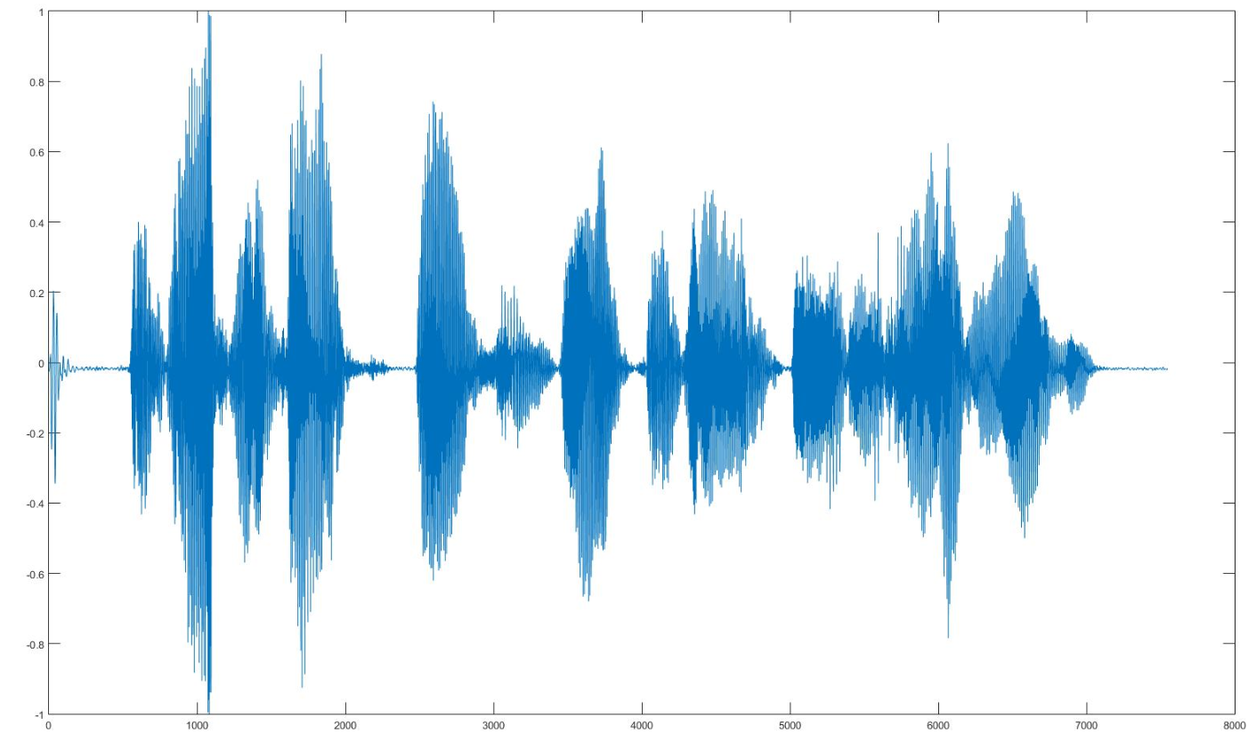
RNN-T model
है कोर्टाना
Output
Post processing
ह ै <space> क ो र ् ट ा न ा
Hybrid vs RNNT models:
𝑷(𝒚|𝒕, 𝒖)
Joint Network
Parameter | Hybrid production models | RNNT models
Model size | ~3 GB | 50 Mb (including the runtime)
Deployment | Cloud | On-device, Cloud
Internet dependency | Yes | No
Personalization, custom grammar support | Yes | limited
Accuracy | Comparable | Comparable
Model simplicity | Fairly complex: AM, n-gram LM, Lexicon, G2P, others | Single neural model
Prediction network
Encoder
𝒚𝒖−𝟏
𝒙𝒕
Previously predicted label
Acoustic feature extraction
Input
RNNT model architecture
Notes:
I will give a brief introduction to RNNT models. There is FE, Encoder, Prediction network, a joint network that combines the encoder and prediction network representations to produce the posterior probabilities over all the symbols.
The input audio is extracted into features as usual in the hybrid systems. MFCC features are the most prominent ones here as well.
The encoder take in the acoustic features and maps them into a higher dimensional representation. This is analogous to acoustic model
The prediction network takes the previously generated non-blank symbol to again to map it into a hidden vector, that helps determine the next symbol to be produced, analogous to the language model.
The joint network then combines the hidden representations from Encoder and prediction network to produce posterior probability over all the symbols. Then beam search algorithm is used to find the optimal sequence of symbols.
After postprocessing you obtain the final output.

Slide 10
Transfer Learning methods
Notes:
Next we will look at Transfer learning methods

Slide 11

2-stage TL for RNN-T
RNNT loss
Grapheme
targets
Senone
targets
CE loss
TL done in 2 stages
First, Hindi CE model is trained by TL from en-US CE model
Subsequently the Hi-IN RNNT model is trained by TL from Hi-IN CE model
Hi-IN CE model is trained with either Grapheme or senone targets
𝑷(𝒚|𝒕, 𝒖)
Joint Network
Joint Network
Joint Network
Prediction network
Encoder
Encoder
Encoder
$$y_{u−1}$$
Hi-IN Acoustic feature extraction
Hi-IN Acoustic feature extraction
en-US Acoustic feature extraction
*Vikas Joshi, Rui Zhao, Rupesh R. Mehta, Kshitiz Kumar, Jinyu Li, “Transfer Learning Approaches for Streaming End-to-End Speech Recognition System”, Interspeech 2020
Notes:
The transfer learning is done in 2 stages. An important thing to note is that the initialization model is not source RNNT model, but the CE trained model.
So in the first stage you train Hi-IN CE model TL from en-US CE model, which is subsequently used to initialize the encoder of the Hindi RNNT model. The paper studies different combinations like initialization Prediction network, then initializing from en-US RNNT model, instead of CE model. But that above shown methods of 2-stage TL is shown to provide the best results.
1. It is interesting to note that TL is so much effective even with different languages and different target models are used to initialize.

Slide 12
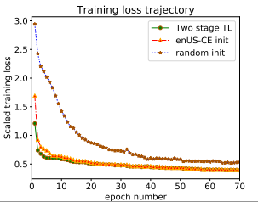
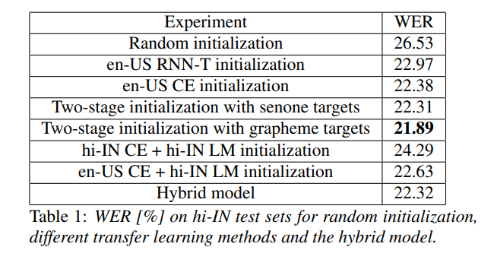
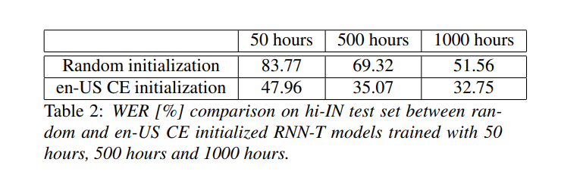
Results
Notes:
Convergence is much faster
2-stage TL shows much better benefit compared to random initialization.
TL significantly helps when the amount of training data is much smaller.

Slide 13
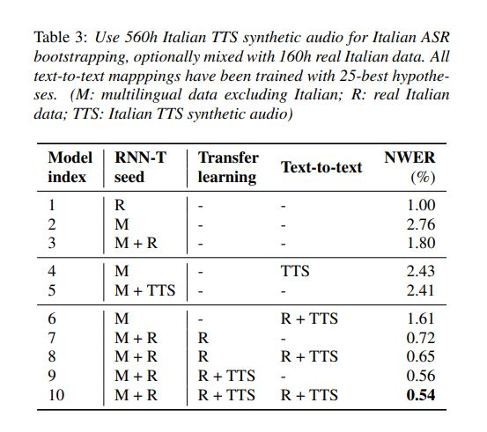
Multilingual seed model
Multilingual seed
Text-to-text mapping
TTS data
Indic language family
Trained with CE loss
En-IN
Hi-IN
Ta-IN
Te-IN
Mr-IN
Gu-IN
Hi-IN Encoder
Encoder
Network
En-IN
Hi-IN
Ta-IN
Te-IN
Mr-IN
Gu-IN
Manuel Giollo, Deniz Gunceler, Yulan Liu, Daniel Willett “Bootstrap an end-to-end ASR system by multilingual training, transfer learning, text-to-text mapping and synthetic audio”, Interspeech 2021
Notes:
A natural extension to this was proposed in the above paper, where the seed model is not from a single source but a multilingual model in itself.
The authors proposed 2 other ideas, one is to post process the outpout symbols.
Use TTS data for data augmentation (for TL and text-to-text mapping)

Slide 14
Story so far
Challenges: Convergence; Higher WER on low resource, CM, noisy; LID free models; Maintenance
2-stage TL and multilingual-seed based TL helps improve WER and faster convergence. Data augmentation helps in certain conditions

Slide 15
Multilingual RNN-T models

Slide 16
Multilingual models
Key tenets:
Build a multilingual seed model
Better convergence
Faster training
Easy maintenance
LID-free multilingual model
No need to know the input language
Notes:
1. Better convergence

Slide 17


Multilingual models (Vanilla & 1hot)
Output probabilities over all symbols
Output probabilities over all symbols
Joint Network
Joint Network
Vanilla model is multilingual, LID-free, streaming
1hot is multilingual and streaming (not LID-free)
Prediction
Network
Encoder
Network
Prediction
Network
Encoder
Network
Embedding
Feature extraction
Label extraction
Feature extraction
1
0
0
0
0
$$y_{u−1}$$
$$y_{u−1}$$
En-IN
Hi-IN
Ta-IN
Mr-IN
Gu-IN
En-IN
Hi-IN
Ta-IN
Mr-IN
Gu-IN
A. Kannan, A. Datta, T. N. Sainath, E. Weinstein, B. Ramabhadran, Y. Wu, A. Bapna, Z. Chen, and S. Lee, “Large-scale multilingual speech recognition with a streaming end-to-end model,” Interspeech 2019.
Notes:
Simplest of multilingual RNNT model is to pool all the training data, and combine all the output symbols. Henceforth I will refer to this model as vanilla. Though vanilla looks very simple, it is yet powerful. It is multilingual, streaming, LID-free.
The above model can be modify to improve the WER by adding a 1-hot vector at the input. However, this now is not LID-free. You need to know the language apriori.

Slide 18
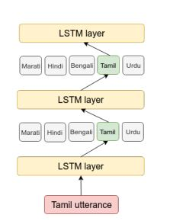
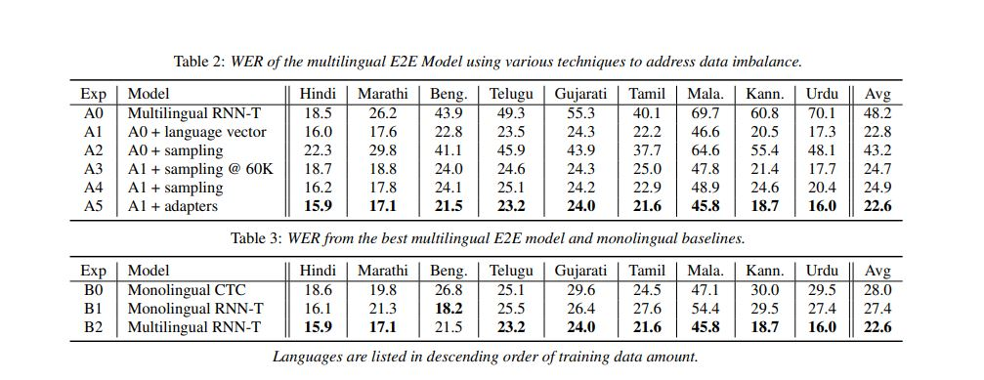
Multilingual model results
Notes:
In the same paper authors also proposed using language specific matrices inbetween the layers as shown above. Again this is not LID-free.
Adding the language vector (1hot) significantly improved the performance
Other approaches like sampling. Language specific adapters only improved the performance marginally.

Slide 19
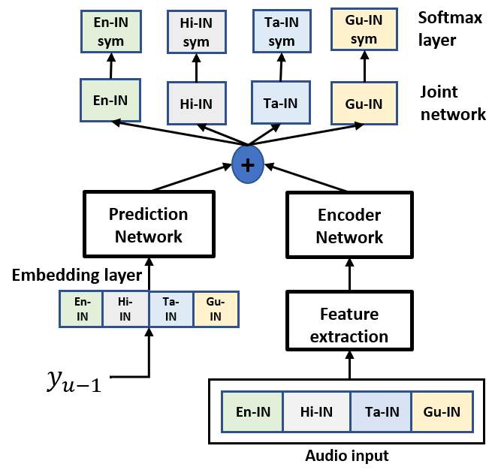
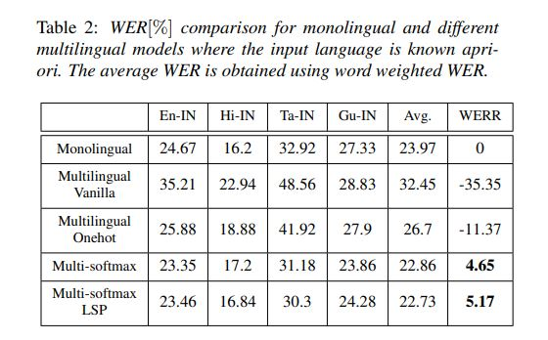
MultiSoftmax model
Vikas Joshi, Amit Das, Eric Sun, Rupesh R. Mehta, Jinyu Li, Yifan Gong, “Multiple Softmax Architecture for Streaming Multilingual End-to-End ASR Systems”, Interspeech 2021.
Notes:
Recently in Interspeech 2021, the multisoftmax based multilingual models are proposed (by our group).
The key difference is that there is language specific output layers, which means that you have softmax, joint network, and embedding layers are organized in the langauge specific fashion.
This is again not LID-free. You need to know the langauge apriori, but you don’t need to specific the 1hot vector to the model, but instead configure the runtime
As you can see from the results, the multisoftmax model shows, much better performance compared to the vanilla or onehot baseline. Wrt to monolingual, the vanilla model was much worse, while multisoftmax model is comparable or better in many cases.

Slide 20
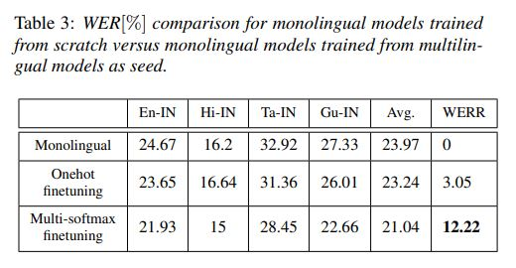

MultiSoftmax as seed model
RNNT loss
En-IN
sym
Hi-IN
sym
Ta-IN
sym
Gu-IN
sym
En-IN
Hi-IN
Ta-IN
Gu-IN
+
Prediction
Network
Encoder
Network
En-IN
Hi-IN
Ta-IN
Mr-IN
Gu-IN
Label extraction
Feature extraction
$$y_{u−1}$$
Hi-IN
Notes:
When we use multilingual models as the seed to train the monolingual models, you see significant improvement with the multisoftmax models with 12.22% WER improvement.
So again multilingual models come to resuce.

Slide 21
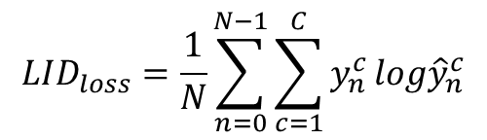

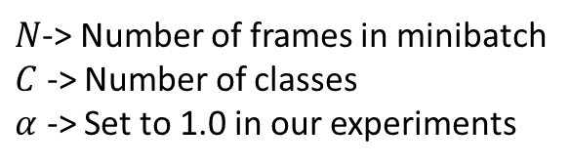

LID-free MultiSoftmax
RNNT loss
CE loss
$$LID_{loss}=\frac{1}{N}\sum_{n=0}^{N−1}{\sum_{c=1}^{C}{y_{n}^{c}}log{\hat{y}}_{n}^{c}}$$
En-IN
sym
Hi-IN
sym
Ta-IN
sym
Gu-IN
sym
LID-Sym
En-IN
Hi-IN
Ta-IN
Gu-IN
LID-FC
$$total_{loss}=RNNT_{loss}+α∗LID_{loss}$$
+
$N$-> Number of frames in minibatch
$C$ -> Number of classes
$α$ -> Set to 1.0 in our experiments
Prediction
Network
Encoder
Network
Just speak in any supported language! Streaming! No language information needed!
LID loss updates the encoder parameters as well, along with LID specific matrix
All decoders run in parallel
Can be optimized with minimal loss in accuracy
Encoder forward pass is done only once!
Inference: Estimate langauge for each frame and chose the language classified for maximum number of frames.
En-IN
Hi-IN
Ta-IN
Mr-IN
Gu-IN
Label extraction
Feature extraction
$$y_{u−1}$$
En-IN
Hi-IN
Ta-IN
Mr-IN
Gu-IN
Notes:
Next we see the LID-free version of the multisoftmax model. Here an LID classifier is integrated as shown in the figure above.
The training loss the weighted combination of the RNNT and LID loss
LID label remains for the entire utterance.
During inference, all decoder are run in parallel. So now there are 4 decoders running (obviously more expensive), but the encoder needs to run only once.
This is still better than having multiple monolingual models, and using and LID to combine them.

Slide 22
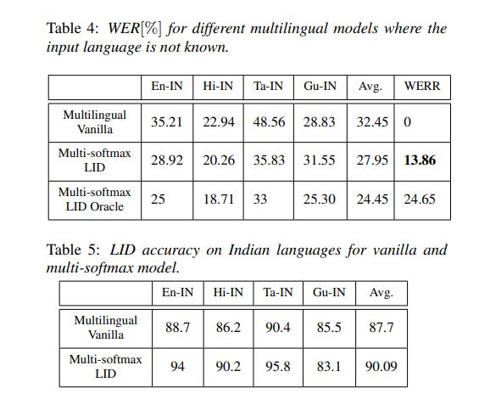
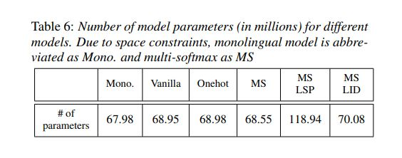
LID-free multilingual model results
Notes:
Comparing it with vanilla (as that is the LID free model), we see 123.86% improvement.
However, it is still far from the oracle (assuming we know the language). This is because of LID loss could backpropagate
LID accuracy from the Multisoftmax LID model is better than the vanilla model
Talk about size

Slide 23




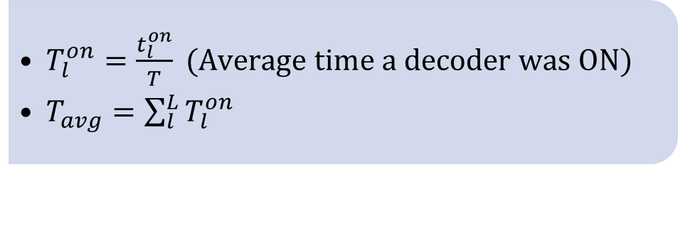




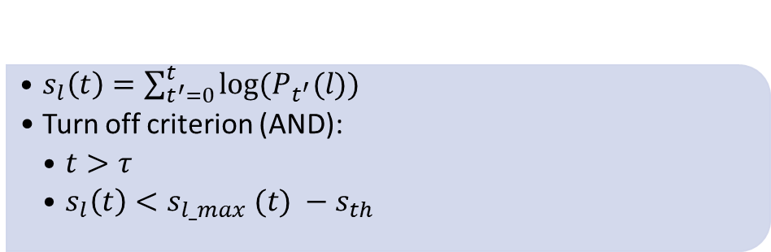
LID with early stopping
What
Switch of some of the decoders early
LID models says, “it is less likely to be language X”
We stop the decoder for X
How?
LID confidence for lang l
$s_{l}\left(t\right)=\sum_{t^{′}=0}^{t}{log⁡(P_{t^{′}}(l))}$
Turn off criterion (AND):
$t>τ$
$s_{l}\left(t\right)<s_{l_max} (t) −s_{th}$
Minimum wait time
Metrics
$T_{l}^{on}=\frac{t_{l}^{on}}{T} (Average time a decoder was ON)$
$T_{avg}=\sum_{l}^{L}{T_{l}^{on}}$
Notes:
Running multiple decoders in parallel is not optimal.
Can we switch some of the decoders early if the LID says “it is not language X, with “good” confidence”
LID confidence for each langauge l, represented by sl(t), summation of log posteriors for l, till time t, These posterior are output of the LID model.
When do we turn off:
We wait for some minimum time Tau
If the confidence score for any language fall below the maximum candidate by a certain threshold, then we stop the decoder.
As a metric we look at the Average time a decoder was ON.
Give example of Tavg interpretation

Slide 24
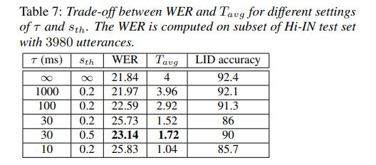
LID with early stopping
Encoder computations are done only once
Each beam search is done on a subset of symbols (unlike union of symbols in vanilla and onehot)
Notes:
Tau is reduced from infinity to 10, similarly we vary sth,
Tau and sth are infinity, all the decoders are ON and hence, you see that the WER and LID accuracy are at its the best and while the Tavg is 4 times using a single model
As you reduce Tau and sth, the Tavg comes down, and while there is increase in the WER
SO there is a trade-off and one needs to find that balance.

Slide 25
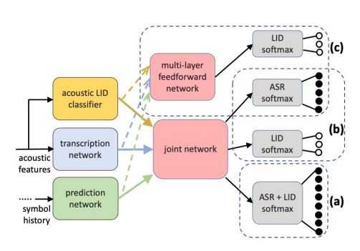
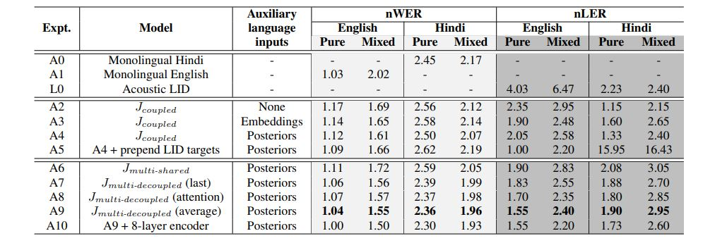
Other LID-free multilingual models
Surabhi Punjabi∗ , Harish Arsikere∗ , Zeynab Raeesy, Chander Chandak, Nikhil Bhave, Ankish Bansal† , Markus Muller, Sergio Murillo, Ariya Rastrow, Sri Garimella, Roland Maas, Mat Hans, Athanasios Mouchtaris, Siegfried Kunzmann “JOINT ASR AND LANGUAGE IDENTIFICATION USING RNN-T: AN EFFICIENT APPROACH TO DYNAMIC LANGUAGE SWITCHING”, ICASSP 2021
Notes:
There is another LID-free model recently proposed. In case (a), the symbols are extended to have language symbols. For every utterance the model should emit the langauge symbol at the end.
Next they segregate the ASR and langauge tokens and train them with the combined training loss like I showed in the previous slides
Finally, the LID training is entirely separated. You don’t want to load the Joint network to do everything. But the encoder and prediction network are used to determine the LID output, but they solely don’t do it.
The decoupled approach © shows the best results

Slide 26
Story so far
Challenges: Convergence; Higher WER on low resource, CM, noisy; LID free models; Maintenance
2-stage TL and multilingual-seed based TL helps improve WER and faster convergence. Data augmentation helps in certain conditions
Vanilla, 1hot and Multisoftmax multilingual models improve over monolingual baselines
LID-free multisoftmax models improve over vanilla models. Fewer studies done so far

Slide 27
Continual learning methods
Notes:
Now let us look into the continual learning methods

Slide 28
Code mixed speech recognition
Often see higher WER for code-mixed utterances compared to monolingual utterances
Most research focus on code-mixed scenario and not worry about monolingual scenario
In practice, ASR model should do well of both monolingual and code-mixed utterances
Our scenario:
Have access to both monolingual and code-mixed data
Explore methods so that we do well on both monolingual and code-mixed data
Brady Houston, Katrin Kirchhoff “Continual Learning for Multi-Dialect Acoustic Models”, Interspeech 2020
Gurunath Reddy M, Sanket Shah, Basil Abraham, Vikas Joshi and Sunayana Sitaram, “Learning Not to Discriminate: Task Agnostic Learning for Improving Monolingual and Code-switched Speech Recognition”, Code-switching workshop, Interspeech 2020
Notes:
Idea behind CL methods is that you have a model trained on certain set of tasks, and now you have a new task. The goal is to train the model in such a way that you improve the model performance on the new task, but don’t regress on the previous task.
There are couple of papers that I have listed here which utilize CL in the context of ASR. IN this paper from Amazon, they treat training the model for multiple dialects as sequence learning new tasks. However, you should not do bad on the previous dialects. Simpler approach is to combine all dialects and learn a single model, however, that can very expensive to do everytime you need to add new dialect. They show interesting results by CL methods.
In the second paper learning on CM is treated as a new task. Here they start with the monolingual models and further train them to learn CM utts. So the final goal is to do well on both monolingual and CM tasks.

Slide 29
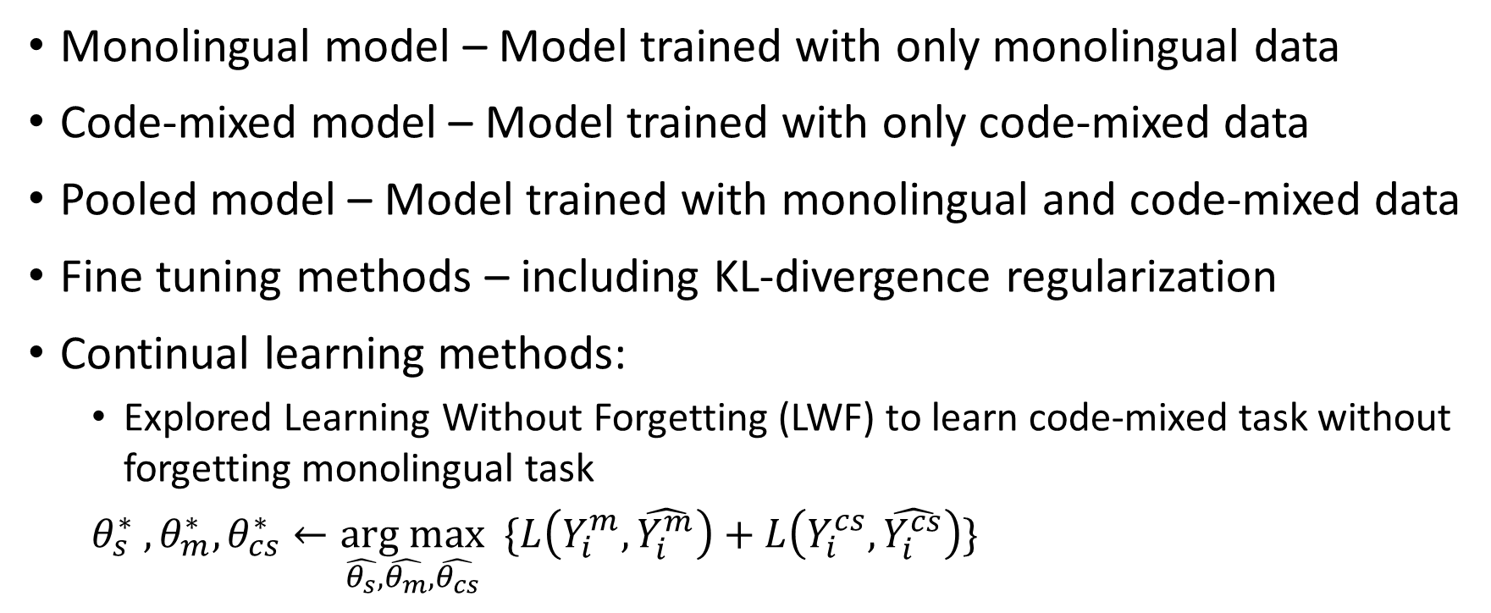
Approaches explored
Monolingual model – Model trained with only monolingual data
Code-mixed model – Model trained with only code-mixed data
Pooled model – Model trained with monolingual and code-mixed data
Fine tuning methods – including KL-divergence regularization
Continual learning methods:
Explored Learning Without Forgetting (LWF) to learn code-mixed task without forgetting monolingual task
$θ_{s}^{∗} , θ_{m}^{∗}, θ_{cs}^{∗}←\underset{\hat{θ_{s}},\hat{θ_{m}},\hat{θ_{cs}}}{\text{arg} \text{max}} \{L\left(Y_{i}^{m},\hat{Y_{i}^{m}}\right)+L\left(Y_{i}^{cs},\hat{Y_{i}^{cs}}\right)\}$
1. Gurunath Reddy M, Sanket Shah, Basil Abraham, Vikas Joshi and Sunayana Sitaram, “Learning Not to Discriminate: Task Agnostic Learning for
Improving Monolingual and Code-switched Speech Recognition”, Code-switching workshop, Interspeech 2020
2. Sanket Shah, Basil Abraham, Gurunath Reddy M, Sunayana Sitaram, Vikas Joshi, “Learning to Recognize Code-switched Speech Without Forgetting Monolingual Speech Recognition”, arXiv:2006.00782

Slide 30
Approaches in a nutshell
Codemixed target (pooled)
Codemixed target (pooled)
Monolingual target
Code-mixed target
Pooled target
Code-mixed target
Code-mixed target
Monolingual vs codemixed
Code-mixed target
FC with softmax
FC with softmax
FC with softmax
FC with softmax
FC with softmax
FC with softmax
FC with softmax
FC with softmax
FC with softmax
GRU
LSTM - 6
LSTM - 6
LSTM - 6
LSTM - 6
LSTM - 6
LSTM - 6
LSTM - 1
LSTM - 1
LSTM - 1
LSTM - 1
LSTM - 1
LSTM - 1
Monolingual acoustic data
Code-mixed acoustic data
Pooled acoustic data
Code-mixed acoustic data
Code-mixed acoustic data
Code-mixed acoustic data
Monolingual training
Code-mixed training
Pooled training
Fine-tuning training (with KLD)
LWF
Adversarial LWF
Notes:
Explaining the approaches pictorially,
The monolingual, code-mixed and pooled models are trained with the respective data-sources as shown in the Fig.
Fine tuning is done on the pooled model using the code-mixed data with the hope that it does better on the code-mixed data and does not degrade much on the monolingual data as we use KLD
Continual methods like LWF is explained where there is a separate head for code-mixed and monolingual data. During training an attempt is made such that the code-mixed head does well on the code-mixed data, while the output from the monolingual head do not deviate from its point where it was optimized for the monolingual task
Finally we also explore the adversarial LWF where we differentiate between monolingual and code-mixed data

Slide 31
Results
Language - Tamil
217 hours of monolingual training data
177 hours of code-mixed training data
24 hours of monolingual test data
19 hours of code-mixed test data
Model | Monolingual WER | Code-mixed WER
Monolingual model | 45.81 | 62.73
Code-mixed model | 66.11 | 58.63
Pooled model | 44.42 | 50.92
Fine tuning | 46.62 | 48.63
LWF | 44.72 | 50.57
Adversarial LWF | 44.31 | 50.12
Notes:
Here is the summary of the results:
1.

Slide 32
Story so far
2-stage TL and multilingual seed-based TL helps
Vanilla, 1hot and Multisoftmax multilingual models improve over monolingual baselines
LID-free multisoftmax models improve over vanilla models. Very few LID-free multilingual models studied
Continual learning methods show promise

Slide 33
What is still missing?
Multilingual models need to know the language before hand
Code-mixing is still not handled well
Difficult to scale to multiple langauges – Training convergence issues
All specialized architecture do not show extend gains when trained on large data

Slide 34
Speech applied science team @ Microsoft, India
14-member team - 3 PhD, 11 Masters
Areas of focus:
Acoustic modeling
Language modeling
Text to speech
E2E speech recognition
3 accepted papers at Interspeech 2020 and a workshop paper at Code-mixed workshop, Interspeech 2020, 1 paper at Interspeech 2021

Slide 35
Experiment details
Languages | #hours of training data | Vocab_size
hiin | 10077 | 133
enin | 10591 | 59
tain | 925 | 97
guin | 1201 | 123
mrin | 121 | 110
Languages | #Utts (test) | #Words (test)
enin | 33159 | 189024
hiin | 13756 | 159078
tain | 10279 | 84547
guin | 10384 | 103248
mrin | 7539 | 58658
Average | 75117 | 594555
All models trained in Pytorch
Random sampling to sample data for each batch
All models trained from scratch
Same hyperparameters (training and eval) used across experiments
Model with best validation accuracy used
Test sets are the official test sets that we track (combination of phrasal, conversation, callcenter)

Slide 36
Transfer learning (TL) for RNN-T
Why TL?
Better converge
Improve WER on low resource languages
What we propose?
Several TL strategies exist in RNNT framework
We explore 4 TL strategies with Hindi (target) and American English (source) language
Proposed 2-stage TL approach*
TL with increasing training data
Notes:
In this paper we present different transfer learning approaches to Streaming on-device models, using RNNT models.
Why TL
What we propose

Slide 37

Transfer learning (TL) for RNN-T
1. En-US CE initialization
RNNT loss
CE loss
En-US RNNT model is initialized with en-US CE model
Hu et.al, showed significant improvements with CE initialized models instead of CTC or random initialization
En-US CE model is trained with en-US word piece targets
Alignments for the CE model training is obtained by converting the word level alignments (obtained from hybrid model) to word piece level alignments
𝑷(𝒚|𝒕, 𝒖)
Joint Network
Joint Network
Prediction network
Encoder
Encoder
$$y_{u−1}$$
Hi-IN Acoustic feature extraction
en-US Acoustic feature extraction
Notes:
First let us examine different encoder initialization methods.
As shown in the above figure, the encoder of the Hindi RNNT model is initialized from an encoder trained from en-US data trained with Cross entropy criteria.
This is same model used to initialize the encoder of en-US RNNT model as well. Since, the RNNT models are different to train,

Slide 38


Transfer learning (TL) for RNN-T
2. En-US RNNT initialization
RNNT loss
(WP targets)
RNNT loss
Hi-IN RNNT Encoder is initialized with en-US RNNT encoder
En-US RNNT model is trained with Word piece targets
En-US RNNT encoder is trained jointly with the en-US prediction network – So, is it just better to initialize with en-US CE which is purely trained as an Encoder?
𝑷(𝒚|𝒕, 𝒖)
Joint Network
Joint Network
Prediction network
Encoder
Encoder
Prediction network
$$y_{u−1}$$
Hi-IN Acoustic feature extraction
en-US Acoustic feature extraction
$$y_{u−1}$$
Notes:
First let us examine different encoder initialization methods.
As shown in the above figure, the encoder of the Hindi RNNT model is initialized from an encoder trained from en-US data trained with Cross entropy criteria.
This is same model used to initialize the encoder of en-US RNNT model as well. Since, the RNNT models are different to train,

Slide 39

Transfer learning (TL) for RNN-T
4. Hi-IN/En-US CE + Hi-IN LM initialization
NCE loss
RNNT loss
CE loss
Encoder and prediction network initialization
Encoder is initialized with a pretrained Hi-IN CE model or en-US CE model
Prediction network is trained from a pretrained LM trained from external Hindi text corpus
Trained with 200 million words
Only unique sentences are used
𝑷(𝒚|𝒕, 𝒖)
Joint Network
Joint Network
Joint Network
Prediction network
Prediction network
Encoder
Encoder
Hi-IN external text corpus
$$y_{u−1}$$
Hi-IN Acoustic feature extraction
Hi-IN Acoustic feature extraction
Notes:
1. No en-US data is used at all!

Slide 40
Experimental set-up
Data
Features/Labels
Model
65K hour En-US data
640-dim LFB features (80*8)
6-layer LSTM encoder (1600*800)
~8.5K hours Hi-IN data
133-dim Grapheme Hi-IN symbols
2-layer LSTM prediction network
17619 test utterances
4K En-US word piece
Trained in CNTK

