Slide 1

Teegala Krishna Reddy Engineering College Project Title: Smart Time Table Generator (STTG)
Presented By:
T. Sai (24R91A6760) S.K. Pasha (24R91A6757) N. Savitha (24R91A6743)
Internal Guide:
Mrs. Ch Sai Priya

Slide 2
Agenda
Abstract
Introduction
Existing system
Proposed system
Workflow
System Architecture
UML Diagrams- Class, Use-case, Sequence and Activity diagrams
Modules
System requirements
References

Slide 3
Abstract
The Smart Time Table Generator (STTG) addresses the labor-intensive and error-prone nature of manual institutional scheduling by providing an automated, deterministic solution. Traditional methods often result in double-booked faculty or rigid workloads. By utilizing a Constraint Satisfaction Problem (CSP) algorithm with backtracking logic, the system systematically explores scheduling parameters to guarantee a collision-free timetable. The platform strictly enforces hard constraints, such as room capacity and double-booking, while optimizing soft constraints like faculty preferences. Beyond initial generation, the STTG features a rules-based smart substitution module that automatically queries the database to identify the best available faculty based on subject expertise and current workload.

Slide 4
Introduction
Traditional timetabling is a cumbersome, manual process that costs institutions valuable time and resources, often leading to scheduling conflicts and faculty burnout. The Smart Time Table Generator (STTG) aims to deliver a collision-free, optimized schedule rapidly using a deterministic Constraint Satisfaction Problem (CSP) algorithm with backtracking logic. By automating these complexities through structured constraints rather than manual guesswork, the system shifts institutional scheduling from reactive management to proactive optimization, significantly reducing administrative overhead and improving overall academic planning efficiency.

Slide 5
Existing System
Current institutional scheduling systems rely heavily on manual processes, where administrators spend weeks creating and finalizing timetables that are highly susceptible to human error, often resulting in double-booked rooms, faculty overlaps, and uneven workload distribution. Reshuffling schedules due to unexpected faculty absences is an incredibly difficult and time-consuming task, frequently leaving departments without adequate coverage. These rigid, error-prone methods lead to imbalanced lecture distributions among faculty and provide no systematic mechanism for conflict detection or automated substitution, ultimately causing significant inefficiencies in academic operations.

Slide 6
Proposed System
The proposed STTG system provides rapid, automatic schedule generation powered by a CSP algorithm with backtracking, which systematically explores all scheduling parameters to guarantee a collision-free timetable. It instantly flags and prevents any time or resource overlaps before they occur through built-in conflict detection, while a Smart Substitution module automatically identifies substitute teachers by querying the database for availability, subject expertise, and weekly workload balance. The system ensures an equitable distribution of lectures across faculty, supports multi-tenant administration where each admin manages their own isolated data, and maintains a full timetable history with draft and published states for seamless academic scheduling management.

Slide 7
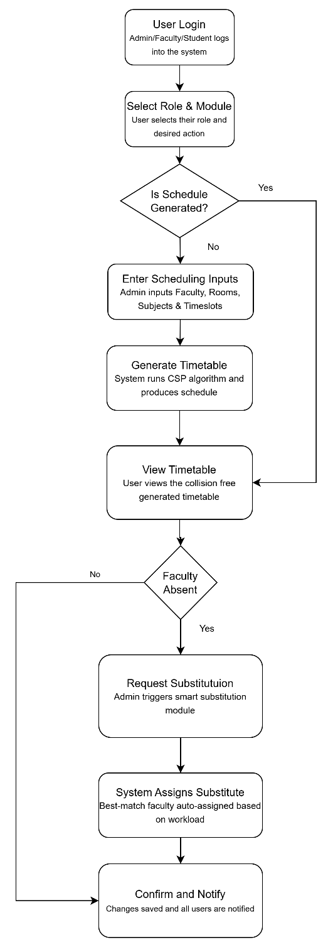
Workflow

Slide 8
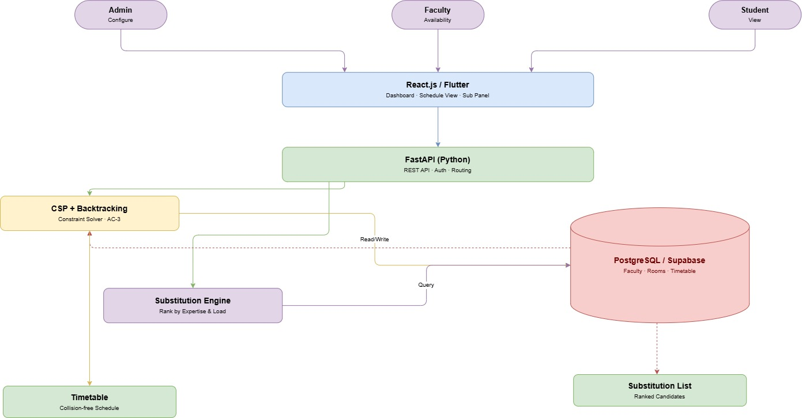
System Architecture

Slide 9
System Requirements
Software Requirements:
Frontend Environment: React.js / Node Package Manager (NPM)
Backend Environment: Python 3.x
Database: PostgreSQL
IDE: VS Code or PyCharm
Hardware Requirements (Minimum):
Processor: Intel Core i3 / AMD Ryzen 3 or equivalent
RAM: 8 GB
Storage: 256 GB SSD
Internet: Stable connection for cloud integration

Slide 10
UML Diagrams –Use Case

Slide 11
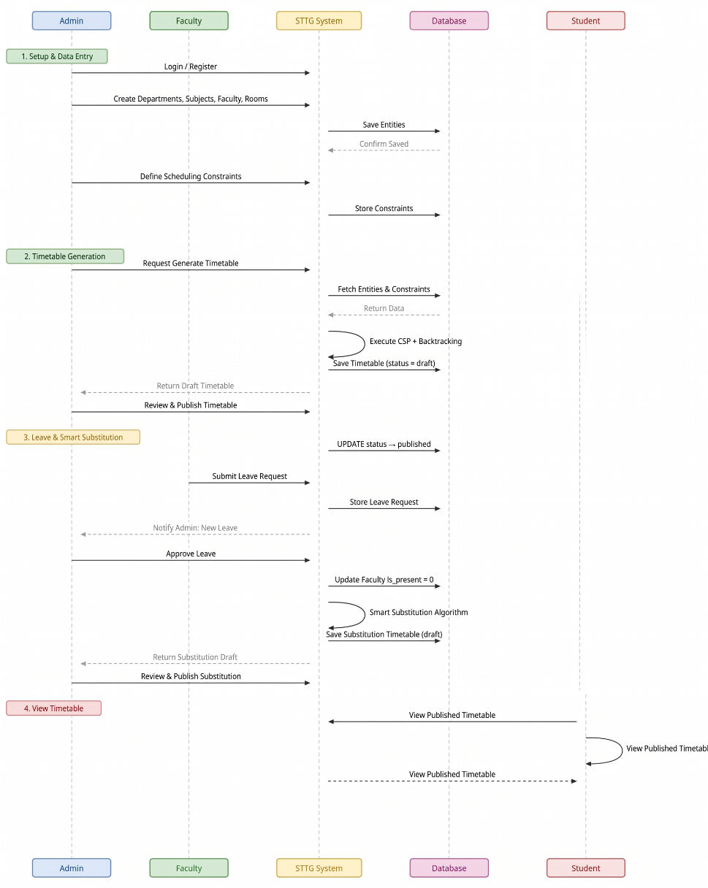
UML Diagram - Sequence

Slide 12
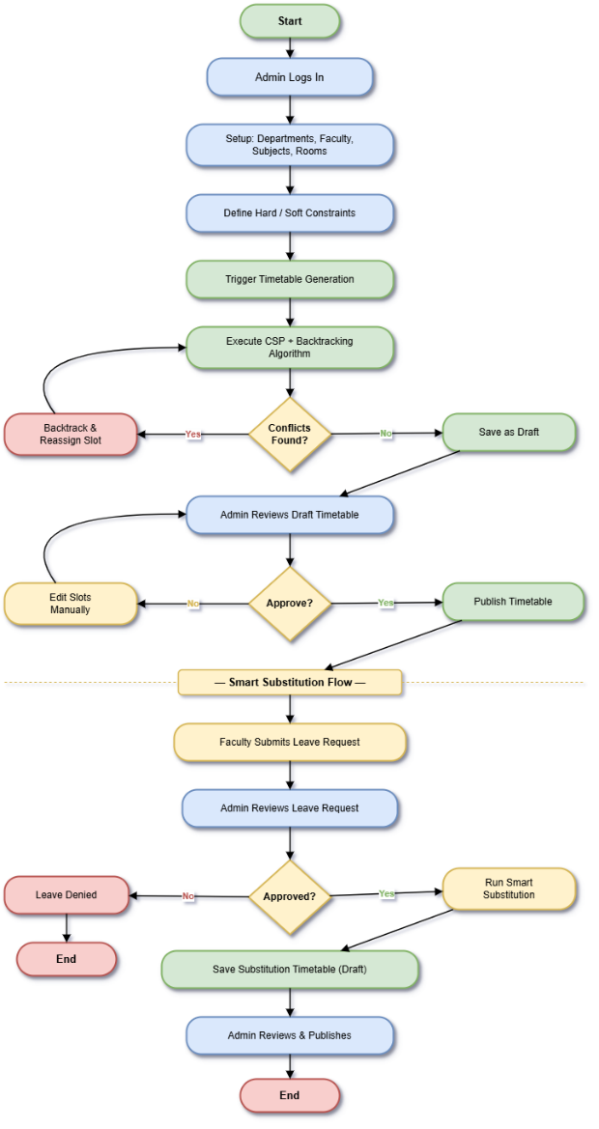
UML Diagram - Activity

Slide 13
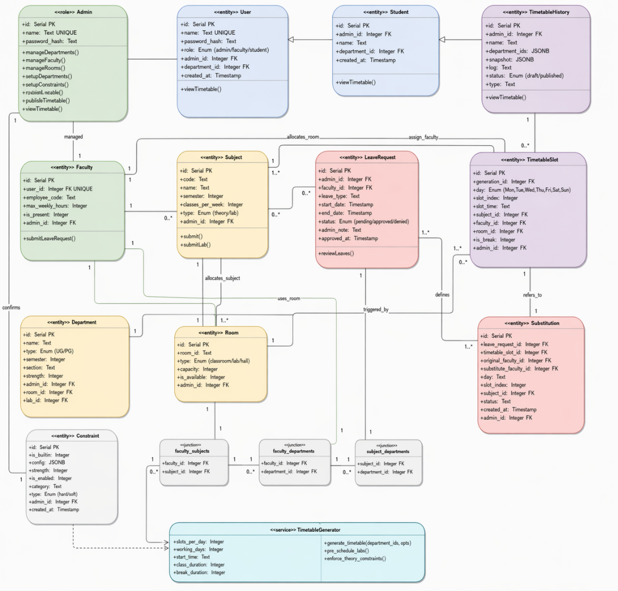
UML Diagram – Class Diagram

Slide 14
Modules
Data Management: Subjects, Faculty, Departments.
Constraints Engine: Hard/Soft rule enforcement.
Generation: CSP-based optimization.
Smart Substitution: Backup faculty mapping.

Slide 15
References
1. Constraint Processing and Backtracking Search algorithms in modern scheduling. https://personales.upv.es/misagre/papers/jim-survey.pdf
2. Relational Database Design for Academic Timetabling Systems. https://www.ijraset.com/best-journal/examination-timetable-generator
3. Graph Coloring and its Applications to Timetable Generation. https://www.researchgate.net/profile/Baki-Koyuncu/publication/242611694_STUDENT_TIME_TABLE_BY_USING_GRAPH_COLORING_ALGORITHM/links/5e591bb74585152ce8f64bca/STUDENT-TIME-TABLE-BY-USING-GRAPH-COLORING-ALGORITHM.pdf

Slide 16
Conclusion
In conclusion, the Smart Time Table Generator (STTG) successfully addresses the complex, time-consuming challenge of academic scheduling by transforming a manual, error-prone process into an automated, highly efficient system. By leveraging advanced optimization algorithms alongside a robust, modern technology stack, STTG delivers a scalable, multi-tenant platform that guarantees clash-free timetables, seamlessly handles dynamic constraints, and intelligently manages faculty substitutions. Ultimately, STTG empowers educational institutions to minimize administrative overhead, optimize resource allocation, and ensure a smooth, uninterrupted academic experience for both faculty and students.

Slide 17
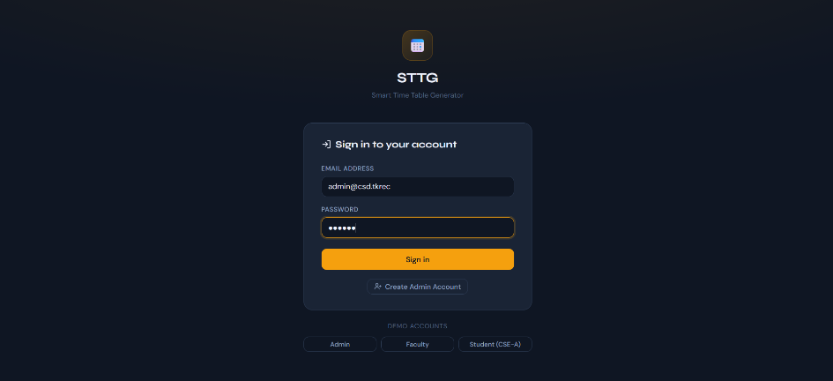
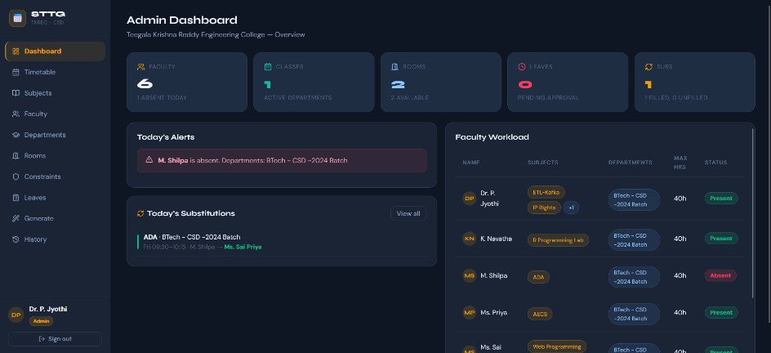
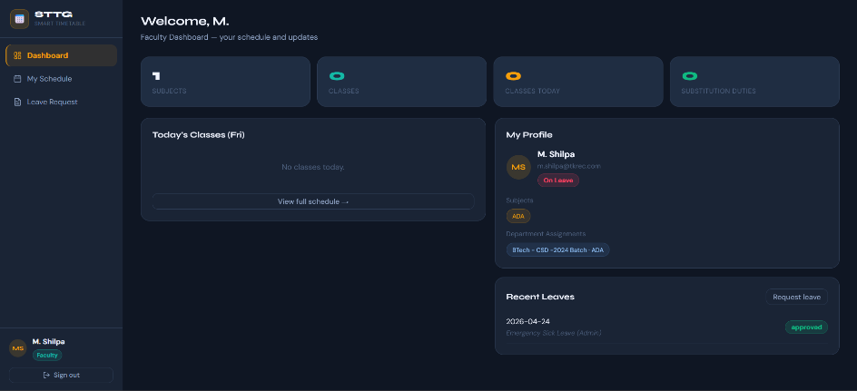
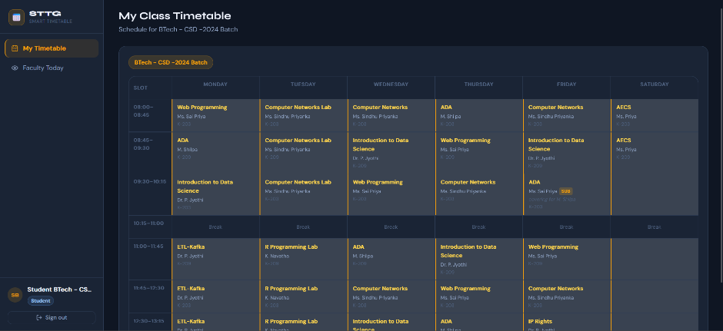
Output

