Slide 1
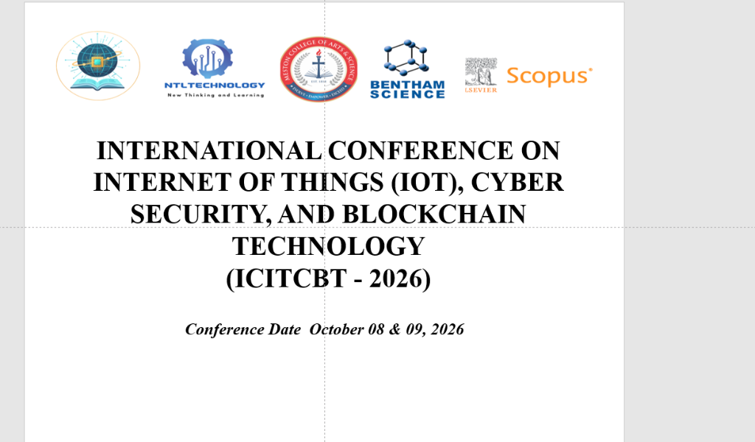
INTERNATIONAL CONFERENCE ON INTERNET OF THINGS (IOT), CYBER SECURITY, AND BLOCKCHAIN TECHNOLOGY
(ICITCBT - 2026)
Conference Date October 08 & 09, 2026

Slide 2
Paper Presentation Details
Paper Title: Blockchain Based Farm-to-Fork Food Traceability System With AI/ML Integrations
Paper ID: [Insert Paper ID]
Author(s): Bhagyashree Ambore, Tanush Patil J, Vellanki Sricharan, B S Krishna, Supreet Kumar

Slide 3
Table of Contents
1. Abstract
2. Introduction
3. Related Work / Survey
4. Proposed System / Methodology
5. Experimental Setup / Results
6. Analysis / Discussion
7. Conclusion
8. References

Slide 4
1. Abstract
Tracks agricultural produce to origin, solving lack of market transparency.
FarmChain AI empowers farmers at harvest using Python-powered AI predictive tools and Ethereum smart contracts.
Six stakeholder roles with permanent, untamperable records on Ethereum Sepolia Testnet.
AI market price prediction using XGBoost Regressor (MAPE: 2.72%, R²: 0.984).
Consumer verification via QR code scanning with a six-milestone authenticity checklist.

Slide 5
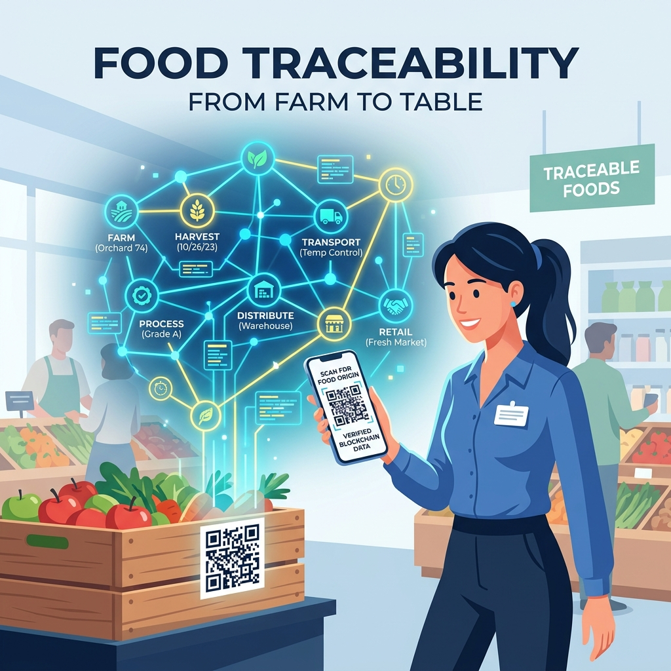
2. Introduction
Agriculture is vital but supply chains are disorganized and lack transparency.
Structural asymmetry of information limits farmers' negotiation power.
Centralized tracking systems are vulnerable to manipulation; enterprise blockchains are too expensive.
FarmChain AI returns data sovereignty to farmers without subscription fees.

Slide 6
3. Related Work / Survey
Blockchain: Prior enterprise systems (e.g., IBM Food Trust, BIFTS) lacked affordability and usability for rural farmers.
AI Microservices: XGBoost has become the dominant algorithm for agricultural forecasting.
Research Gap: A full-range platform integrating AI market predictions with multi-stakeholder custody tracking and consumer verification designed specifically for small farmers is missing.

Slide 7
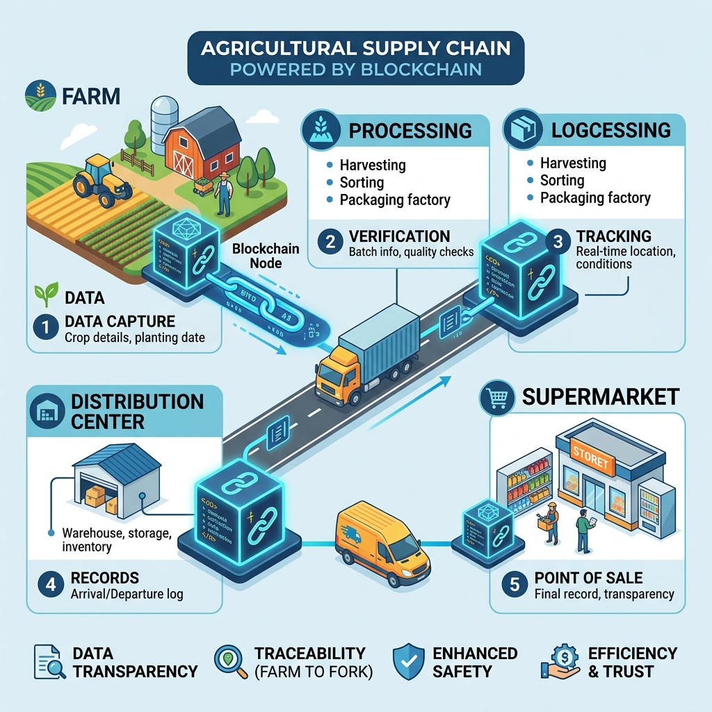
4. Proposed System / Methodology
Four Layers: React 18 Frontend, Node.js/Express API, FastAPI AI Microservice, Solidity Blockchain Persistence.
Workflow: Farmer Registration → Admin Approval → Processor Intake → Distributor Custody → Retailer Receipt → Consumer Verification.
Validation Mechanisms: Admin gate, Physical Inspection, AI Anomaly Detection.

Slide 8
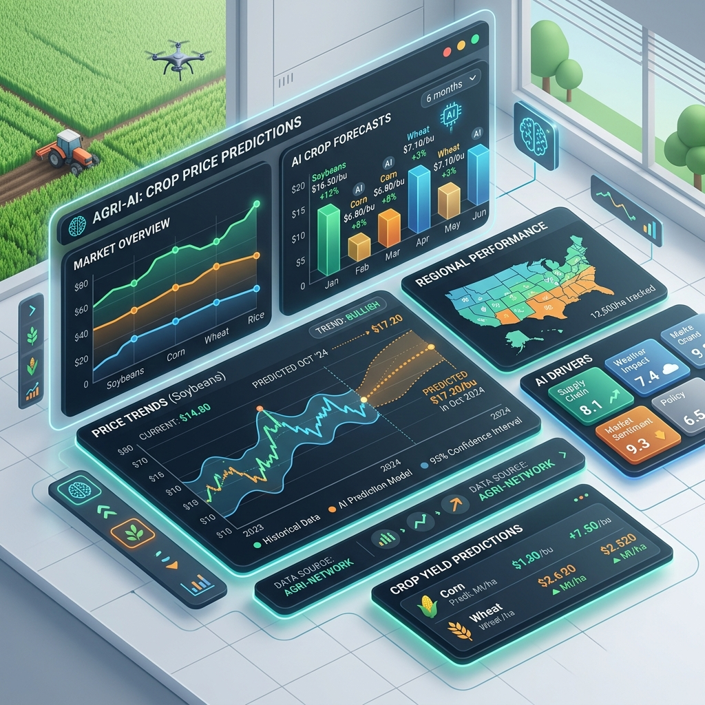
5. Experimental Setup / Results
AI Pipeline: 2,940 historical records, 30 time-series features. XGBoost achieved 1.26 MAE, 1.86 RMSE, 2.72% MAPE.
Smart Contracts: Deployed on Sepolia testnet.
Cost: ~185,432 gas (~0.00037 ETH) for product registration. Total journey ~0.00120 ETH.
System Latency: Node.js API < 14ms; Python AI ~35ms. Total time < 1.5s.

Slide 9
6. Analysis / Discussion
Provides complete traceability with verifiable custody transfers.
Actionable AI market intelligence directly benefits farmers.
Three-gate off-chain validation successfully addresses blockchain's input truthfulness limitations.
Decoupled microservice architecture maintains high responsiveness.

Slide 10
7. Conclusion
FarmChain AI effectively integrates blockchain transparency with AI intelligence.
Provides a secure, low-cost, and responsive agricultural logging system.
Empowers small-scale farmers against middlemen without enterprise costs.
Future work: Expand datasets and migrate to Layer-2 scaling networks (e.g., Polygon).

Slide 11
8. References
[1] Ministry of Agriculture & Farmers Welfare, 'Agricultural Statistics at a Glance 2023'.
[2] F. Tian, 'An agri-food supply chain traceability system for China based on RFID & blockchain technology'.
[3] Q. Lin et al., 'Food Safety Traceability System Based on Blockchain and EPCIS'.
[4] T. Chen and C. Guestrin, 'XGBoost: A Scalable Tree Boosting System'.

Slide 12
Thank You

