Slide 1
TITLE PAGE
Problem Statement ID – 4
Problem Statement Title- AI-Powered Behavioural Anomaly Detection for CypherSecurity
Theme- CypherSecurity
PS Category- Software
Student Name- Tanush Aggarwal
Student ID- 23BAI10320

Slide 2
AI-Powered Behavioural Anomaly Detection for CypherSecurity
Proposed Solution (Describe your Idea/Solution/Prototype)
Learns each entity's normal behaviour instead of matching known attack signatures, then fuses 4 signals — a rule engine, Isolation Forest, XGBoost, and an LSTM autoencoder — into one 0-100 risk score per event
Detects 7 attack patterns (brute force, impossible travel, lateral movement, device spoofing, credential stuffing, low-and-slow exfiltration) across users, service accounts and edge devices, with cold-start and concept-drift handling built in
Every alert is explainable (rules fired + SHAP-attributed features) and honestly evaluated on a held-out time window — 98% out-of-time accuracy, 100% precision at a 1% analyst alert budget

Slide 3
TECHNICAL APPROACH
Python, scikit-learn (Isolation Forest), XGBoost, TensorFlow (LSTM autoencoder), SHAP, Streamlit + Plotly (dashboard), pandas, Docker
Synthetic access logs → per-entity baseline profiling + rule engine → 15-feature matrix → 4 signals fused into a 0-100 risk score → Streamlit analyst dashboard
Rule Engine (30%)
Isolation Forest (25%)
XGBoost Classifier (25%)
LSTM Autoencoder (20%)
Fused 0–100 Risk Score + Plain-English Explanation
Streamlit Analyst Dashboard

Slide 4
FEASIBILITY AND VIABILITY
98% out-of-time accuracy on a fully held-out window (train: days 0-21, eval: days 22-29) — not an in-sample number
low_and_slow_exfiltration is the hardest class (39% precision); insider_drift is deliberately ambiguous; synthetic data is cleaner than real traffic
Strategies: correlate raw events into one alert per episode before the review budget; iterate features on the weakest class; move to a Kafka/feature-store pipeline at scale
98%
Out-of-time accuracy
100%
Precision @ top-1% alert budget
5.5%
Events on cold-start fallback

Slide 5
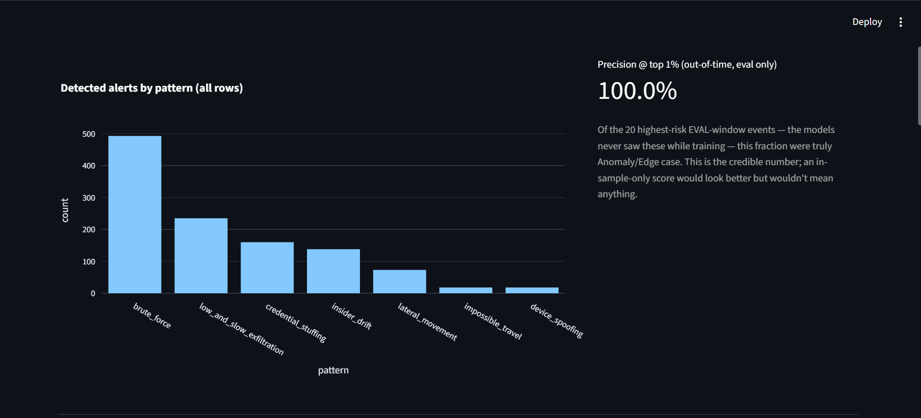
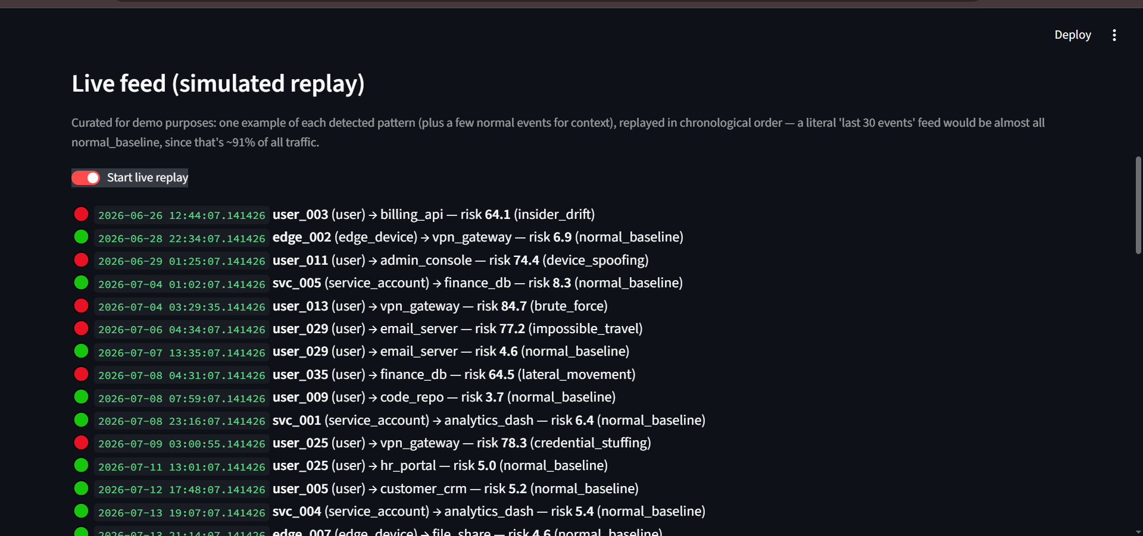
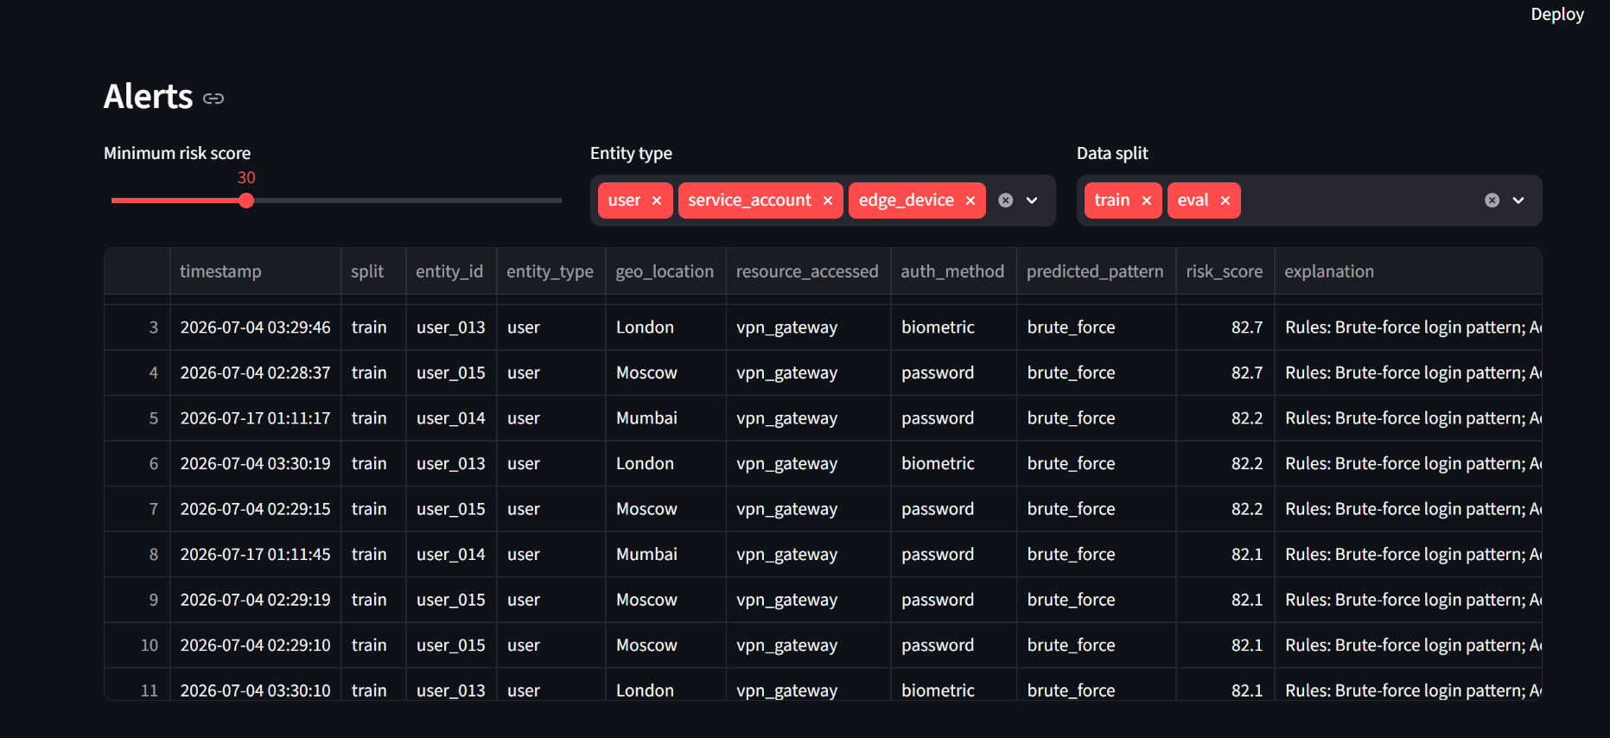
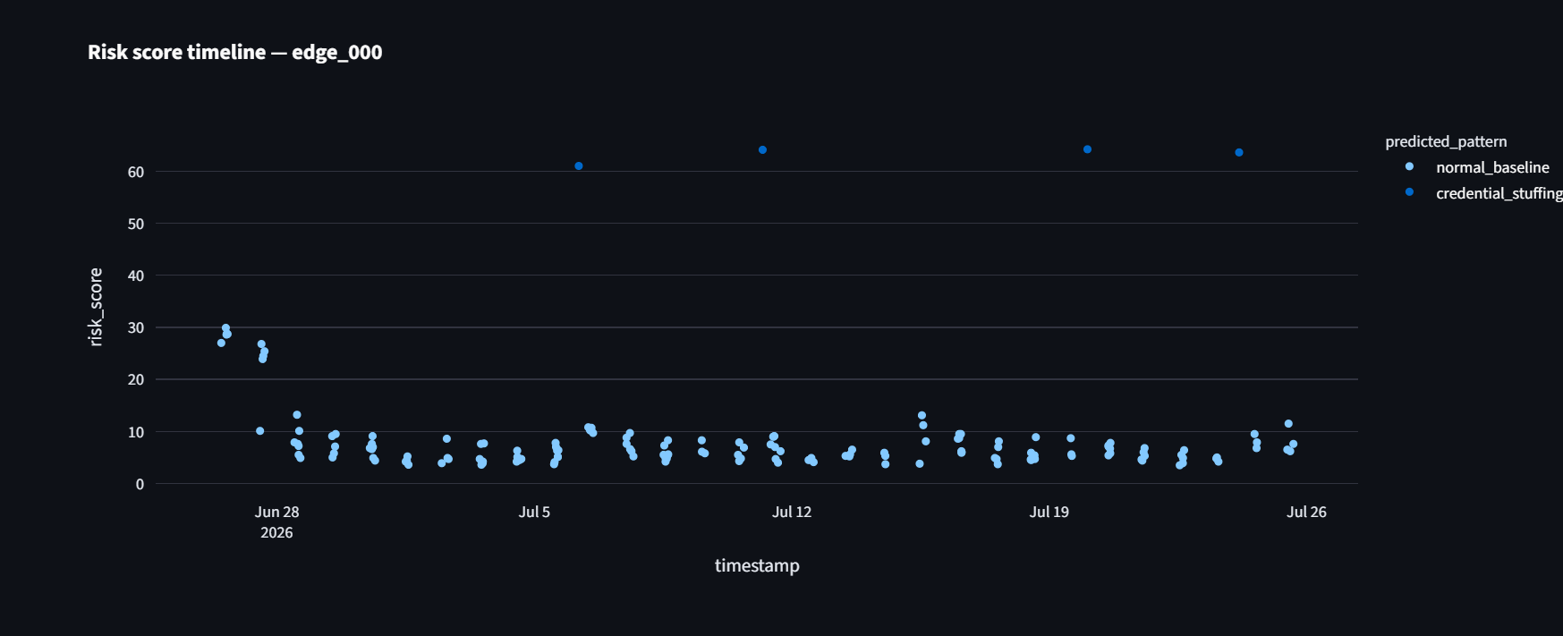
ARTIFACTS
Code: github.com/Tanush008/Anomaly-Detection-CypherSecurity • Report: report/anomaly_detection_report.pdf • Dashboard: Streamlit + Plotly
Detected alerts by pattern, with out-of-time precision @ top 1%
Live feed — simulated real-time alert replay
Filterable alerts table with risk scores and explanations
Per-entity risk score timeline

Slide 6
RESEARCH AND REFERENCES
Project repository — github.com/Tanush008/Anomaly-Detection-CypherSecurity
scikit-learn Isolation Forest — Liu, Ting & Zhou, “Isolation Forest,” ICDM 2008
XGBoost — Chen & Guestrin, “XGBoost: A Scalable Tree Boosting System,” KDD 2016
SHAP explainability — Lundberg & Lee, “A Unified Approach to Interpreting Model Predictions,” NeurIPS 2017
TensorFlow/Keras LSTM autoencoders for sequence anomaly detection — TensorFlow documentation

