Slide 1
ONLINE BANK MANAGEMENT
THE BANK OF LNMIIT

Slide 2
About
The project online bank management comprises all the data of users of bank and accessing and retrieving that data . In that we used :
Jdbc (connecting the java code with database)
Netbeans (front end)
Mysql (for creating database)

Slide 3
Packages Used:
javax.swing;
java.sql;
java.util.Random;
Frame Class Objects:
JLabel
JButton
JPasswordField
JTextField
JPanel
JTable
JPopUpMenu
JScrollPane

Slide 4
Class Diagram

Slide 5
HOME PAGE
USER REGISTER
USER LOGIN
ADMIN LOGIN
LANDING PAGE
ADMIN HOME PAGE
MAIN PAGE
TRANSACTION HISTORY
USER INFO
MONEY TRANSFER
UPDATE INFO

Slide 6
ER DIAGRAM

Slide 7
name
Email
password
DOB
AdminId
UserId
password
ADMIN
USER
TransactionId
Transaction
Amount
HAS
Withdraw
accno
ACCOUNT
HAVING
TRANSACTION
status
Date
accountno
balance
Deposit
accno

Slide 8
Working Snippets

Slide 9
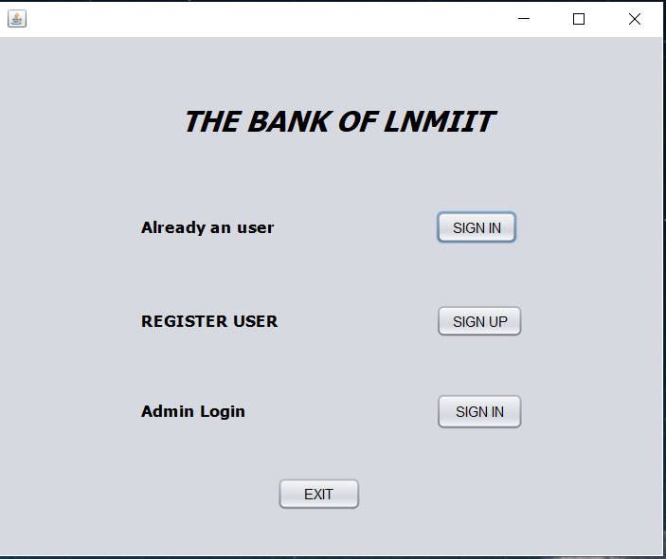
Home Page

Slide 10
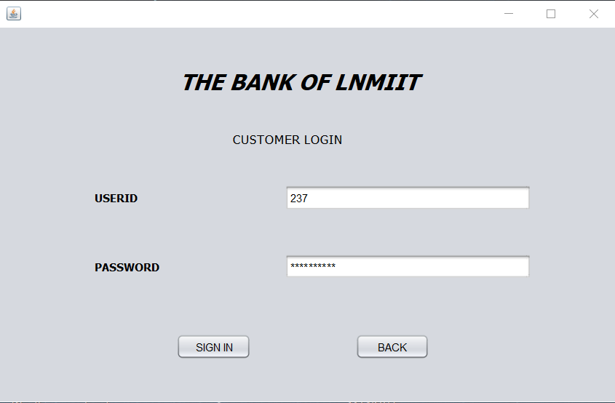
Customer Login

Slide 11
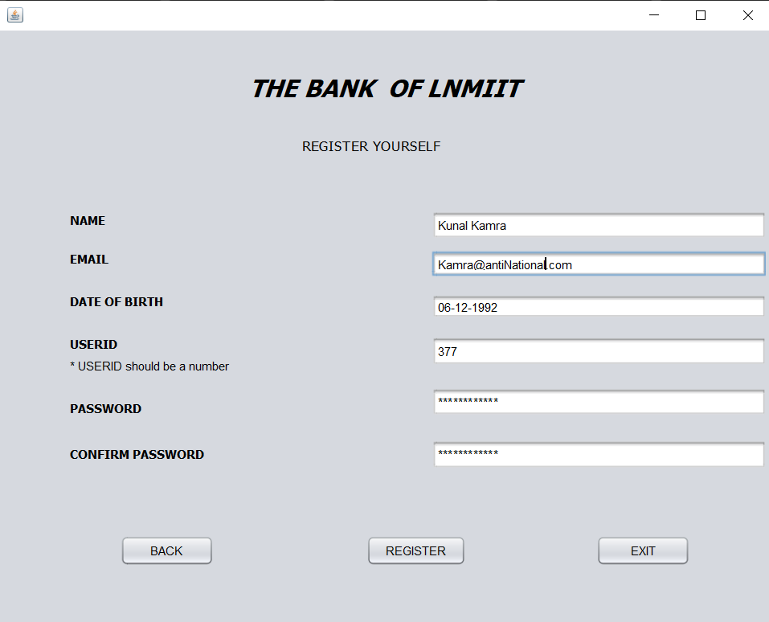
Register Page

Slide 12
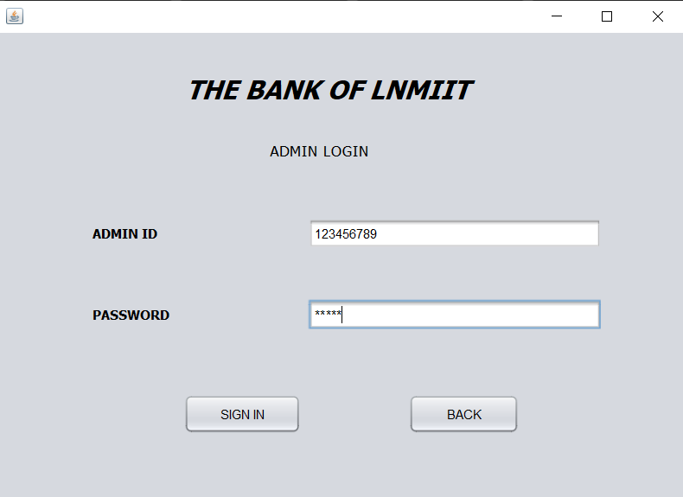
Admin Login

Slide 13
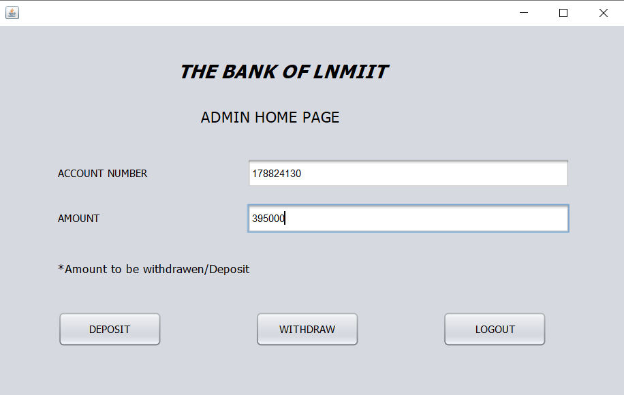
Admin HomePage

Slide 14
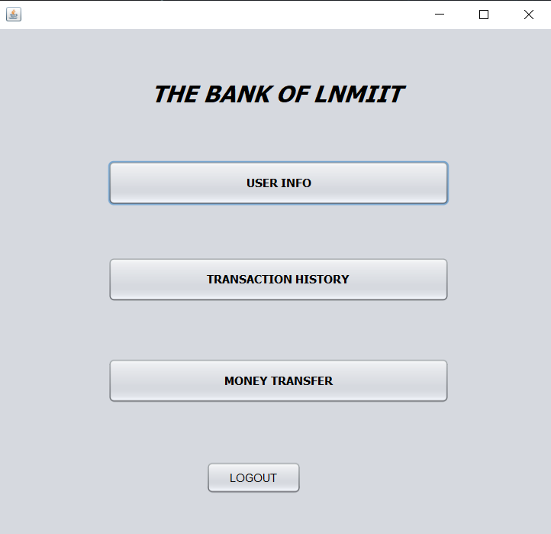
Main Page

Slide 15
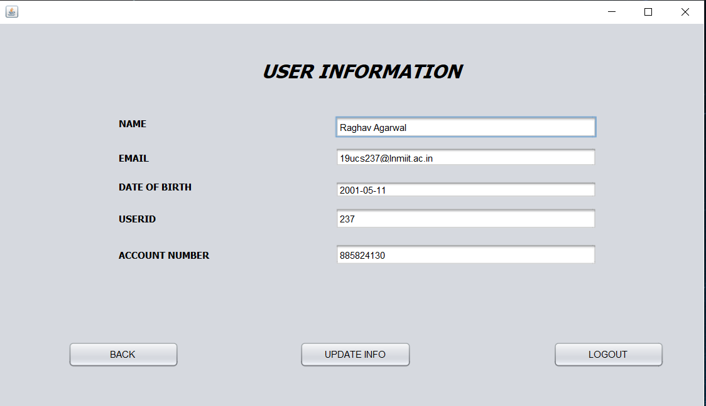
User Info Page

Slide 16
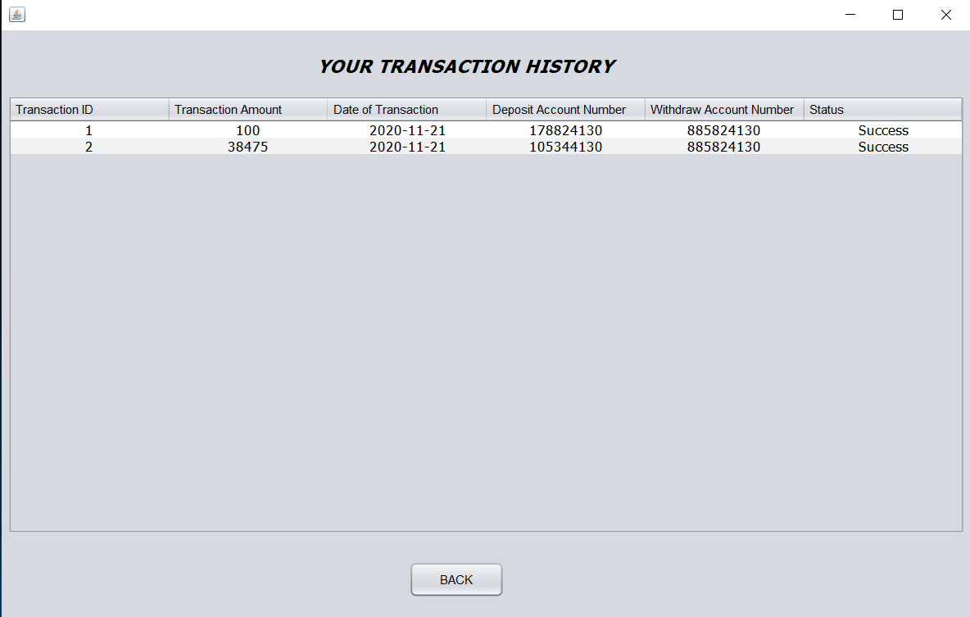
Transaction History

Slide 17
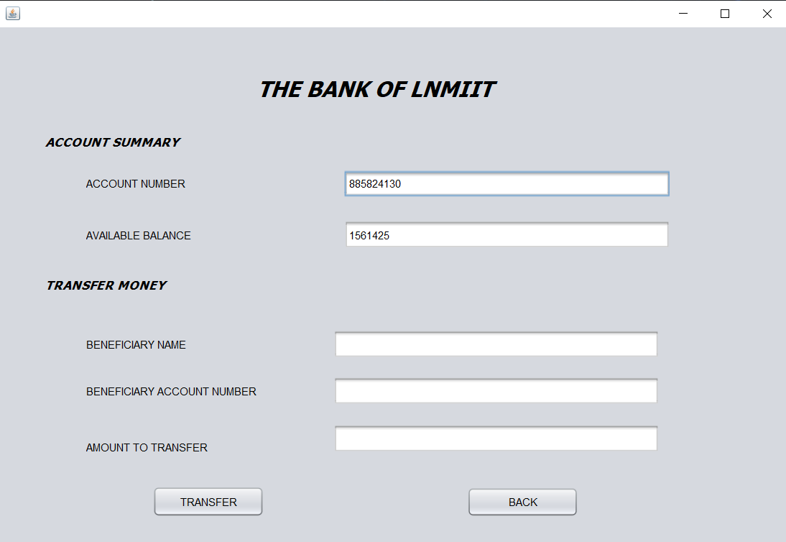
Money Transfer

Slide 18
Code Snippets

Slide 19
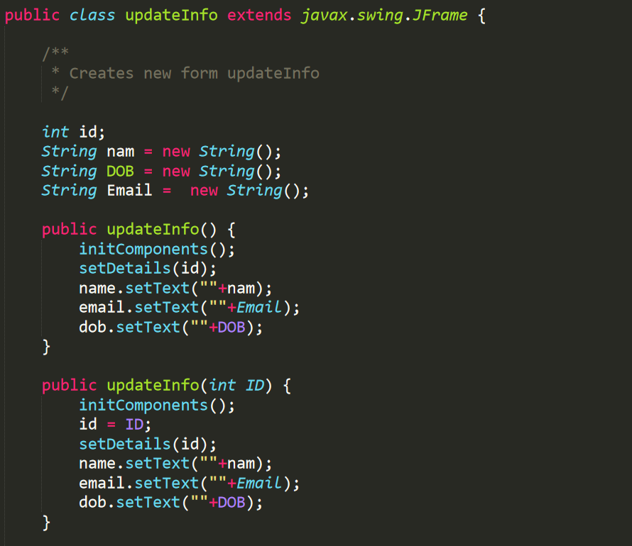

Slide 20
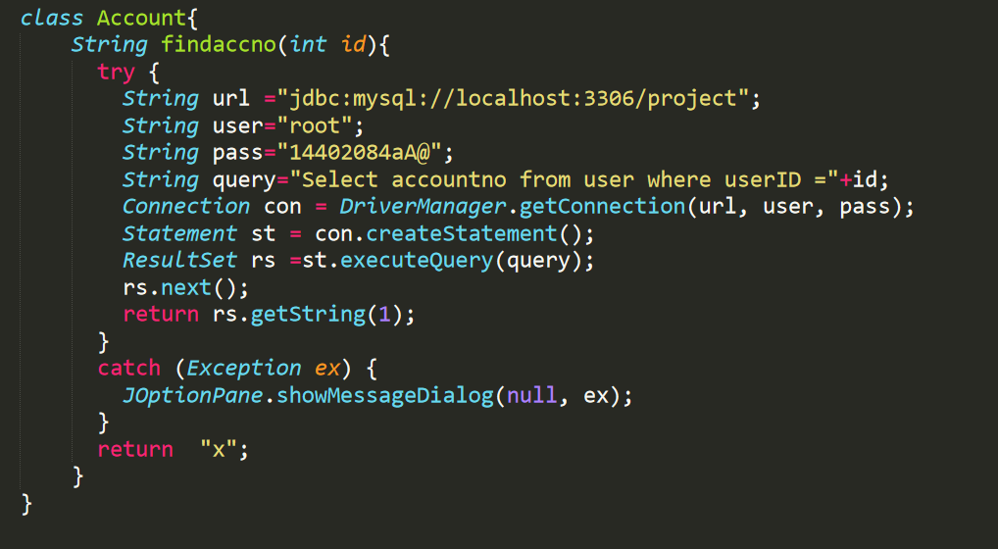

Slide 21
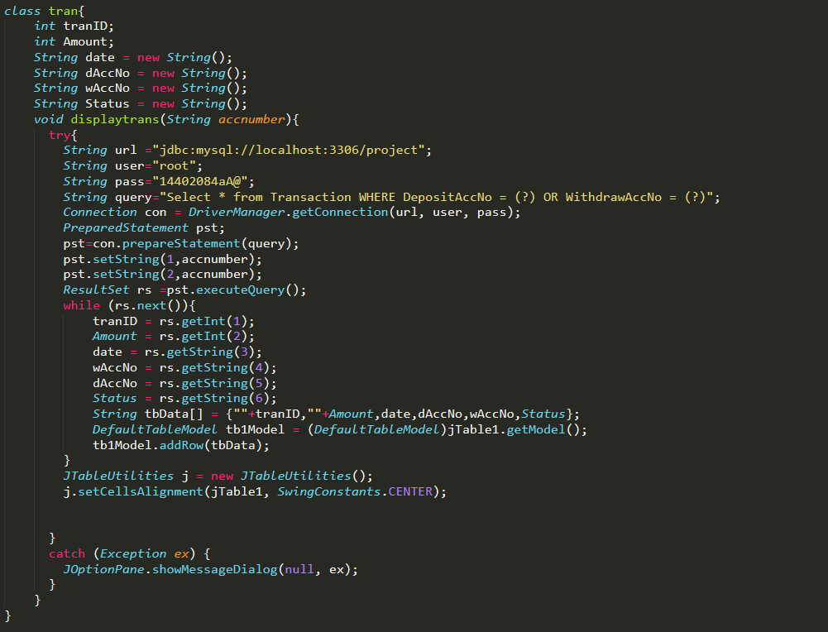

Slide 22
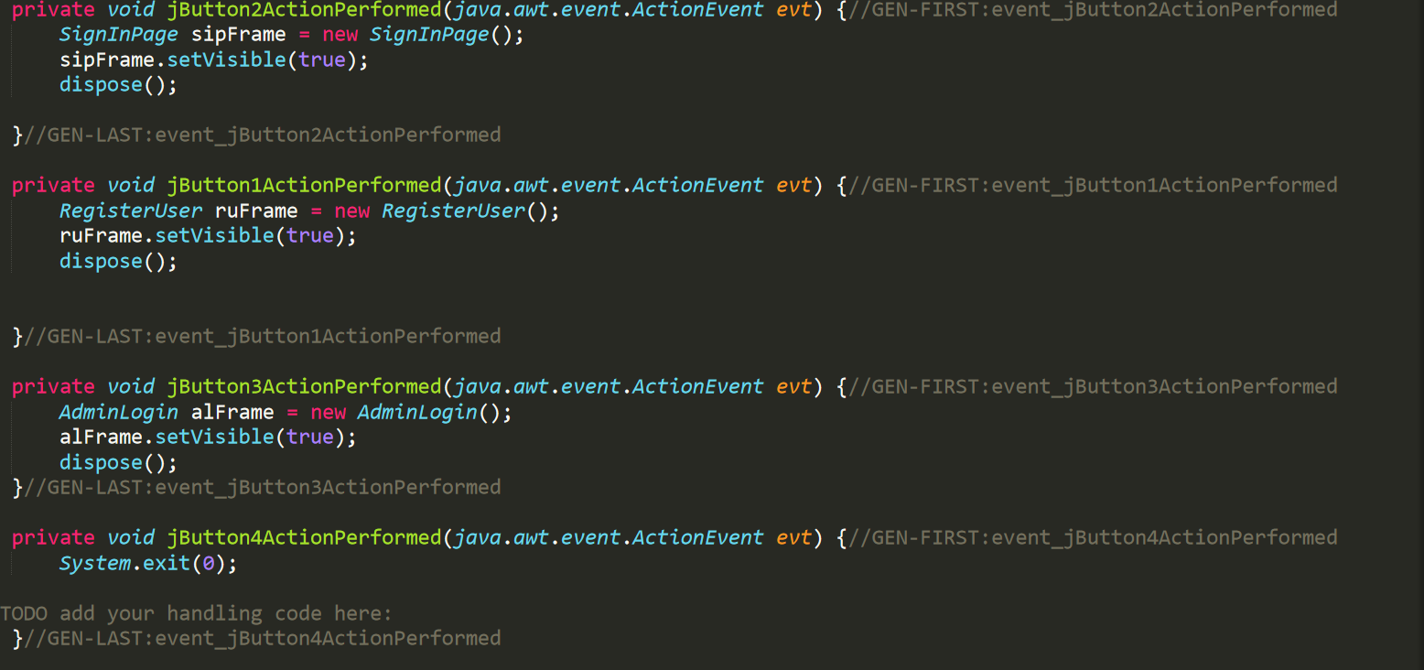

Slide 23
Database Snippets

Slide 24
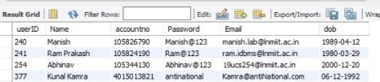
Select * from user ;

Slide 25
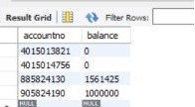
Select * from account ;

Slide 26

Select * from transaction ;

Slide 27
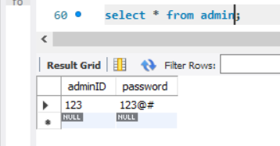
Select * from admin ;

Slide 28
Group Members
Garvit Vijayvargia 19UCS201
Tanush Garg 19UCS203
Raghav Agrawal 19UCS237
Abhinav Agarwal 19UCS254

Slide 29
THANK YOU

