Slide 1
Azure Blob Index Tags for Large-Scale Data Organisation
P-092
Subtitle
A simple approach to tagging, organizing, searching, and retrieving large-scale data efficiently
Presented by:
2400032868- G.MANOJ
2400032850- K.BABI
2400032733- P.TANUSH GOPI
2400032795- K.HEMANAND

Slide 2
Problem Statement
• Large-scale cloud storage can contain thousands of blobs, making it difficult to organize, identify, and retrieve specific data efficiently.
• In this project, the goal is to use Azure Blob Index Tags to assign meaningful metadata to blobs, organize data based on attributes such as type, category, or status, and enable efficient searching and filtering across large amounts of stored data.
• Poor data organization can lead to slower data retrieval, difficulty in identifying required files, increased management effort, and reduced efficiency when handling large-scale blob storage.

Slide 3
Why Reliability Matters?
Large-scale blob storage can become difficult to manage due to:
• Unstructured and poorly organized blob data
• Difficulty identifying specific files or data categories
• Lack of meaningful metadata for blobs
• Time-consuming manual searching and filtering
• Increasing management effort as data volume grows
• Difficulty efficiently retrieving relevant data
“The objective is not just to store large amounts of data, but to organize and index it so that the required data can be found quickly and efficiently.”

Slide 4
Project Objective
• Analyze blob storage requirements for large-scale data organization.
• Create meaningful Blob Index Tags for stored data.
• Categorize blobs using attributes such as file type, department, status, or category.
• Enable efficient searching and filtering of blobs using index tags.
• Reduce the time and effort required to locate specific data.
• Demonstrate improved data organization and retrieval efficiency using Azure Blob Index Tags.

Slide 5
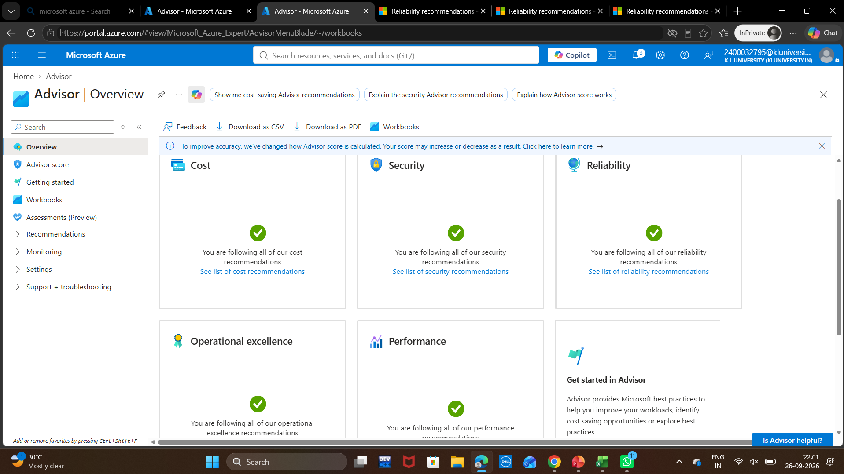
HOW OUR SOLUTION WORKS
• “Azure Blob Index Tags transform unstructured blob storage into searchable and organized data by assigning meaningful attributes to individual blobs.”
• We use Blob Index Tags to categorize data, quickly identify relevant blobs, apply filters based on tag values, and improve the efficiency of data management and retrieval.

Slide 6
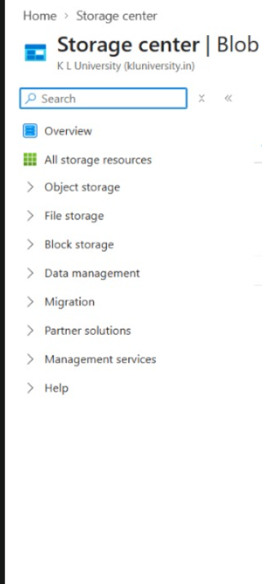
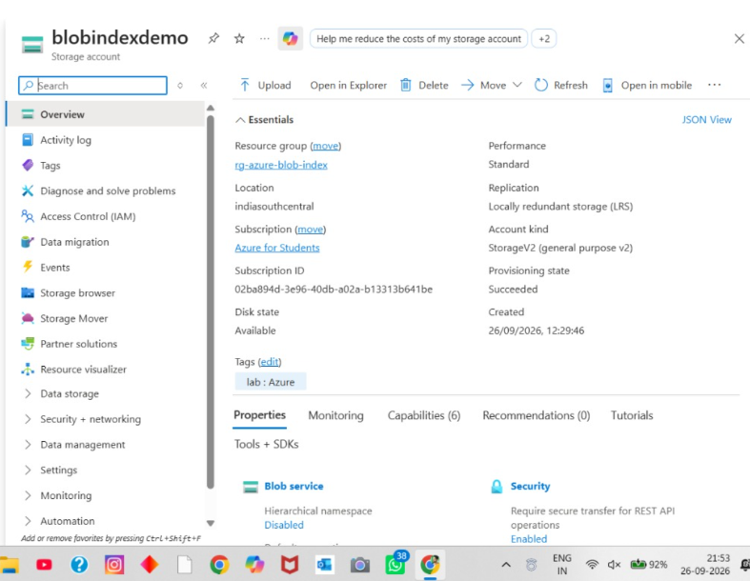
Our Azure Environment
• Our test environment contains an Azure Storage Account named blobindexdemo, created under the rg-azure-blob-index resource group.
Current Configuration
• Location: India South Central
• Account Type: StorageV2
• Replication: LRS
• Provisioning Status: Succeeded
• Blob Index Tags: Used to organize and categorize blobs using meaningful key-value attributes.

Slide 7
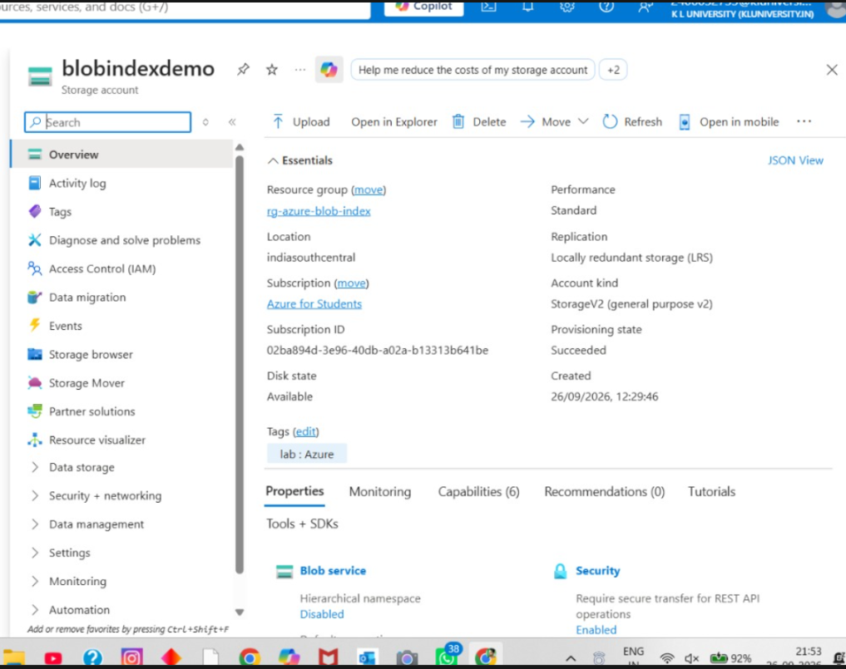
Findings & Validation
• Our test environment uses an Azure Storage Account named blobindexdemo, created under the rg-azure-blob-index resource group.
Current Configuration
• Location : India South Central
• Account Type: StorageV2
• Replication : LRS
• Provisioning Status: Succeeded
• Blob Index Tags: Used to categorize and organize blobs using meaningful key-value attributes.
This environment serves as the baseline for demonstrating organized data management, searching, and filtering using Azure Blob Index Tags.

Slide 8
workflow follow
Component Explanation
Resource Group – Organizes all related Azure resources in one place.
Storage Account – Provides cloud storage for our files and documents.
Container – Acts as a folder-like space to store blobs.
Upload Files – Stores documents such as PDF, PNG, and TXT files.
Blob Tags – Adds details like department, file type, and category.
Tagged Blobs – Keeps files stored with useful identifying information.
Search by Tags – Helps find files based on their assigned tags.
Retrieve Files – Allows users to quickly access the required documents.
Data Organization – Makes file management simple, structured, and efficient.
START
↓
Create Resource Group
↓
Create Storage Account
↓
Create Container
↓
Upload Files
↓
Add Blob Tags
↓
Store Tagged Blobs
↓
Search by Tags
↓
Retrieve Files
↓
Organize & Retrieve Easily -> END

Slide 9
Conclusion
• Our project demonstrated how Azure Blob Index Tags can improve the organization and management of large-scale blob data.
• We assigned meaningful tags to blobs and used them to categorize, search, and filter data efficiently, reducing the effort required to locate specific information.
Future Scope
• Automate tag assignment for newly uploaded blobs.
• Use more tag categories for better data classification.
• Integrate tag-based searching into applications and data workflows.
• Scale the tagging approach for larger and continuously growing datasets.
Final Line
“Better data organization makes large-scale cloud storage easier to search, manage,
and use.”

Slide 10
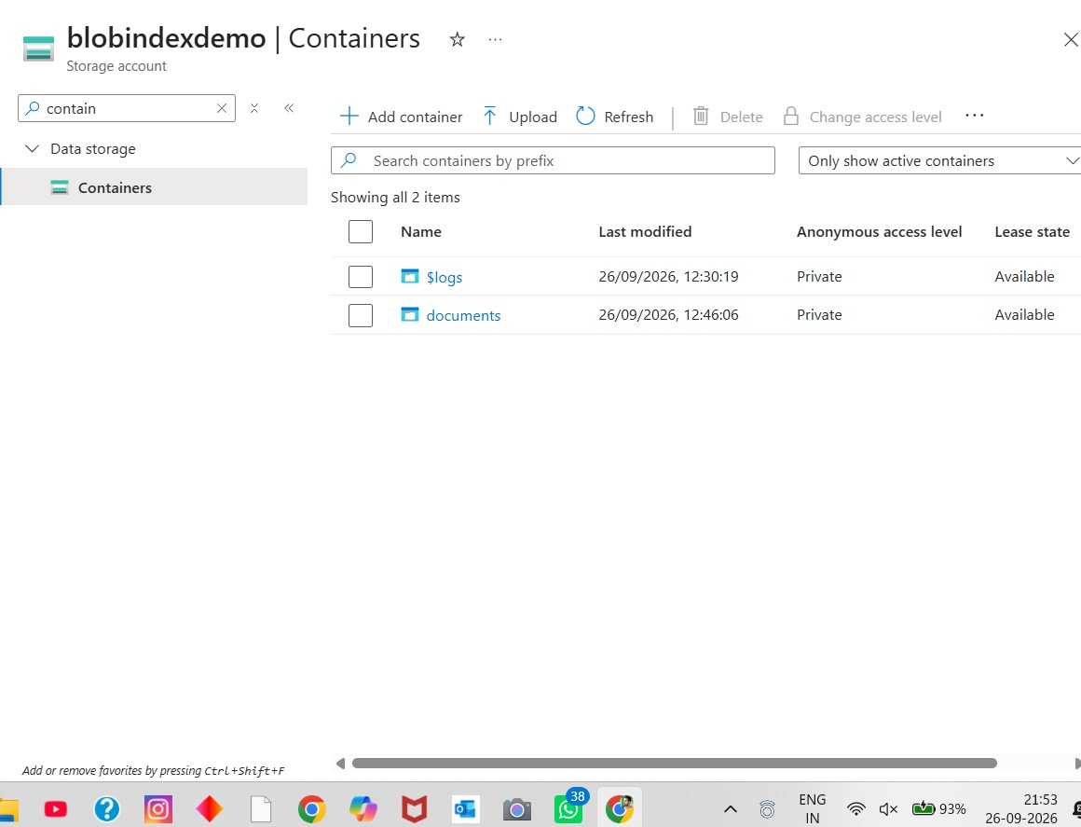
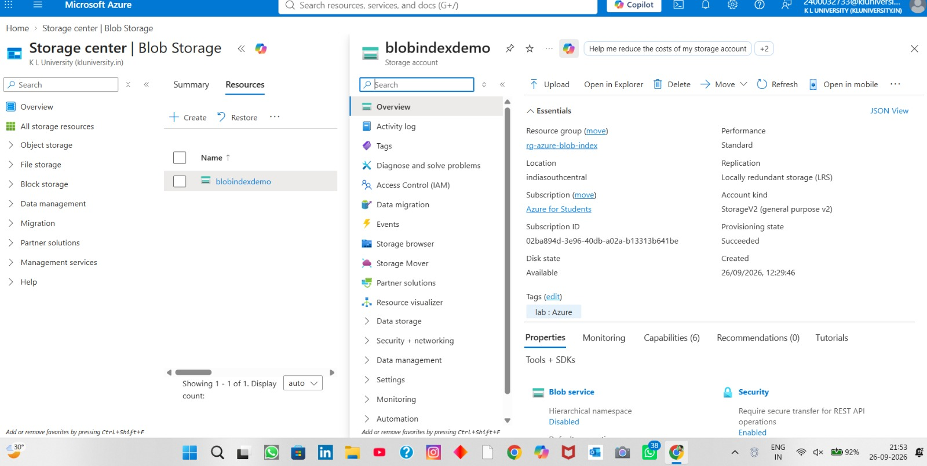
Output

Slide 11
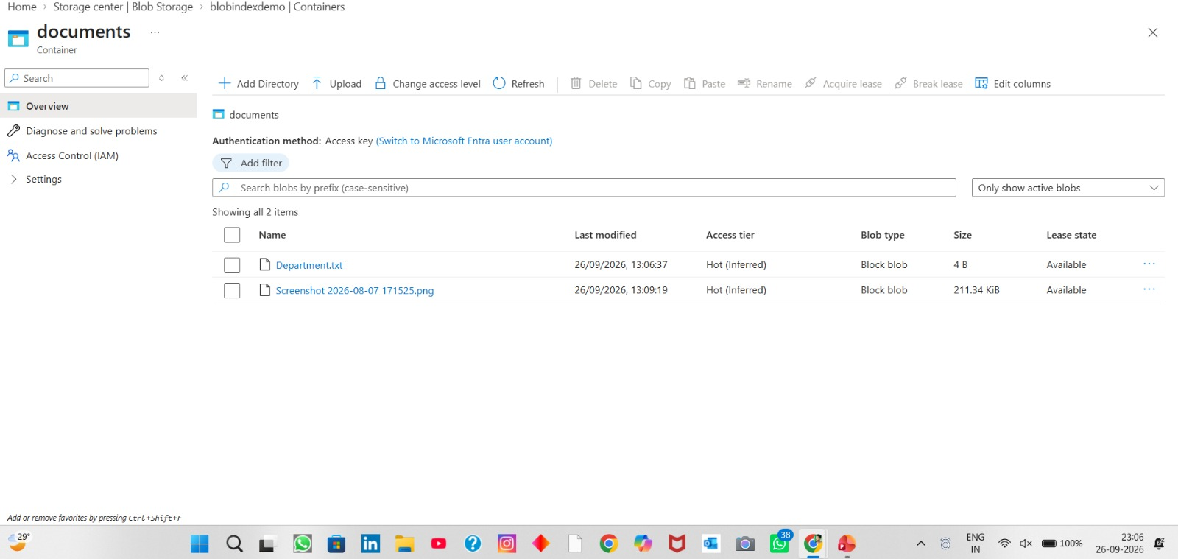
Final output

