Slide 1
SESSION 21 • DEVOPS CAPSTONE PROJECT
StudySpace
From student planner to monitored cloud deployment
Application / Containers / CI/CD / Kubernetes / Observability
AWS demo completed in ap-southeast-2
Resources destroyed after evidence capture
Tanush Shoor • 24BCS10265
Notes:
Introduce StudySpace, a student assignment planner developed as a full-stack DevOps capstone. This presentation follows the rubric from application and tests through cloud infrastructure and observability. AWS resources were destroyed after capture.

Slide 2
PROJECT AT A GLANCE
One app, delivered through a complete DevOps workflow
The capstone connects product behavior with repeatable delivery, deployment, and monitoring.
1 Build the product
2 Prove and package
3 Secure delivery
React dashboard • FastAPI • PostgreSQL
Alembic schema migration
Six API tests pass • Docker Compose
Non-root runtime containers
GitHub Actions • Trivy scans
SHA-tagged GHCR images
4 Deploy
5 Observe
6 Clean up
Terraform VPC and EKS
Helm chart • Kubernetes Ingress
Prometheus scrape targets UP
Grafana API dashboard
58 Terraform resources destroyed
AWS cluster confirmed absent
Session 21 • Evidence captured before AWS teardown
Notes:
Frame the lifecycle and map it to grading modules: application, testing, GitHub, Docker, CI/CD, DevSecOps, Terraform, Kubernetes/Helm, observability, and presentation/documentation.

Slide 3
APPLICATION ARCHITECTURE
A small full-stack app with clear service boundaries
The same frontend and API run locally in Compose and as services in Kubernetes.
Student browser
HTTPS
React + Vite
/api
FastAPI
SQL
PostgreSQL
localhost:3000
or cloud Ingress
Dashboard and forms
NGINX unprivileged image
REST API • /health • /ready
/metrics • Prometheus
Assignment storage
Alembic migrations
Local development
Cloud runtime
Docker Compose starts frontend, backend, and database with health checks.
EKS deployments and Services run the same app; Ingress exposes the frontend.
Metrics flow from FastAPI → Prometheus → Grafana
Session 21 • Evidence captured before AWS teardown
Notes:
Explain the architecture as an editable diagram. Student browser traffic reaches React; REST calls go to FastAPI; SQLAlchemy connects to PostgreSQL. Alembic runs migrations. Metrics expose health and API performance to Prometheus and Grafana.

Slide 4
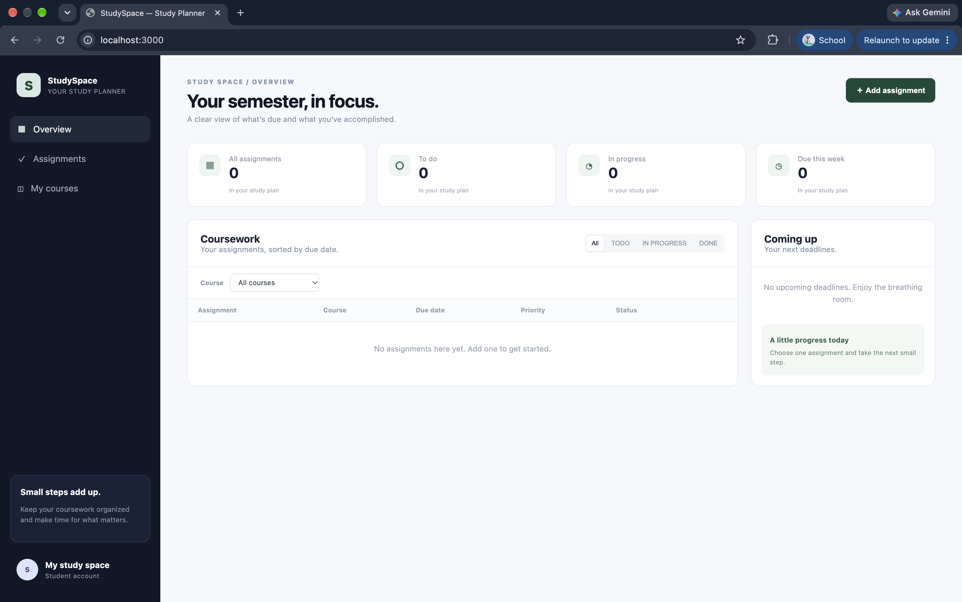
APPLICATION
The product: StudySpace planner
The React dashboard gives students one place to track assignments, due dates, status, and priority.
The captured view is the initial empty state; the UI is running locally at port 3000.
Session 21 • Evidence captured before AWS teardown
Notes:
The product: StudySpace planner. The React dashboard gives students one place to track assignments, due dates, status, and priority. The captured view is the initial empty state; the UI is running locally at port 3000.
Screenshot placeholder: evidence/01-local-app.png. Replace it with the corresponding image before presenting.

Slide 5
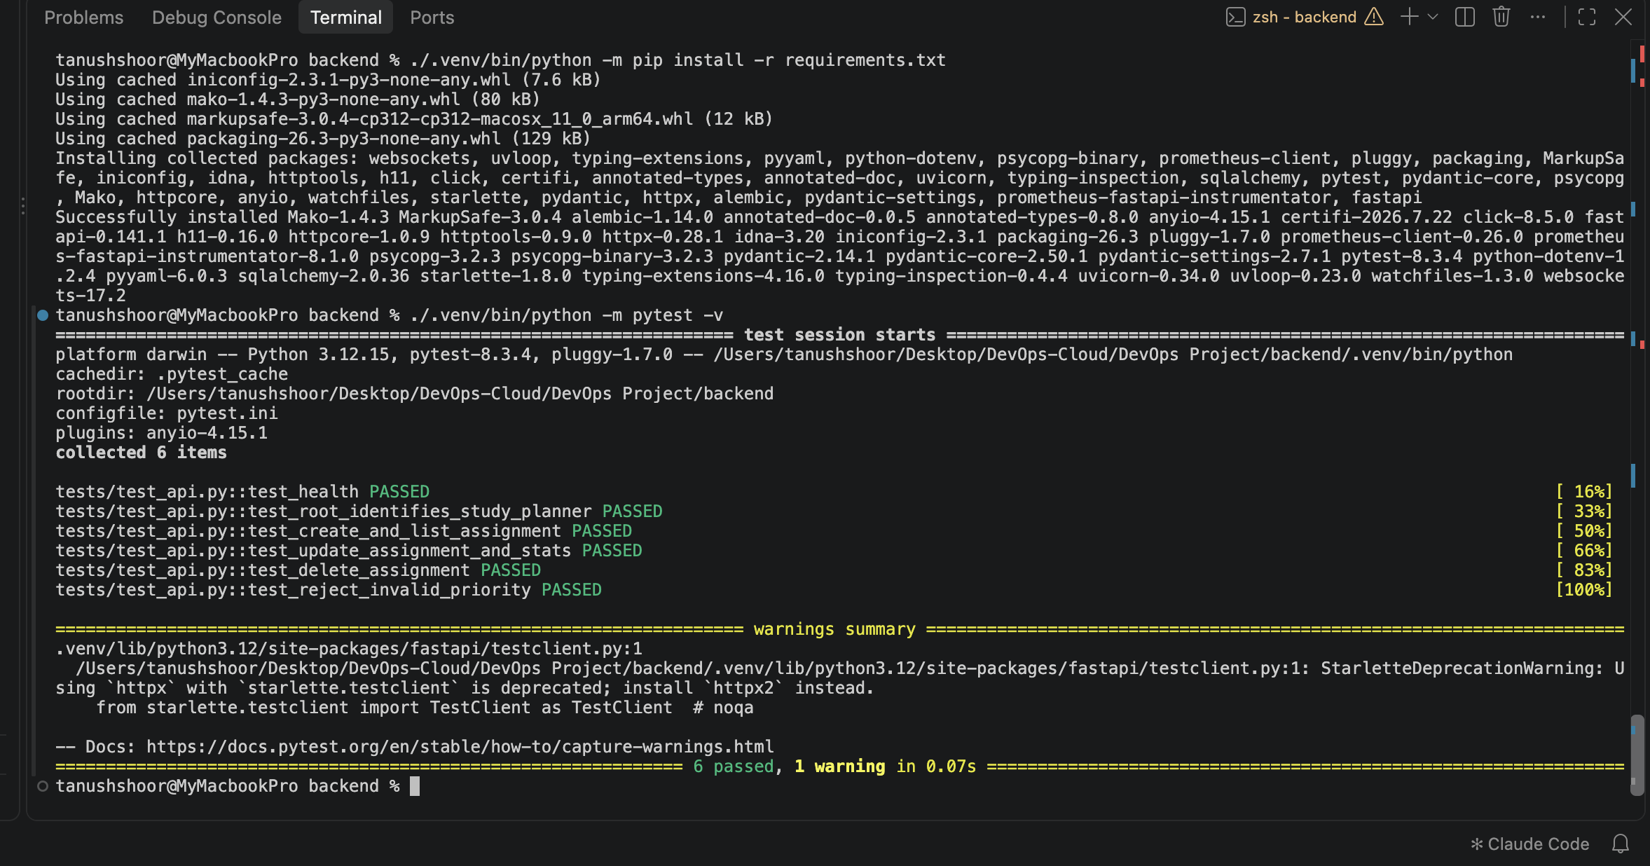
TESTING
Automated API tests: 6 passed
The test suite covers health, root response, assignment CRUD, statistics, and validation.
Run shown with Python 3.12.15. One Starlette/httpx deprecation warning is non-failing.
Session 21 • Evidence captured before AWS teardown
Notes:
Automated API tests: 6 passed. The test suite covers health, root response, assignment CRUD, statistics, and validation. Run shown with Python 3.12.15. One Starlette/httpx deprecation warning is non-failing.
Screenshot placeholder: evidence/02-pytest.png. Replace it with the corresponding image before presenting.

Slide 6
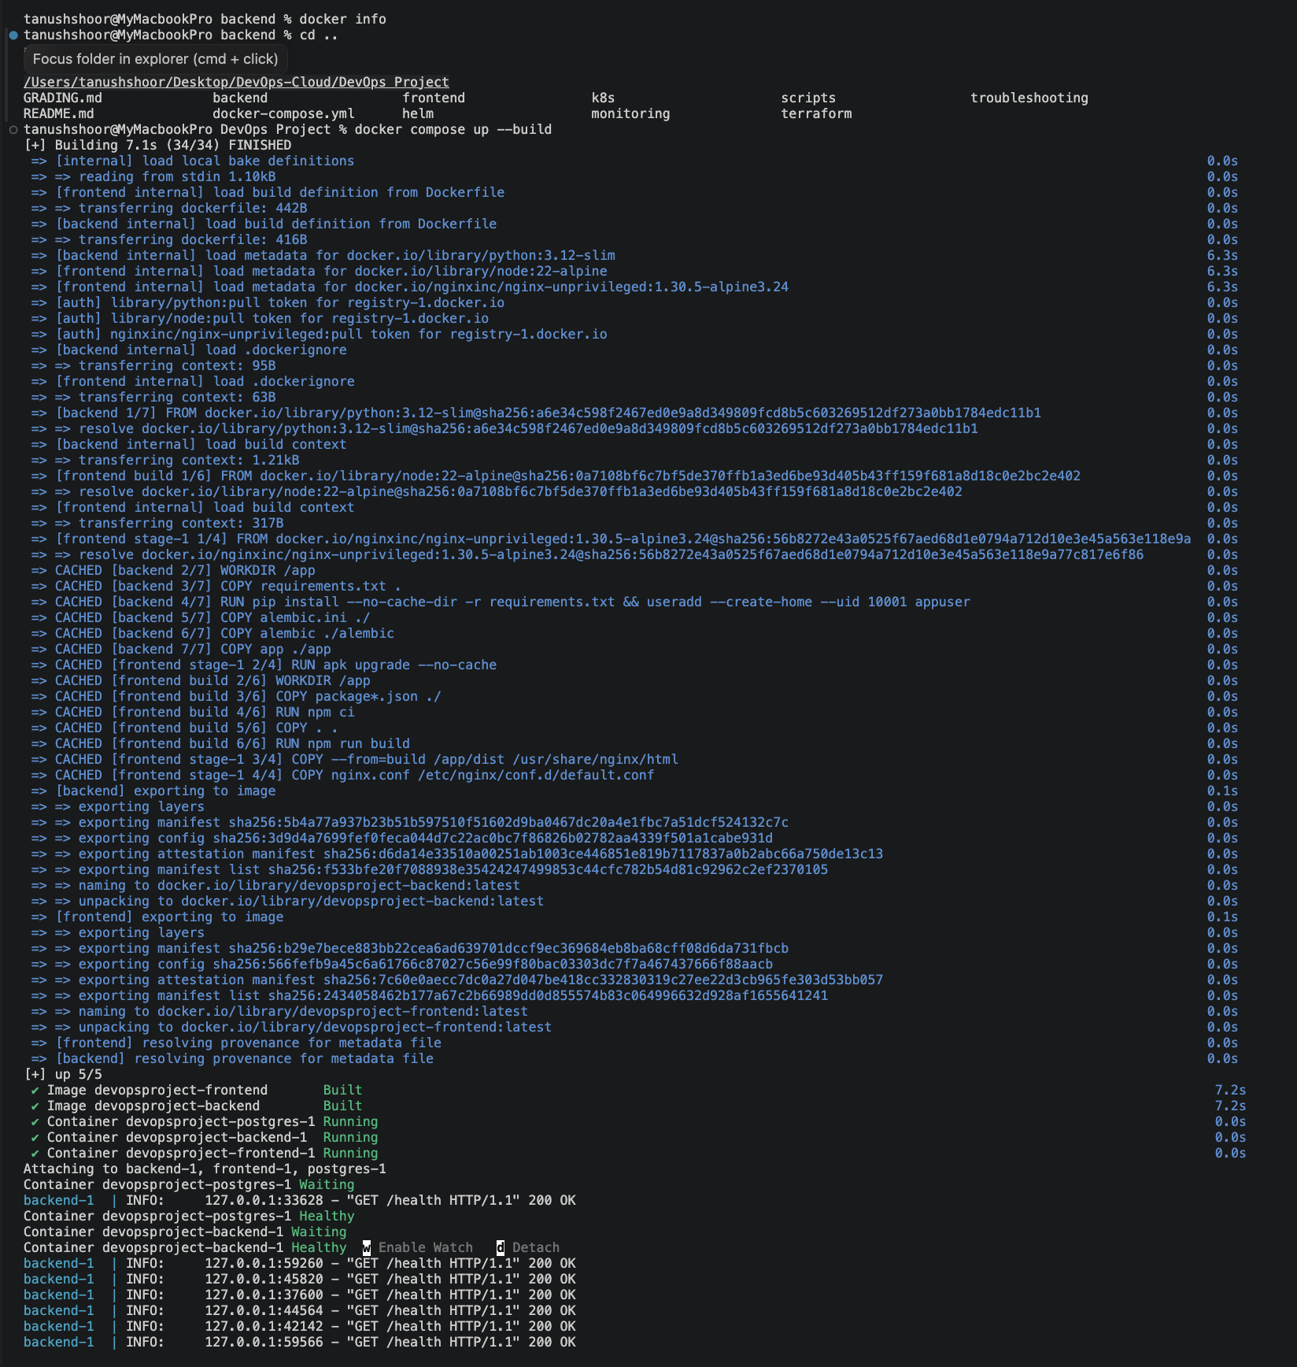
CONTAINERS
Docker Compose brings the stack up
Compose builds and starts the frontend, backend, and PostgreSQL with service health checks.
Local entry points: frontend :3000 • API :8000 • PostgreSQL :5432.
Session 21 • Evidence captured before AWS teardown
Notes:
Docker Compose brings the stack up. Compose builds and starts the frontend, backend, and PostgreSQL with service health checks. Local entry points: frontend :3000 • API :8000 • PostgreSQL :5432.
Screenshot placeholder: evidence/03-compose-startup.png. Replace it with the corresponding image before presenting.

Slide 7
CONTAINERS
Three services are running together
The container view confirms the app components are separated and communicating.
This is the reproducible local demo path used before the AWS deployment.
Session 21 • Evidence captured before AWS teardown
Notes:
Three services are running together. The container view confirms the app components are separated and communicating. This is the reproducible local demo path used before the AWS deployment.
Screenshot placeholder: evidence/04-compose-containers.png. Replace it with the corresponding image before presenting.

Slide 8
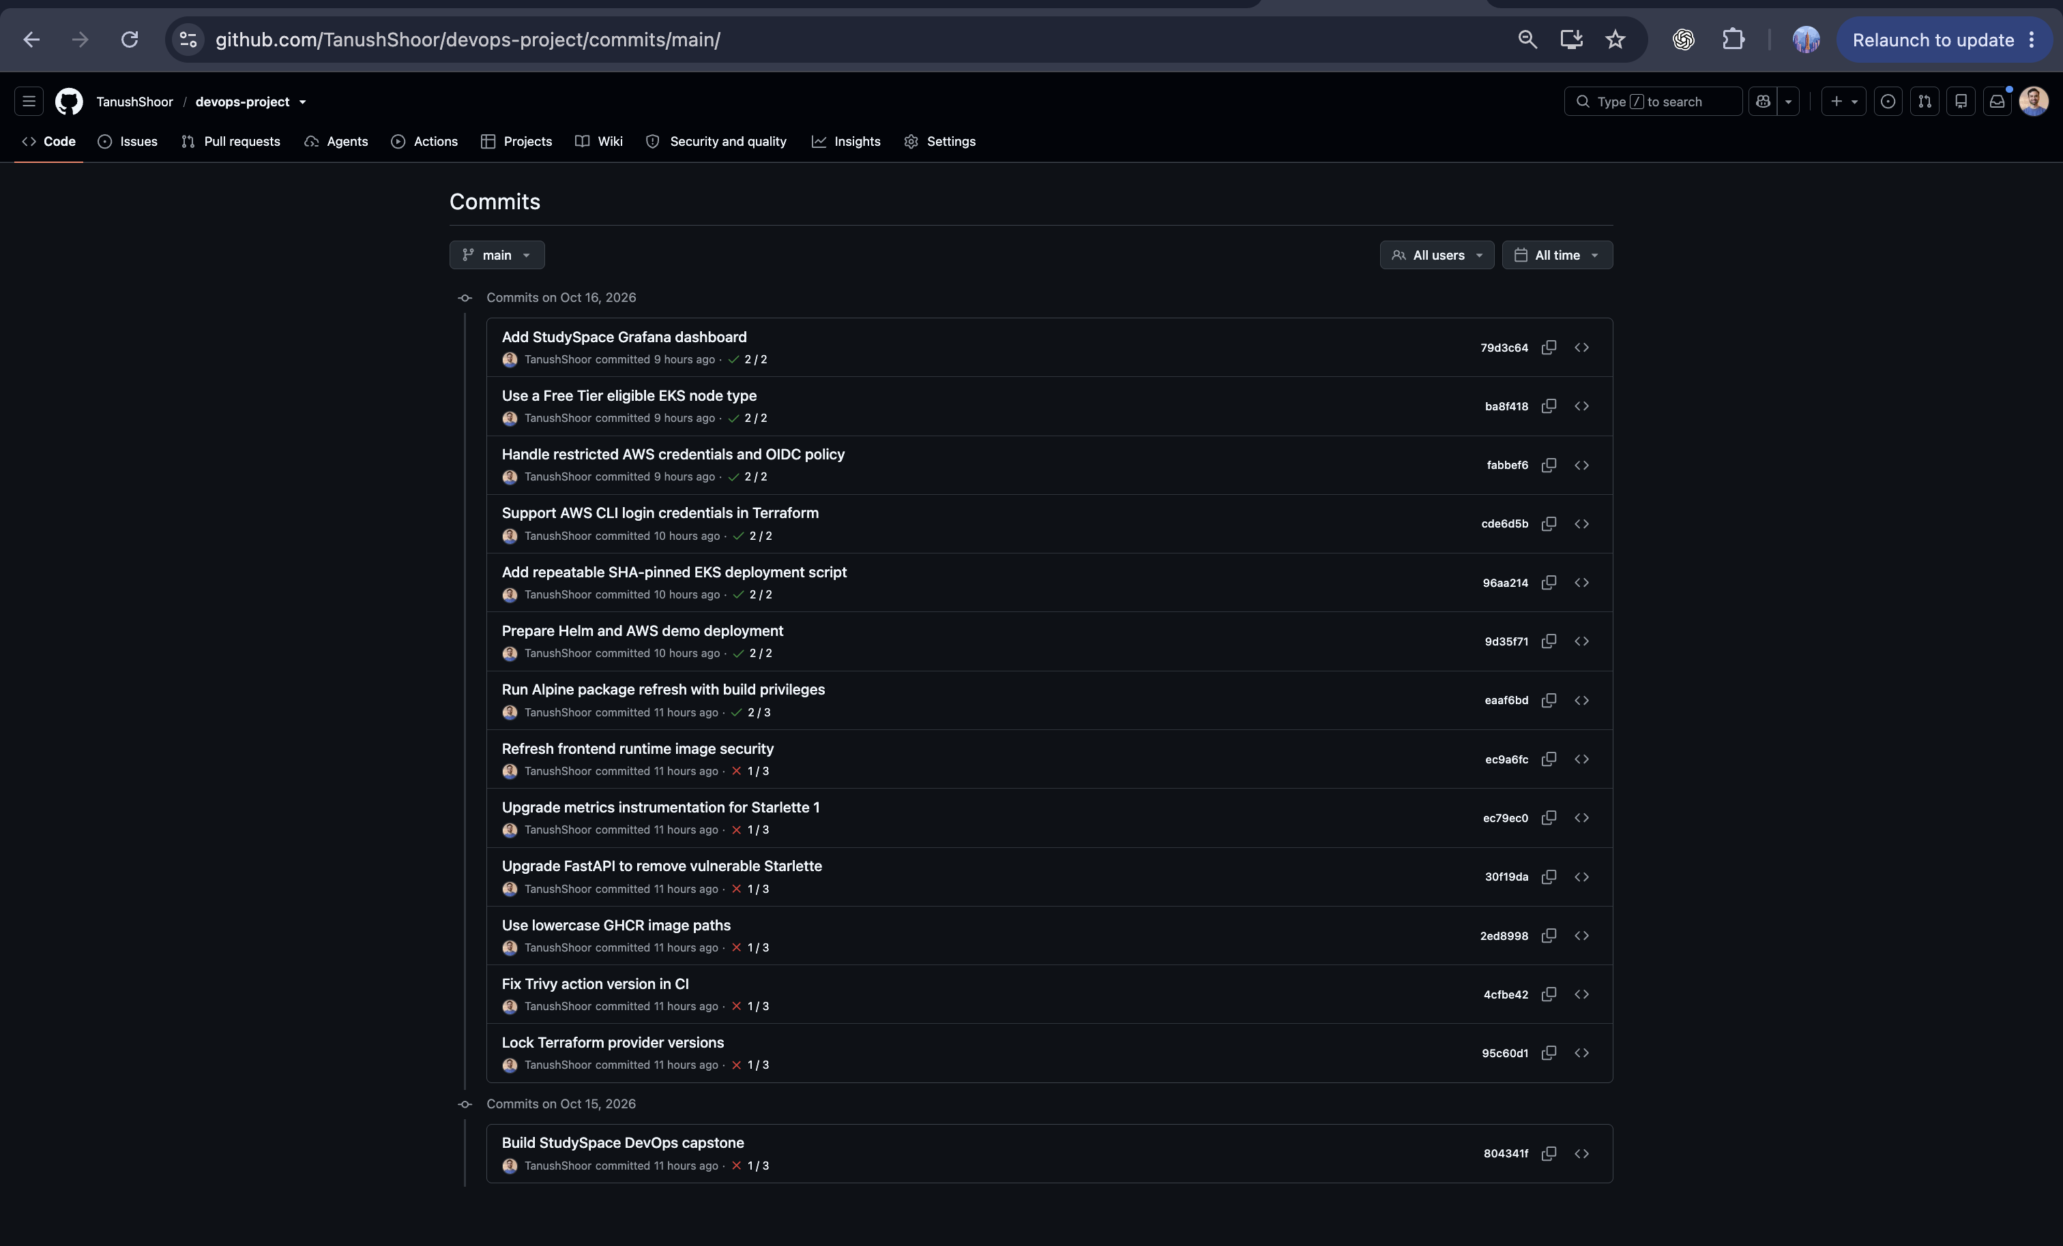
Git history records incremental delivery
The repository history shows the project evolving through reviewable changes.
Source repository: github.com/TanushShoor/devops-project.
Session 21 • Evidence captured before AWS teardown
Notes:
Git history records incremental delivery. The repository history shows the project evolving through reviewable changes. Source repository: github.com/TanushShoor/devops-project.
Screenshot placeholder: evidence/05-github-commits.png. Replace it with the corresponding image before presenting.

Slide 9
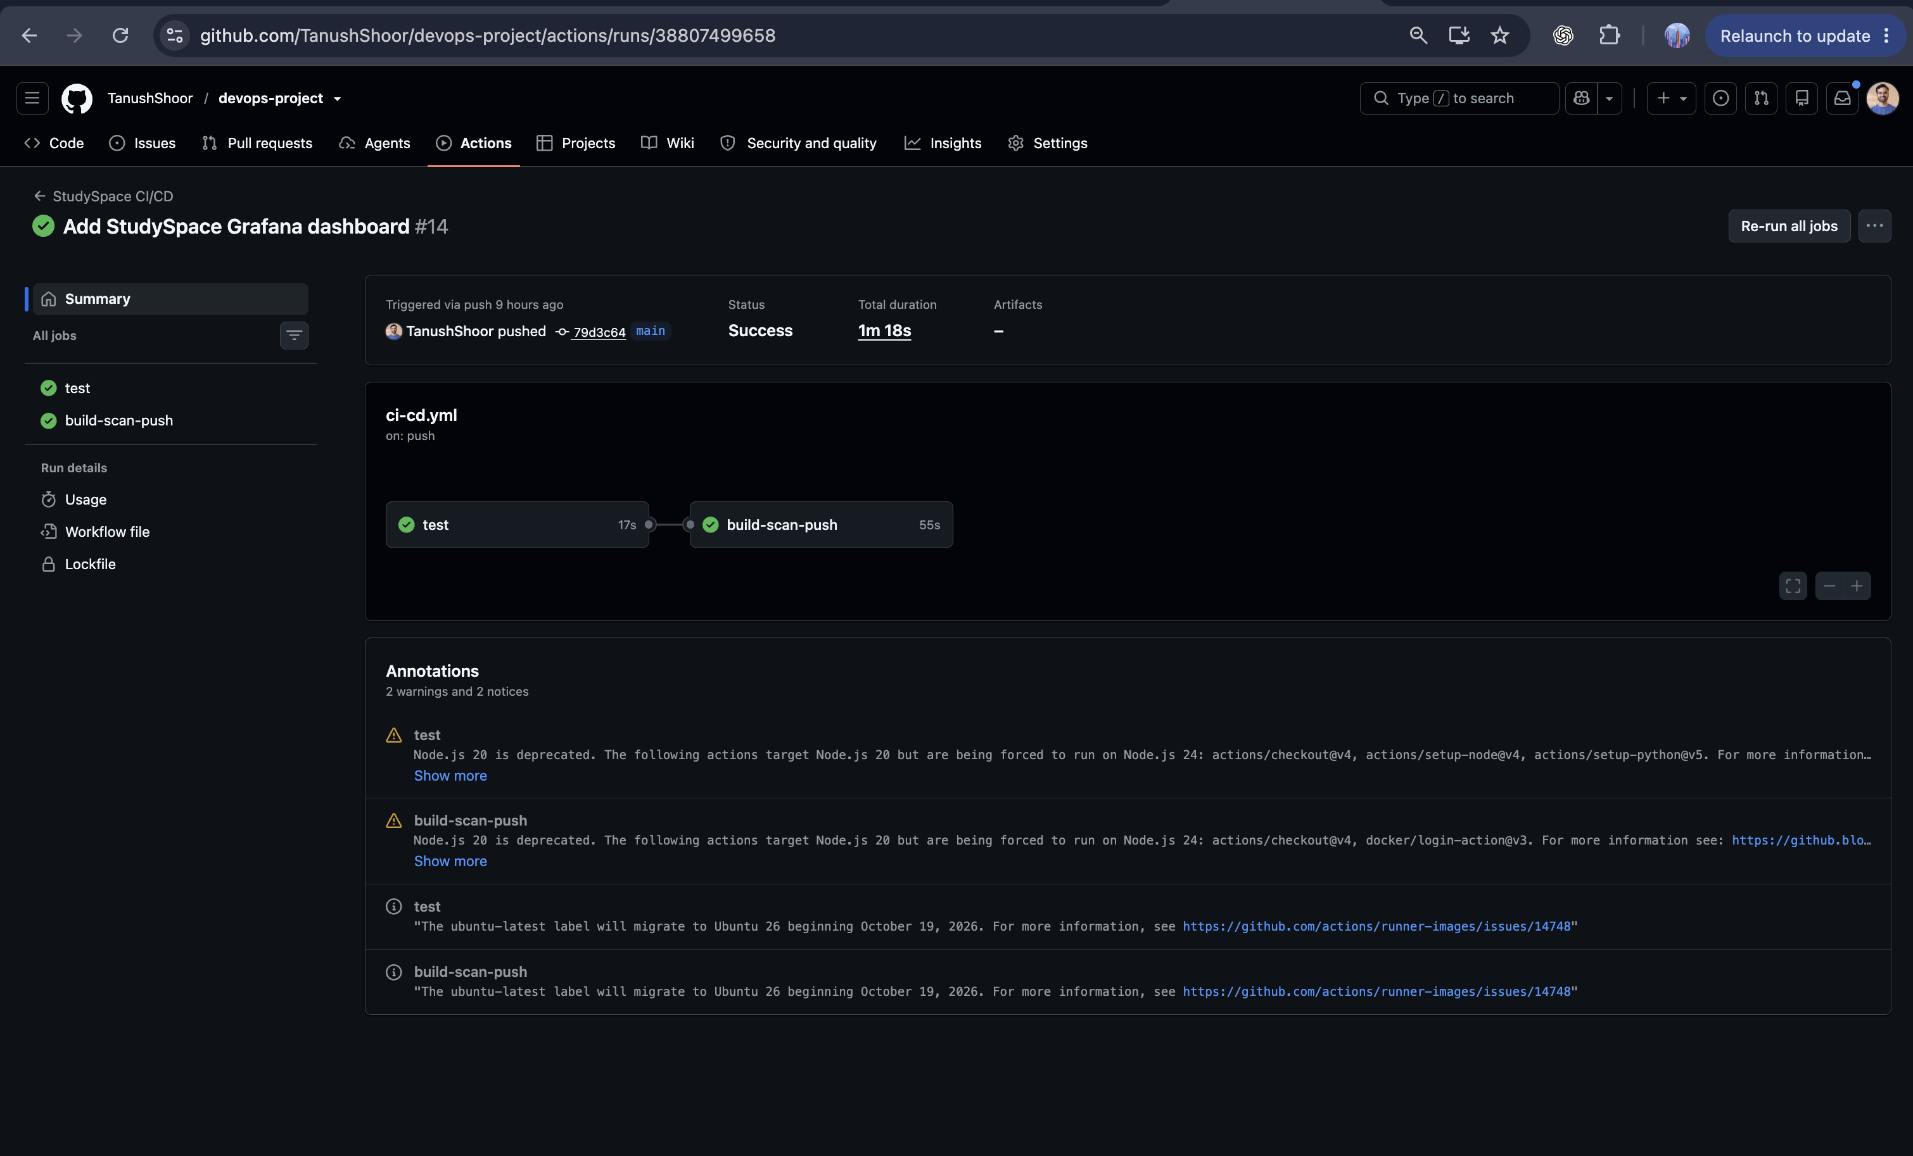
CI/CD
GitHub Actions: final pipeline succeeds
The final captured run is green for the tested commit and build/scan/push stages.
Run #14 • commit 79d3c64 • test job and build-scan-push job succeeded.
Session 21 • Evidence captured before AWS teardown
Notes:
GitHub Actions: final pipeline succeeds. The final captured run is green for the tested commit and build/scan/push stages. Run #14 • commit 79d3c64 • test job and build-scan-push job succeeded.
Screenshot placeholder: evidence/06-actions-green.png. Replace it with the corresponding image before presenting.

Slide 10
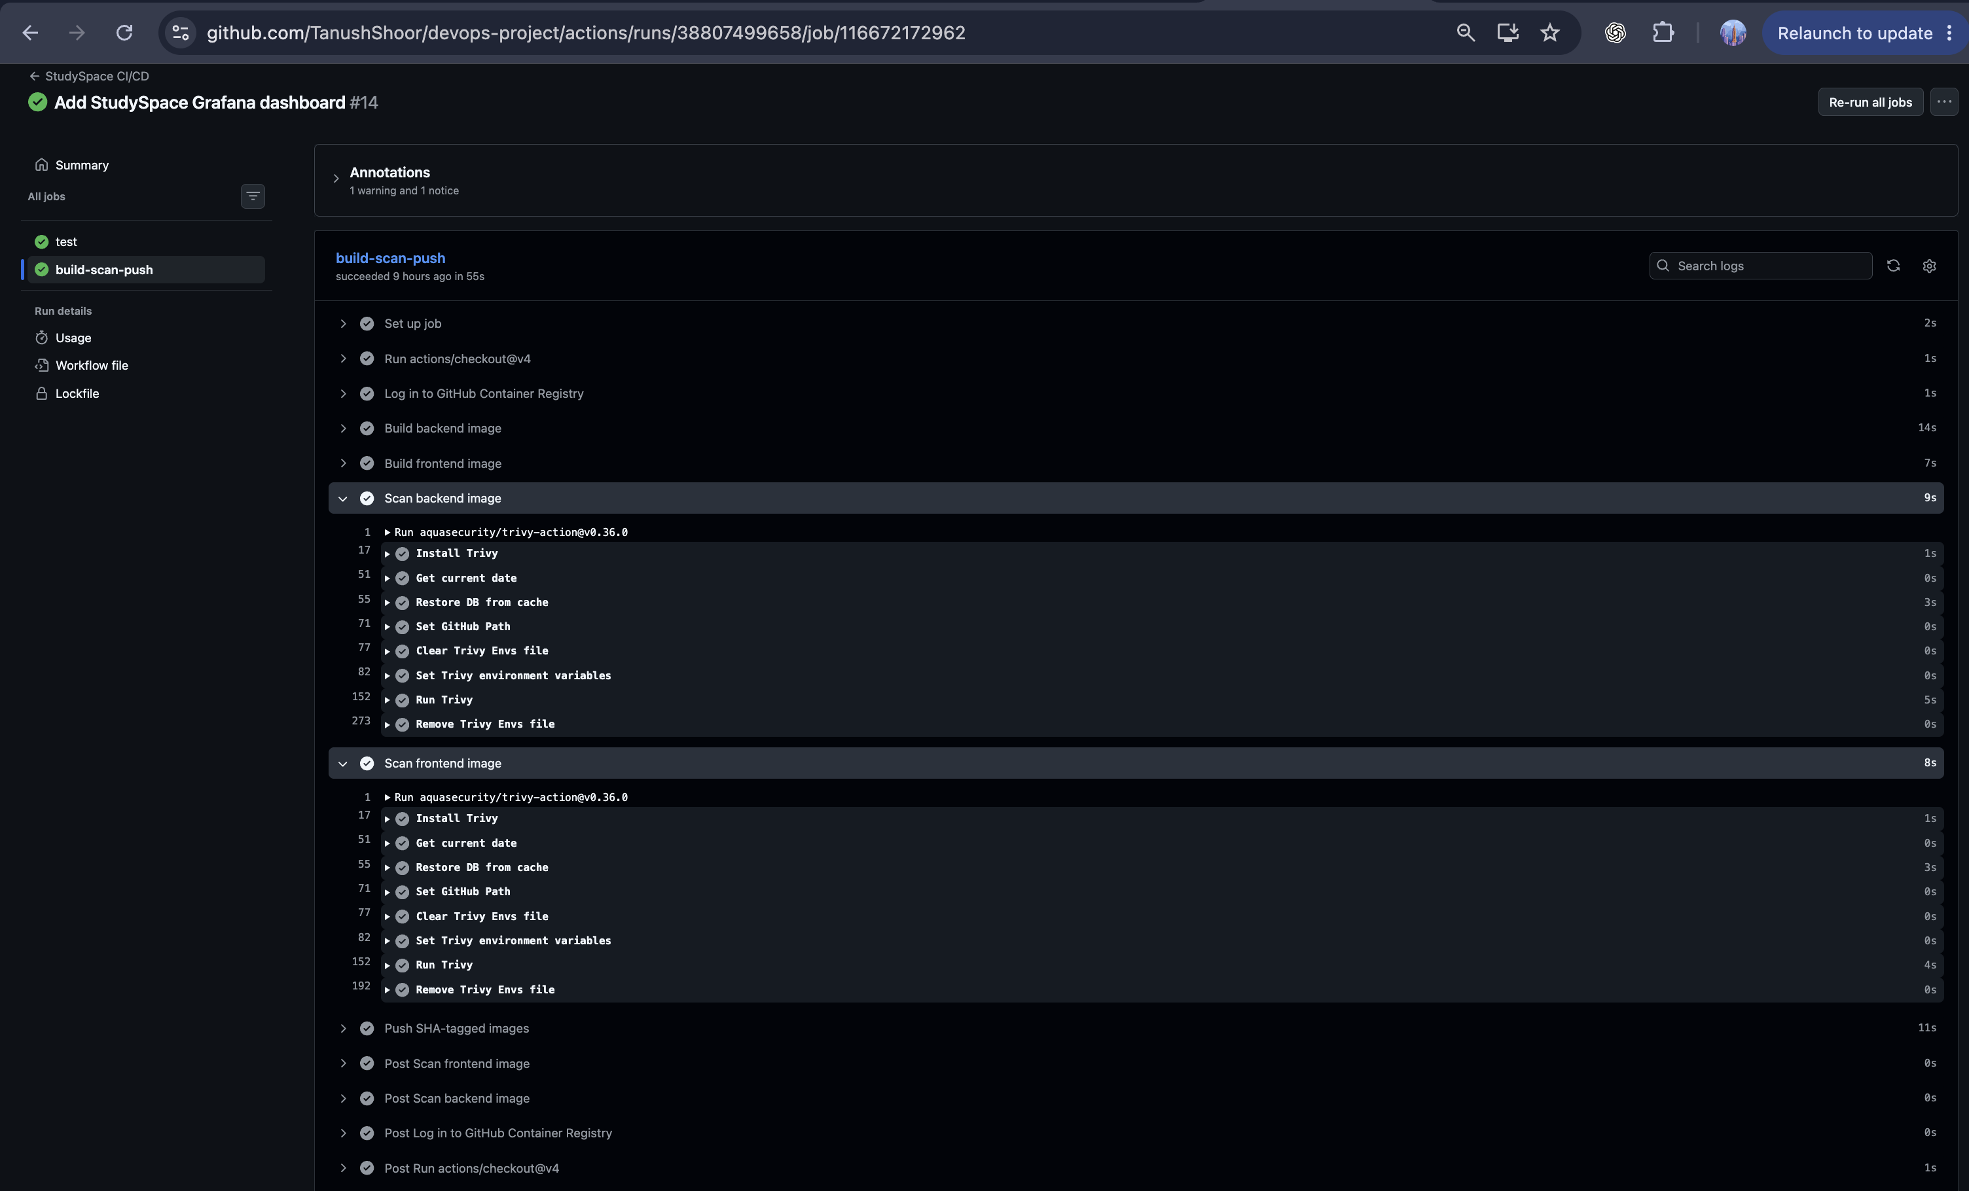
DEVSECOPS
Security scan stage in the workflow
The pipeline scans the built backend and frontend images before publishing.
The workflow blocks images with unfixed HIGH or CRITICAL findings.
Session 21 • Evidence captured before AWS teardown
Notes:
Security scan stage in the workflow. The pipeline scans the built backend and frontend images before publishing. The workflow blocks images with unfixed HIGH or CRITICAL findings.
Screenshot placeholder: evidence/07-trivy-scans.png. Replace it with the corresponding image before presenting.

Slide 11
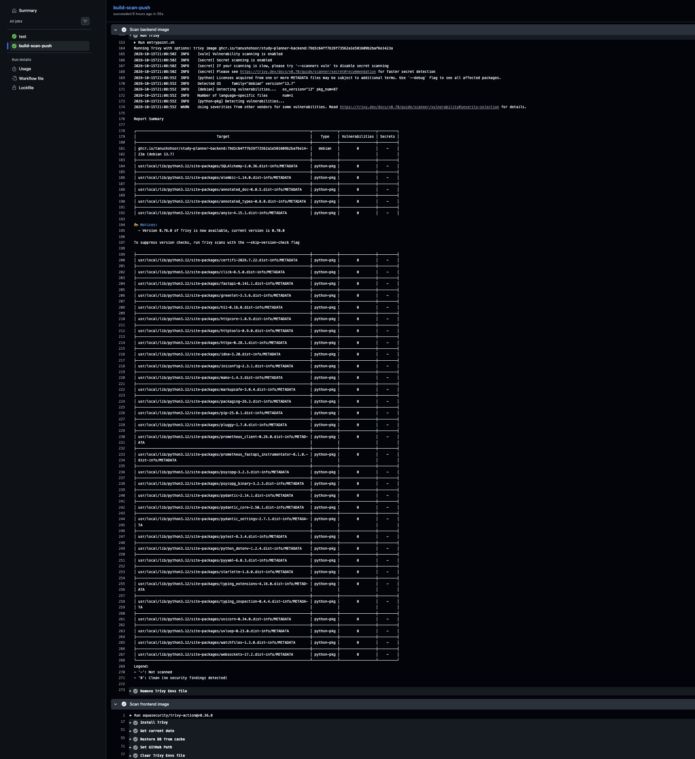
DEVSECOPS
Backend image scan result
Trivy reports zero vulnerabilities for the backend image in this captured run.
The scan applies to the exact image produced for the recorded commit.
Session 21 • Evidence captured before AWS teardown
Notes:
Backend image scan result. Trivy reports zero vulnerabilities for the backend image in this captured run. The scan applies to the exact image produced for the recorded commit.
Screenshot placeholder: evidence/07(a)-trivy-scans.png. Replace it with the corresponding image before presenting.

Slide 12
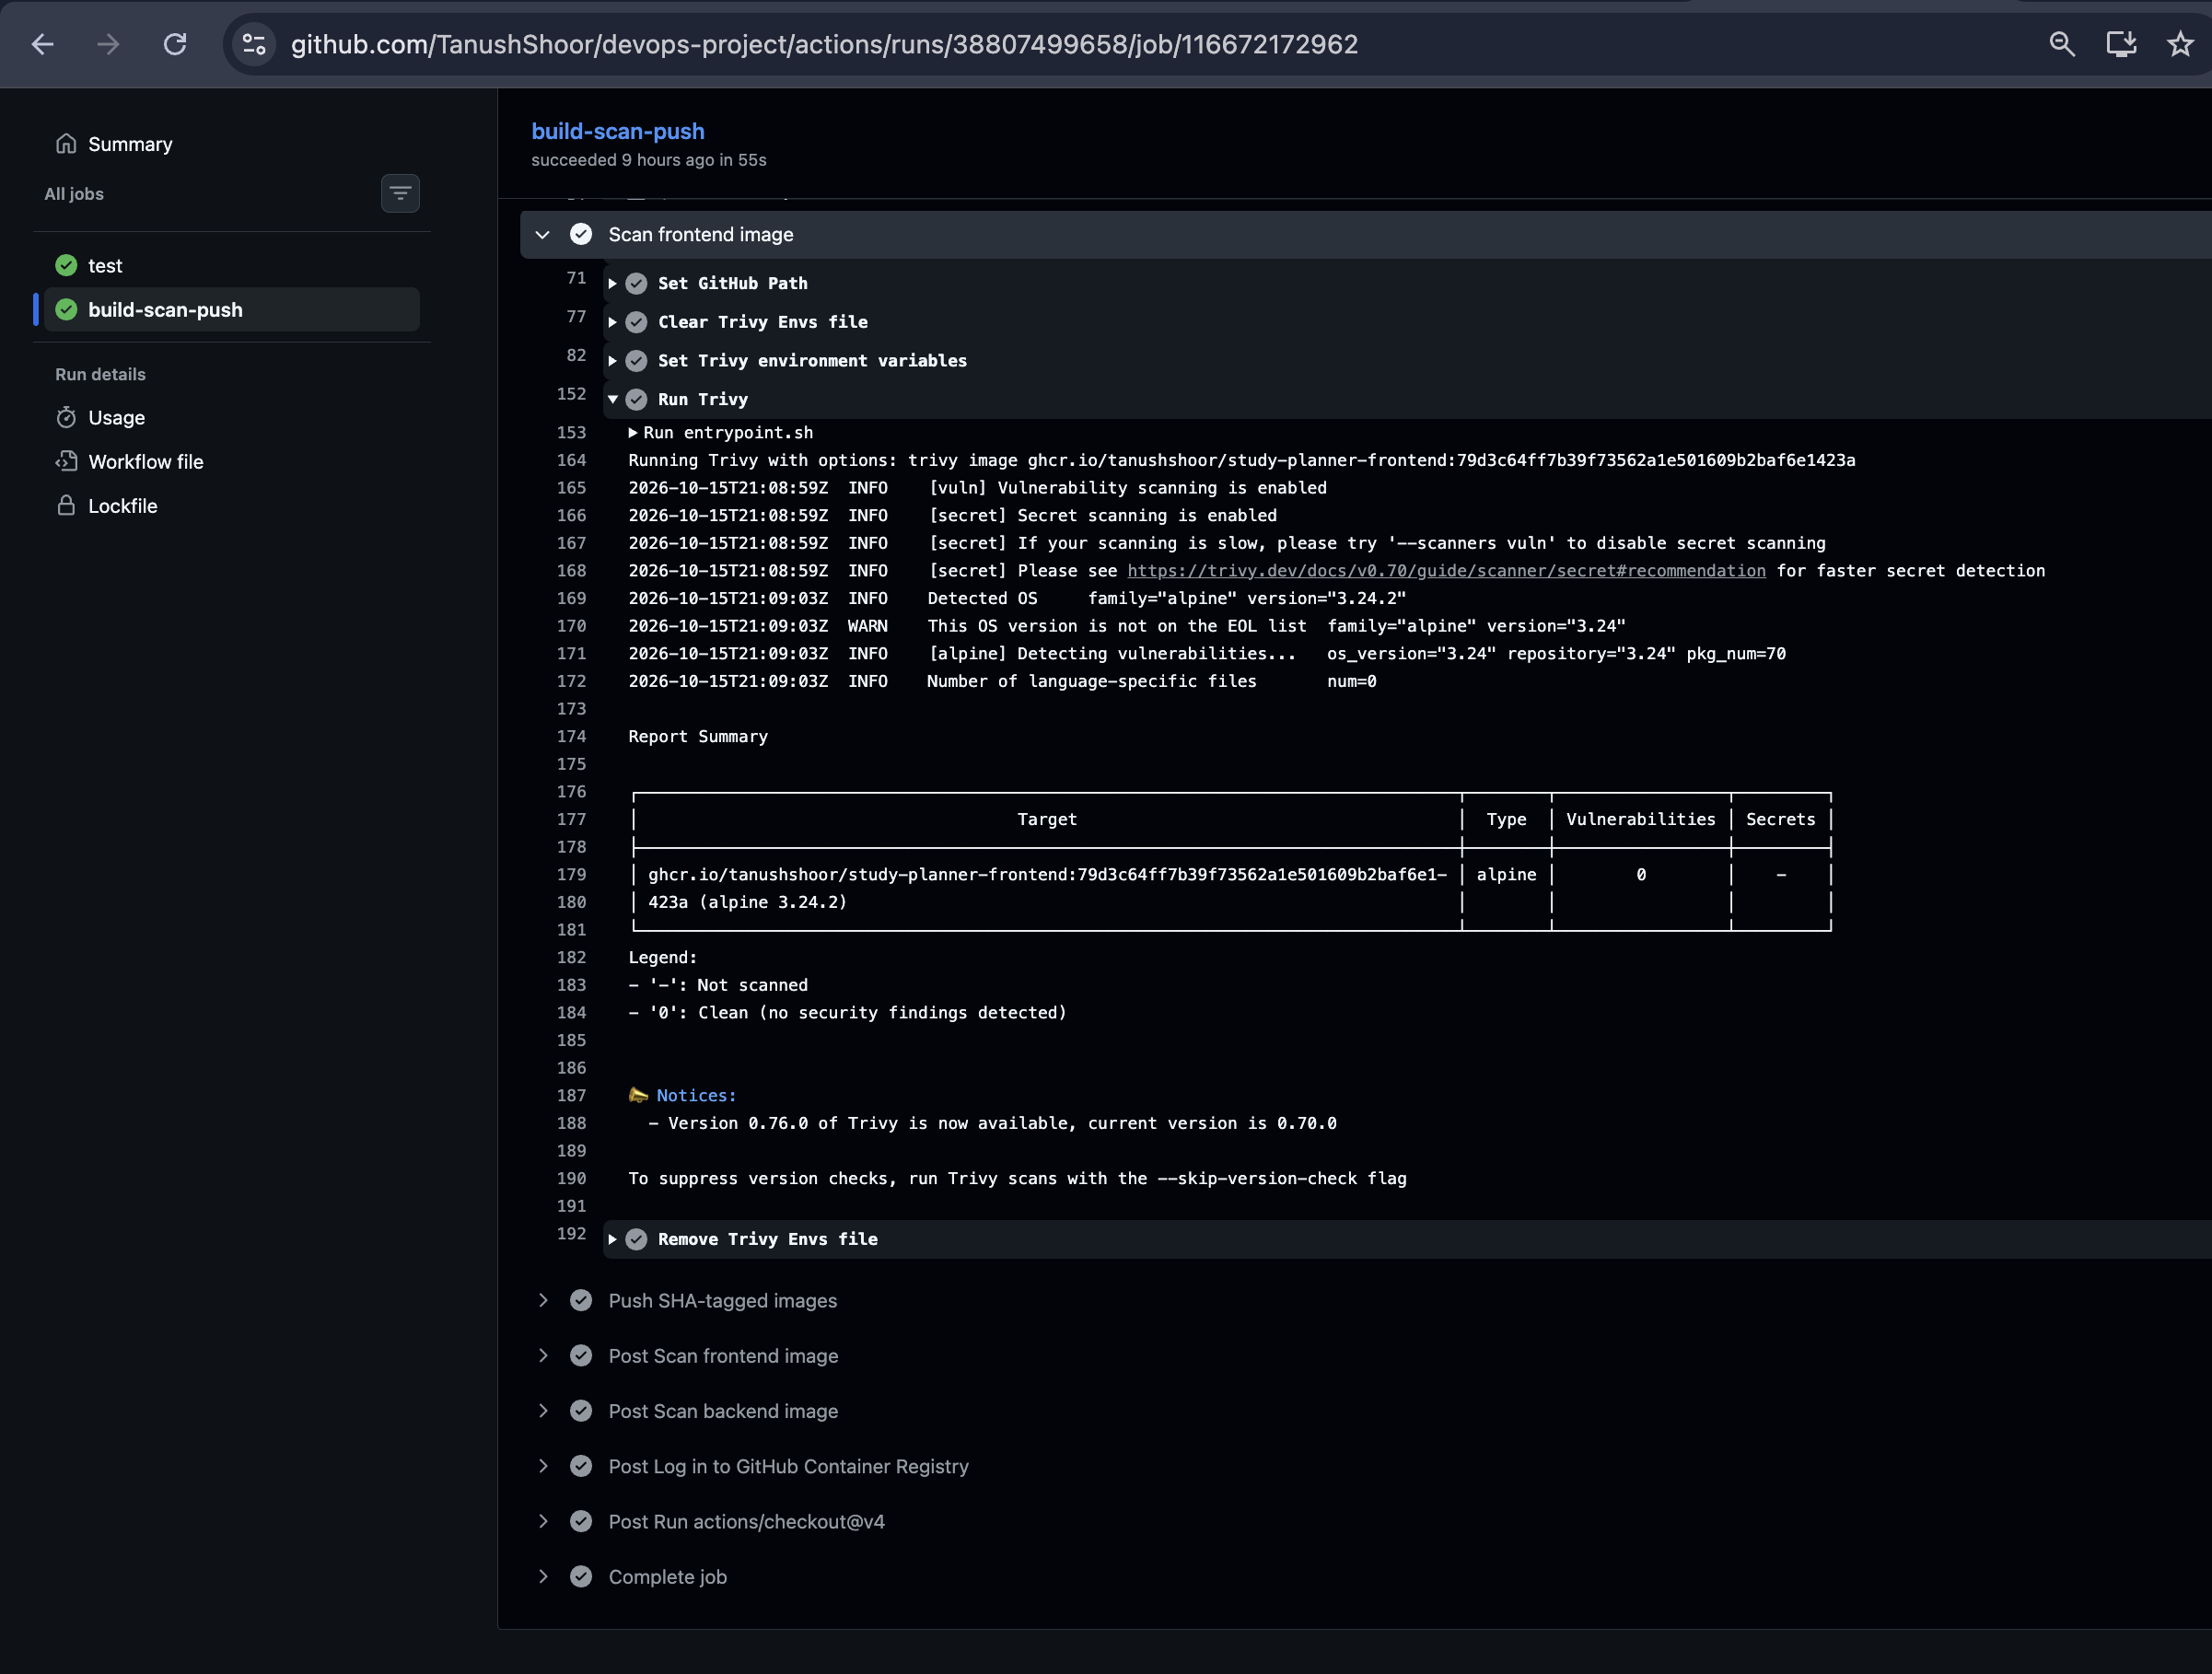
DEVSECOPS
Frontend image scan result
Trivy reports zero vulnerabilities for the frontend image in this captured run.
Both application images passed the configured severity gate.
Session 21 • Evidence captured before AWS teardown
Notes:
Frontend image scan result. Trivy reports zero vulnerabilities for the frontend image in this captured run. Both application images passed the configured severity gate.
Screenshot placeholder: evidence/07(b)-trivy-scans.png. Replace it with the corresponding image before presenting.

Slide 13
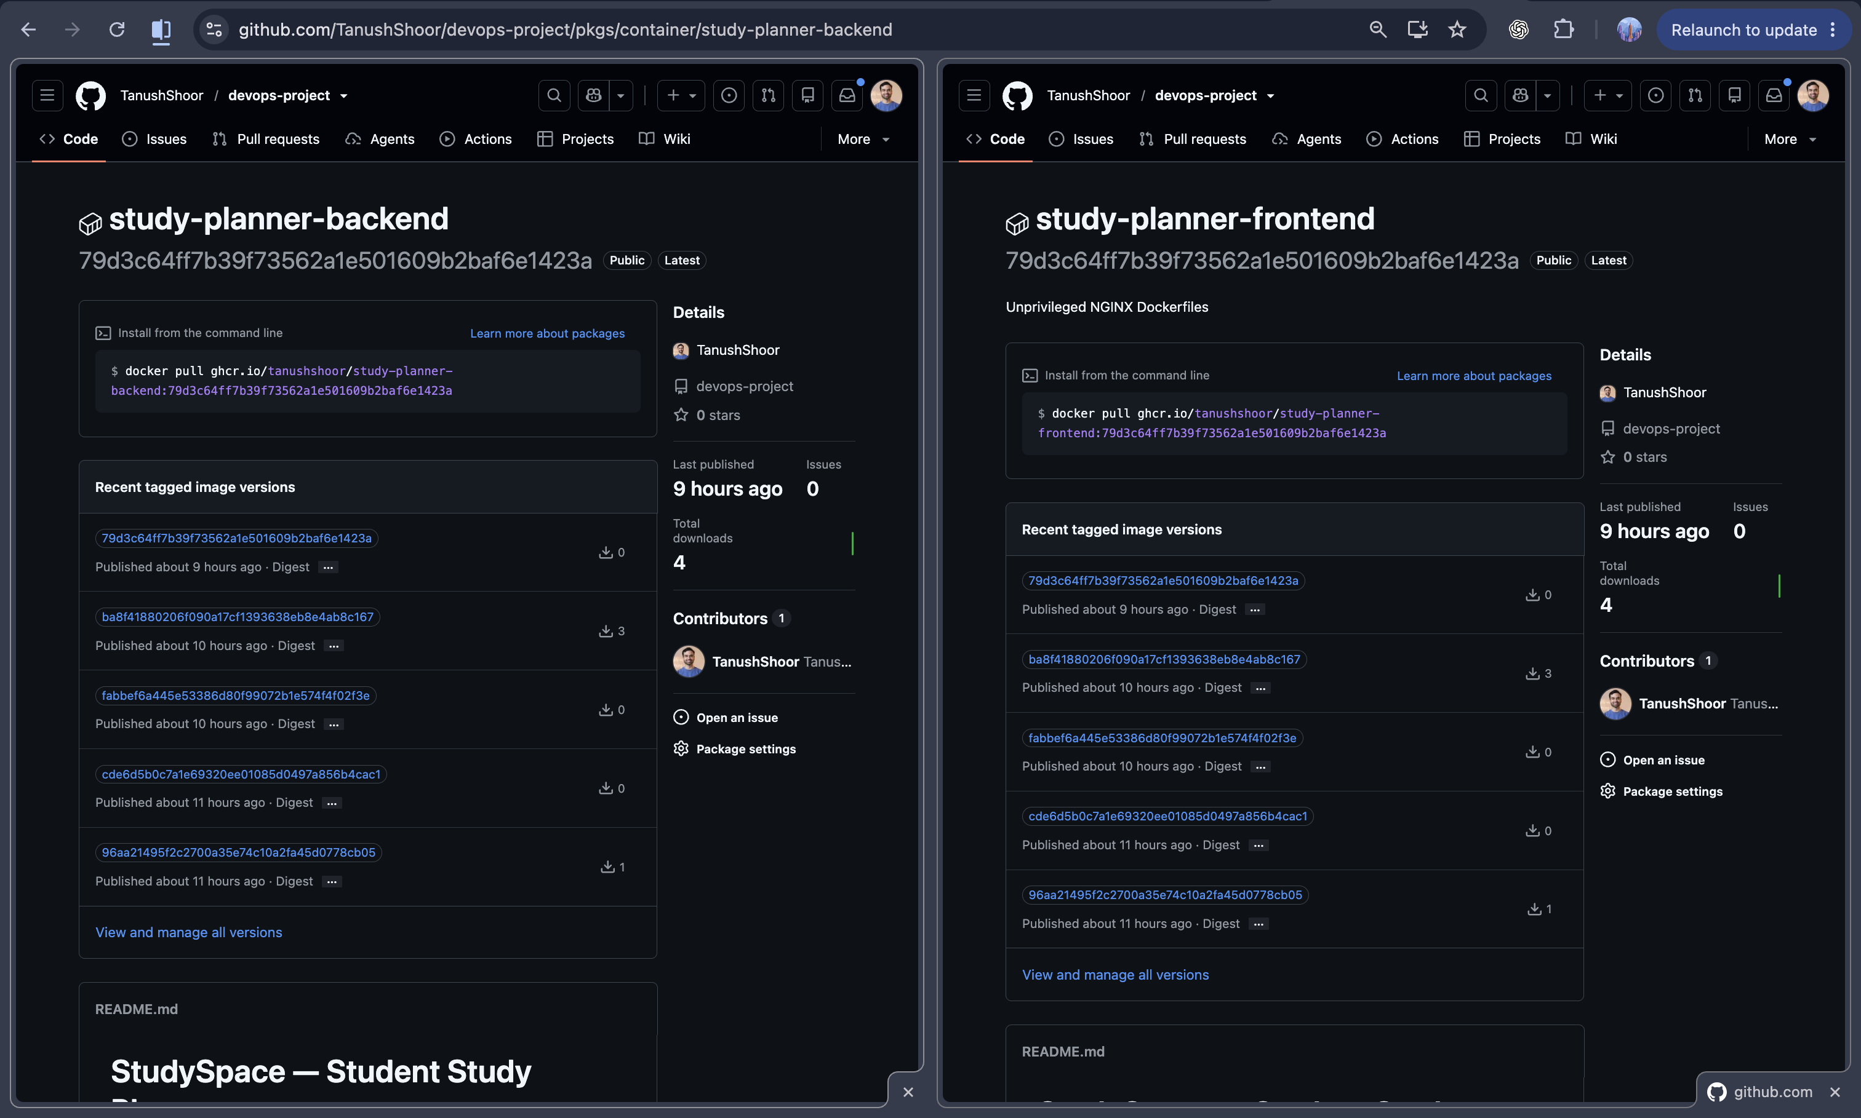
ARTIFACTS
Immutable images published to GHCR
Both services are published under separate package names and tagged with the full commit SHA.
The SHA ties a deployed image back to a specific source revision.
Session 21 • Evidence captured before AWS teardown
Notes:
Immutable images published to GHCR. Both services are published under separate package names and tagged with the full commit SHA. The SHA ties a deployed image back to a specific source revision.
Screenshot placeholder: evidence/08-ghcr-images.png. Replace it with the corresponding image before presenting.

Slide 14
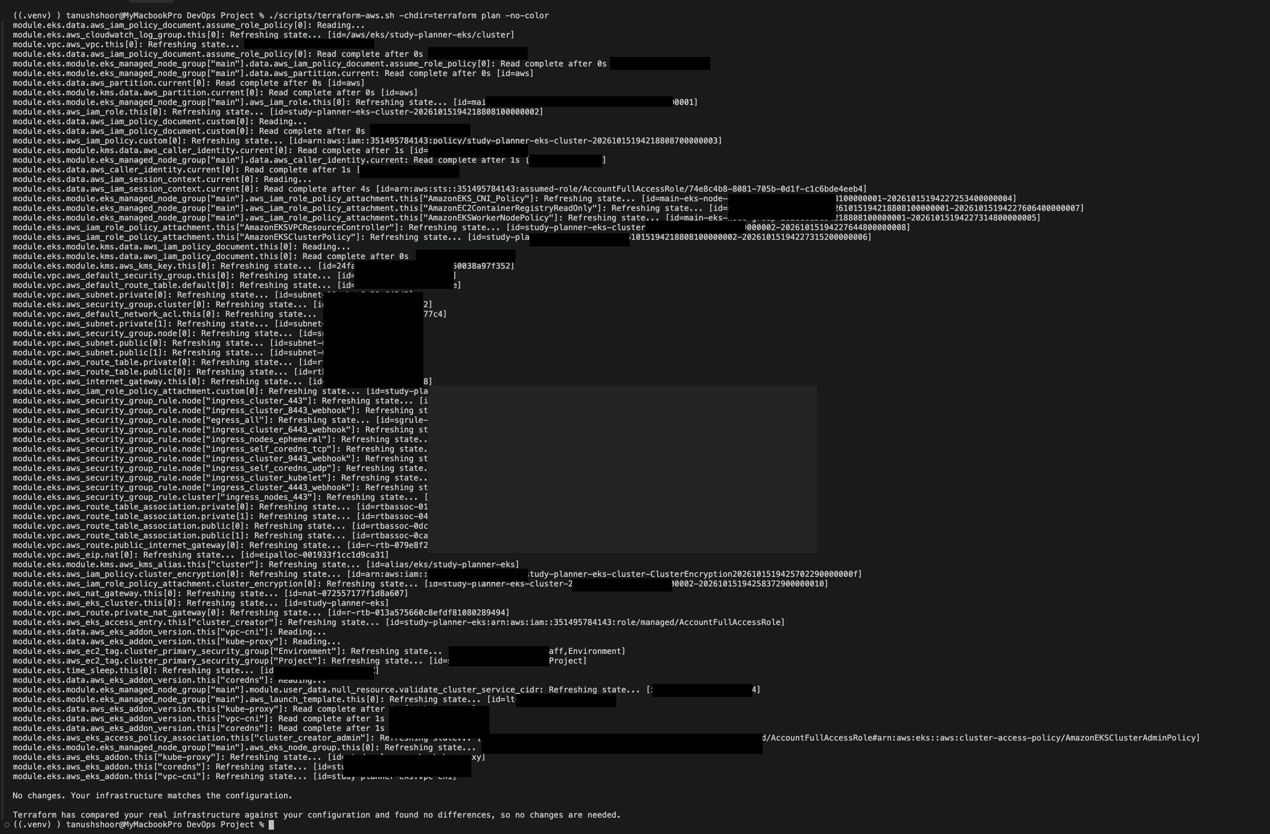
INFRASTRUCTURE
Terraform plan check after provisioning
This screenshot is a post-apply plan check and reports no remaining changes.
The original reviewed plan was 4 to add; that initial non-empty plan screenshot is not in the evidence folder.
Session 21 • Evidence captured before AWS teardown
Notes:
Terraform plan check after provisioning. This screenshot is a post-apply plan check and reports no remaining changes. The original reviewed plan was 4 to add; that initial non-empty plan screenshot is not in the evidence folder.
Screenshot placeholder: evidence/09-terraform-plan.png. Replace it with the corresponding image before presenting.

Slide 15
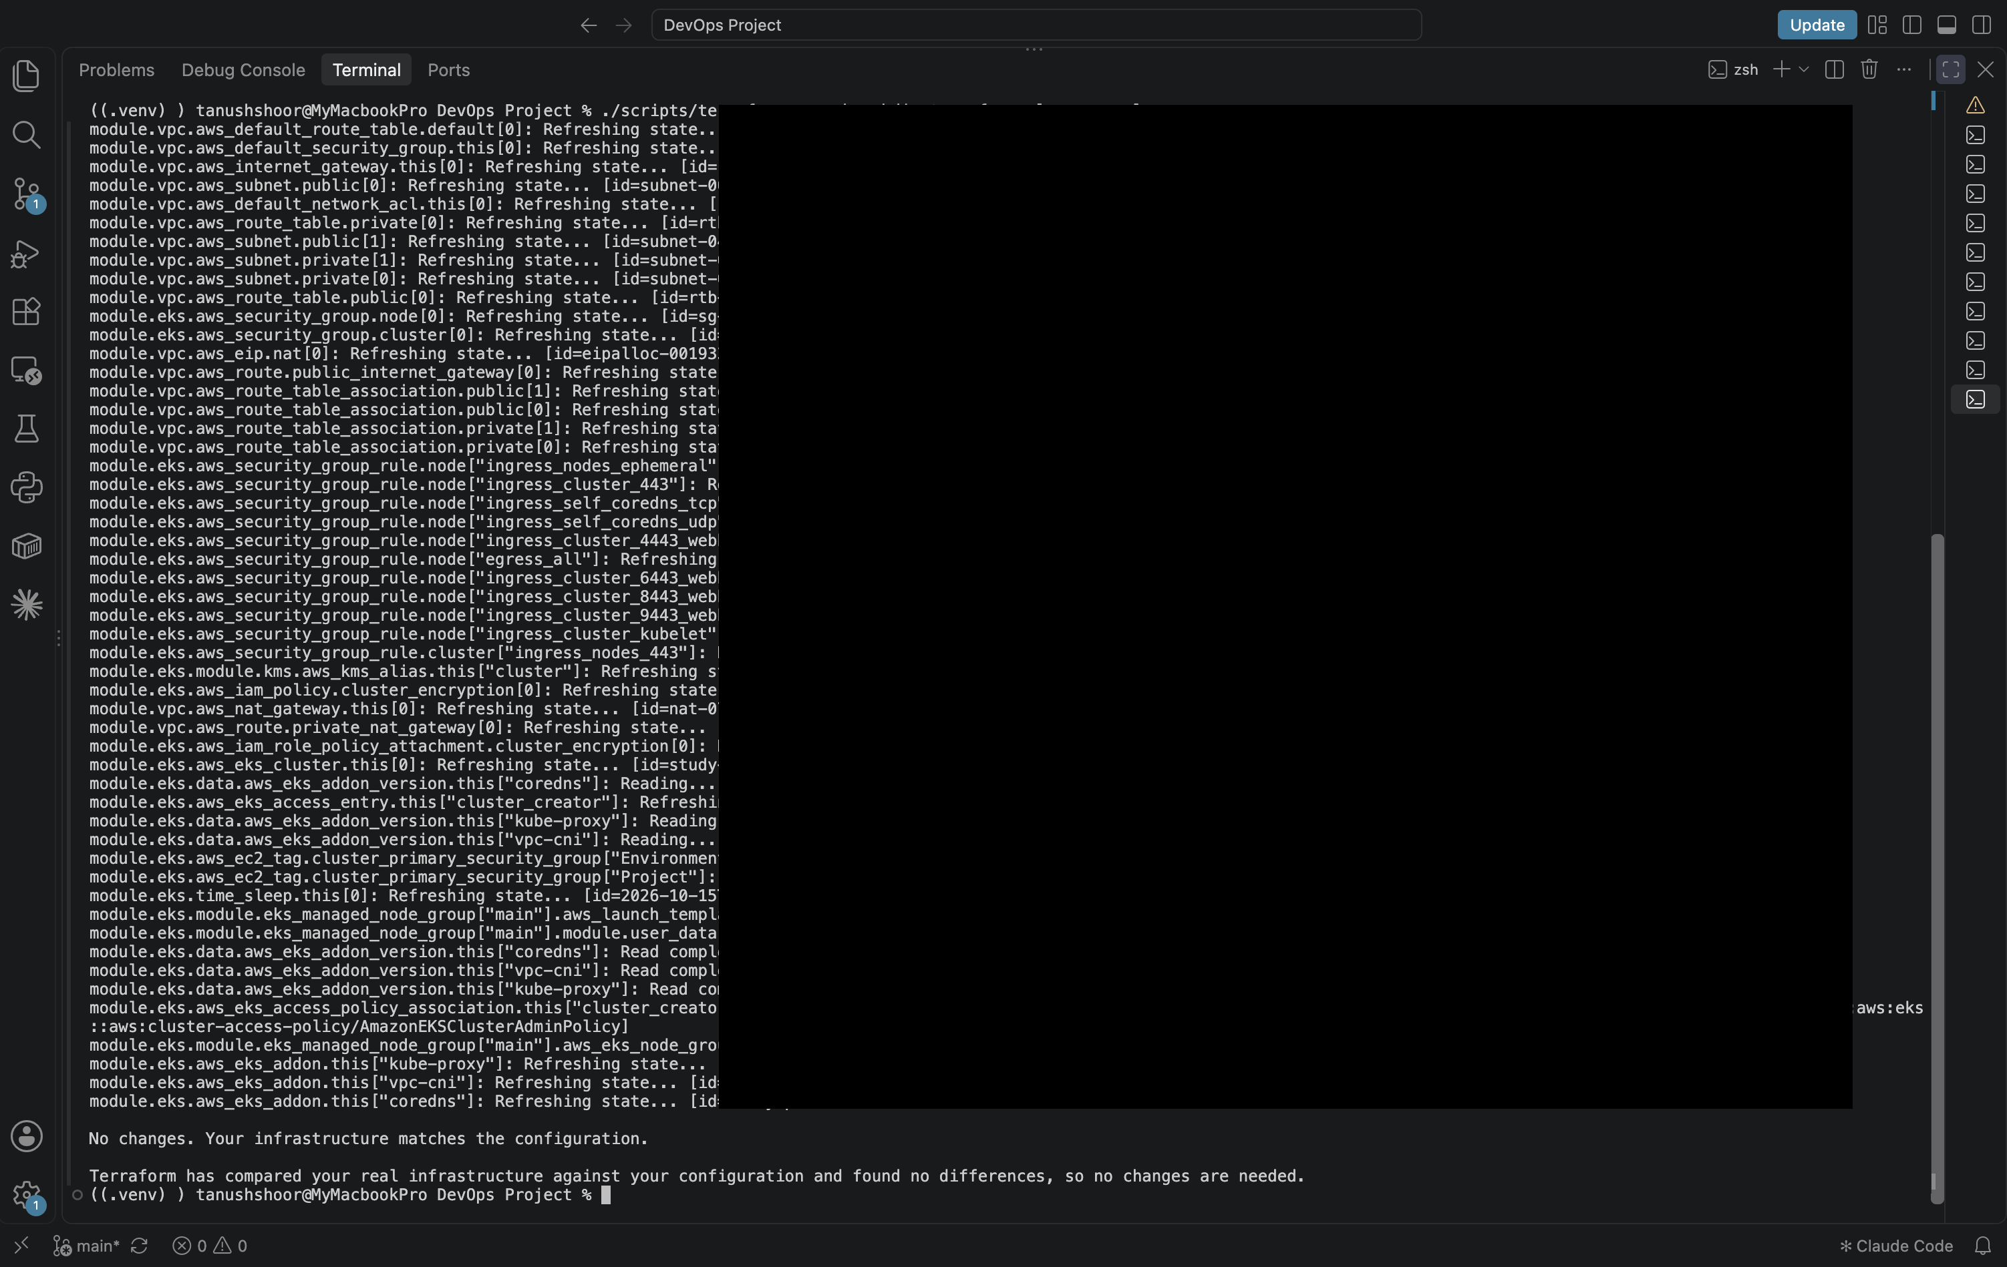
INFRASTRUCTURE
A second no-change Terraform check
The additional plan capture also confirms the provisioned configuration was stable.
Do not interpret this screenshot as the original create plan; it was taken after deployment.
Session 21 • Evidence captured before AWS teardown
Notes:
A second no-change Terraform check. The additional plan capture also confirms the provisioned configuration was stable. Do not interpret this screenshot as the original create plan; it was taken after deployment.
Screenshot placeholder: evidence/18-terraform-plan.png. Replace it with the corresponding image before presenting.

Slide 16
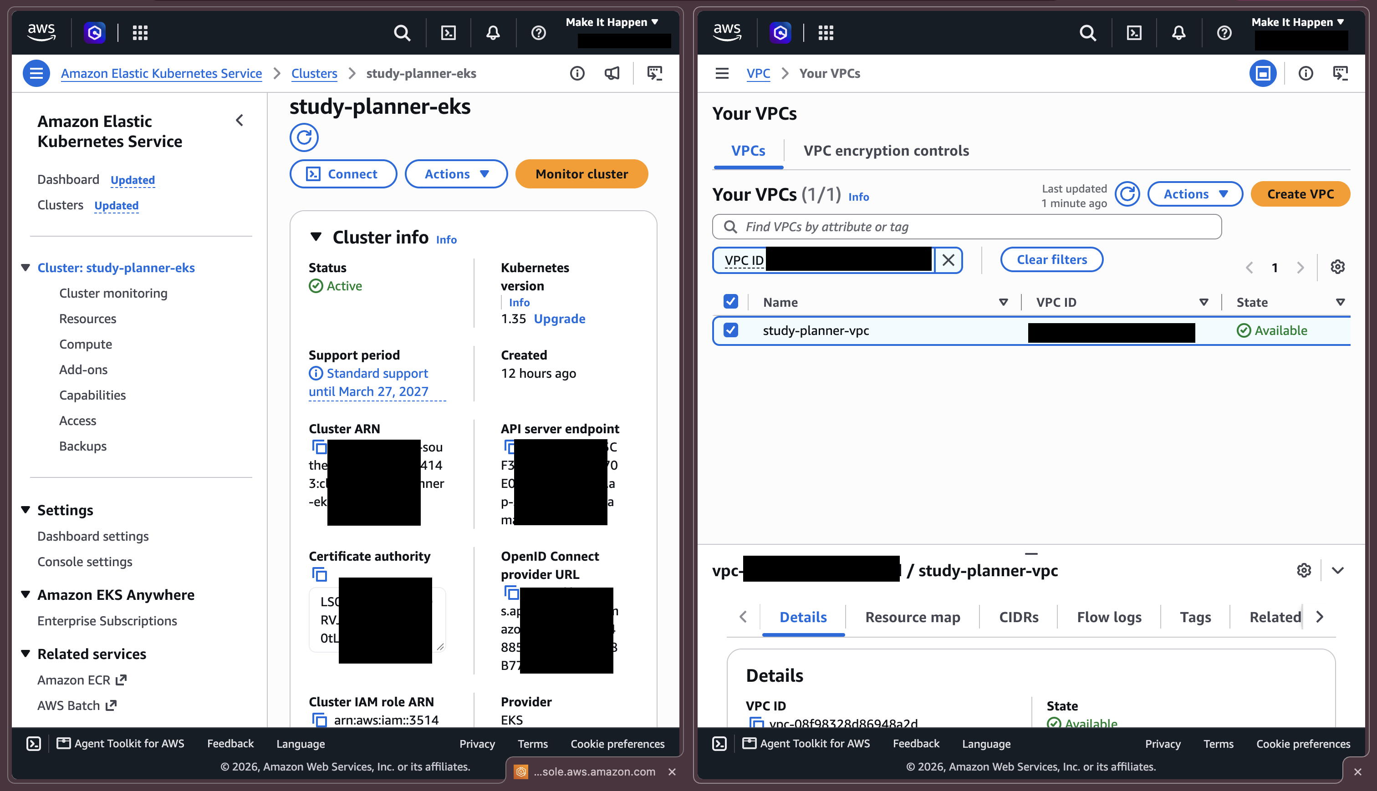
AWS
AWS network and EKS cluster were live
The console evidence shows the VPC and EKS cluster available in ap-southeast-2.
INSERT SCREENSHOT HERE
10-aws-vpc-eks.png
This was a temporary student demo environment and has since been destroyed.
Session 21 • Evidence captured before AWS teardown
Notes:
AWS network and EKS cluster were live. The console evidence shows the VPC and EKS cluster available in ap-southeast-2. This was a temporary student demo environment and has since been destroyed.
Screenshot placeholder: evidence/10-aws-vpc-eks.png. Replace it with the corresponding image before presenting.

Slide 17
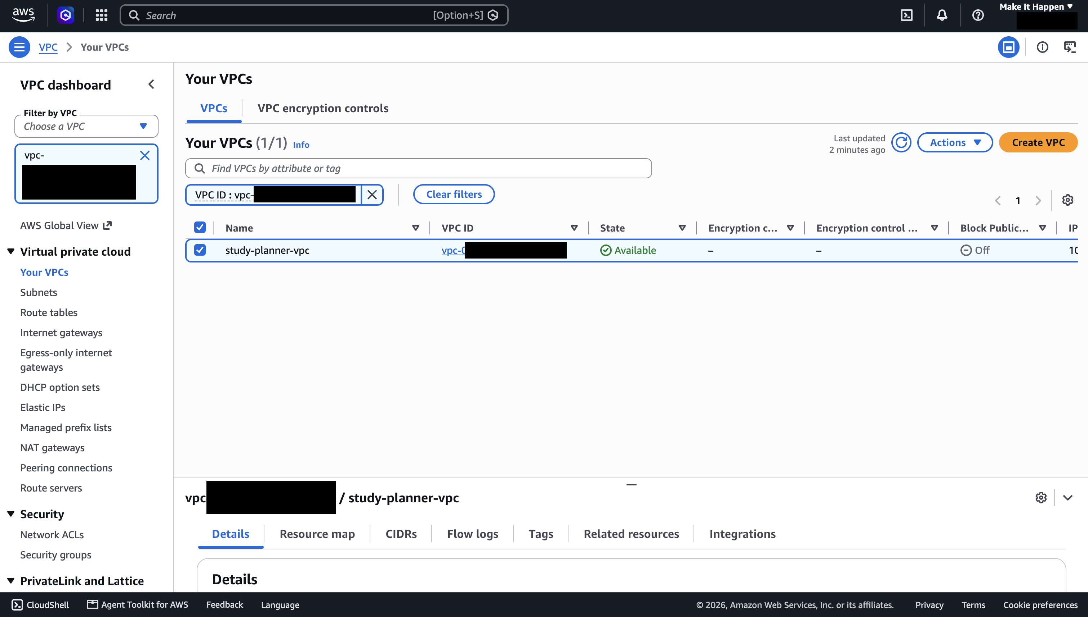
AWS
VPC layout: public and private subnets
The network layer contains two public and two private subnets with a NAT gateway.
INSERT SCREENSHOT HERE
vpc.png
Replace this placeholder with the matching image from the evidence folder.
Terraform managed the VPC resources used by the EKS cluster.
Session 21 • Evidence captured before AWS teardown
Notes:
VPC layout: public and private subnets. The network layer contains two public and two private subnets with a NAT gateway. Terraform managed the VPC resources used by the EKS cluster.
Screenshot placeholder: evidence/vpc.png. Replace it with the corresponding image before presenting.

Slide 18
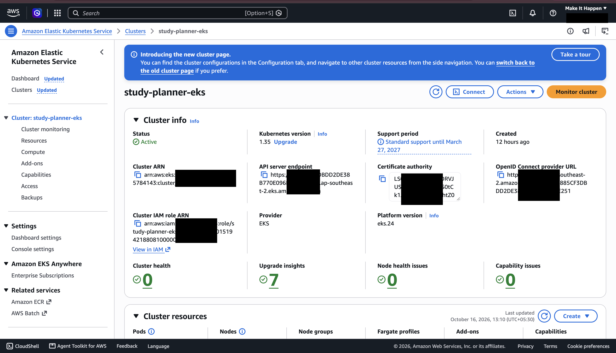
AWS
EKS control plane and managed nodes
The EKS console confirms the StudySpace cluster and managed capacity during the demo.
INSERT SCREENSHOT HERE
eks.png
Replace this placeholder with the matching image from the evidence folder.
The worker group used two t3.small instances for this short evidence run.
Session 21 • Evidence captured before AWS teardown
Notes:
EKS control plane and managed nodes. The EKS console confirms the StudySpace cluster and managed capacity during the demo. The worker group used two t3.small instances for this short evidence run.
Screenshot placeholder: evidence/eks.png. Replace it with the corresponding image before presenting.

Slide 19
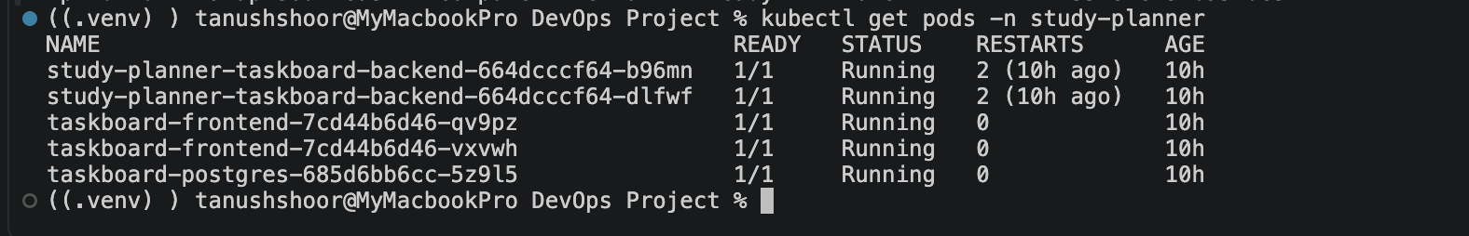
KUBERNETES
Kubernetes workloads reached Running
The application and PostgreSQL pods were scheduled and ready in the cluster.
INSERT SCREENSHOT HERE
11-kubernetes-pods.png
Replace this placeholder with the matching image from the evidence folder.
Backend and frontend ran as Deployments with multiple replicas.
Session 21 • Evidence captured before AWS teardown
Notes:
Kubernetes workloads reached Running. The application and PostgreSQL pods were scheduled and ready in the cluster. Backend and frontend ran as Deployments with multiple replicas.
Screenshot placeholder: evidence/11-kubernetes-pods.png. Replace it with the corresponding image before presenting.

Slide 20
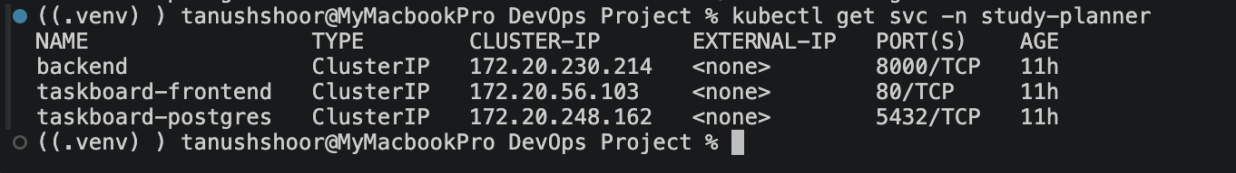
KUBERNETES
Kubernetes Services connect the pods
ClusterIP Services provide stable internal endpoints for the frontend, API, and database.
INSERT SCREENSHOT HERE
12-kubernetes-services.png
Replace this placeholder with the matching image from the evidence folder.
The service layer routes requests independently of individual pod addresses.
Session 21 • Evidence captured before AWS teardown
Notes:
Kubernetes Services connect the pods. ClusterIP Services provide stable internal endpoints for the frontend, API, and database. The service layer routes requests independently of individual pod addresses.
Screenshot placeholder: evidence/12-kubernetes-services.png. Replace it with the corresponding image before presenting.

Slide 21
KUBERNETES
Helm manages the StudySpace release
The Helm release records the chart deployment and revision in the cluster.
INSERT SCREENSHOT HERE
13-helm-release.png
Helm packages the Kubernetes configuration for repeatable installs and upgrades.
Session 21 • Evidence captured before AWS teardown
Notes:
Helm manages the StudySpace release. The Helm release records the chart deployment and revision in the cluster. Helm packages the Kubernetes configuration for repeatable installs and upgrades.
Screenshot placeholder: evidence/13-helm-release.png. Replace it with the corresponding image before presenting.

Slide 22
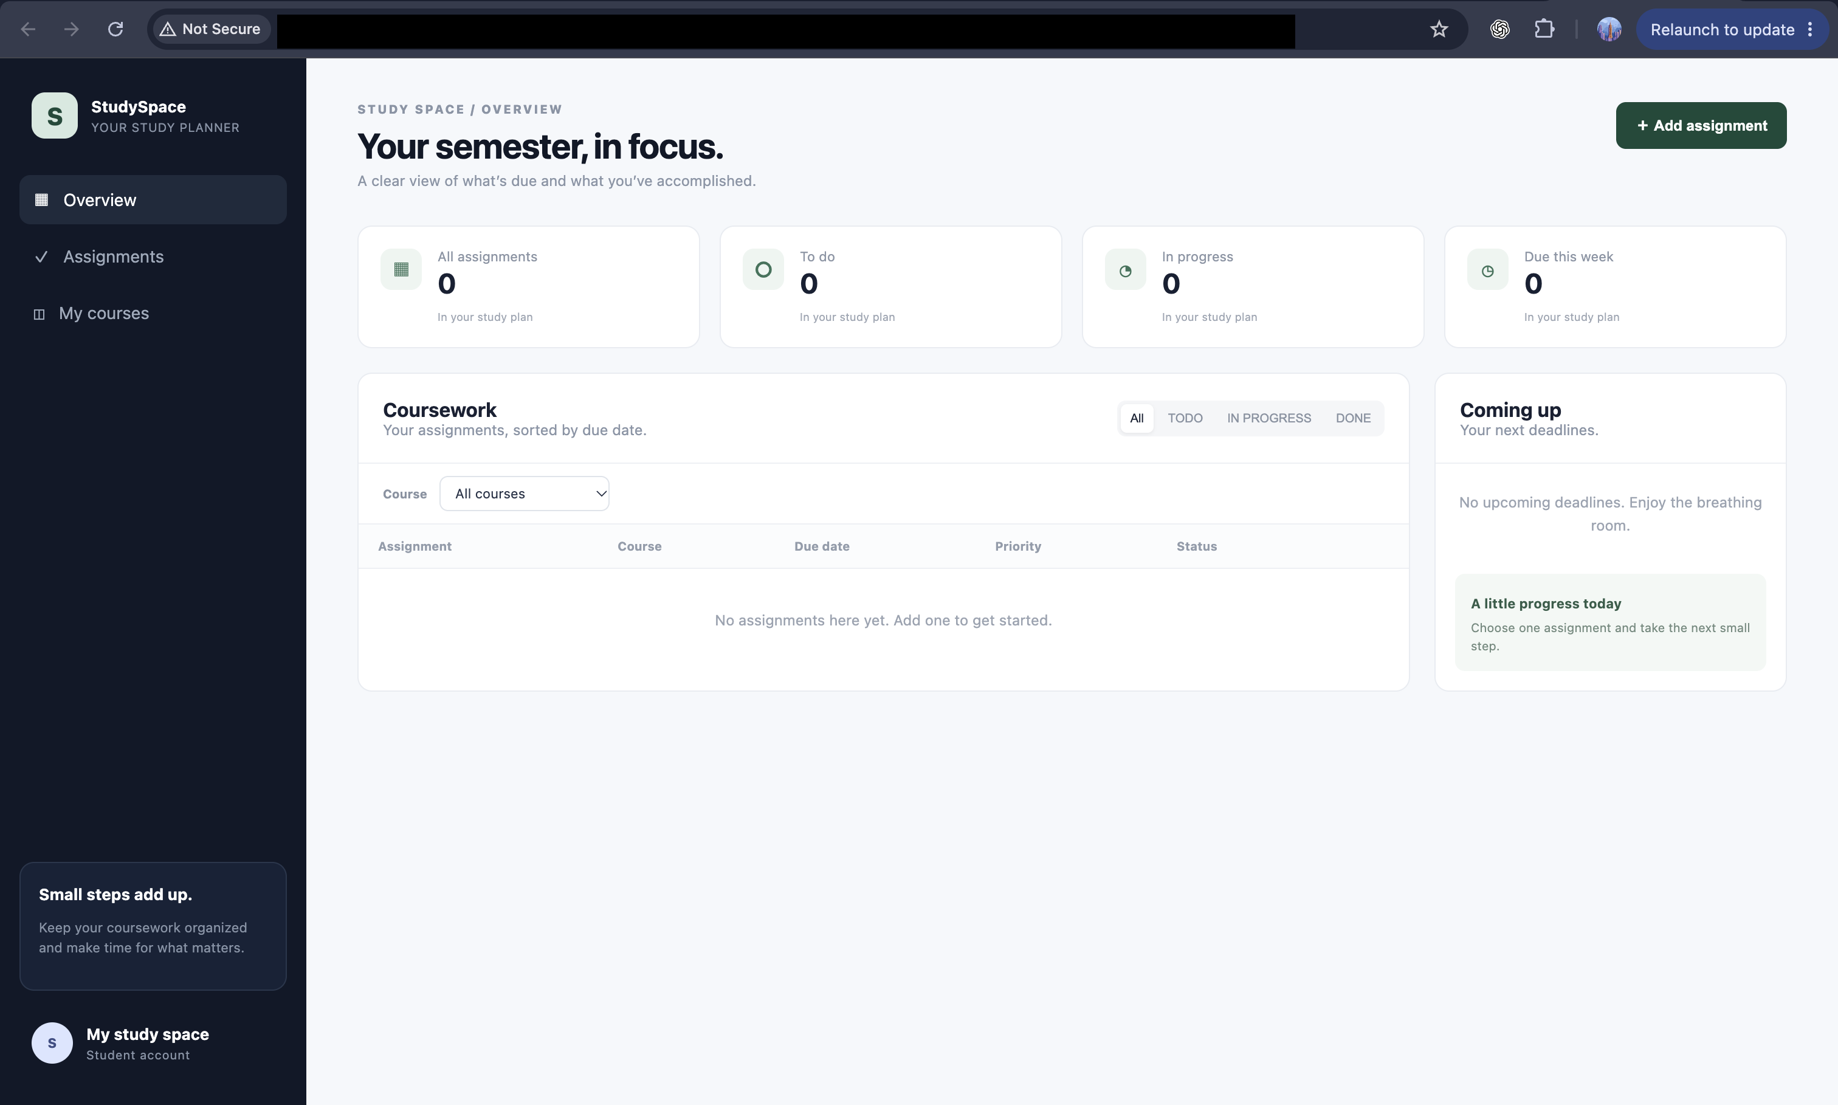
KUBERNETES
The deployed app was reachable through Ingress
The browser screenshot proves the application was available through the cloud load balancer.
14-ingress-app.png
The AWS load balancer endpoint was temporary and is no longer active after teardown.
Session 21 • Evidence captured before AWS teardown
Notes:
The deployed app was reachable through Ingress. The browser screenshot proves the application was available through the cloud load balancer. The AWS load balancer endpoint was temporary and is no longer active after teardown.
Screenshot placeholder: evidence/14-ingress-app.png. Replace it with the corresponding image before presenting.

Slide 23
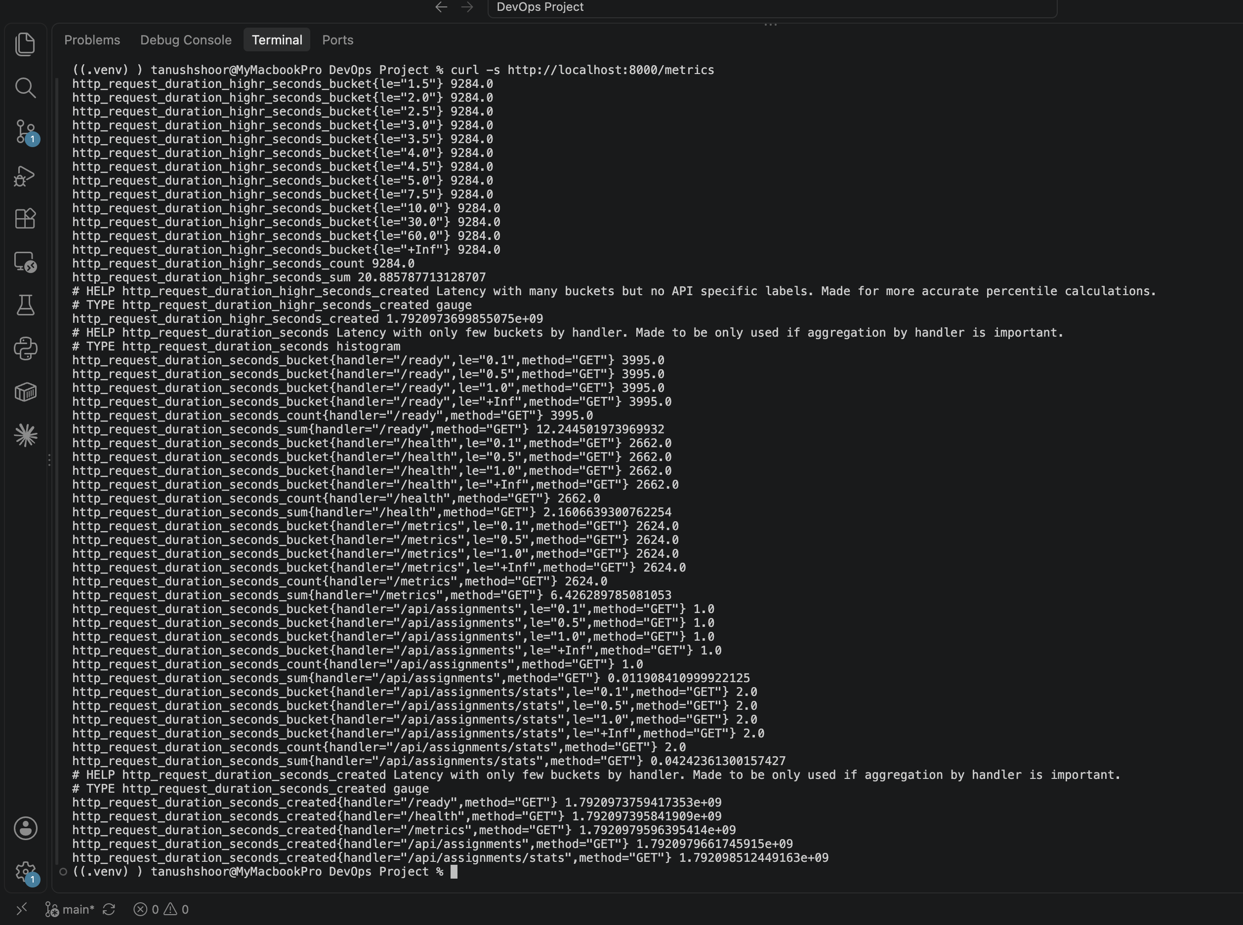
OBSERVABILITY
FastAPI exposes operational metrics
The backend metrics endpoint reports request counts and response measurements.
15-backend-metrics.png
Prometheus can scrape the metrics endpoint for alerting and dashboards.
Session 21 • Evidence captured before AWS teardown
Notes:
FastAPI exposes operational metrics. The backend metrics endpoint reports request counts and response measurements. Prometheus can scrape the metrics endpoint for alerting and dashboards.
Screenshot placeholder: evidence/15-backend-metrics.png. Replace it with the corresponding image before presenting.

Slide 24
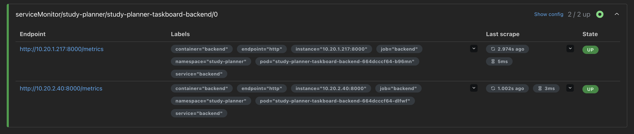
OBSERVABILITY
Prometheus scraped both backend replicas
Both backend targets are marked UP in the captured Prometheus targets page.
16-prometheus-target.png
This confirms service discovery and live scraping worked during the demo.
Session 21 • Evidence captured before AWS teardown
Notes:
Prometheus scraped both backend replicas. Both backend targets are marked UP in the captured Prometheus targets page. This confirms service discovery and live scraping worked during the demo.
Screenshot placeholder: evidence/16-prometheus-target.png. Replace it with the corresponding image before presenting.

Slide 25
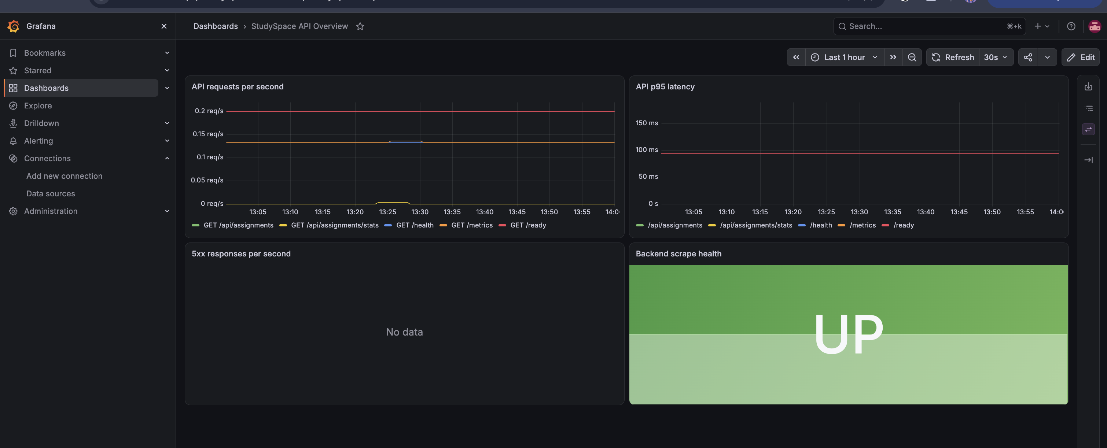
OBSERVABILITY
Grafana visualizes API health
The StudySpace dashboard shows request-rate data and backend scrape health as UP.
17-grafana-dashboard.png
The p95 and 5xx panels show no samples in this capture; the dashboard is provisioned for those metrics.
Session 21 • Evidence captured before AWS teardown
Notes:
Grafana visualizes API health. The StudySpace dashboard shows request-rate data and backend scrape health as UP. The p95 and 5xx panels show no samples in this capture; the dashboard is provisioned for those metrics.
Screenshot placeholder: evidence/17-grafana-dashboard.png. Replace it with the corresponding image before presenting.

Slide 26
CLEANUP
Cloud resources were destroyed after capture
Terraform reported 58 resources destroyed, and the EKS cluster was verified absent.
18-terraform-destroyed.png
Cleanup keeps the student AWS account from leaving demo infrastructure running.
Session 21 • Evidence captured before AWS teardown
Notes:
Cloud resources were destroyed after capture. Terraform reported 58 resources destroyed, and the EKS cluster was verified absent. Cleanup keeps the student AWS account from leaving demo infrastructure running.
Screenshot placeholder: evidence/18-terraform-destroyed.png. Replace it with the corresponding image before presenting.

Slide 27
SUBMISSION SUMMARY
A complete capstone lifecycle, with honest evidence
What is complete, and what a live reviewer should know.
Implemented and evidenced
Validated outcomes
Application, tests, Compose, GitHub Actions, Trivy, GHCR, Terraform, EKS, Helm, Ingress, and Prometheus/Grafana.
6 API tests passed • final CI run green • both Trivy scans clean • Prometheus targets UP • AWS resources destroyed.
Current runtime state
Live demo sequence
The local Compose stack can be started with `docker compose up --build`. AWS infrastructure is not running.
Start Compose for the app; show passing tests and Actions run; use screenshots for cloud stages unless you intentionally reprovision AWS.
Project files: README.md • evidence/ • StudySpace-DevOps-Capstone.pptx
Session 21 • Evidence captured before AWS teardown
Notes:
Close by summarizing outcomes against the grading rubric. The AWS runtime is intentionally gone after cleanup. For a live demo without incurring cloud usage, show the local stack, test results, successful Actions workflow, and captured cloud evidence.

