Slide 1
End-Term Presentation for Project I (EC 300)
on
VLSI Architecture for Hyperspectral image Processing
By
Tanushka Sharma
Roll No.:2301227
B.Tech (Electronics and Communication Engineering)
Under the supervision of Dr. Rakesh Biswas Assistant Professor
Department of Electronics and Communication Engineering
Indian Institute of Information Technology Guwahati Bongora, Assam, Pin-781015

Slide 2
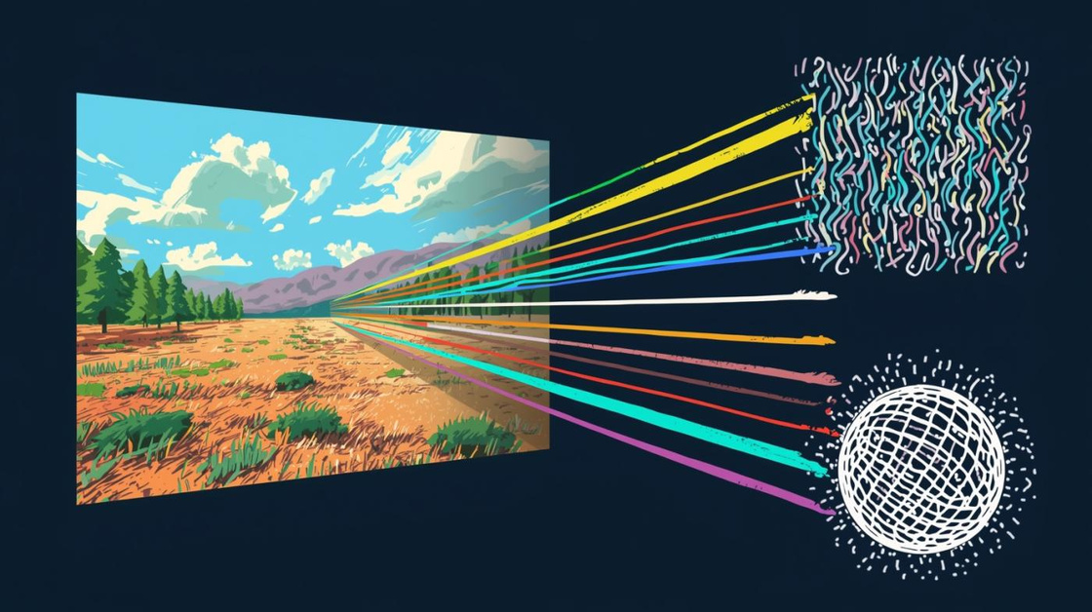
VLSI Architecture for
Hyperspectral image processing
[ 1]

Slide 3
Outline
Introduction
Literature review
Motivation and problem statement
Methodology
Results and discussion
Conclusion and future work
References

Slide 4
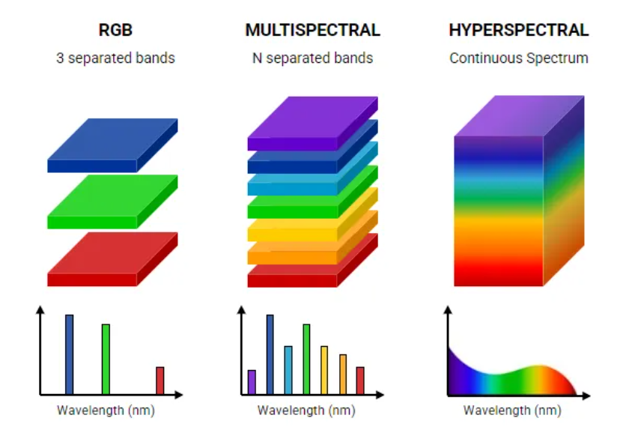
Hyperspectral Image Processing
Hyperspectral Image Processing (HSIP) is the technique of analyzing images captured across hundreds of narrow and continuous spectral bands of the electromagnetic spectrum to extract detailed information about materials in a scene.
Unlike normal RGB images (which use only Red, Green, Blue), hyperspectral images record a full spectral signature at every pixel.
Figure 1.: Hyperspectral imaging [2]

Slide 5
What is hyperspectral imaging used for?
Remote Sensing: Mineral mapping, environmental monitoring, and vegetation analysis.
Precision Agriculture: Monitoring crop health, nutrient deficiency, and disease.
Food Safety: Non-destructive quality inspection, such as detecting contaminants or grading.
Forensics and Security: Material detection and identification.

Slide 6
Literature Review
Paper | Key Contribution | Limitation | Difference from Proposed Work
N. Muthukumaran, r. Ravi (2014) | Efficient Lossless Image Compression System using Adjusted Binary code and Golomb Rice code | Used Golomb Rice code | We proposed a lossless compression method utilizing Adaptive Golomb Rice code .
CCSDS Secretariat National Aeronautics and Space Administration (NASA) (2016) | Lossless Multispectral and Hyperspectral Image Compression | Applicable only to 3D data | Extends the method to 4D Hyperspectral Image (HSI) compression.
Paul G. Howard and Jeffrey Scott Vitte (1993) | Fast and Efficient Lossless Image Compression | Applicable only to 2D data and have not been implemented in hardware | Extends the method to 4D Hyperspectral Image (HSI) compression + Hardware Implementation

Slide 7
Motivation & Problem Statement
Challenge of Data Volume:
Multitemporal hyperspectral images generate huge amounts of data (4D data: spatial + spectral + temporal dimensions).
Data sizes easily reach Gigabytes or Terabytes, creating serious problems for storage, transmission and real-time processing.
Limitations of Existing Methods:
Most existing methods target only spatial and spectral correlations (3D HSI), not temporal.
Some 4D approaches exist but are either lossy or too computationally complex.

Slide 8
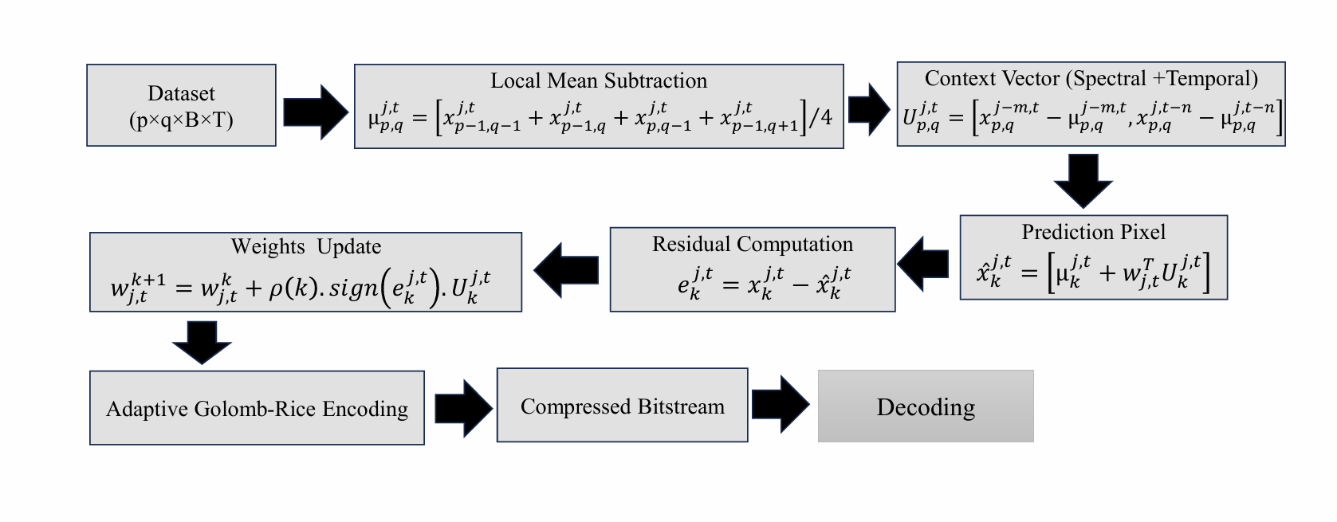











Proposed 4D Compression Scheme

Slide 9
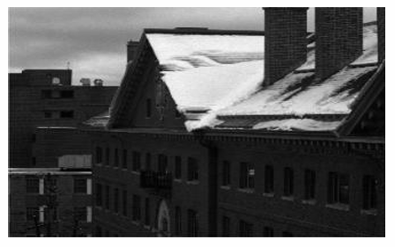
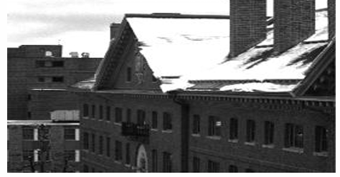
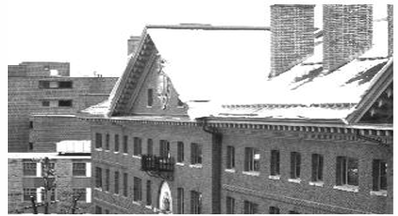
1. Input Data Preparation
Loaded three hyperspectral cubes: Morning, Noon, and Afternoon
Noon and Afternoon datasets were generated by using controlled brightness scaling to emulate temporal variations.
Each cube contains 292x153 pixels and 31 spectral bands
Verified all cubes have same dimensions
Stacked together to form a 4-D hyperspectral dataset (m × n × B × T)
This prepares the data for spatial, spectral, and temporal prediction
Morning Dataset – 31st Spectral Band
Afternoon Dataset – 31st Spectral Band
Noon Dataset – 31st Spectral Band
Figure 3.: Deep RGB-driven Learning Network for Unsupervised Hyperspectral Image Super-resolution [3]

Slide 10
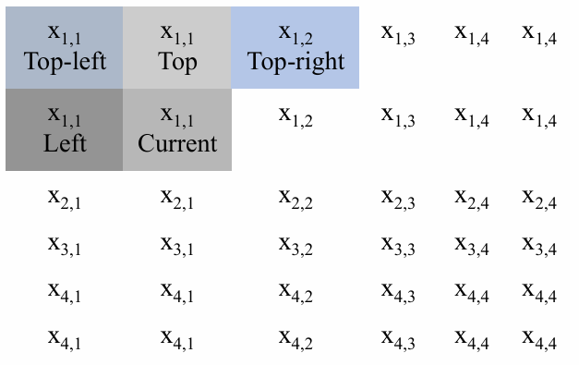
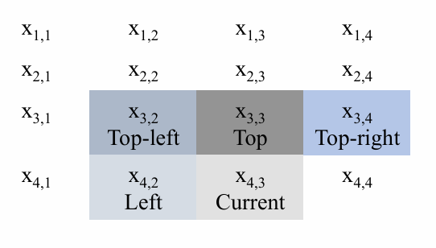
2. Spectral–Temporal Prediction
Why Spatial Prediction?
Predicts each pixel using neighboring pixels → reduces spatial redundancy
The difference (residual) between the original and predicted pixel has lower entropy, which improves compression efficiency.
4-Neighbor Mean Predictor:
The current pixel is predicted using Top, Top-left, Top-right, and Left neighbors.
Neighbourhood matrix for prediction
Neighborhood matrix with replicated padding for edge prediction

Slide 11
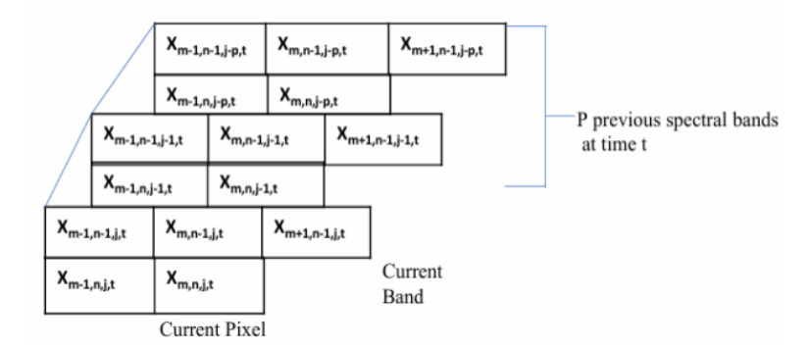
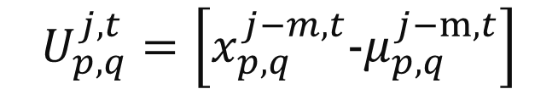
Why 4-Neighbor over 3-Neighbor?
3-neighbor considers only left, up, and up-left ignores correlation with up-right pixel.
4-neighbor includes up-right, which improves prediction accuracy.
Only requires simple addition and bit-shift, no division, making it hardware-friendly
3. Context Vector Formation (Spectral & Temporal)
Why Context Vectors?
Remove spatial smoothness and redundancy
Retain high-frequency details (edges/textures)
Capture spectral and temporal correlations for efficient prediction
Spectral Context Vector:
Goal: Predict Band j using previous spectral bands (1…j−1) Process:
Take previous bands
Compute 4-neighbor spatial mean (μ) for each band
Subtract mean → removes smooth spatial component
Remaining detail = spectral context (high-frequency variations)
Figure 4.: Spectral Context Vector Formation [4]
$$U_{p,q}^{j,t}=\left[x_{p,q}^{j−m,t}{−μ}_{p,q}^{j−m,t}\right]$$

Slide 12
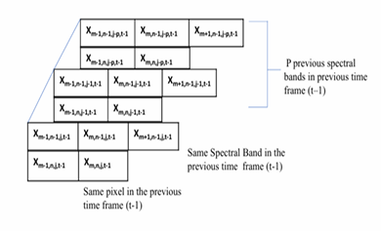

Temporal Context Vector:
Goal: Predict Frame t using past frames (t-1,t-2,…)
Process:
Take the same band j from previous time frames
Compute 4-neighbor spatial mean 𝜇 for each past frame
Subtract mean → removes spatial smoothness
Remaining detail = temporal context (illumination, motion, time-based variations)
$$U_{p,q}^{j,t}=\left[x_{p,q}^{j,t−n}{−μ}_{p,q}^{j,t−n}\right]$$
Figure 5.: Temporal Context Vector Formation [4]

Slide 13
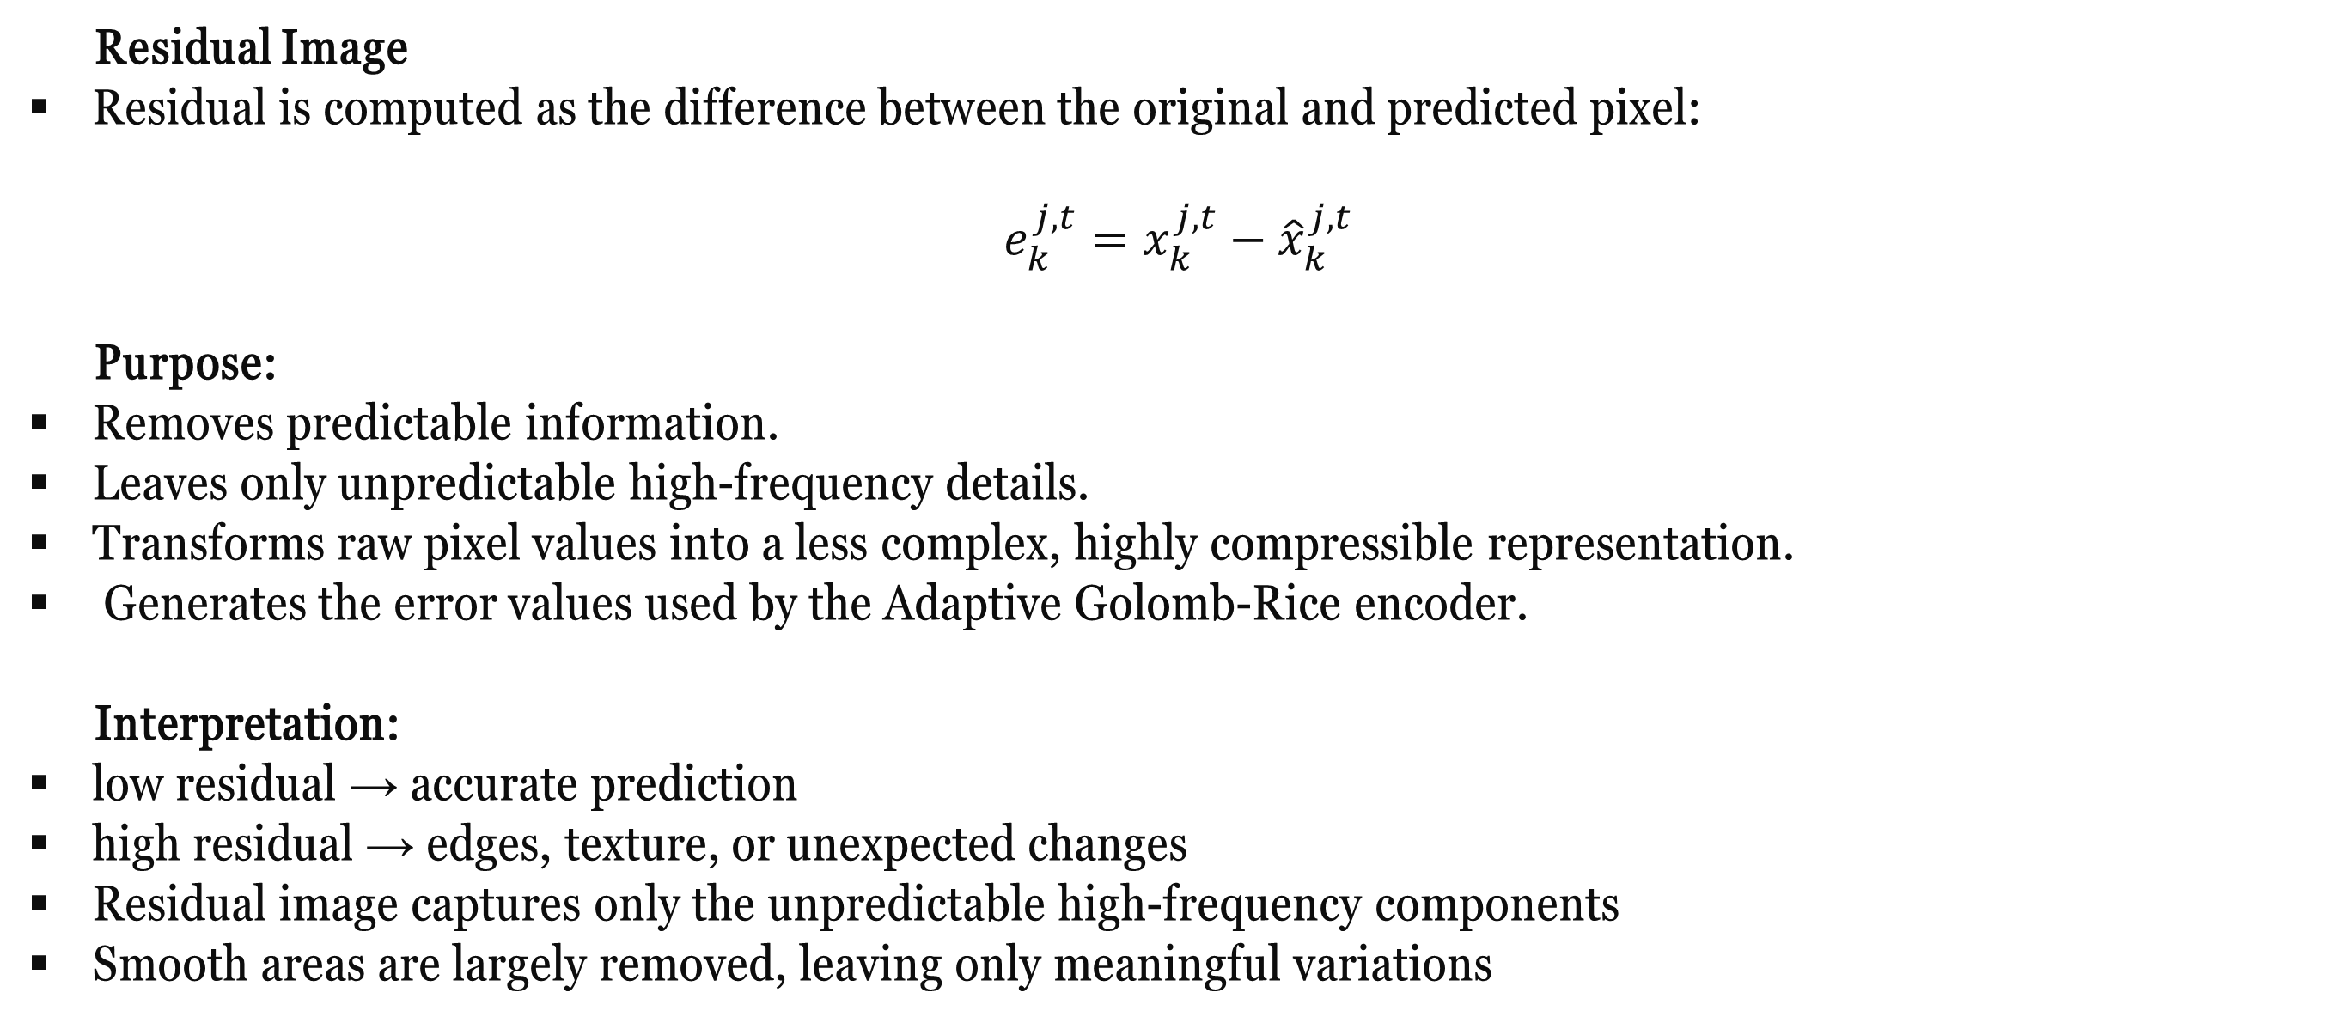
4. Residual Generation
Residual Image
Residual is computed as the difference between the original and predicted pixel:
$$e_{k}^{j,t}=x_{k}^{j,t}−{\hat{x}}_{k}^{j,t}$$
Purpose:
Removes predictable information.
Leaves only unpredictable high-frequency details.
Transforms raw pixel values into a less complex, highly compressible representation.
Generates the error values used by the Adaptive Golomb-Rice encoder.
Interpretation:
low residual → accurate prediction
high residual → edges, texture, or unexpected changes
Residual image captures only the unpredictable high-frequency components
Smooth areas are largely removed, leaving only meaningful variations

Slide 14
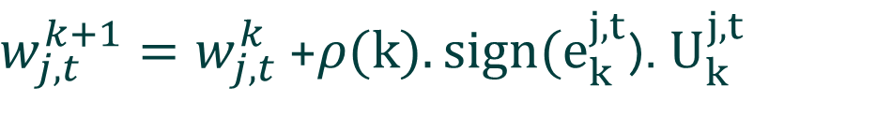
5. Weights Update
Purpose:
To continuously improve prediction accuracy by adjusting weights based on the error (residual).
How Weight Update Works?
Residual = Actual − Predicted
Large residual → Big weight update
Small residual → Small weight update
Weight update formula:
Why Weight Update Is Needed?
Automatically learns correlation between spectral bands and time frames.
Adapts prediction at each pixel, improving accuracy in real-time.
Reduces future residuals → improves compression
$w_{j,t}^{k+1}=w_{j,t}^{k}$ +$ρ(k).sign(e_{k}^{j,t}$). $U_{k}^{j,t}$

Slide 15
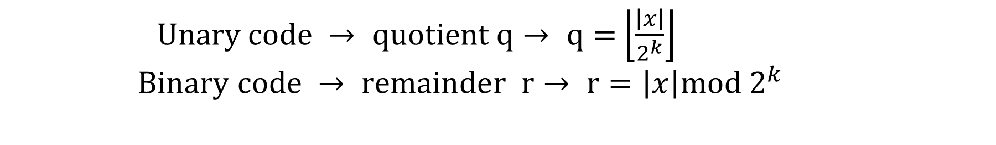
6. Adaptive Golomb-Rice Encoding
Purpose:
Convert residuals into a compact lossless bitstream
Fully compatible with FPGA and real-time systems
Why Adaptive Rice Coding?
Residuals are centered around zero → Rice distribution fits perfectly
Automatically selects optimal 𝑘 for each band/frame → best compression
How It Works?
Scale residuals → convert floating-point → exact integers
Compute optimal Rice parameter (k) for minimum bit-length
Encode each value:
$Unary code → quotient q→ q=$ $\left\lfloor \frac{\left|x\right|}{2^{k}}\right\rfloor$
$Binary code → remainder r→ r=\left|x\right|mod 2^{k}$

Slide 16
7. Lossless Decoding
Purpose:
Recover the original hyperspectral image exactly from the compressed bitstream.
How It Works?
Decoder reads Rice-encoded bitstream, k, and scale factor.
Residuals are losslessly reconstructed
Residuals + prediction model give the exact original pixel values
Key Features
Perfect reconstruction
Very low hardware complexity (only shift + add)

Slide 17
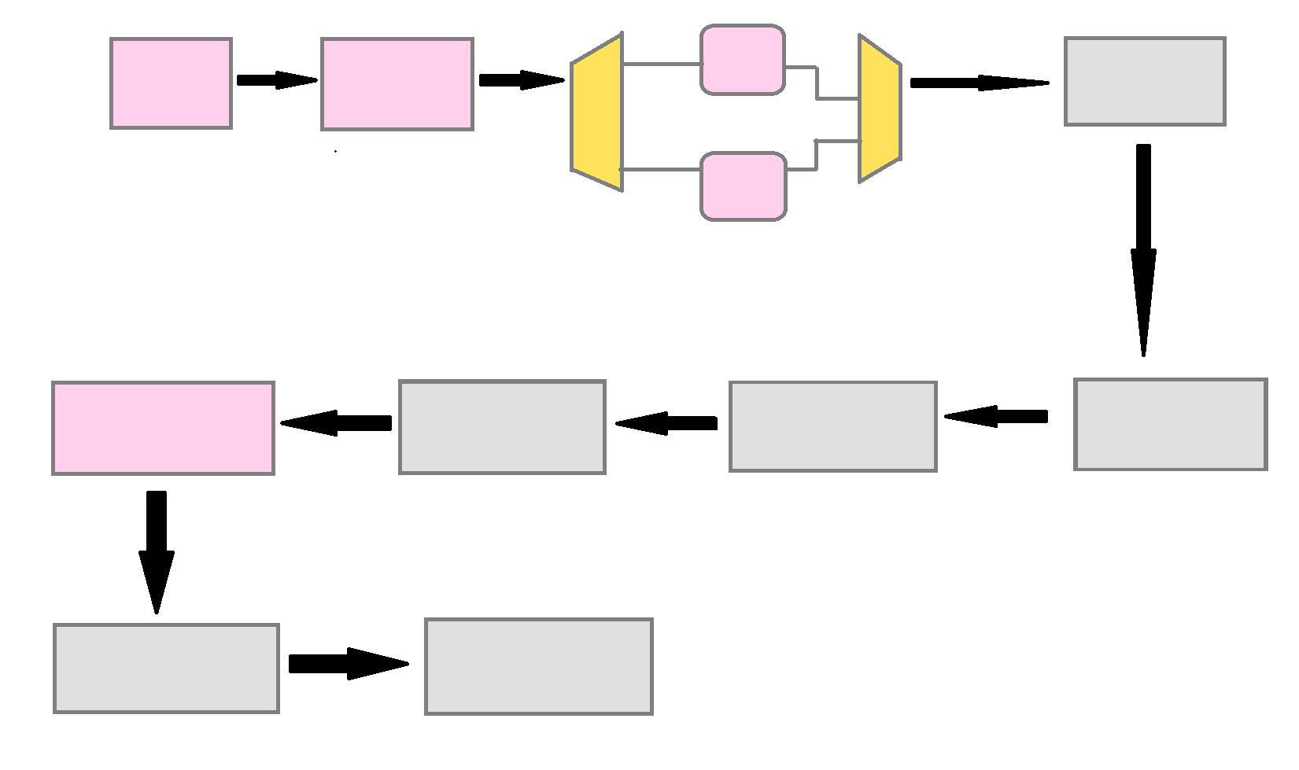
Proposed Architecture
PREDICTED MEAN VALUE
BRAM1
SPECTRAL + TEMPORAL
ROM
MUX
MUX
BRAM2
ADAPTIVE RICE GOLOMB ENCODING
WEIGHT UPDATE
RESIDUAL COMPUTATION
PREDICTION PIXEL
COMPRESSED BITSTREAM
DECODING

Slide 18
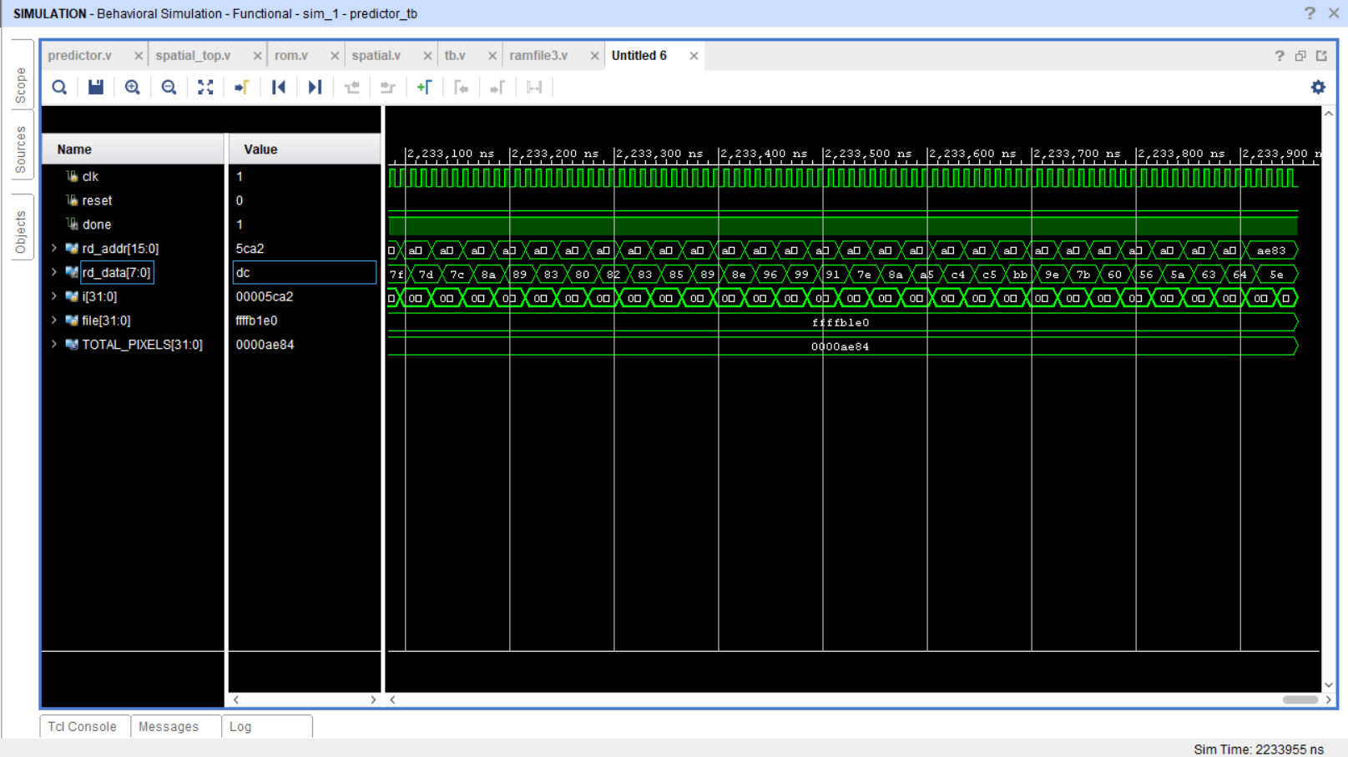
Result and Discussion
Hardware Implementation Results:
a.) FPGA Implementation: The proposed spatial pixel prediction architecture is implemented and synthesised on a Xilinx FPGA (xc7s50csga324-1). The resource utilisation shows that the design occupies 25,174 LUTs (77.22%), 325 flip-flops (0.50%), 16 BRAM blocks (21.33%), 27 I/O pins (12.86%), and 1 BUFG (3.13%) of the available device resources.
Figure 5: The waveform represents that reading and writing of the predicted pixels in a text file.

Slide 19
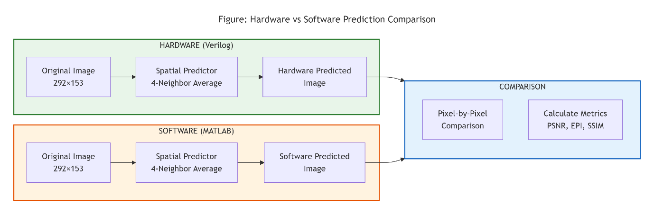
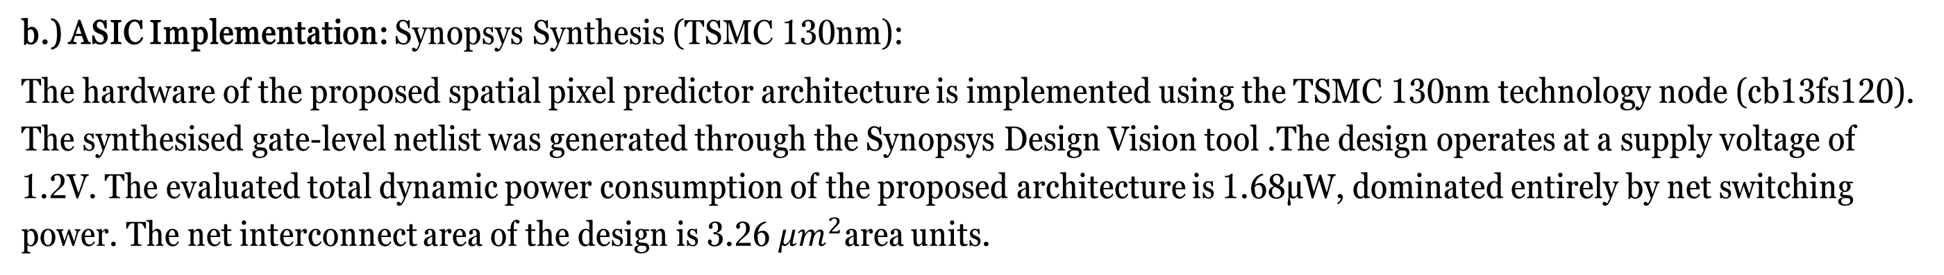
b.) ASIC Implementation: Synopsys Synthesis (TSMC 130nm):
The hardware of the proposed spatial pixel predictor architecture is implemented using the TSMC 130nm technology node (cb13fs120). The synthesised gate-level netlist was generated through the Synopsys Design Vision tool .The design operates at a supply voltage of 1.2V. The evaluated total dynamic power consumption of the proposed architecture is 1.68μW, dominated entirely by net switching power. The net interconnect area of the design is 3.26 $μm^{2}$area units.
Comparison of Predicted Images:
The experiment was conducted on a 292 × 153 grayscale image (44,676 pixels). The following pipeline was implemented:
Figure 5 : Hardware VS Software Prediction Comparison

Slide 20
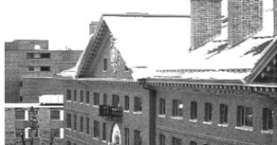
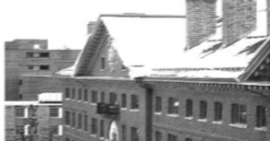

Noon Dataset
i) Original Image [3]
ii) Predicted Image using Hardware iii) Predicted Image using Software
Figure 6.1: Original and Predicted Images of dimension (292x153)(Noon Dataset)
PSNR: 52.13 dB
SSIM: 0.9993
EKI (Edge Keeping Index): 0.9999
Correlation Coefficient: 1.0000 (1 = perfect correlation)
Pixel-wise Similarity: 99.8%

Slide 21
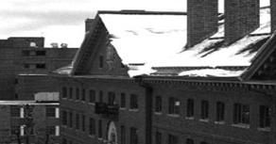


Afternoon Dataset
i) Original Image [3]
ii) Predicted Image using Hardware iii) Predicted Image using Software
Figure 6.2: Original and Predicted Images of dimension (292x153)(Afternoon Dataset)
PSNR: 51.45 dB
SSIM: 0.9984
EKI (Edge Keeping Index): 0.9999
Correlation Coefficient: 1.0000 (1 = perfect correlation)
Pixel-wise Similarity: 99.8%

Slide 22
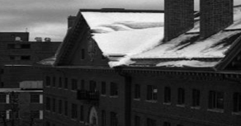

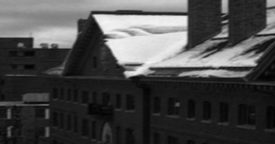
Morning Dataset
i) Original Image [3]
ii) Predicted Image using Hardware iii) Predicted Image using Software
Figure 6.3 : Original and Predicted Images of dimension (292x153)(Morning Dataset)
PSNR: 51.14 dB
SSIM: 0.9978
EKI (Edge Keeping Index): 0.9999
Correlation Coefficient: 1.0000 (1 = perfect correlation)
Pixel-wise Similarity: 99.8%
Overall: PSNR = 51.57 , SSIM = 0.9988 , EKI = 0.9999

Slide 23
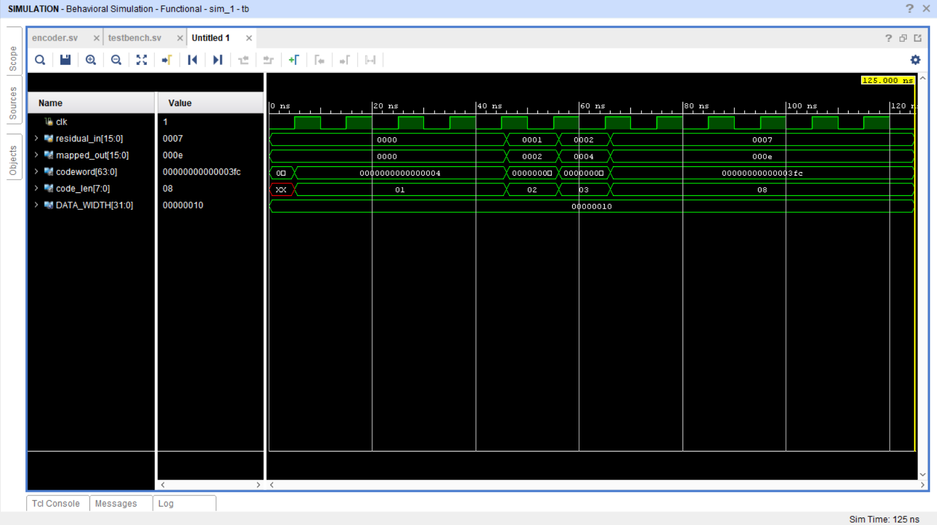
Adaptive Golomb Rice Encoding:
a.)FPGA Implementation:
The Adaptive Golomb-Rice encoder was synthesised and implemented on a Xilinx FPGA (xc7s50csga324-1). The resource utilisation shows that the design occupies 1,364 LUTs (4.18%), 1,301 flip-flops (2.00%), 154 IO pins (73.33%), and 1 BUFG (3.13%) of the available device resources. Notably, the encoder requires no dedicated BRAM blocks, as all encoding operations are performed through combinational logic and registers alone.
Figure 7: Behavioural Simulation verification of the Adaptive Golomb-Rice encoder. The waveform displays the input residual (residual_in), mapped value (mapped_out), generated codeword (codeword), and code length (code_len) over time.

Slide 24
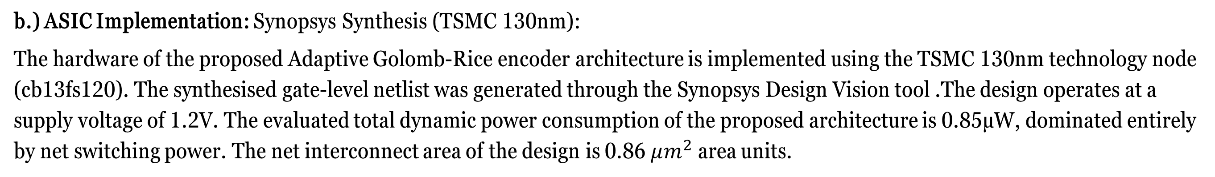
b.) ASIC Implementation: Synopsys Synthesis (TSMC 130nm):
The hardware of the proposed Adaptive Golomb-Rice encoder architecture is implemented using the TSMC 130nm technology node (cb13fs120). The synthesised gate-level netlist was generated through the Synopsys Design Vision tool .The design operates at a supply voltage of 1.2V. The evaluated total dynamic power consumption of the proposed architecture is 0.85μW, dominated entirely by net switching power. The net interconnect area of the design is 0.86 $μm^{2}$area units.

Slide 25
Conclusion and Future work
A hardware-friendly lossless compression framework was successfully implemented in Verilog, comprising a 4-neighbour causal spatial predictor and an Adaptive Golomb-Rice entropy encoder. Hardware-software comparison confirmed excellent prediction accuracy — PSNR of 52.13 dB, SSIM of 0.9993, EKI of 0.9999, correlation of 1.0000, and 99.8% pixel-wise similarity — with minor deviation attributed to integer truncation in hardware.
The AG-Rice encoder achieved 100% functional correctness. FPGA synthesis on the Xilinx xc7s50csga324-1 showed a compact encoder (1,364 LUTs) alongside a more resource-intensive spatial predictor (25,174 LUTs, 16 BRAMs), while TSMC 130 nm ASIC implementation consumed 1.68 μW and 0.85 μW respectively.
For Future work, the implemented modules, namely the spatial predictor, predictor core, and Adaptive Golomb-Rice encoder, will be integrated with other additional modules to develop a complete lossless compression framework for hyperspectral image processing.

Slide 26
References
[1] Image source: Canva AI, “AI-generated image,” Canva, 2026.
[2] Image source: What is hyperspectral imaging? — Nireos (https://nireos.com/application/what-is-hyperspectral-imaging/)
[3] X. Liu, H. Shan, Y. Zhao, K. Wei, and M. Wang, “Deep RGB-driven Learning Network for Unsupervised Hyperspectral Image Super-resolution,” in Proceedings of the ACCV 2022 Workshops on Machine Learning in Computer Vision for Spectral Applications (MLCSA), 2022.
[4] Consultative Committee for Space Data Systems (CCSDS), Lossless Multispectral and Hyperspectral Image Compression, Informational Report, CCSDS 120.2-G-1, Green Book, Issue 1, December 2015
[5] P. G. Howard and J. S. Vitter, “Fast and Efficient Lossless Image Compression,” in Proceedings of the IEEE Computer Society/NASA/CESDIS Data Compression Conference (DCC), Snowbird, Utah, USA, Mar. 30–Apr. 1, 1993 (pp. 351–360).
[6] M. Serkan, P. Arulmozhivarman, and R. Ramachandran, “Simulation Based VLSI Implementation of Fast Efficient Lossless Image Compression System Using Adjusted Binary Code & Golomb Rice Code,” International Journal/Conference, 2022
[7] J. Olaf, "Exponential Golomb-Rice Encoding: Adaptive Run-length Conjecture — Case Study," Medium, Jan. 25, 2026. [Online]. Available: https://medium.com/@jolalf/exponential-golomb-rice-encoding-adaptive-run-length-conjecture-case-study-b0ca1f19eb8a

Slide 27
THANK YOU !

Slide 28







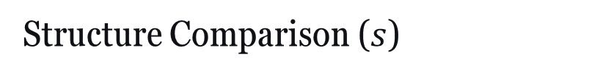
Peak Signal-to-Noise Ratio (PSNR)
Step 1: Mean Squared Error (MSE):
Step 2: PSNR Formula :
Structural Similarity Index (SSIM)
Luminance Comparison ($l$)
Structure Comparison ($s$)
Contrast Comparison ($c$)

Slide 29
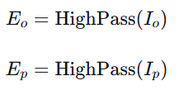
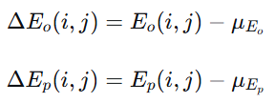
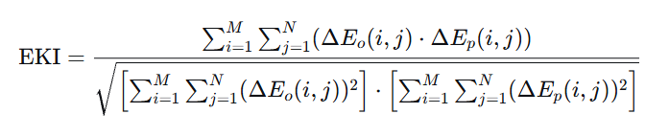
:
Edge Keeping Index (EKI)
Step 1: High-Pass Filtering (Edge Extraction)
Step 2: Mean Subtraction
Step 3: Correlation Calculation

