Slide 1

Industry Visit at Daikin Industries
Tanushree Nangia
055052
Section- K

Slide 2
1
PROBLEM STATEMENT
During an industry visit to Daikin Industries, the objective was to gain insights into the company's internal operations and data management framework. A key challenge was to design an Entity-Relationship Diagram (ERD) that effectively represents the organization's data flow, covering aspects such as order processing, inventory management, supplier coordination, and employee interactions. By developing this ERD, the goal is to enhance data organization, improve operational efficiency, and ensure seamless information flow across departments. This structured approach will aid in identifying critical data relationships and optimizing business processes within Daikin Industries.

Slide 3
3
DATA AND ANALYTICS
The Entity-Relationship Diagram (ERD) for Daikin Industries encompasses key entities essential for internal operations, including:
Department – Stores department details (ID, Name, Location).
Employee – Includes employee information and links to a department.
ServiceRequest – Tracks service issues assigned to employees.
Payment – Manages employee payments with method and amount.
Supplier – Contains supplier details (Name, Contact, Address).
Supplier Order – Tracks supplier orders and their respective departments.
Product – Stores product details (Name, Description, Price, etc.).
Inventory – Manages product stock within departments.
Warehouse – Stores warehouse location and capacity information.
Shipment – Tracks supplier order shipments (Carrier, Tracking Number).
Service Technician – Stores technician details linked to departments.

Slide 4
4
OBSERVATIONS
Efficient Departmental Structure: Employees, service technicians, and procurement activities are organized department-wise.
Service & Maintenance Management: Tracks internal service requests and technician assignments for smooth operations.
Streamlined Supplier & Procurement Flow: Links supplier orders, inventory, and warehouse storage for optimized stock management.
Financial Tracking: Payment records for employees and suppliers ensure transparency.
Shipment & Inventory Control: Monitors stock levels and supplier order deliveries efficiently.

Slide 5
5
INSIGHTS AND RECOMMENDATIONS
Add Performance Metrics: Introduce tables for tracking employee and supplier performance based on key KPIs.
Enhance Automation: Implement triggers for low inventory alerts and delayed service requests.
Integrate Real-Time Tracking: Include a shipment status column for better visibility into order fulfillment.
Improve Data Security: Use role-based access controls to restrict sensitive financial and supplier data.
Optimize Service Efficiency: Introduce a priority column in ServiceRequest to manage urgent issues effectively.

Slide 6
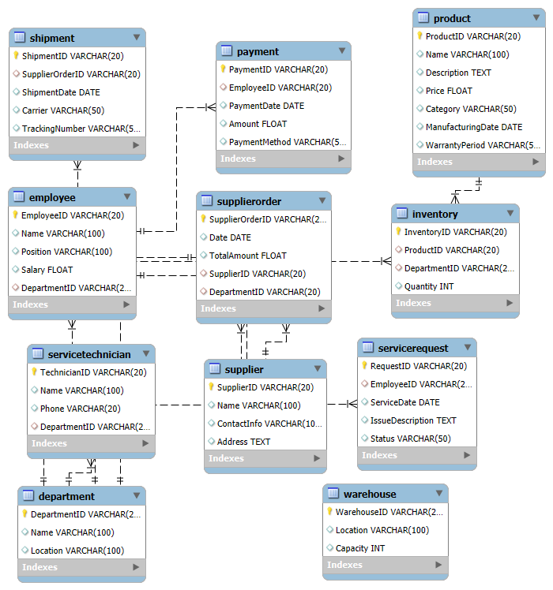
ERD DIAGRAM
6

