Slide 1
Diabetes Prediction A Machine Learning Approach to Reduce Global Diabetes Burden

Slide 2
agenda
Introduction
Literature review
Problem statement
Methodology
Result and discussion
Conclusion
References

Slide 3
Introduction
Domain Introduction
Diabetes is a widespread chronic disease that can lead to severe health complications if not detected early. Traditional diagnostic methods can be slow and costly, making early prediction crucial. Machine learning (ML) has become a powerful tool in healthcare, enabling faster and more accurate predictions based on patient data.
Project Introduction
This project uses supervised learning for diabetes prediction with SVM, Decision Tree, Naïve Bayes, and Random Forest classifiers. Additionally, K-Means and Hierarchical Clustering help group patients based on similarities for risk assessment. The aim is to build an efficient, data-driven model for early detection and better patient management.

Slide 4
Literature review
1. Predicting Diabetes Mellitus with Machine Learning Techniques
This study explores the application of machine learning (ML) techniques in diabetes prediction. It evaluates multiple algorithms, including Support Vector Machine (SVM), Decision Tree, Random Forest, and Naïve Bayes, to determine their effectiveness in classifying diabetic and non-diabetic individuals. The research emphasizes the importance of feature selection, highlighting how parameters like glucose levels, BMI, and blood pressure significantly impact prediction accuracy. The study concludes that ensemble methods like Random Forest outperform individual classifiers due to their ability to reduce variance and improve generalization. The authors also discuss the importance of data preprocessing and handling imbalanced datasets for better model performance.

Slide 5
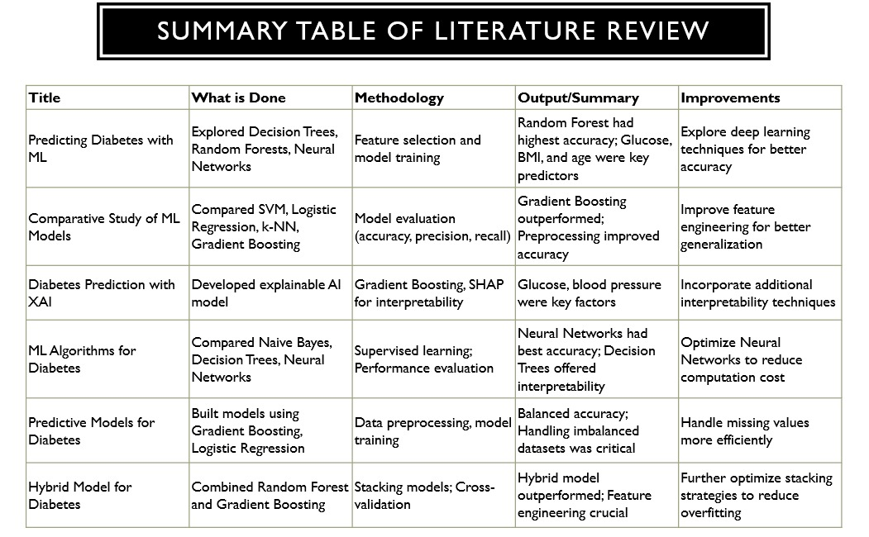

Slide 6
Problem Statement
This project aims to predict diabetes using machine learning with a dataset containing Pregnancies, Glucose, Blood Pressure, BMI, and Age. Classification (SVM, Decision Tree, Naïve Bayes, Random Forest) and clustering (K-Means, Hierarchical Clustering) techniques will be used for analysis.
The goal is to develop a reliable model for early diabetes detection and risk assessment.

Slide 7
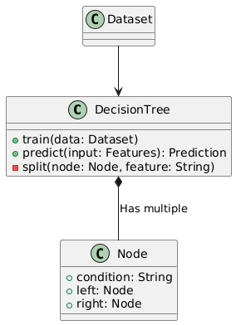
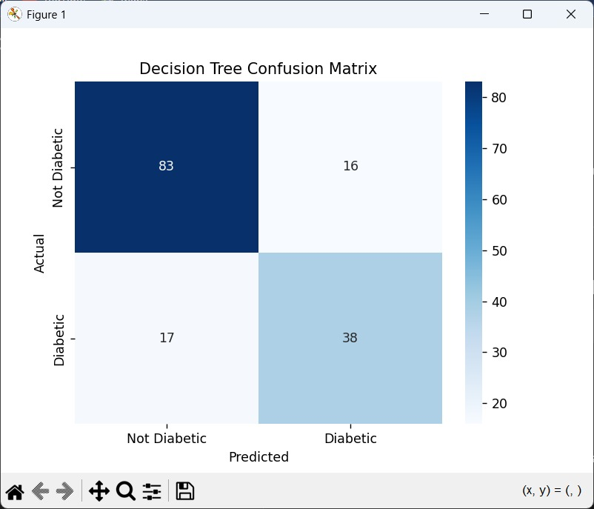
Methodology
DECISION TREE:
A tree-like structure that splits data based on conditions (e.g., Glucose > 120).
Used for classification, making yes/no decisions at each node.
Pros: Easy to interpret, handles both numerical and categorical data.
Cons: Prone to overfitting, sensitive to small data changes.

Slide 8
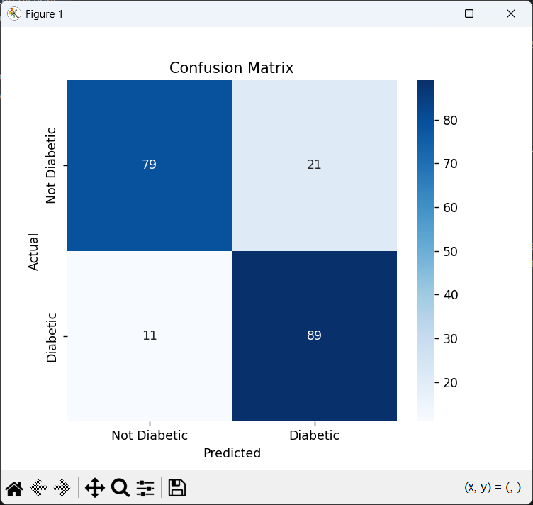
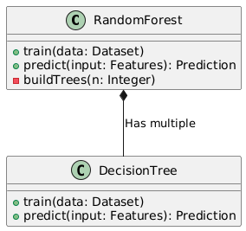
Random Forest Classifier
An ensemble model that uses multiple decision trees to improve accuracy and reduce overfitting.
Each tree makes a prediction and final decision is based on final voting.
Provides higher accuracy compared to single decision tree.

Slide 9
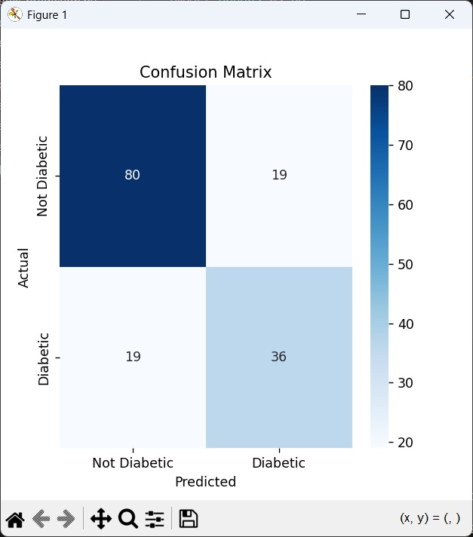
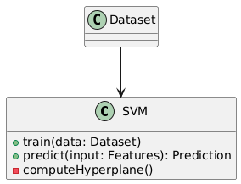
Support Vector Machine (SVM)
Finds an optimal hyperplane to separate diabetic and non-diabetic cases.
Works well with high-dimensional data like multiple health parameters.
Can use kernels (Linear, RBF) to handle complex patterns.

Slide 10
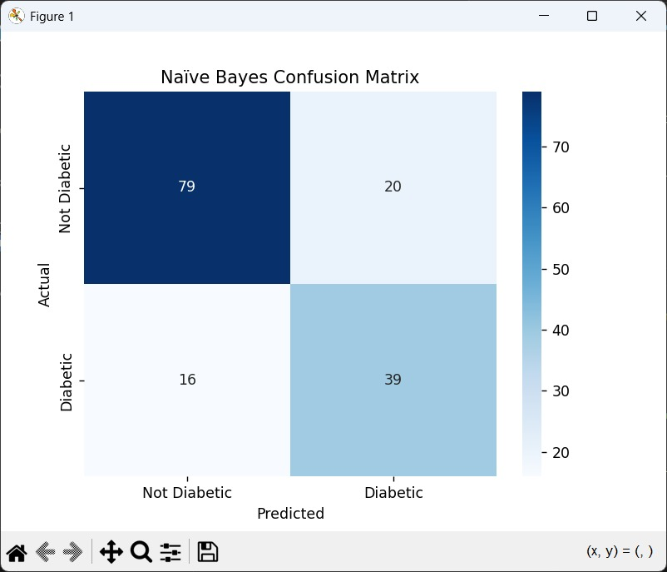
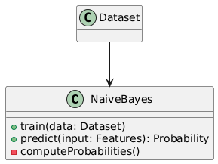
Naïve Bayes
Probabilistic classifier based on Bayes' Theorem.
Assumes features (Glucose, BMI, etc.) are independent.
Pros: Works well with small datasets, fast computation.
Cons: Assumes feature independence, may not always hold true in real-world data.

Slide 11
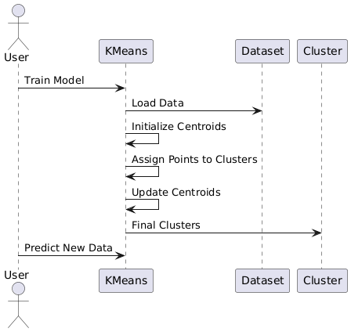
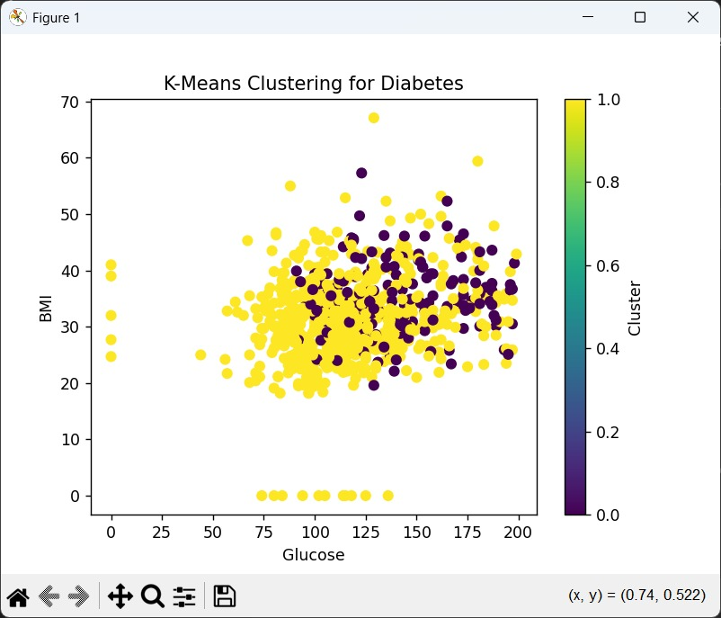
K-Means Clustering
Groups similar patients into K clusters based on feature similarity (e.g., risk levels).
Used for risk categorization (e.g., high/medium/low risk of diabetes).
Pros: Simple and efficient for large datasets.
Cons: Choosing the right number of clusters (K) is tricky.

Slide 12
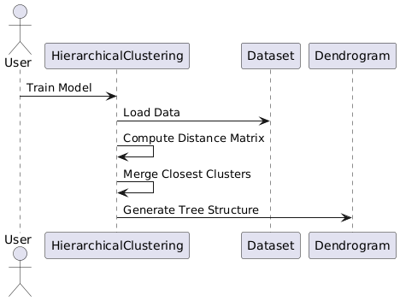
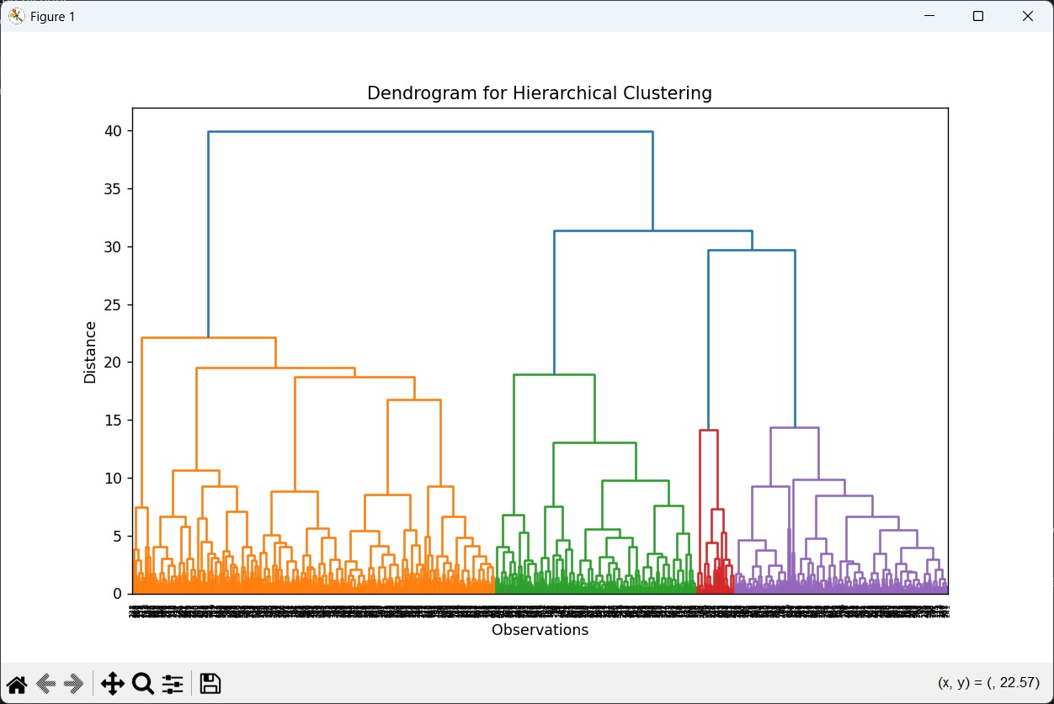
Hierarchical Clustering
Forms a hierarchy of clusters using either agglomerative (bottom-up) or divisive (top-down) approaches.
Visualized using a dendrogram, which helps determine optimal clusters.
Pros: No need to specify K, provides a clear tree structure.
Cons: Computationally expensive for large datasets.

Slide 13
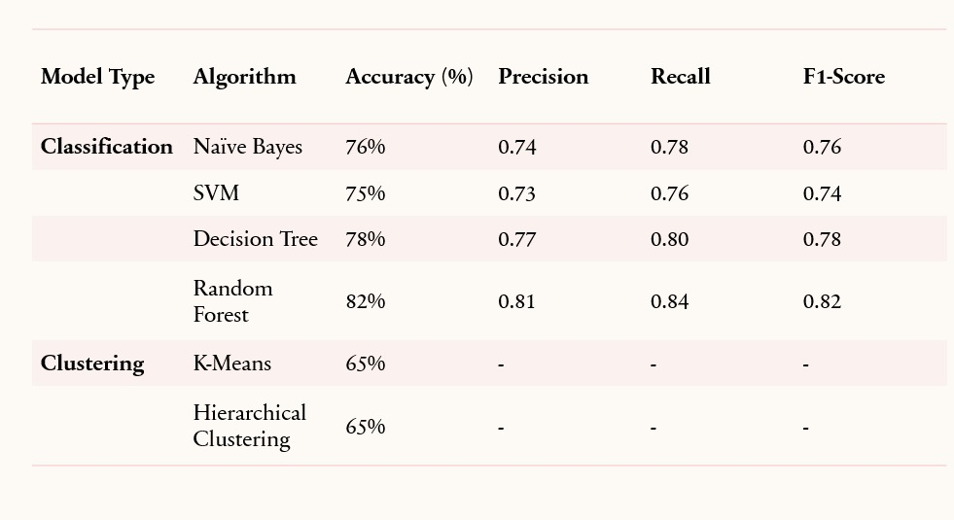
Results and discussions

Slide 14
Insights and observations
Key Takeaways:
Random Forest performed best for classification.
Clustering helped identify patient risk levels.
Limitations:
Logistic Regression struggled with complex patterns.
K-Means required careful tuning for best results.

Slide 15
Conclusions
Diabetes requires early detection to prevent complications, but traditional methods are slow and costly. This project applies classification (SVM, Decision Tree, Naïve Bayes, Random Forest). Random Forest performed best, making it the most reliable model for early diabetes prediction. And clustering (K-Means, Hierarchical Clustering) to predict diabetes using key health parameters. Challenges like false negatives and clustering issues were addressed through data preprocessing and tuning. Additionally, clustering techniques like K-Means and Hierarchical Clustering help in categorizing patients into risk groups, enabling early intervention.

Slide 16
References
https://helixscientific.pub/index.php/Home/article/view/123/123
https://www.sciencedirect.com/science/article/pii/S2405959521000205
https://www.frontiersin.org/journals/genetics/articles/10.3389/fgene.2018.00515/full
https://www.sciencedirect.com/science/article/pii/S1319157812000390

Slide 17
tHANKYOU

