Slide 1

Presented by
Tanushree Dwibedi,
Nandana Devi,
Smita Rath ,
Monalisa Panda ,
Deepak Kumar Patel
Department of Computer Science & Information Technology
Faculty of Engineering & Technology(ITER),
Siksha ‘O’ Anusandhan Deemed to be University, Bhubaneswar, Odisha

Slide 2
Presentation Outline
Introduction
Motivation
Objective or Problem statement
Data set description
Configuration of system
Architecture of LSTM and bi- directional LSTM
Important features used
Hyper parameter table
Simulation figure
Result and Discussion
Conclusion
Bibliography

Slide 3
Introduction
The stock market allows investors to analyze a company’s current and future financial value, offering better returns than savings or bonds.
Artificial intelligence (AI) and machine learning (ML) analyze large datasets, identify trends, and improve stock market forecasting.
Techniques like neural networks, natural language processing (NLP), and sentiment analysis are applied to news, social media, and stock prices for better predictions.
This paper uses a BiLSTM (Bidirectional Long Short-Term Memory) model to predict closing prices for Meta, Amazon, Apple, and Tesla using Yahoo Finance data. The study demonstrates BiLSTM's ability to capture patterns and outperform traditional forecasting methods.

Slide 4
Literature survey
Traditional stock prediction methods include statistical models like ARIMA, Exponential Smoothing, and GARCH.
These assume linear fits under stable conditions, which are rare in real-world data.
Ensemble methods, such as Random Forest (RF), Gradient Boosting Machines (GBM), and XGBoost, improve accuracy by combining multiple models and capturing non-linear relationships.
While ensemble methods are effective, their performance on noisy, high-frequency financial data is less explored.
Comparative studies on optimizers and loss functions for financial time series are also lacking. Future research could test BiLSTM with different optimization strategies.

Slide 5
Motivation
Traditional methods like Simple Moving Average (SMA), RSI, Bollinger Bands, EMA, and Linear Regression have been used for decades.
These rely on historical data, have low predictive power, and ignore external factors like sentiment or macroeconomic indicators.
Machine learning techniques address these issues with advanced models like Random Forest, XGBoost, LightGBM, ARIMA, Reinforcement Learning, and NLP for sentiment analysis.
These methods capture non-linear relationships, integrate diverse data, and improve accuracy.
LSTM neural networks are especially effective for sequential data and time-series trend prediction.

Slide 6
Objective
This paper presents a deep learning model-BiLSTM (Bidirectional Long Short-Term Memory) neural networks predicts the closing prices of main stocks: Meta, Amazon, Apple, and Tesla.
The study leverages socioeconomic data as predictors to improve the accuracy of the forecasts.
Comparative analysis is done on the performance of six well-known optimization algorithms in the Keras machine learning library—Adam, Adagrad, Stochastic Gradient Descent, RMSprop, and others—that are utilized to train the LSTM model.
Performance metrics, such as MAE and RMSE, are used to evaluate model performance.
The results allow one to understand the most efficient method for optimizing the prediction of stock prices and practical implications in terms of offering data driven strategies for decision-making by financial analysts and investors.

Slide 7
Data Set Description
Tesla
Date Open High Low Close Adj Close Volume
2023.01.01 118.470001 118.800003 104.639999 108.099998 108.099998 231402800
2023.01.02 109.110001 114.589996 107.519997 113.639999 113.639999 180389000
2023.01.03 110.510002 111.750000 107.160004 110.339996 110.339996 157986300
2023.01.04 103.000000 114.389999 101.809998 113.059998 113.059998 220911100
2023.01.05 118.959999 123.519997 117.110001 119.769997 119.769997 190284000
Amazon
Date Open High Low Close Adj Close Volume
2023.01.01 85.459999 86.959999 84.209999 85.820000 85.820000 76706000
2023.01.02 86.550003 86.980003 83.360001 85.139999 85.139999 68885100
2023.01.03 85.330002 85.419998 83.070000 83.120003 83.120003 67930800
2023.01.04 83.029999 86.400002 81.430000 86.080002 86.080002 83303400
2023.01.05 87.459999 89.480003 87.080002 87.360001 87.360001 65266100

Slide 8
Data Set Description
Apple
Date Open High Low Close Adj Close Volume
2023.01.01 130.279999 130.899994 124.169998 125.070000 123.904625 112117500
2023.01.02 126.889999 128.660004 125.080002 126.360001 125.182610 89113600
2023.01.03 127.129997 127.769997 124.760002 125.019997 123.855087 80962700
2023.01.04 126.010002 130.289993 124.889999 129.619995 128.412231 87754700
2023.01.05 130.470001 133.410004 129.889999 130.149994 128.937271 70790800
Meta
Date Open High Low Close Adj Close Volume
2023.01.01 122.820000 126.370003 122.279999 124.739998 124.365547 35528500
2023.01.02 127.379997 129.050003 125.849998 127.370003 126.987656 32397100
2023.01.03 126.129997 128.520004 124.540001 126.940002 126.558952 25447100
2023.01.04 128.970001 130.330002 126.040001 130.020004 129.629700 27584500
2023.01.05 131.160004 132.949997 129.279999 129.470001 129.081360 26649100

Slide 9
Configuration of system
Hardware configuration-
The experiments were conducted on a OS Microsoft Windows 11 system , Version 10.0.26100 Build 26100, System Model HP Laptop 15s-dr2xxx , System Type 64-bit ,
BIOS Version/Date Insyde F.53, 15-10-2021. Equipped with an Processor-Intel(R) Core(TM) i5-1035G1 CPU @ 1.00GHz, 1190 Mhz, 4 Core(s), 8 Logical Processor(s) ,
With installed RAM 8.00 GB (7.79 GB usable).
Software configuration-
The program used Python 3.12.3 , conda 24.5.0 . The implementation leveraged TensorFlow 2.18.0 for deep learning, and Scikit-learn 1.4.2 for data preprocessing.

Slide 10
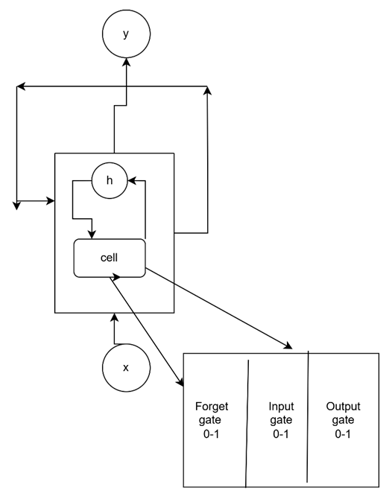
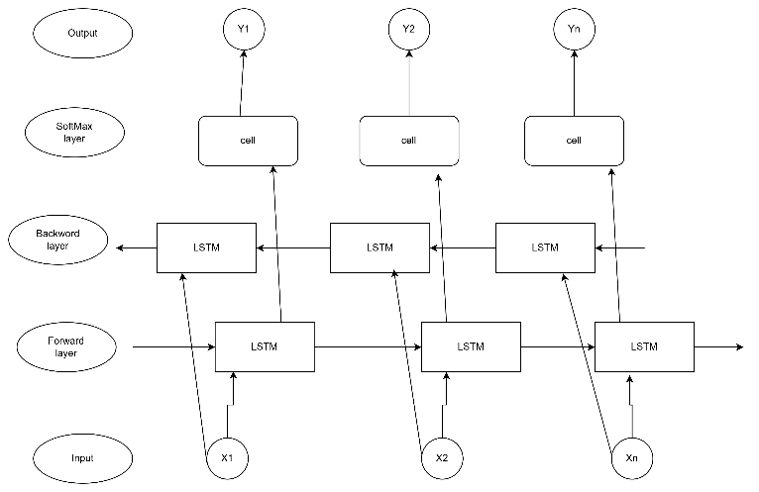
Architecture of LSTM vs Bidirectional LSTM
Fig 1: LSTM Architecture
Fig 2 : Bidirectional LSTM Architecture

Slide 11
Important Features used
LSTM is advanced version of RNN specially proposed to overcome the limitations like the inability of RNNs to capture long term dependencies properly and also problems like gradients vanishing or explosion during forward or backward pass.
Unlike traditional RNNs, which rely on only a single hidden state, the LSTM incorporates a memory cell that allows the model to retain and manage data for longer periods
The memory cell Incorporates specialized gates (Forget, Input, and Output) to handle temporal dependencies and avoid vanishing/exploding gradients.
Bidirectional LSTM (BiLSTM) is an extension of the traditional LSTM that involves two LSTMs running in parallel, one processing the input sequence from start to end (forward direction) and the other processing the sequence from end to start (backward direction).
Forward LSTM: Processes the input data in the forward direction.
Backward LSTM: Processes the input data in the reverse direction.
Combined Output: The outputs of both the forward and backward LSTMs are typically concatenated or summed to form the final output.
Bidirectional-LSTM: reads the input sequence in both forward and backward directions.
This allows the model to learn context from both past (previous time steps) and future (next time steps) data, improving the understanding of sequence relationships. It extends LSTM with bidirectional processing to capture both past and future temporal dependencies.
In terms of computational time and accuracy, BiLSTM emerged as the more effective model for stock price forecasting as compared to lstm.

Slide 12
Table 2. Hyper parameter Tuning using Different Optimizers
Hyper parameter table
Table 1. Hyper parameter Tuning using Different Optimizers
Optimizer | Learning rate | Batch Size | Epoch
Adam optimizer | 0.001 | 32 | 1000
Adam optimizer | 0.0001 | 64 | 2000
RMS prop optimizer | 0.001 | 32 | 1000
RMS prop optimizer | 0.0005 | 64 | 2000
SGD optimizer | 0.01 | 32 | 1000
SGD optimizer | 0.001 | 64 | 2000
Adagrad optimizer | 0.005 | 32 | 1000
Adagrad optimizer | 0.0001 | 64 | 2000

Slide 13
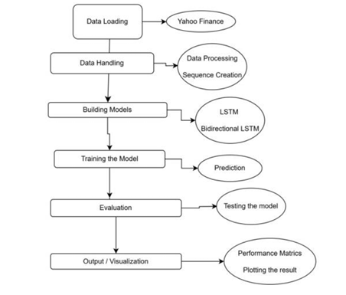
Simulation figure
Fig. 3. Proposed Flowchart for Forecasting Closing Price of a Stock with different optimizers tested during training and testing

Slide 14
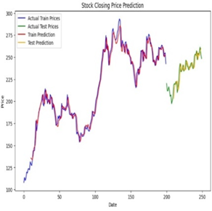
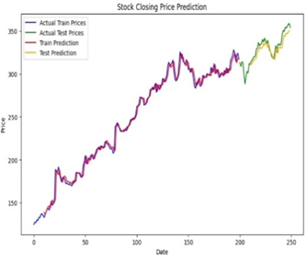
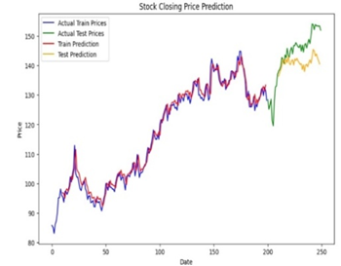
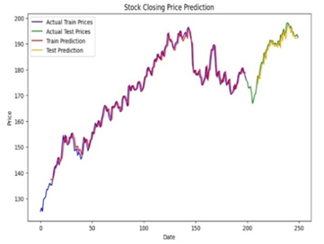
Results and Discussion
Fig.4. Stock prediction of Actual vs Predicted for TESLA | Fig.5. Stock prediction of Actual vs Predicted for META
Fig. 6. Stock prediction of Actual vs Predicted for APPLE | Fig. 7. Stock prediction of Actual vs Predicted for AMAZON

Slide 15
Results and Discussion
Table 3. Error detection in Training Data using Different Optimizer
Optimizer | Company | Training Data |  |  | Testing Data
 |  | MAE | MSE | RMSE | MAE | MSE | RMSE
Adam Optimizer | META | 3.944 | 31.602 | 5.621 | 5.271 | 41.328 | 6.428
 | TESLA | 5.352 | 48.138 | 6.932 | 4.818 | 40.92 | 6.347
 | APPLE | 4.520 | 4.520 | 2.126 | 1.633 | 4.124 | 2.030
 | AMAZON | 1.843 | 5.643 | 2.375 | 5.653 | 43.72 | 6.612
RMS prop optimizer | META | 4.001 | 35.068 | 5.486 | 3.271 | 21.32 | 4.428
 | TESLA | 5.001 | 42.068 | 6.486 | 5.303 | 46.04 | 6.785
 | APPLE | 1.613 | 4.247 | 2.061 | 1.740 | 4.599 | 2.144
 | AMAZON | 1.843 | 6.643 | 2.375 | 4.653 | 25.72 | 5.612
SGD optimizer | META | 7.137 | 88.836 | 9.632 | 10.271 | 146.3 | 10.428
 | TESLA | 11.13 | 185.836 | 13.632 | 5.875 | 54.81 | 7.403
 | APPLE | 3.208 | 17.029 | 4.126 | 4.103 | 23.32 | 4.829
 | AMAZON | 1.843 | 5.643 | 2.375 | 4.653 | 28.72 | 5.612
Adagrad optimizer | META | 3.409 | 15.348 | 3.713 | 11.93 | 175.4 | 3.247
 | TESLA | 11.72 | 204.098 | 14.286 | 5.958 | 55.66 | 7.461
 | APPLE | 3.29 | 17.374 | 4.168 | 4.347 | 25.45 | 5.044
 | AMAZON | 3.086 | 15.378 | 3.921 | 4.717 | 29.47 | 5.428

Slide 16
Table 4. Statistical value of t-satatistic and p-value on actual and predicted values
Optimizer Comparison | t-statistic | p-value
Adam vs RMSprop | 1.13 | 0.341
Adam vs SGD | -1.20 | 0.317
Adam vs Adagrad | -0.85 | 0.457

Slide 17
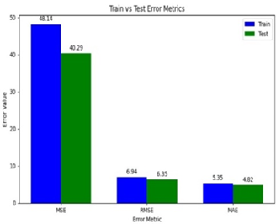
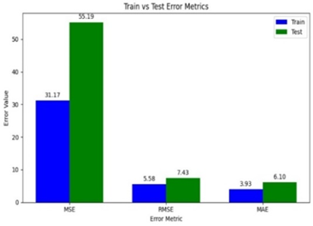
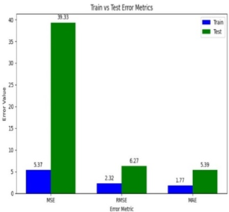
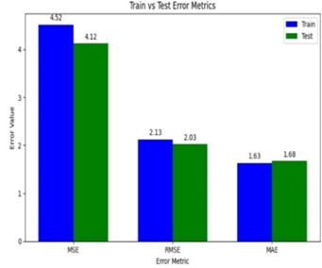
Fig.8. Error evaluation for closing price prediction of Tesla (2023-2024) | Fig.9. Error evaluation for closing price prediction of META (2023-2024)
Fig.10. Error evaluation for closing price prediction of Apple (2023-2024) | Fig.11. Error evaluation for closing price prediction of Amazon (2023-2024)

Slide 18
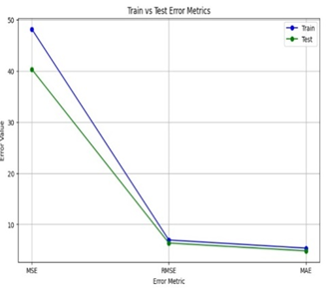
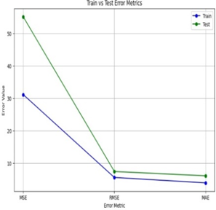
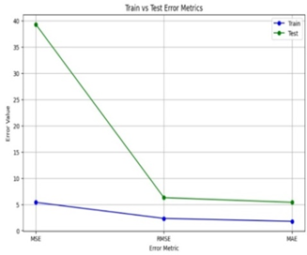
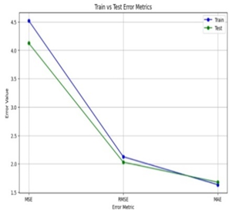
Fig.12. Error in Tesla closing price prediction | Fig.13. Error in Meta closing price prediction
Fig.14. Error in Apple closing price prediction | Fig.15. Error in Amazon closing price prediction

Slide 19
Conclusion
Achieved outputs of Proposed System
This paper presents the successful application of Bi-Long Short-Term Memory (LSTM) networks with different optimizers on stock closing price prediction of META, Amazon, Apple, and Tesla.
With historical stock data, it captures the temporal patterns, which make this LSTM model a good tool for future price forecast.
Evaluation metrics such as MSE, RMSE, and MAE showed that this model was performing reasonably both for the training and testing set in terms of accuracy about which information can be derived from such models.
The Adam optimizer turns to be the most effective here that is because of its properties related to adaptive learning rate and momentum, and, particularly, its ability to accommodate noisy, nonstationary data in finance.

Slide 20
Limitations of Proposed System
Despite the promising results of the study, it highlights many inherent challenges in financial forecasting, such as volatility and external factors that can influence the stock prices. These complexities can affect the model's predictive accuracy, further emphasizing the need for continued refinement.
Future Scope of Proposed System
Future improvements would involve incorporating additional features like trading volume, sentiment analysis, and economic indicators in order to enhance the robustness of the model.
This study affirms that, despite the challenges ahead, deep learning models, specifically LSTMs, are well on their way to changing the financial forecasting world.
As long as these models have something meaningful to say about stock price trends, investors and analysts would benefit from using these models as an aid in decision-making processes.

Slide 21
Bibliography
[1] Billah, M. M., Sultana, A., Bhuiyan, F., & Kaosar, M. G.: Stock price prediction: compar ison of different moving average techniques using deep learning model. Neural Compu ting and Applications, 36(11), 5861-5871(2024)
[2]. ingh, S., Joshi, K., & Kanna, D.: Stock market price prediction analysis (LSTM vs EMA). In AIP Conference Proceedings (Vol. 3075, No. 1). AIP Publishing, (2024, July).
[3]. Daniswara, D. A., Widjanarko, H., & Hikmah, K.: The Accuracy Test of Technical Analy sis of Moving Average, Bollinger Bands, and Relative Strength Index on Stock Prices of Companies Listed in Index Lq45. Indikator, 6(2), 411842(2022).
[4]. Garraux, H.: The Measure of Potential Profitability in Intraday Trading Utilizing the Rela tive Strength Index (RSI) with Various Simple Moving Averages (SMA) on the S&P 500(2024).
[5]. Karim, R., Alam, M. K., & Hossain, M. R.: Stock market analysis using linear regression and decision tree regression. In 2021 1st International Conference on Emerging Smart Technologies and Applications (eSmarTA) (pp. 1-6). IEEE. (2021, August).
[6 ].HarHartanto, A. D., Kholik, Y. N., & Pristyanto, Y.: Stock Price Time Series Data Forecasting Using the Light Gradient Boosting Machine (LightGBM) Model. JOIV: International Journal on Informatics Visualization, 7(4), 2270-2279(2023).

Slide 22
[7]. Kavinnilaa, J., Hemalatha, E., Jacob, M. S., & Dhanalakshmi, R.: Stock price prediction based on LSTM deep learning model. In 2021 International Conference on System, Com putation, Automation and Networking (ICSCAN) (pp. 1-4). IEEE(2021, July).
[8]. Khanderwal, S., & Mohanty, D.: Stock price prediction using ARIMA model. International Journal of Marketing & Human Resource Research, 2(2), 98-107(2021).
[9]. Yang, H., Liu, X. Y., Zhong, S., & Walid, A.: Deep reinforcement learning for automated stock trading: An ensemble strategy. In Proceedings of the first ACM international confer ence on AI in finance (pp. 1-8) (2020, October).
[10]. Patel, R., Choudhary, V., Saxena, D., & Singh, A. K.: Lstm and nlp based forecasting model for stock market analysis. In 2021 First International Conference on Advances in Computing and Future Communication Technologies (ICACFCT) (pp. 52-57). IEEE(2021, December).
[11]. Jabin, S.: Stock market prediction using feedforward artificial neural network. Internation al Journal of Computer Applications, 99(9), 4-8(2014).
[12] . Gupta, S., & Wang, L. P.: Stock forecasting with feedforward neural networks and gradual data sub-sampling. Australian Journal of Intelligent Information Processing Sys tems, 11(4), 14-17(2010).
[13] .Rubi, M. A., Chowdhury, S., Rahman, A. A. A., Meero, A., Zayed, N. M., & Islam, K. A.: Fitting multi-layer feed forward neural network and autoregressive integrated moving av erage for Dhaka Stock Exchange price predicting. Emerging Science Journal, 6(5), 1046 1061(2022).
[14]. Gu, Y., Shibukawa, T., Kondo, Y., Nagao, S., & Kamijo, S.: Prediction of stock perfor mance using deep neural networks. Applied Sciences, 10(22), 8142(2020).

Slide 23
[15] . Srivinay, Manujakshi, B. C., Kabadi, M. G., & Naik, N.: A hybrid stock price prediction model based on PRE and deep neural network. Data, 7(5), 51(2022).
[16]. Alshammari, T.T. et al.: Forecasting Stock Volatility Using Wavelet-based Exponential Generalized Autoregressive Conditional Heteroscedasticity Methods. Intelligent Automa tion Soft Computing. 35, 2589–601 (2023).
[17]. Toochaei, M. R., & Moeini, F.: Evaluating the performance of ensemble classifiers in stock returns prediction using effective features. Expert Systems with Applications, 213, 119186 (2023).
[18]. Yong, B. X., Abdul Rahim, M. R., & Abdullah, A. S.: A stock market trading system using deep neural network. In Modeling, Design and Simulation of Systems: 17th Asia Simula tion Conference, AsiaSim 2017, Melaka, Malaysia, August 27–29, 2017, Proceedings, Part I 17 (pp. 356-364). Springer Singapore(2017).
[19]. Jahan, I., & Sajal, S.: Stock price prediction using recurrent neural network (RNN) algo rithm on time-series data. In 2018 Midwest instruction and computing symposium. Duluth, Minnesota, USA: MSRP(2018).
[20]. Thong, L., Jeenanunta, C., & Chaysiri, R.: Stock price prediction with long short-term memory recurrent neural network (Doctoral dissertation, Thammasat University) (2018).
[21]. Kamijo, K. I., & Tanigawa, T.: Stock price pattern recognition-a recurrent neural network approach. In 1990 IJCNN international joint conference on neural networks (pp. 215-221). IEEE (1990, June).

Slide 24
Thank you

